Slide 1
JOREK simulations of MGI-triggered disruptions in JET
E. Nardon, D. Hu, J. Artola, C. Sommariva, M. Hoelzl, G. Huijsmans,
JOREK team, JET contributors
Runaway Electron Meeting, Gothenburg,
13-17 January 2020
1

Slide 2
Foreword
Warning: ongoing work!
General goals:
Validate: compare evolution of I_{p}, P_{rad}, n_{e}, δB, using synthetic diagnostics (bolometry, interferometry, saddle loops, …)
Investigate key mechanisms, e.g.:
What leads to the Thermal Quench (TQ)?
What is going on during the TQ?
What are the mechanisms behind the I_{p} spike?
What determines electron stochastic losses?
Determine consequences of deviating from realistic parameters
To what extent can we make reliable ITER predictions?

Slide 3
Outline
The model
Overview on a simulation
Mechanisms leading to the TQ
Physics of the TQ, I_{p} spike, magnetic stochasticity
Question of the radiative collapse
Overview of previous results with test electrons (from C. Sommariva’s PhD)

Slide 4
The model

Slide 5
The JOREK model for MMI (i.e. MGI or SPI) simulations
Reduced MHD, no diamagnetic effects
8 variables:
Poloidal magnetic flux ( )
Toroidal current density
Electric/flow potential
Parallel velocity
Vorticity
Impurity mass density (summed over all charge states)
Total mass density (main ions + impurities)
Temperature , assumed common to all species
(assumed common for all species)

Slide 6
Main simplifications of the model
Coronal Equilibrium (CE) assumption provides charge state distribution, radiation losses, ionization energy (ADAS data)
Benchmark with M3D-C1 and NIMROD suggests that CE assumption slows down the radiative collapse
Gas dynamics not treated self-consistently
Real situation: gas flow at 3 c_{s} in vacuum arrives at plasma edge, then suddenly heated and braked by its interaction with the hot plasma → Complex process [Nardon NF 57 (2017) 016027]
In JOREK, we simply have a volumetric neutral source, which we adjust empirically to match experimental measurements
More precisely, the temporal shape of the neutral source is the same as one would get from the gas flow in vacuum, but the amplitude is scaled down by an adjusted factor

Slide 7
Ohm’s law
(+ hyper-resistivity)
Vorticity
(+ hyper-viscosity)
// momentum
Mass conservation
(impurities)
MGI/SPI
Mass conservation
(all)
Energy density
where

Slide 8
Overview on a simulation

Slide 9
Simulated pulse: JET #85943
Ohmic, 2 MA, 3 T, T_{e0}=3.3 keV, n_{e0}=2.1x10¹⁹ m⁻³
Pure Ar MGI from Disruption Mitigation Valve (DMV1) at 33 bar into a healthy plasma
Produces a RE beam (~1 MA)
Part of a set of 3 pulses with a shot-to-shot B_{t} scan
I_{p}
P_{rad}
Locked mode
Mirnov

Slide 10
Simulation parameters
Argon deposited at midplane, near q=2 surface, and spread over a Gaussian of width 8 cm poloidally and 2 radians toroidally
Resistivity ~ 20 x Spitzer (↔ Lundquist number ~ 3 x 10⁷)
+ Hyper-resistivity for numerical stabilization
Perpendicular viscosity: ~ 200 m²/s
Parallel hyper-viscosity: very large, to damp parallel flow
Parallel heat conductivity: realistic (3 x 10³⁰ /m/s)
Perpendicular heat conductivity: ~ 2 m²/s
Particle perpendicular diffusivities: ~ 30 m²/s
No // diffusion

Slide 11
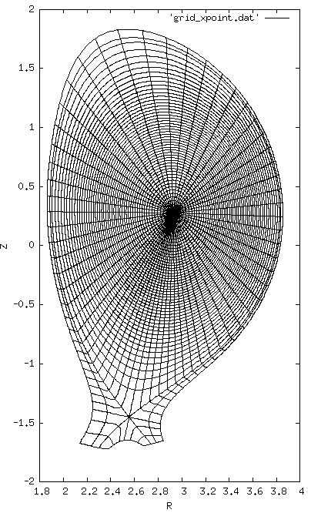
Flux-surface-aligned poloidal grid
~50 (radial) x 60 (poloidal) elements
Toroidal discretization uses Fourier harmonics
n from 0 to 10
Resistive wall (for n=0 to 5 harmonics)
Takes ~1 month to run on 11x48 CPUs on Marconi

Slide 12
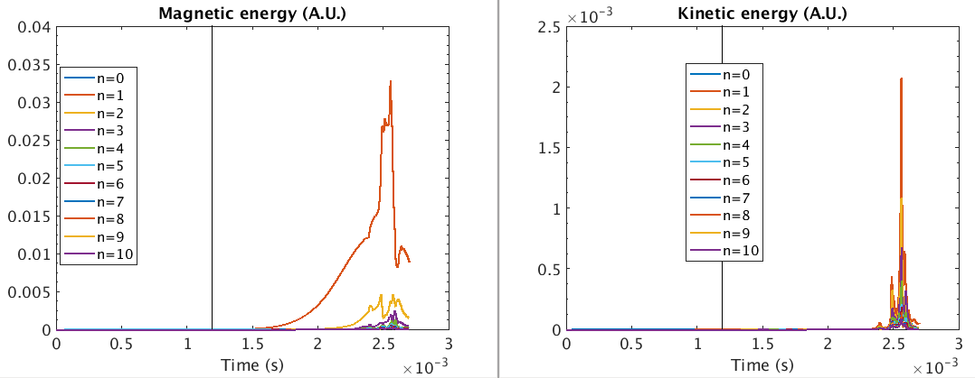
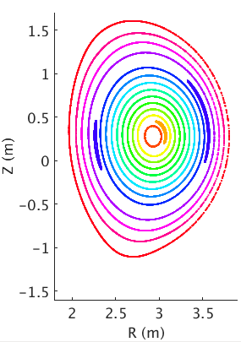
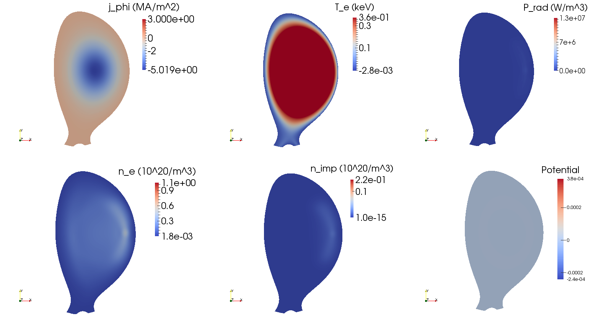
Magnetic energy
Kinetic energy
n=1
n=2
j_{φ} (MA/m²)
T_{e} (keV)
P_{rad} (W/m³)
n_{e} (10²⁰/m³)
n_{imp} (10²⁰/m³)
u

Slide 13
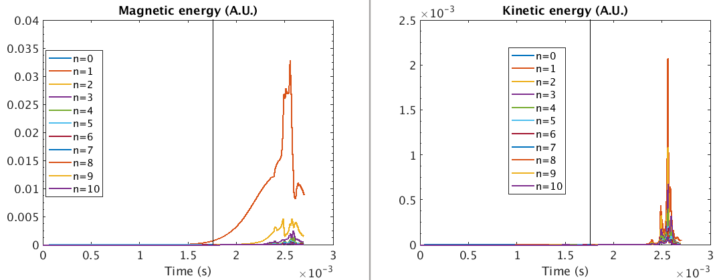
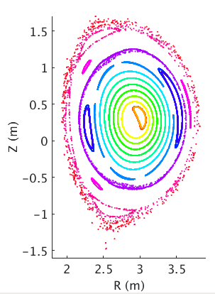
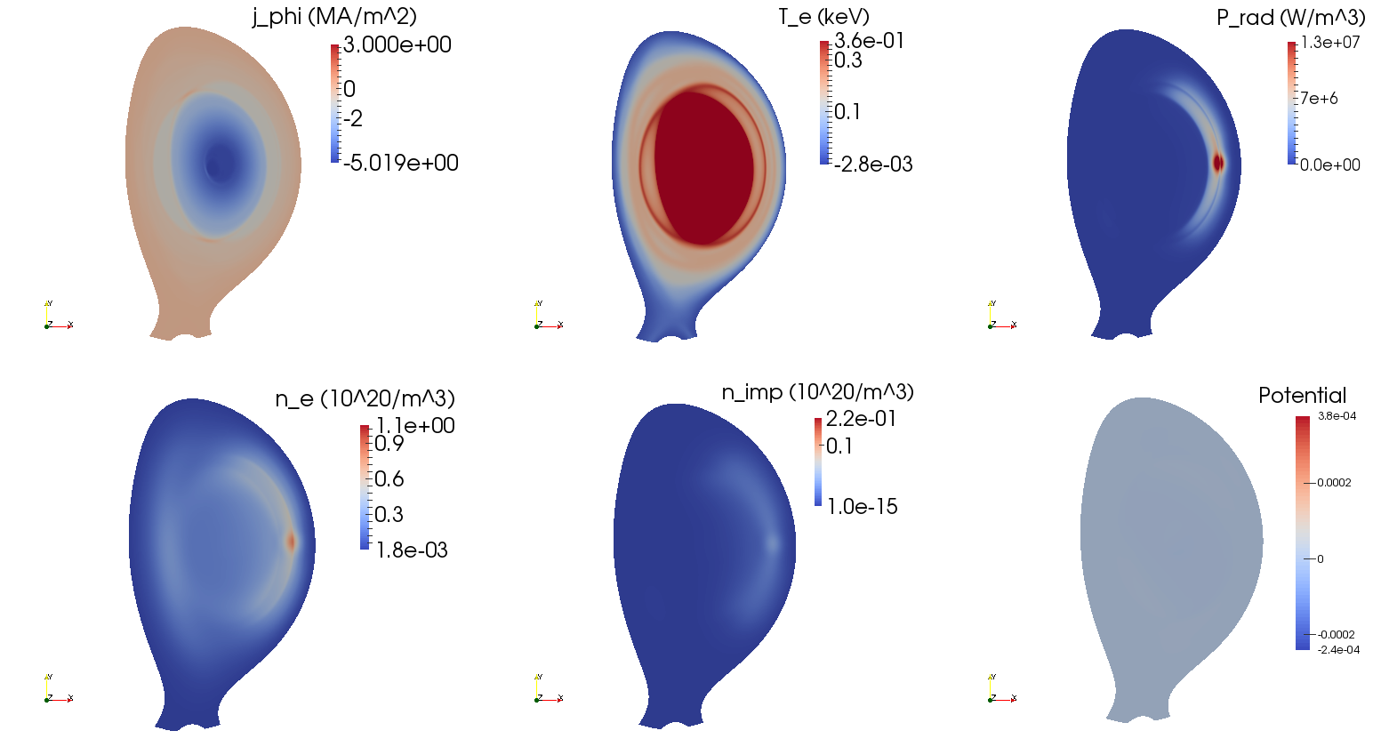
Magnetic energy
Kinetic energy
n=1
n=2
j_{φ} (MA/m²)
T_{e} (keV)
P_{rad} (W/m³)
n_{e} (10²⁰/m³)
n_{imp} (10²⁰/m³)
u

Slide 14
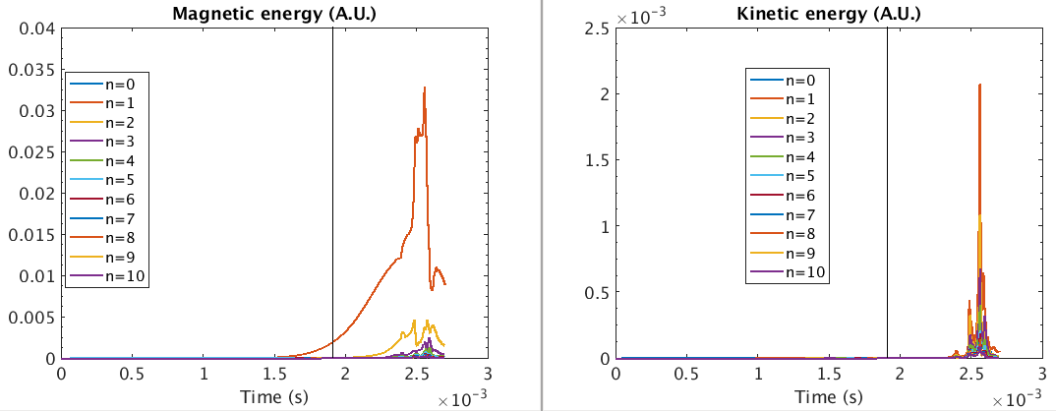
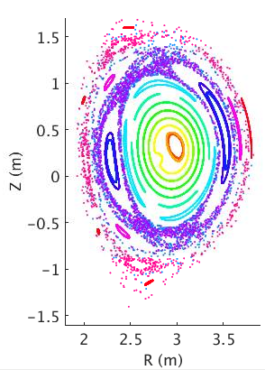
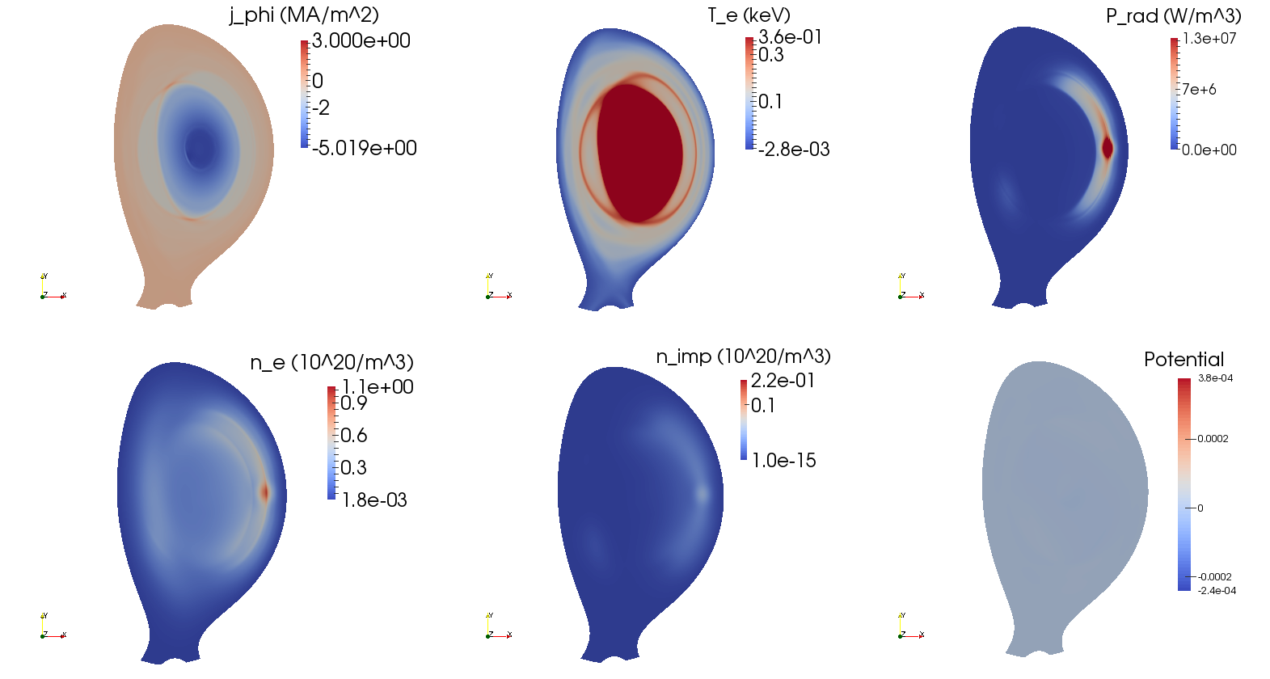
Magnetic energy
Kinetic energy
n=1
n=2
j_{φ} (MA/m²)
T_{e} (keV)
P_{rad} (W/m³)
n_{e} (10²⁰/m³)
n_{imp} (10²⁰/m³)
u

Slide 15
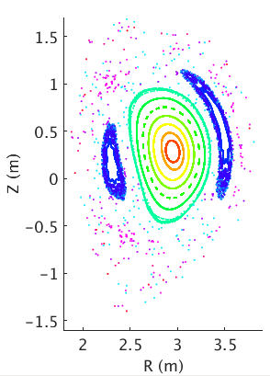
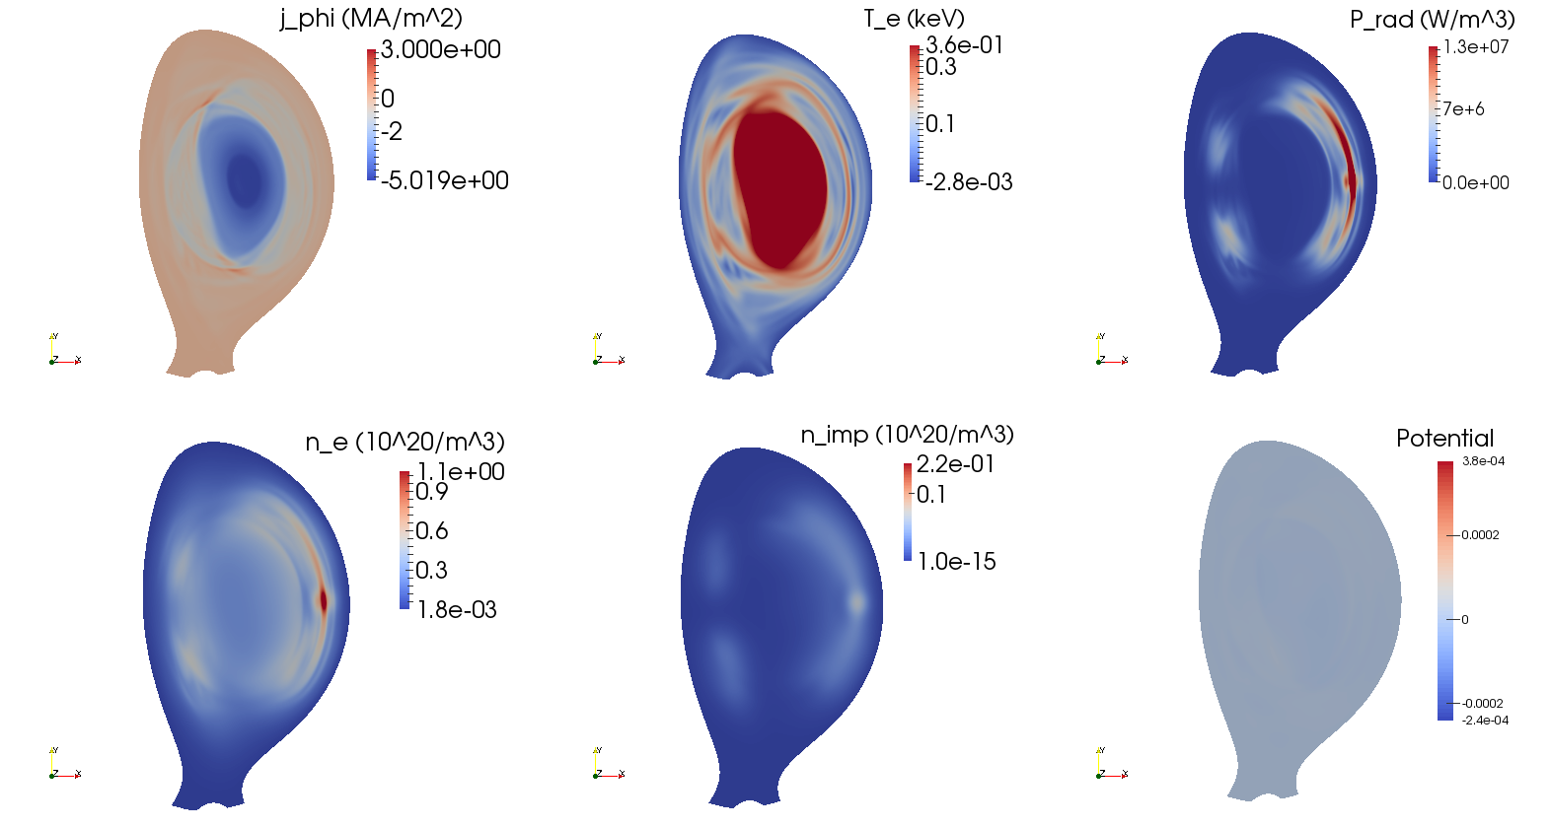
Magnetic energy
Kinetic energy
n=1
n=2
j_{φ} (MA/m²)
T_{e} (keV)
P_{rad} (W/m³)
n_{e} (10²⁰/m³)
n_{imp} (10²⁰/m³)
u

Slide 16
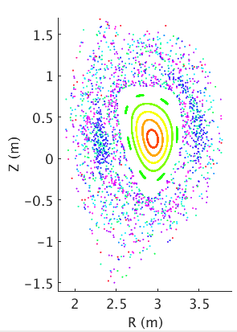
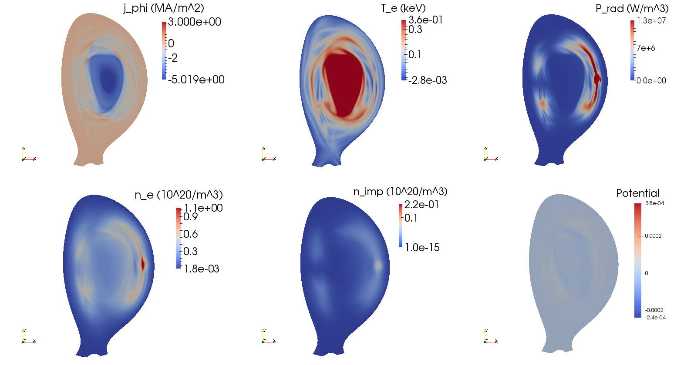
Magnetic energy
Kinetic energy
n=1
n=2
j_{φ} (MA/m²)
T_{e} (keV)
P_{rad} (W/m³)
n_{e} (10²⁰/m³)
n_{imp} (10²⁰/m³)
u

Slide 17
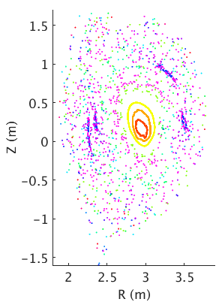
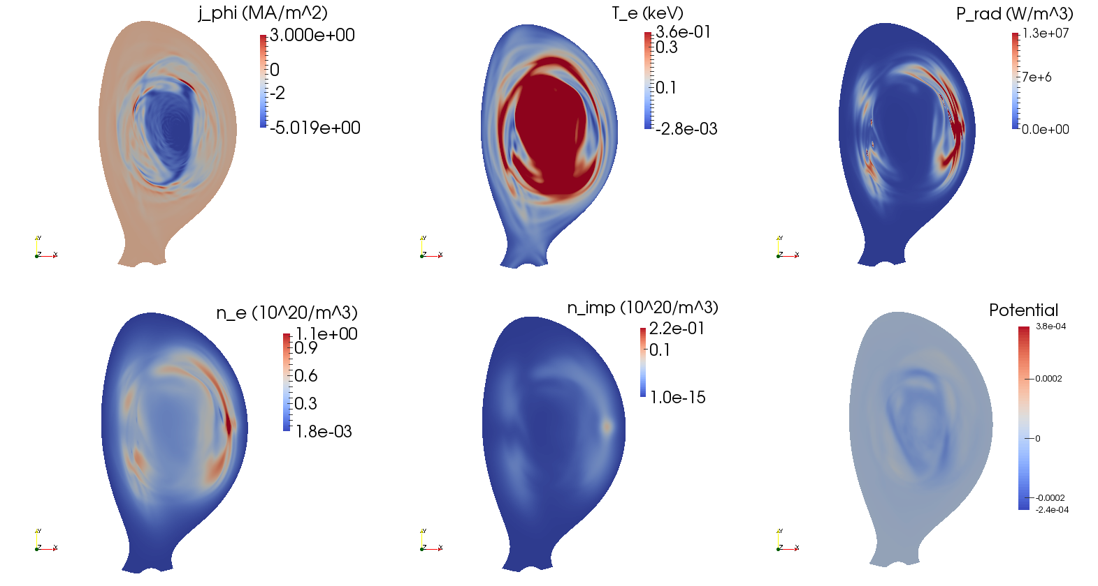
Magnetic energy
Kinetic energy
n=1
n=2
j_{φ} (MA/m²)
T_{e} (keV)
P_{rad} (W/m³)
n_{e} (10²⁰/m³)
n_{imp} (10²⁰/m³)
u

Slide 18
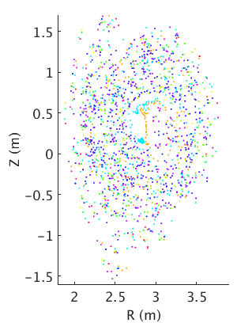
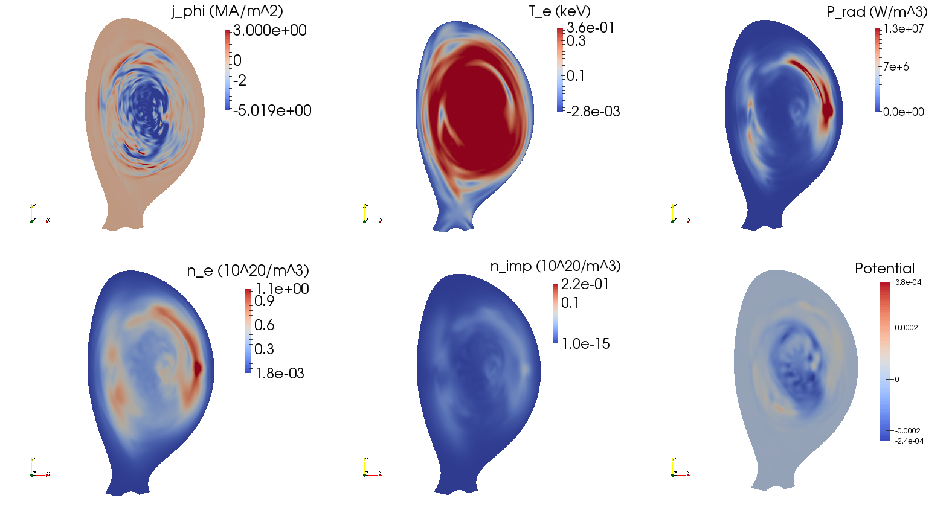
Magnetic energy
Kinetic energy
n=1
n=2
j_{φ} (MA/m²)
T_{e} (keV)
P_{rad} (W/m³)
n_{e} (10²⁰/m³)
n_{imp} (10²⁰/m³)
u

Slide 19
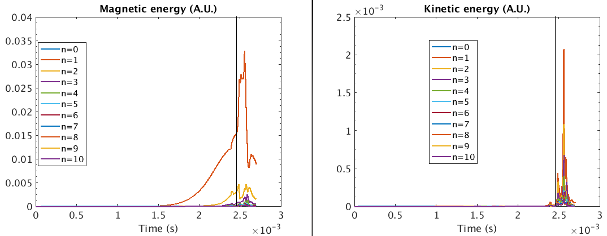
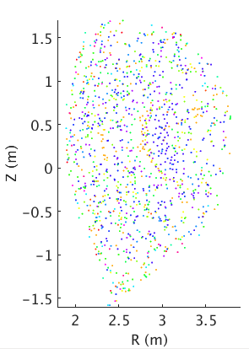
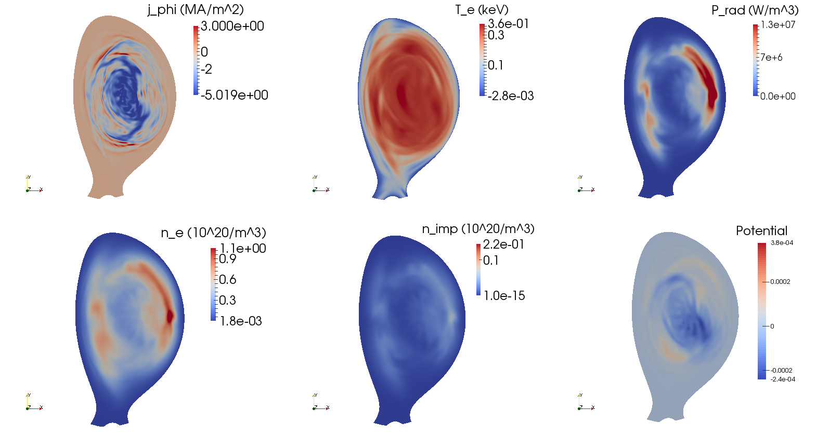
Magnetic energy
Kinetic energy
n=1
n=2
j_{φ} (MA/m²)
T_{e} (keV)
P_{rad} (W/m³)
n_{e} (10²⁰/m³)
n_{imp} (10²⁰/m³)
u

Slide 20
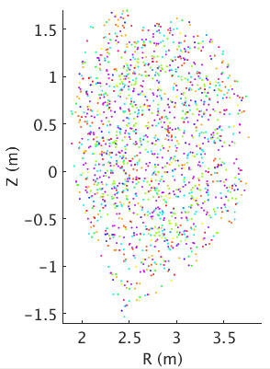
Magnetic energy
Kinetic energy
n=1
n=2
j_{φ} (MA/m²)
T_{e} (keV)
P_{rad} (W/m³)
n_{e} (10²⁰/m³)
n_{imp} (10²⁰/m³)
u

Slide 21
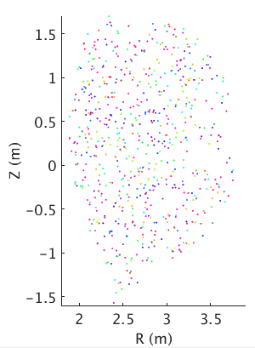
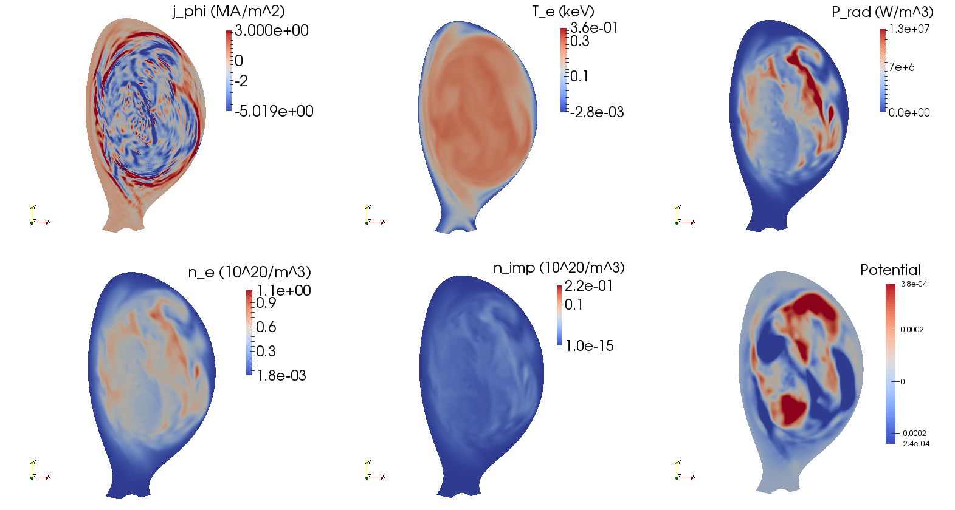
Magnetic energy
Kinetic energy
n=1
n=2
j_{φ} (MA/m²)
T_{e} (keV)
P_{rad} (W/m³)
n_{e} (10²⁰/m³)
n_{imp} (10²⁰/m³)
u

Slide 22
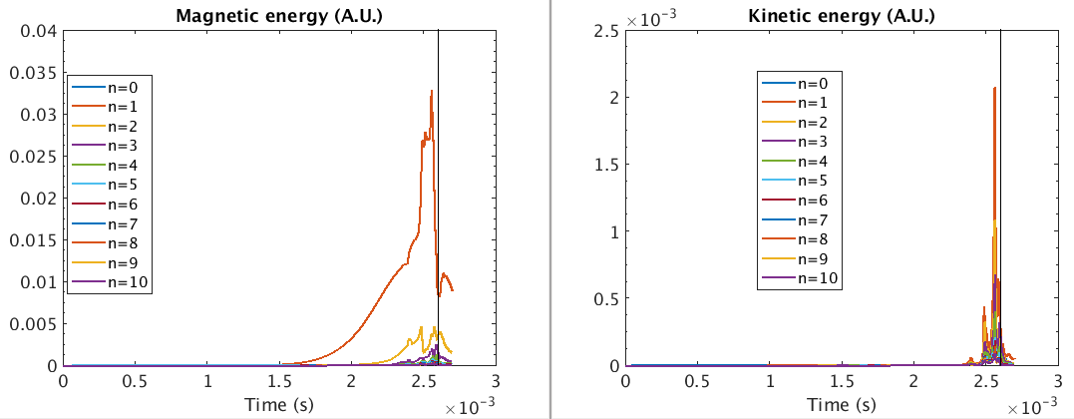
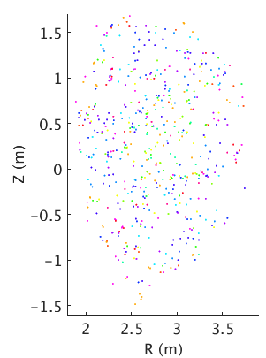
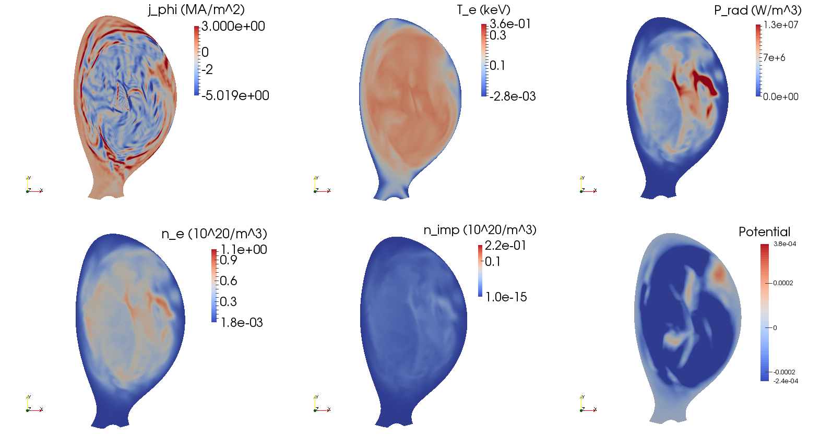
Magnetic energy
Kinetic energy
n=1
n=2
j_{φ} (MA/m²)
T_{e} (keV)
P_{rad} (W/m³)
n_{e} (10²⁰/m³)
n_{imp} (10²⁰/m³)
u

Slide 23
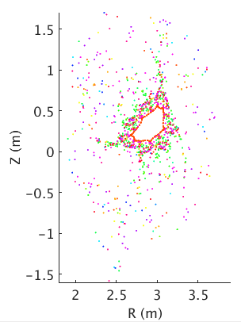
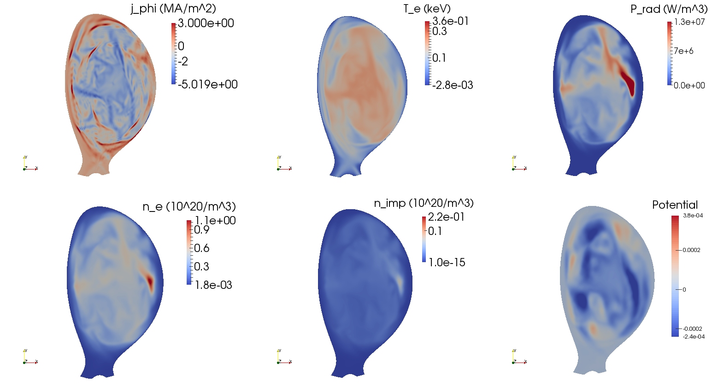
Magnetic energy
Kinetic energy
n=1
n=2
j_{φ} (MA/m²)
T_{e} (keV)
P_{rad} (W/m³)
n_{e} (10²⁰/m³)
n_{imp} (10²⁰/m³)
u

Slide 24
Summary of main observations
Ar cloud cools down flux tube connected to it
2/1 tearing mode dominant
Progressive destruction of flux surfaces, until complete destruction → Thermal Quench
Flattening of T_{e} and j_{φ}
Fast transient flow
After the TQ, flux surfaces quickly reappear in the core

Slide 25
Mechanisms leading
to the Thermal Quench

Slide 26
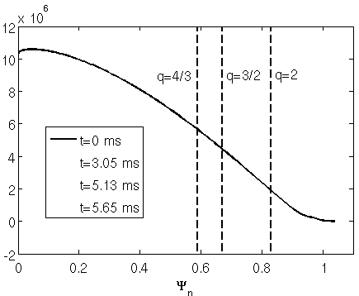
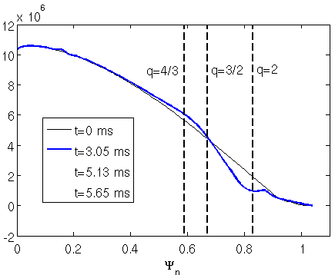
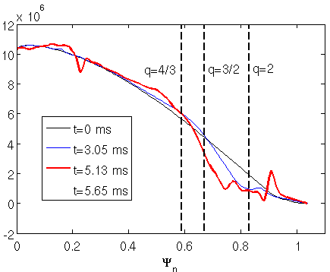
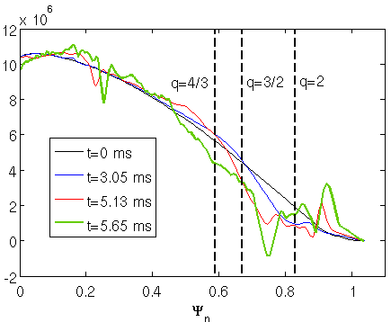
(Here, a D₂ MGI simulation is shown but the same process occurs with Ar MGI)
[E. Nardon et al., PPCF 59 (2017) 014006]
The thermal quench is triggered by a “current profile avalanche” effect
Ψ_{n=1}
Ψ_{n=2}
Ψ_{n=3}
j_{ϕ,n=0} (A/m²)
2/1
t = 4.1 ms
3/2
t = 5.1 ms
4/3
Island overlap → magnetic stochasticity → TQ
t = 5.7 ms

Slide 27
Physics of the TQ, I_{p} spike, magnetic stochasticity

Slide 28
The question of the I_{p} spike
Mechanism of the I_{p} spike [D. Biskamp, Nonlinear MHD]:
MHD relaxation at TQ → broadening of current profile
Conservation of magnetic helicity H ≡ ∫ A∙B dV → I_{p} has to increase
In the past, 3D non-linear MHD simulations used to strongly under-estimate the I_{p} spike
MHD relaxation not well captured?
Unreliable predictions on electron stochastic losses?

Slide 29
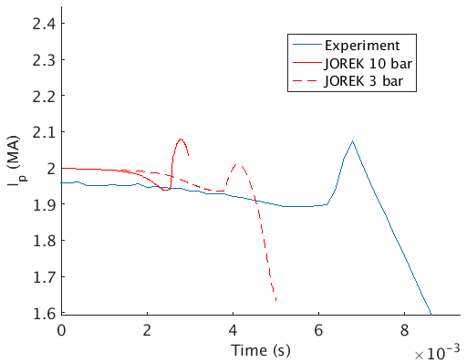
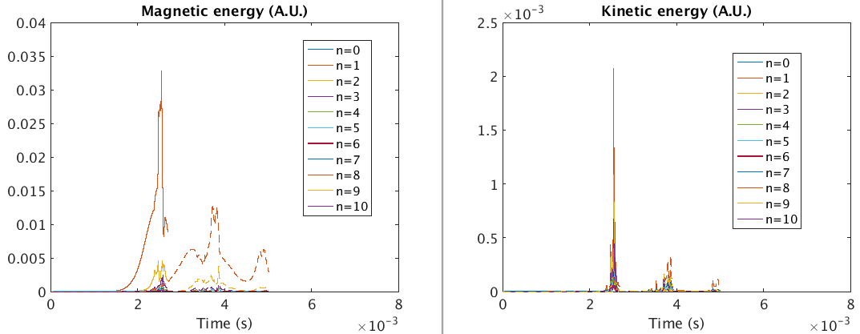
Our simulations approach a realistic magnitude of the I_{p} spike
Probably thanks to low enough η and high enough spatial resolution
Larger spike with more Ar
I_{p} spike associated to spikes in magnetic and kinetic energy

Slide 30
Investigating stochastic transport
Here, we use field line tracing as a first approach
Test electron studies planned in the coming months
Next slide: field lines initialized on a circle a given (R_{start},Z_{start}), track them and count how many are still in the plasma after N toroidal turns

Slide 31
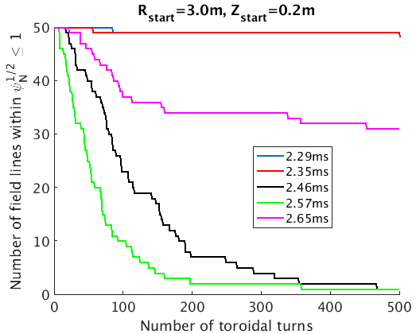
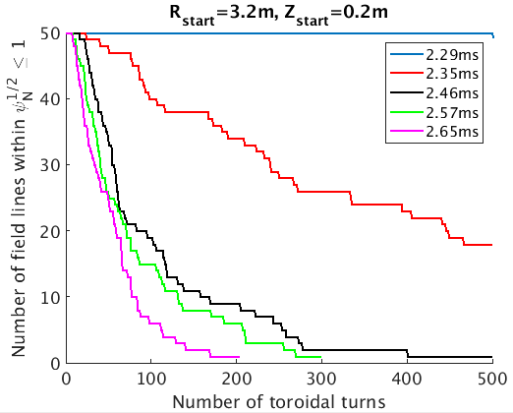
Field lines are lost within a few 100 turns during TQ
For a 1 keV electron, that would mean a few 100 μs, i.e. ~ duration of the TQ
Very core less affected by stochasticity
R_{start}=3.0m, Z_{start}=0.2m
R_{start}=3.2m, Z_{start}=0.2m
2.29ms
2.35ms
2.46ms
2.57ms
2.65ms

Slide 32
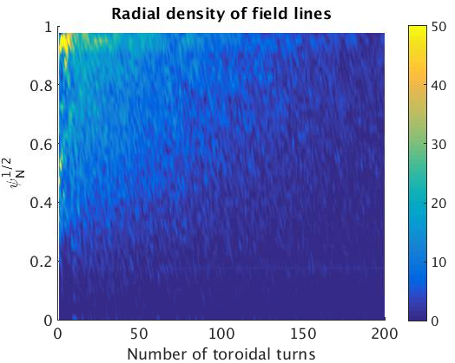
Important note: N_{loss} >> N_{spread}
N_{loss} = number of turns for FL to be lost
~ 100 during TQ
N_{spread} = number of turns for FL distribution to spread over the plasma
~ 1 during TQ: extremely fast spreading!
Reason: ‘field line transport barrier’ at the edge
Flux-surface-averaged density of field lines
Start
@ 2.57ms

Slide 33
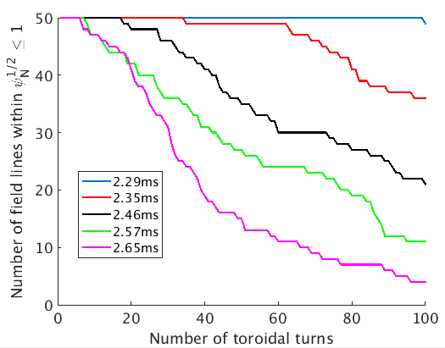
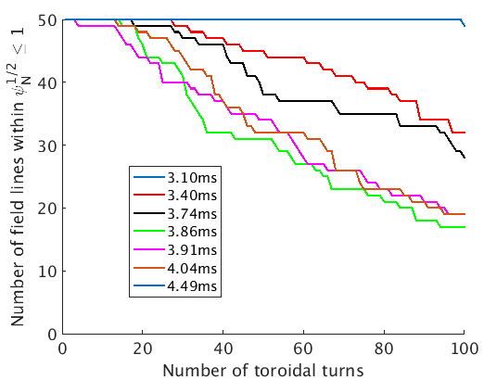
A larger I_{p} spike correlates with faster stochastic losses
R_{start}=3.2m
Z_{start}=0.2m

Slide 34
To have or not to have a radiative collapse

Slide 35
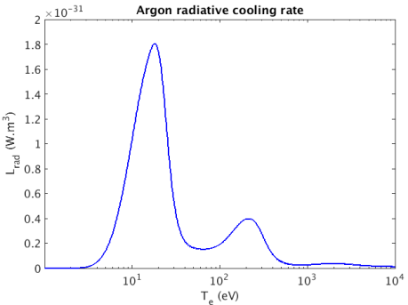
Ward and Wesson, NF 32 (1992) 1117: Parallel heat conduction along stochastic field lines can only bring T_{e} down to ~ 100 eV
That’s because κ// ~ T_{e}^{5/2}
Need a radiative collapse to « finish the job » and bring T_{e} down to ~ 10 eV or below
Radiative collapse is a bifurcative process stemming from the L_{rad}(T_{e}) shape
For RE studies, it is critical to get the radiative collapse right: determines T_{e} and therefore η and E//
Argon radiative cooling rate assuming coronal equilibrium
~20eV
~200eV

Slide 36
Simulations shown in previous slides did not have a full radiative collapse
Will now show a simulation which has a full (pre-TQ) radiative collapse
Uses ~10 times smaller η (which makes it ~ realistic), but with a cut-off at high T_{e}
Favorizes radiative collapse because Ohmic heating is ~10 times smaller
Drawback: runs slowly and stops converging late in TQ

Slide 37
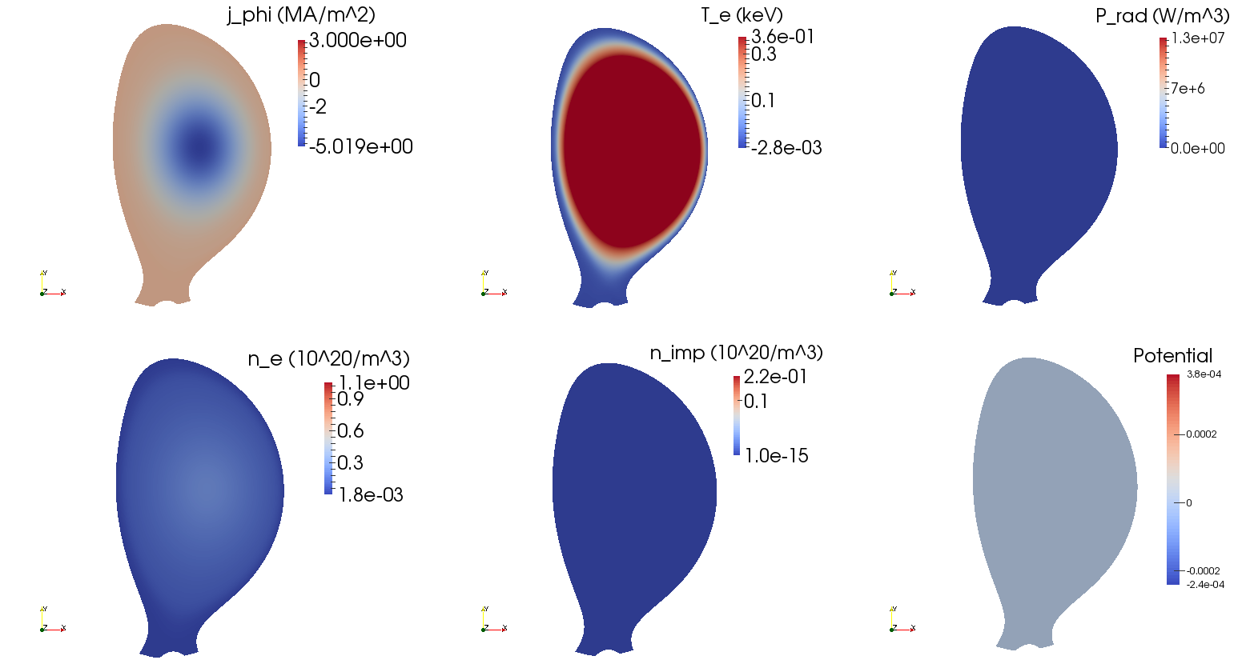
0.00ms
j_{φ} (MA/m²)
T_{e} (keV)
P_{rad} (W/m³)
n_{e} (10²⁰/m³)
n_{imp} (10²⁰/m³)
u

Slide 38
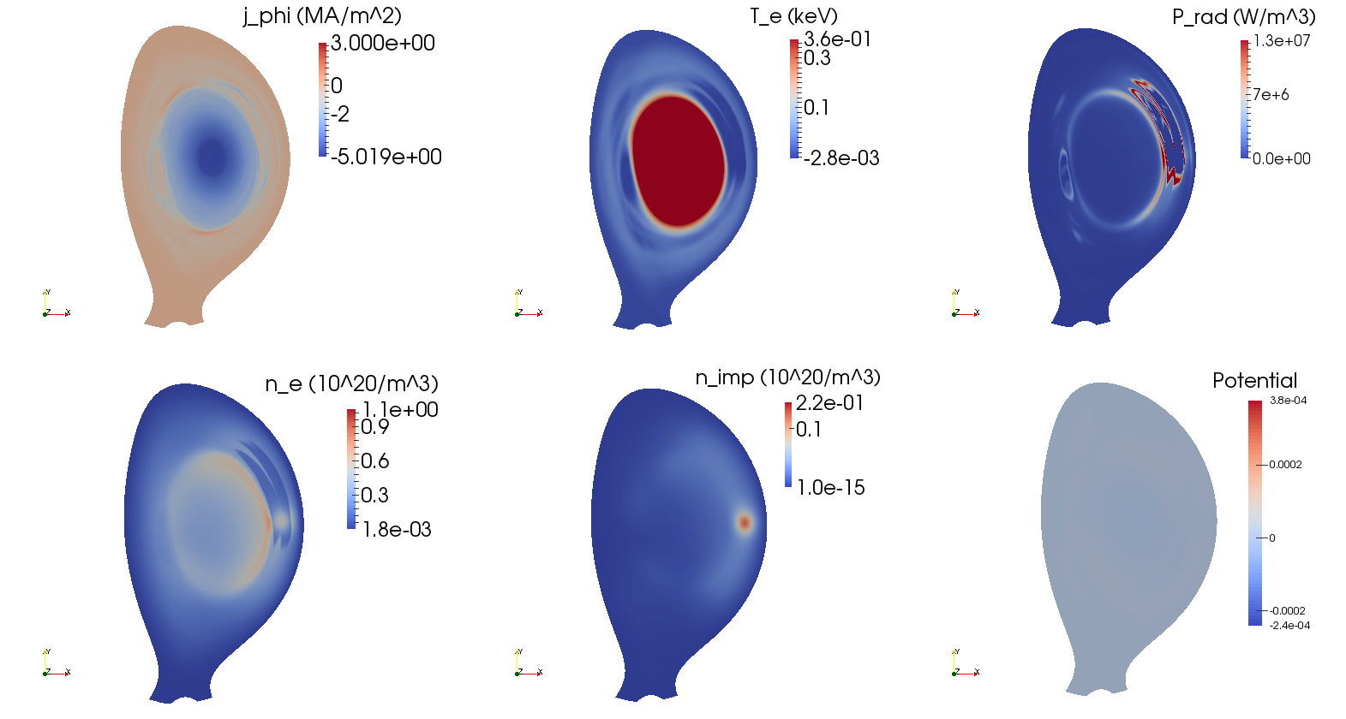
3.91ms
j_{φ} (MA/m²)
T_{e} (keV)
P_{rad} (W/m³)
n_{e} (10²⁰/m³)
n_{imp} (10²⁰/m³)
u

Slide 39
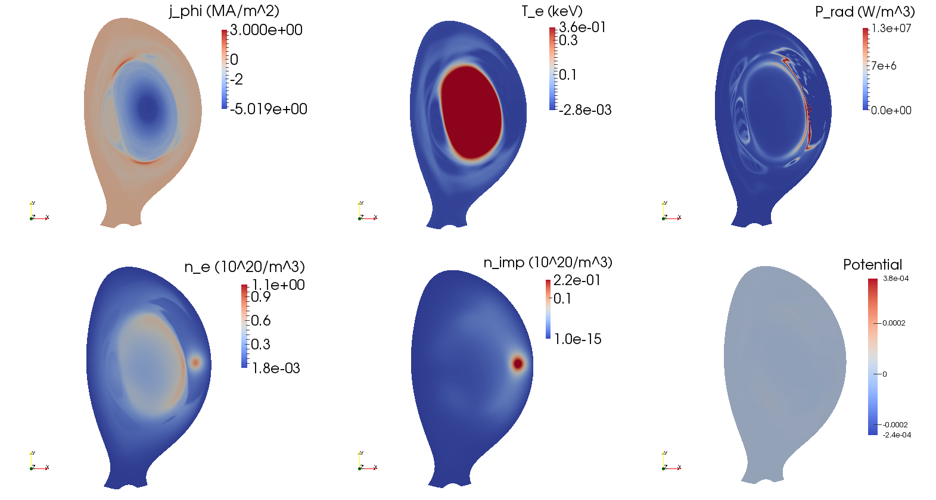
4.08ms
j_{φ} (MA/m²)
T_{e} (keV)
P_{rad} (W/m³)
n_{e} (10²⁰/m³)
n_{imp} (10²⁰/m³)
u

Slide 40
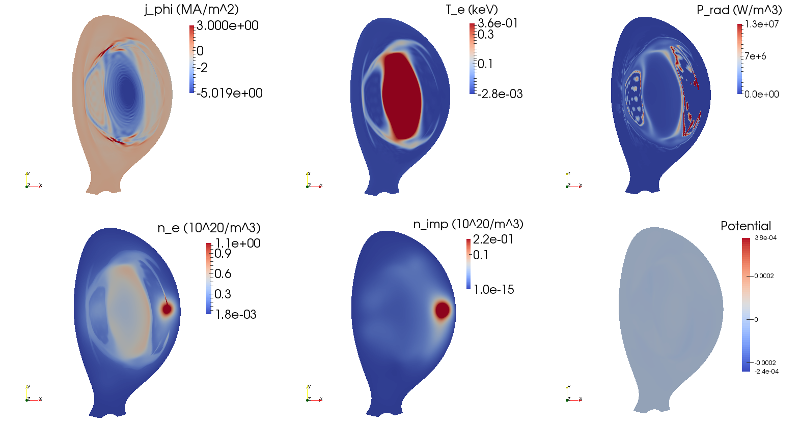
4.52ms
j_{φ} (MA/m²)
T_{e} (keV)
P_{rad} (W/m³)
n_{e} (10²⁰/m³)
n_{imp} (10²⁰/m³)
u

Slide 41
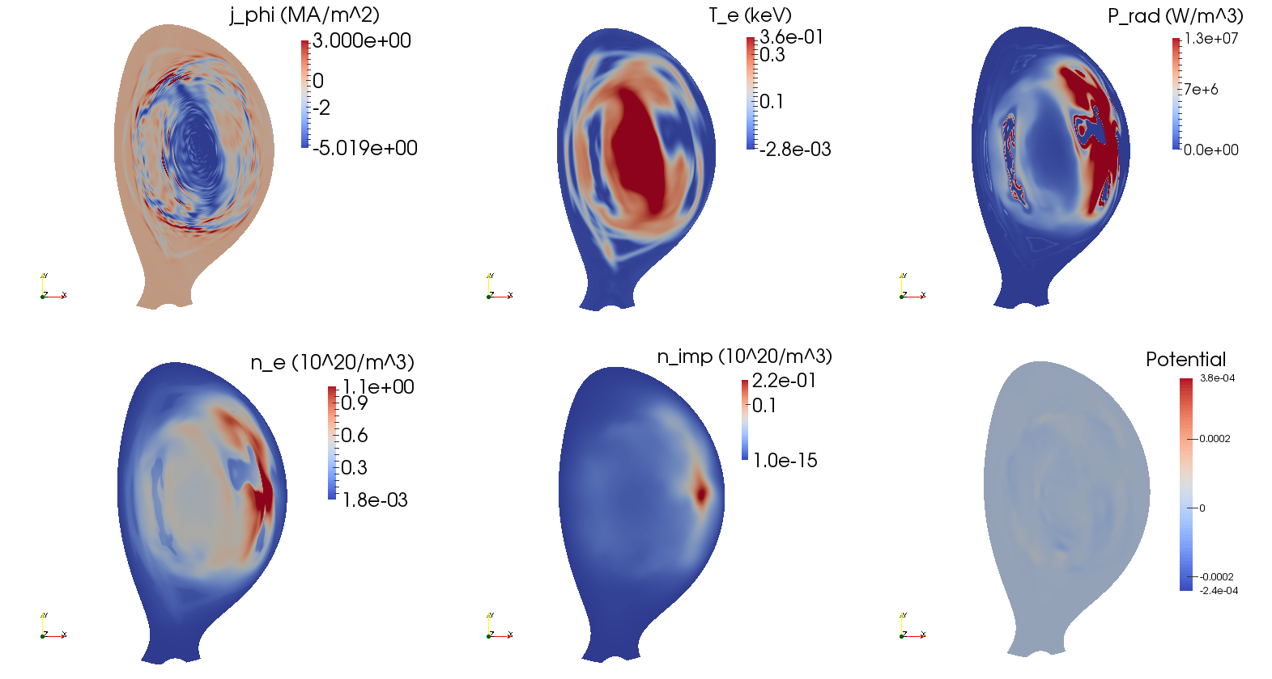
4.82ms
j_{φ} (MA/m²)
T_{e} (keV)
P_{rad} (W/m³)
n_{e} (10²⁰/m³)
n_{imp} (10²⁰/m³)
u

Slide 42
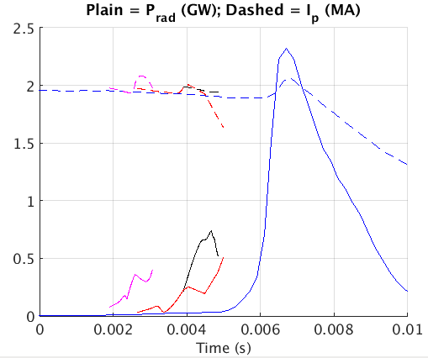
Simulation with pre-TQ radiative collapse (black lines) has a P_{rad} close to the experimental value at the moment when I_{p} starts to go up
Experiment
« Large » η; 3 bar
« Large » η; 10 bar
Realistic η (with cut-off)
Vertical line = moment when I_{p} starts to go up

Slide 43
A quick overview of past results with test particles in JOREK D₂ MGI simulations

Slide 44
Test particle studies are meaningful in situations where RE production is negligible, which is the kind of situation we desire for ITER
Test particle module implemented by C. Sommariva during his PhD and used to post-process JOREK simulations of D₂ MGI in JET
[E. Nardon et al., PPCF 59 (2017) 014006]
2 studies:
One at ~ constant energy, cutting-off E// and friction (« pure transport » study) [C. Sommariva et al., NF 58 (2018) 016043]
One with self-consistent energy evolution, including E// and friction (« runaway » study) [C. Sommariva et al., NF 58 (2018) 106022]

Slide 45
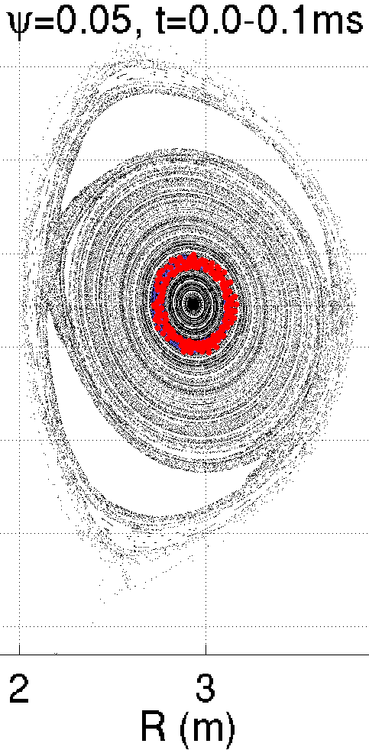
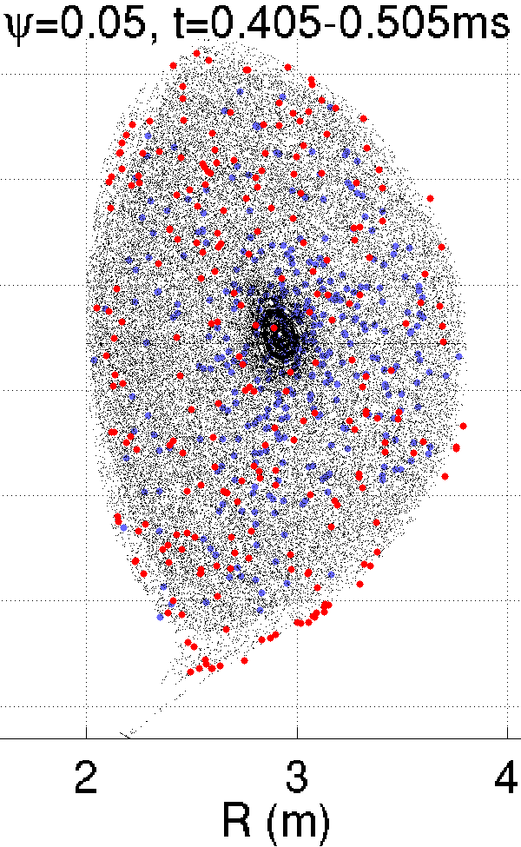
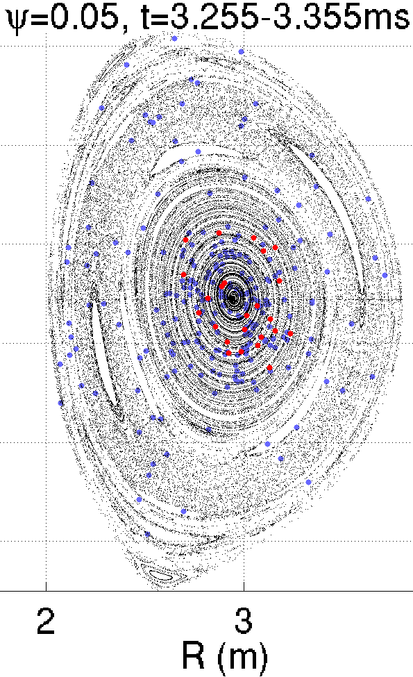
Pure transport study
1 keV
10 MeV
Moderate stochastic losses
Limited by prompt flux surface reformation starting in the core
Magnetic stochasticity underestimated?
I_{p} spike much too small

Slide 46
Runaway study
Dynamics of electrons initialized in the core at 1keV during the TQ
Net parallel force (in V/m):
$F_{net}\left(Ekin,θ\right)=[qE_{⫽}+F_{coll⫽}\left(Ekin,θ\right)]/\left|q\right|$
Blue/red = accelerating/decelerating (in RE direction)
Run away
E_{kin} (MeV)
Lost
Thermalized
Pre-TQ
Time (ms)
~10-100V/m
A few % of e⁻ run away (which is a lot!)
Accelerated by strong E// fluctuations during TQ
Confined in the core due to prompt flux surface reformation
However, no RE observed experimentally.
Possible reasons for mismatch:
Too large η → too large E// in CQ
Absence of core fuelling by MGI
Underestimated stochasticity
TQ
~2000V/m
CQ
~10-100V/m

Slide 47
Summary and plans

Slide 48
Summary
JOREK simulations suggest the following picture for MGI-triggered disruptions:
3/2 TM
Current
profile
contraction
Current profile
contraction
& 3D effects
4/3 TM
MGI
2/1 TM
…
B field stochastization
TQ & I_{p} spike
Note 1: 1/1 mode plays no role in TQ in these simulations (1/1 crash during pre-TQ phase)
Note 2: The above picture seems to apply (to some extent) to SPI as well
A realistic I_{p} spike magnitude is obtained
An underestimated I_{p} spike is a likely sign of underestimated stochasticity
Field line transport properties during TQ: N_{loss} ~ 100 >> N_{spread} ~ 1
The very core is least affected by stochasticity

Slide 49
Plans
We now have a good working point from which we can scan input parameters in order to:
Try to match everything at once (I_{p} spike, P_{rad}, saddle coils, CQ timescale, …)
See dependencies, assess effect of deviating from realistic parameters
Post-process simulations with test electrons
Repeat simulations with JOREK + RE fluid model (V. Bandaru) when ready
Interact with Chalmers team (Oskar et al.) working on GO simulations of the same pulse

Slide 51
Interferometry comparison
Experiment
JOREK 3 bar
3
JOREK 1 bar
(Interferometer is ~π/2 away toroidally from DMV1)
Vague resemblance between JOREK and experiment
n_{el} increases at TQ
Sharp increase in sim., not as sharp in exp.
TQ, JOREK 3 bar
TQ, exp. & JOREK 1 bar

Slide 52
About the choice of resistivity η₀ and hyper-resistivity η_{H}
∂_{t}Ψ = … + η₀(T/T₀)^{-3/2}j_{φ} + η_{H}Δj_{φ}
For numerical stability
Current density profile (axisymmetric Ar MGI simulations)
η₀ scan
η_{H} scan at realistic η₀=3.3x10⁻⁹
Larger η₀ → smoother skin current → milder MHD and TQ
Need to use a realistic η₀, at least in the pre-TQ phase
η_{H}=10⁻¹⁰ smooths profile w/o affecting skin current much
Consequences on fine structures during TQ are uncertain…

Slide 53
A realistic wall is needed to reproduce the pre-TQ I_{p} evolution
Using a realistic resistive wall (red and magenta curves), the pre-TQ I_{p} drop is well matched
Pre-TQ I_{p} drop ~independent of the gas amount (red vs. magenta)
In contrast, an ideal wall close to the plasma (black curve) makes the pre-TQ I_{p} drop too large
Consistent with theory [Artola et al., submitted]
Current lost in the edge is largely re-induced in the still hot plasma
The process does not depend on the timescale, only on geometry

Slide 54
t=3.973ms
t=4.211ms
t=4.340ms
t=4.459ms
t=4.578ms
Poinc.
j_{φ}
T_{e}

