Slide 1
Towards validating the runaway electron avalanche model in JOREK
E. Nardon
Acknowledgments: A. Järvinen, V. Bandaru, J. Artola, M. Hoelzl, D. Hu, M. Lehnen, C. Reux, N. Schwarz, C. Sommariva, C. Wang, the JOREK team and JET contributors
Runaway Electron Modelling Meeting, 10-14 June 2024

Slide 2
!!!!!!!!!!!!!!!!!!!!!!!!!!!!!!!!!!!!!!!!!!! Warning: Work in progress Preliminary results !!!!!!!!!!!!!!!!!!!!!!!!!!!!!!!!!!!!!!!!!!!

Slide 3
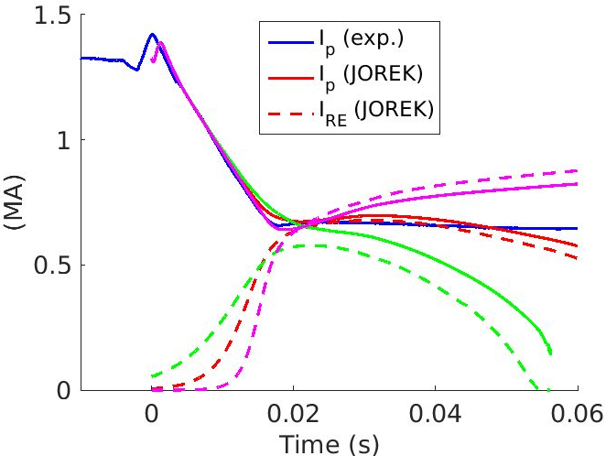
Introduction
Want to validate RE generation models, in particular here the avalanche model, using 2D simulations
Here for JET #95135, where a RE beam was generated by an Ar MGI
Problem:
There are a number of ‘free’ input parameters
E.g. RE seed current, Ar quantity in the plasma, …
Can be used as knobs to fit the experimental data → Validation or ‘fancy fit’?
Possible solution: Show that if we falsify the model, the best possible fit to experimental data degrades
Did this by hand last year [Nardon REM 2023]
Started using Bayesian optimisation framework
[Järvinen JPP 2022]
Not shown today due to lack of time
See [Nardon JOREK General Meeting, Feb. 2024] or backup slides
Recently went back to do more tuning by hand
…May go back to BO later ☺
Γ_{av} x 0.5
True Γ_{av}
Γ_{av} x 2

Slide 4
Outline
The experiment
Simulation setup
Simulation results
A look at synchrotron data
Issues
Summary and future work

Slide 5
The experiment
1

Slide 6
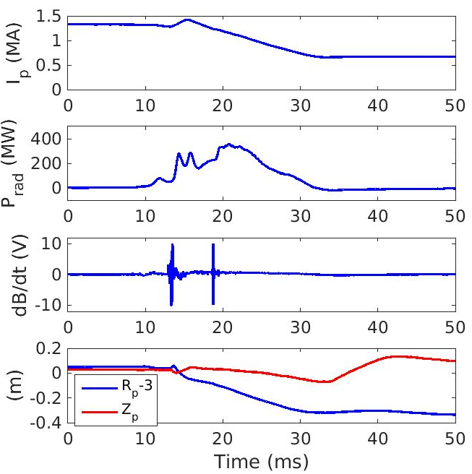
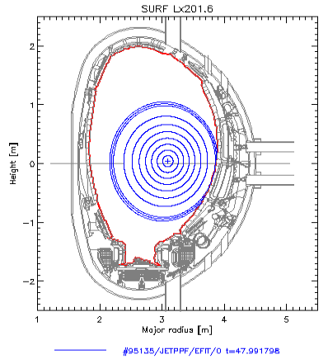
JET #95135
A ‘famous pulse’ with benign RE termination [Reux PRL 2021]
Target plasma: 3 T, 1.45 MA, Ohmic
Ar MGI leads to a 0.65 MA RE beam
Ar
(Note: t=0 is defined arbitrarily)

Slide 7
Simulation setup
2

Slide 8
Model
JOREK reduced MHD model 600 with RE fluid (V. Bandaru)
2D axisymmetric
Free-boundary (JOREK-STARWALL) using ~realistic resistive wall + divertor support structures
Evolve ψ, u (electric/flow potential), ρ, ρ_{Ar}, T (single temperature), n_{RE}
Coronal equilibrium model for Ar
No parallel flow
No model for Ar gas dynamics
→ Cannot describe penetration of Ar into the plasma
→ Use ~homogeneous Ar source
Prescribed RE seed
No modelling of primary RE generation
Here, used a radially broad Gaussian shape
RE avalanche rate from [Hesslow JPP 2018, PPCF 2018]

Slide 9
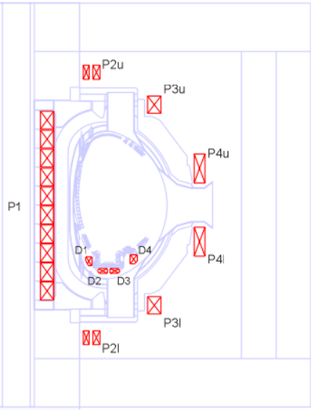
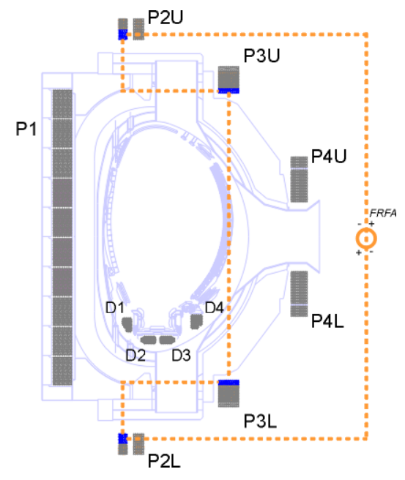
PF coils currents
Initial currents:
Exact experimental values would not give the right plasma position and shape
No iron core in the model
No induced currents in passive structures at t=0 in the model
→ Need adjustment to match EFIT equilibrium
Start from exp. currents and fine-tune during Grad-Shafranov solver iterations
Time evolution:
Use same dI_{PF}/dt as in exp. in all coils except for:
Fast radial field coils, which are used for feedback on Z_{axis}, to match exp. value
P4 (vertical field) coils, whose current is adjusted in some sims. to get a better match on R_{axis}
Fast radial field

Slide 10
Simulation phases
0) Equilibrium calculation
Free-boundary Grad-Shafranov
1) Initialisation of vertical stabilisation
2) Ar injection
Fast (50 µs) and broad (Gaussian of width 2 m, centered on magnetic axis)
3) Thermal quench
Large perpendicular heat conductivity
Hyper-resistivity to flatten the j profile
4) Current quench
Keep injecting some Ar to match I_{p} decay rate

Slide 11
Simulation results
3

Slide 12
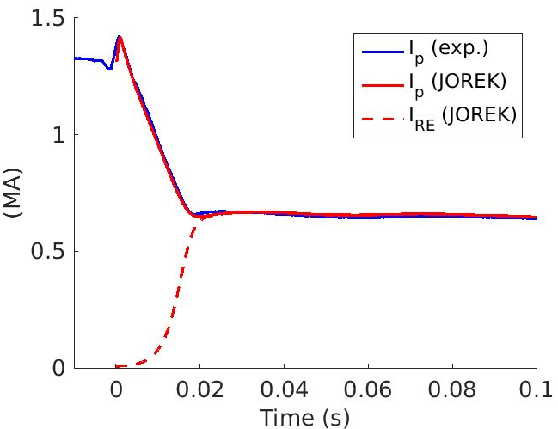
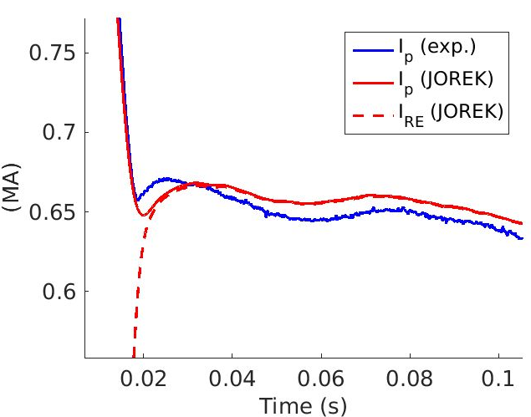
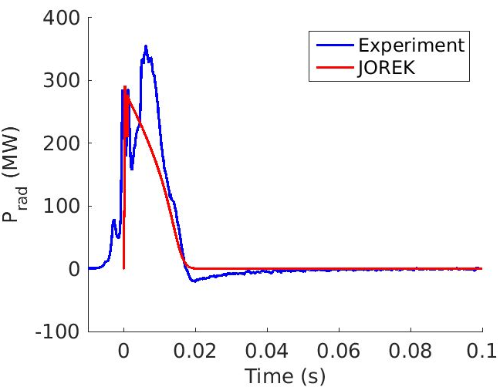
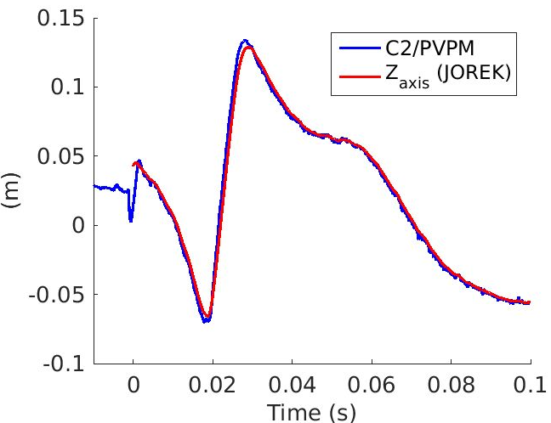
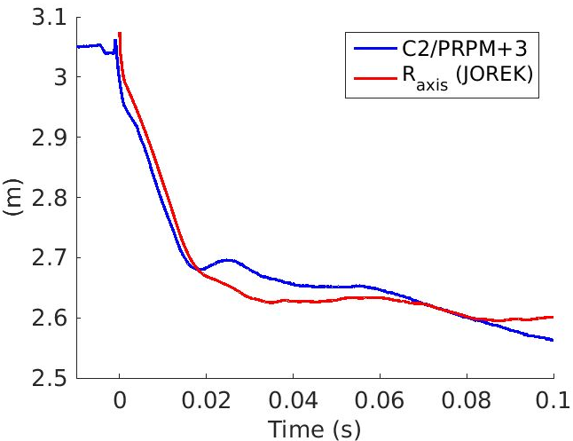
‘Best match’ simulation
1.5·10²⁰ Ar atoms in the plasma at start of RE plateau (19% Ar quantity in DMV)
Avalanche gain ~ 100
T12em6_Dpp1em6_MGICQ2p0e22_Zkpp1em5_reg0p75_rego0p0_regw10_Drei5em9_IP4adj500

Slide 13
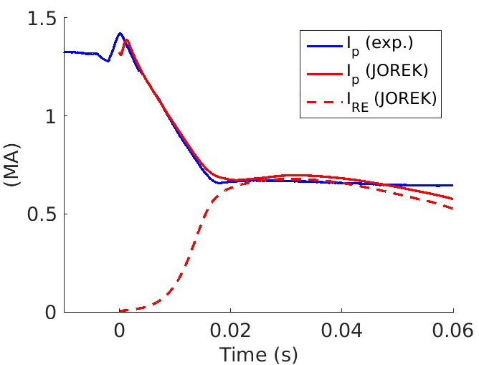
Progress since last year
‘Best match’ as of Spring 2023
‘Best match’ now
☺
Main differences in settings (last year vs. now):
RE perpendicular diffusivity D_{RE,perp}: 3.2 vs. 0.016 m²/s → Avoids drop in plateau
T_{e} at boundary: 2 vs. 0.2 eV → Removes SOL (halo?) current
Ar injection during CQ: no vs. yes → Maintains I_{p} match throughout CQ
JET95135_FB_PS_ZexpmFBinitGpm50Gdm2000_tshift48p0253_REjx4em3_MGI1d25u140_ZKperp1em3Ipspikeu3140_REadv1dm1Dpar1dm2_dtCQ50_n0

Slide 14
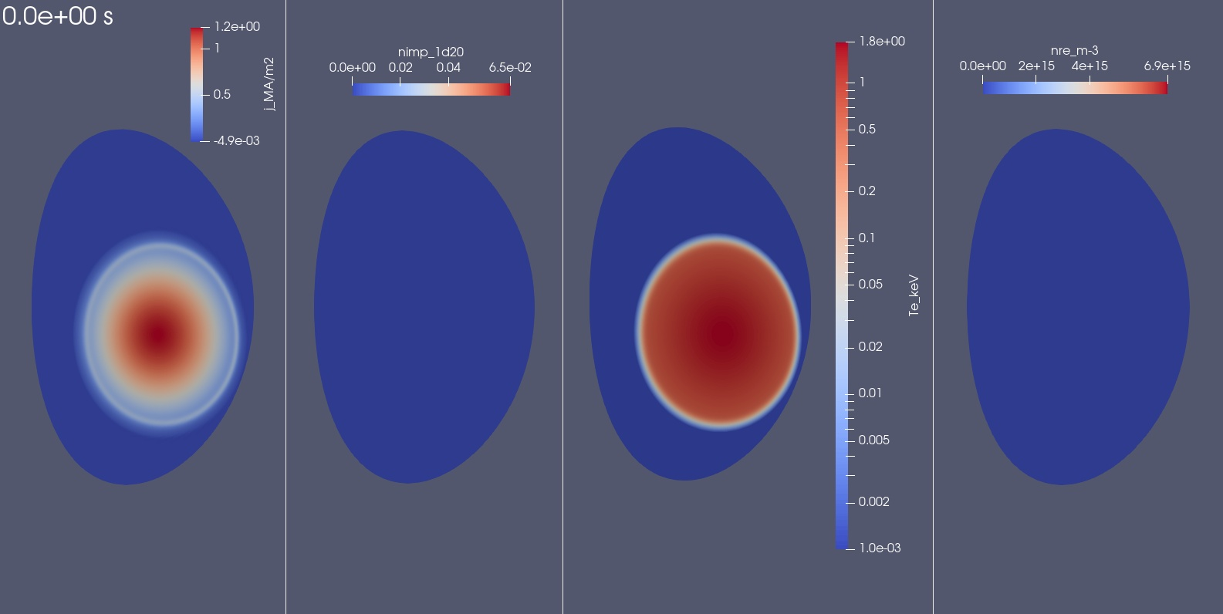
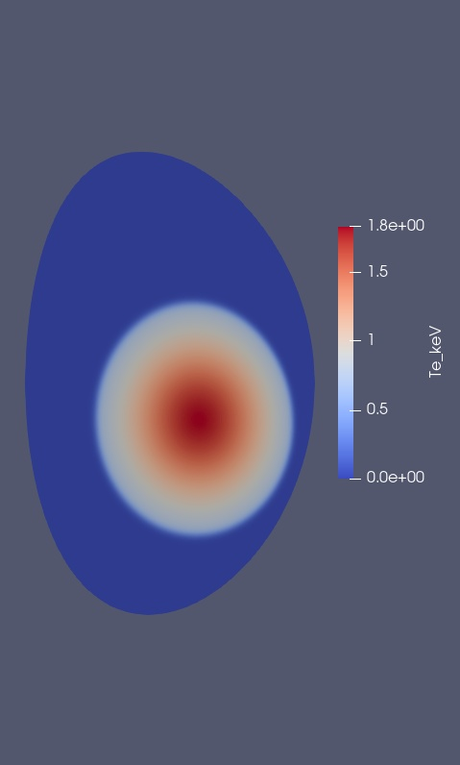
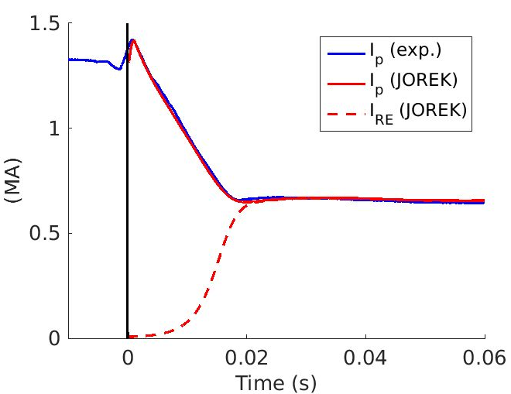
Current density
Argon density
T_{e}
RE density
Max. 1.8 keV

Slide 15
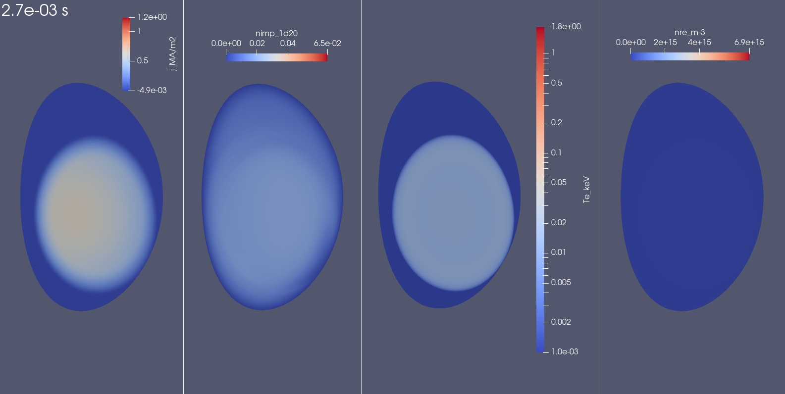
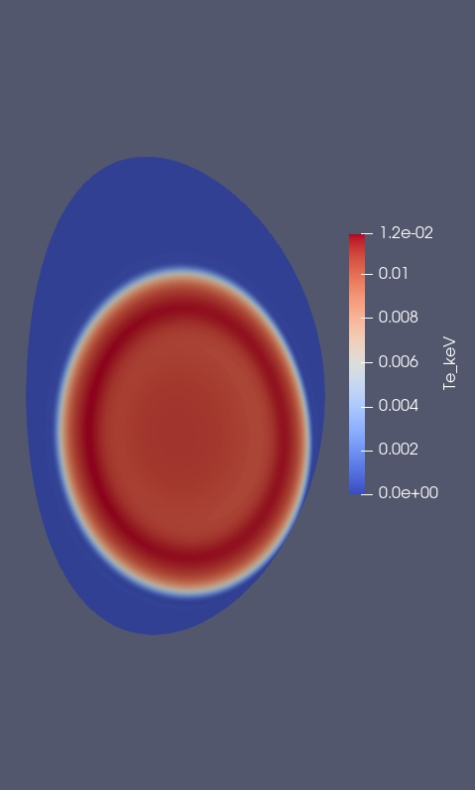
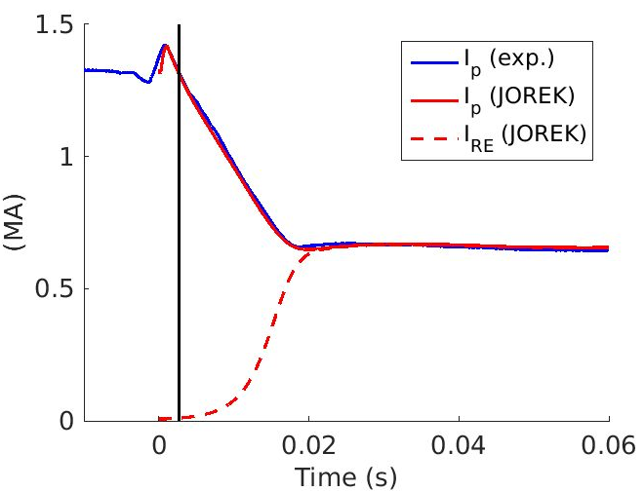
Current density
Argon density
T_{e}
RE density
Max. 12 eV

Slide 16
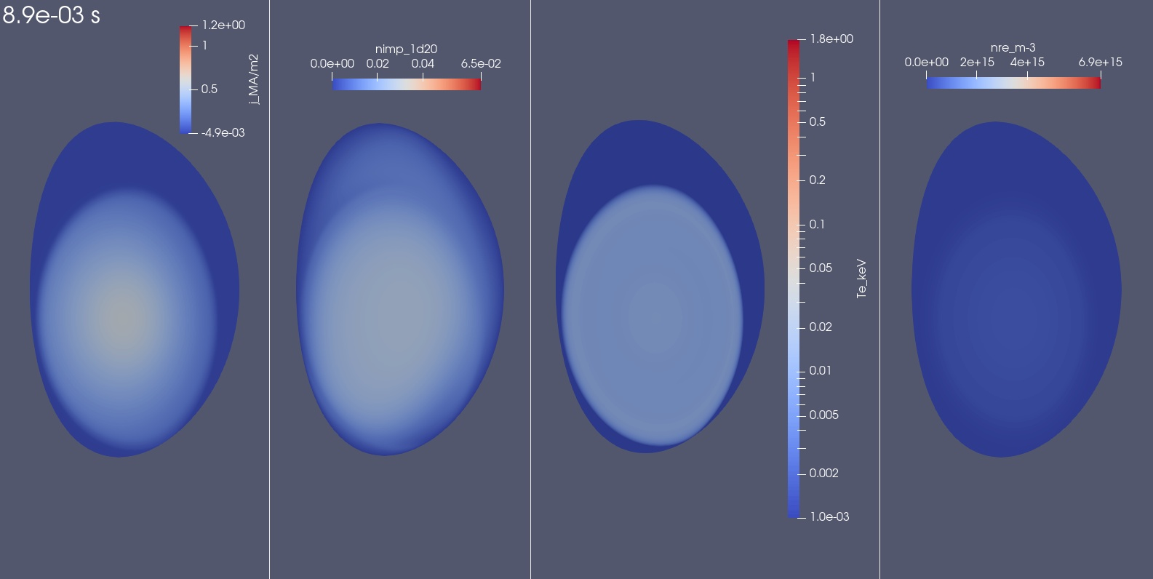
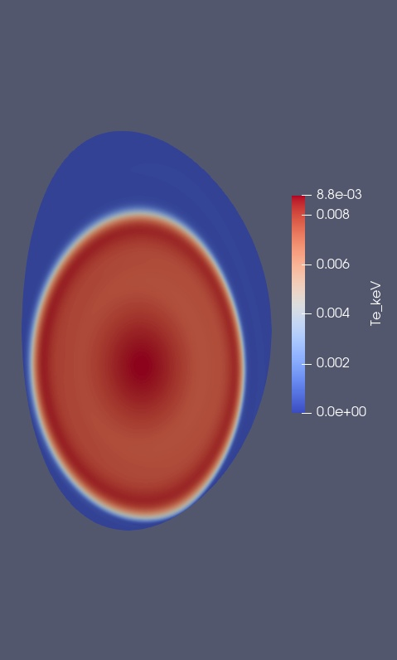
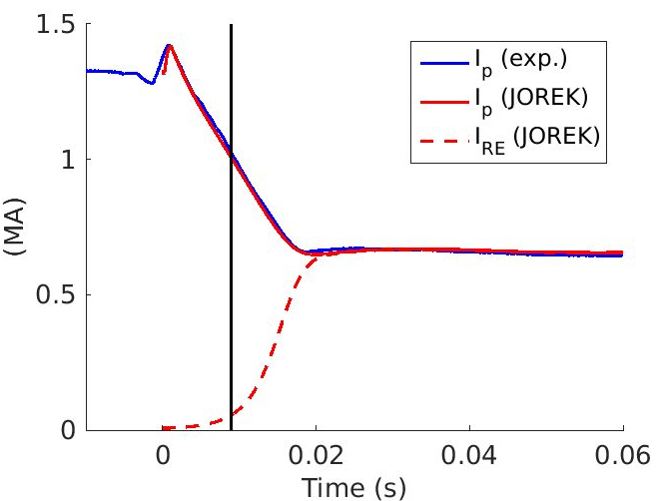
Current density
Argon density
T_{e}
RE density
Max. 8.8 eV

Slide 17
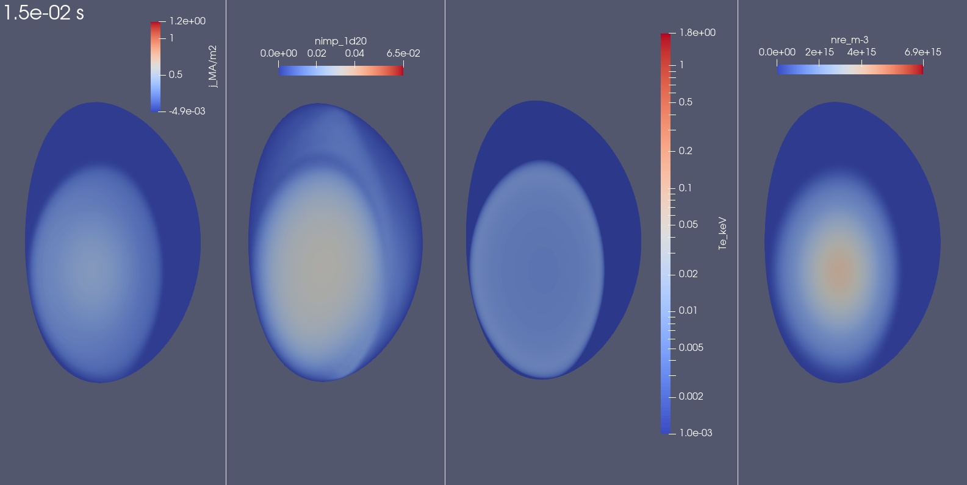
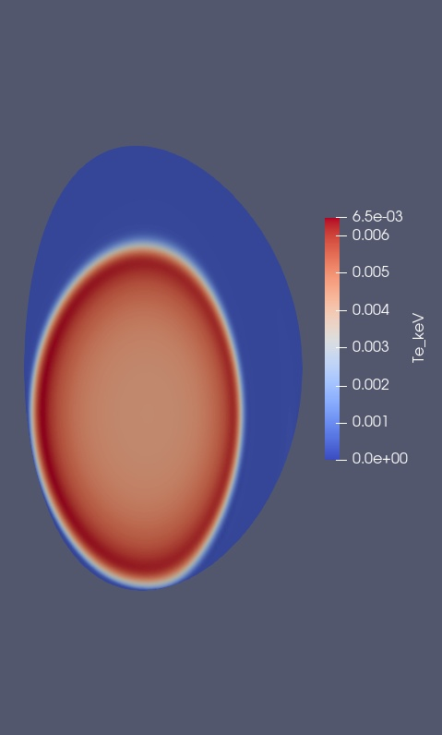
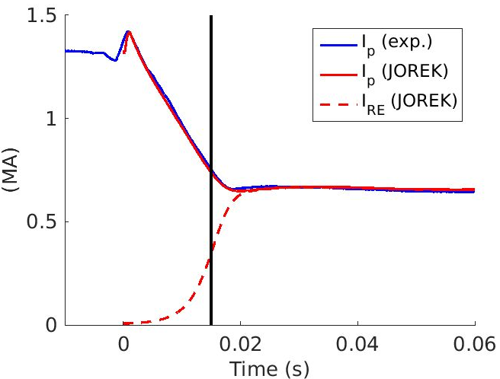
Current density
Argon density
T_{e}
RE density
Max. 6.5 eV

Slide 18
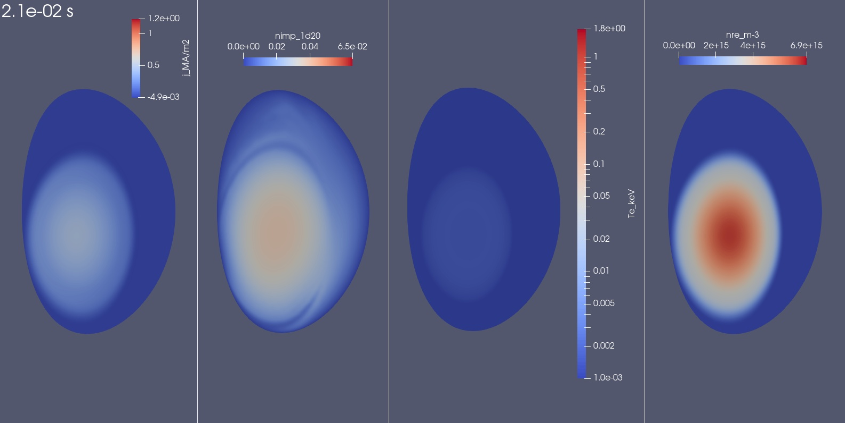
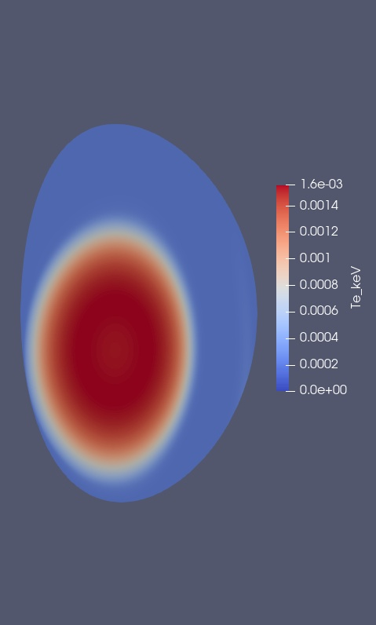
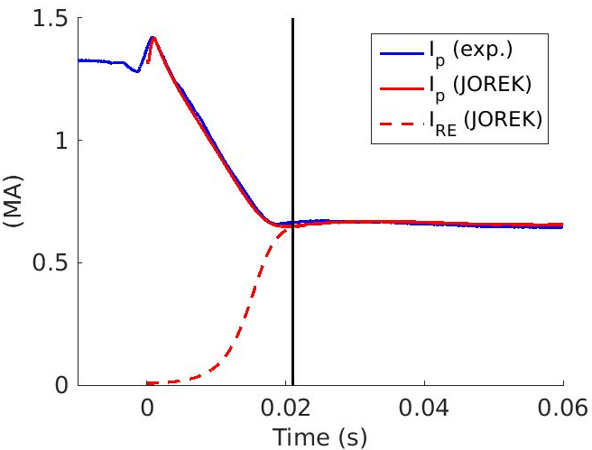
Current density
Argon density
T_{e}
RE density
Max. 1.6 eV

Slide 19
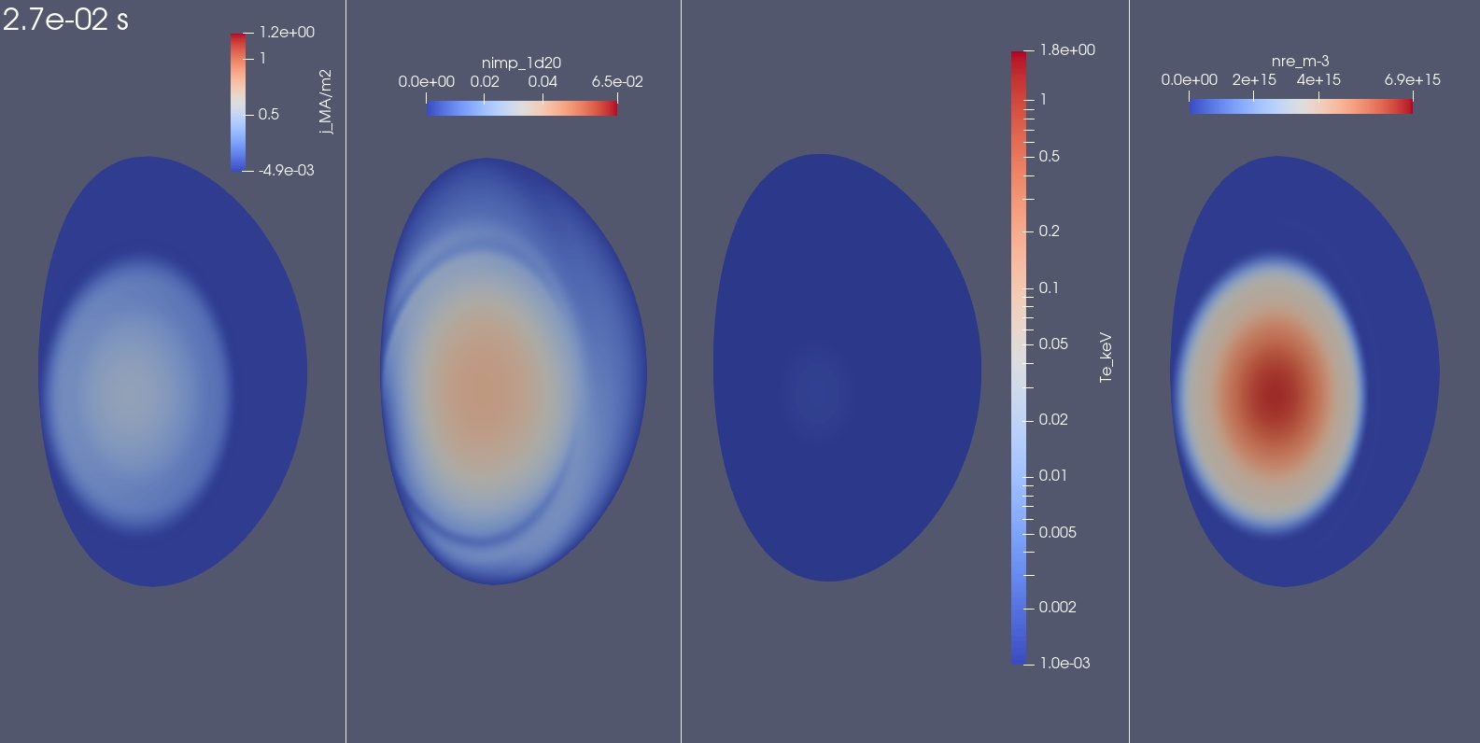
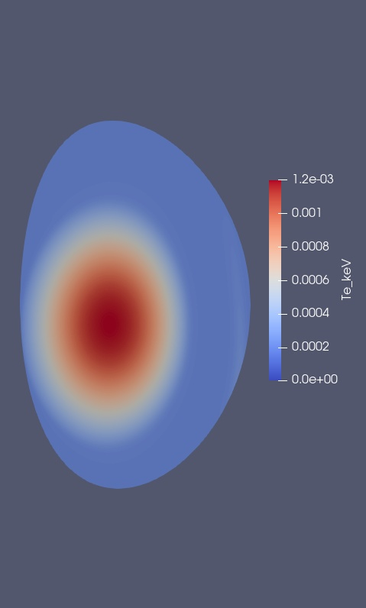
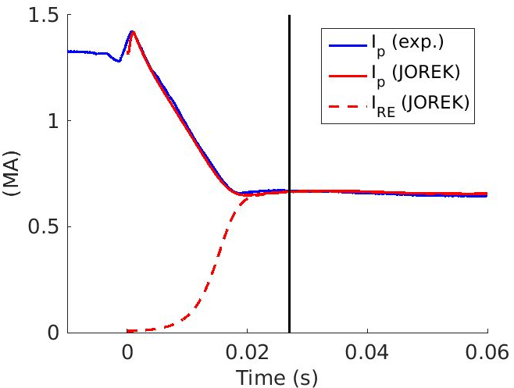
Current density
Argon density
T_{e}
RE density
Max. 1.2 eV

Slide 20
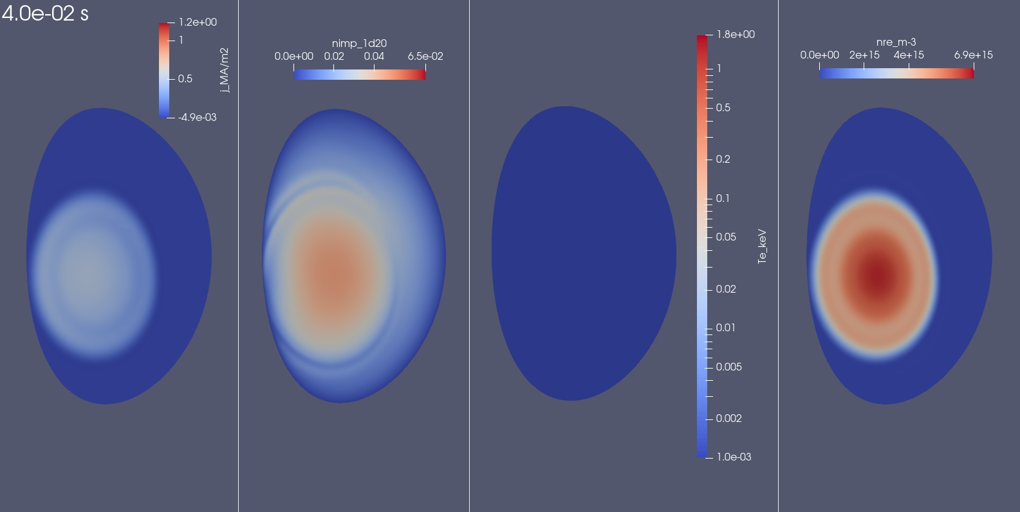
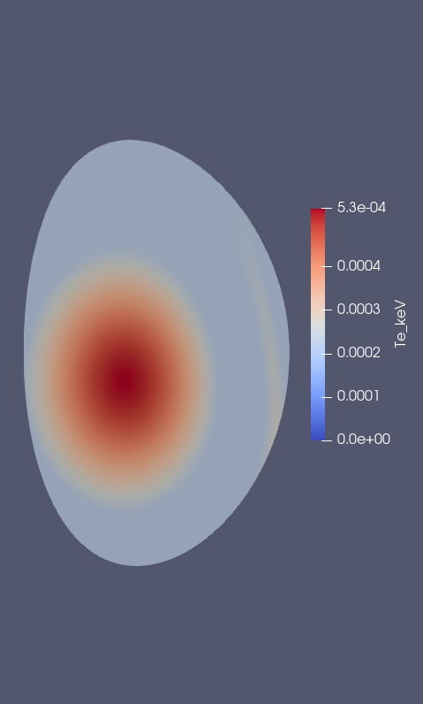
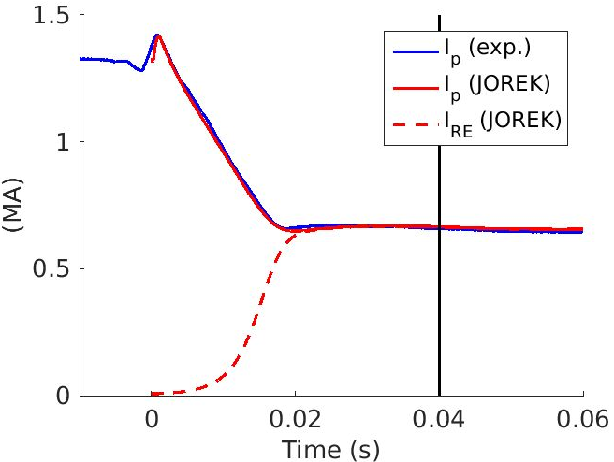
Current density
Argon density
T_{e}
RE density
Max. 0.5 eV

Slide 21
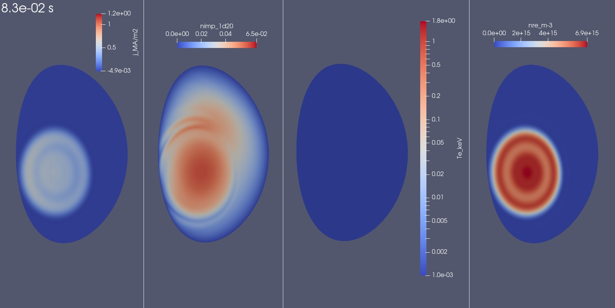
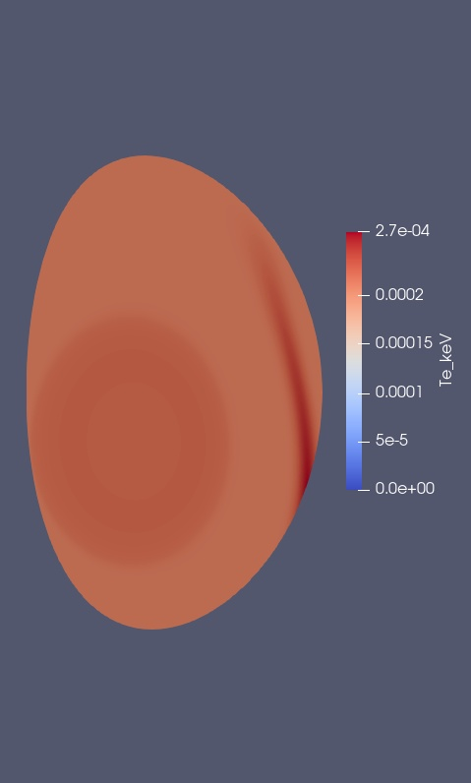
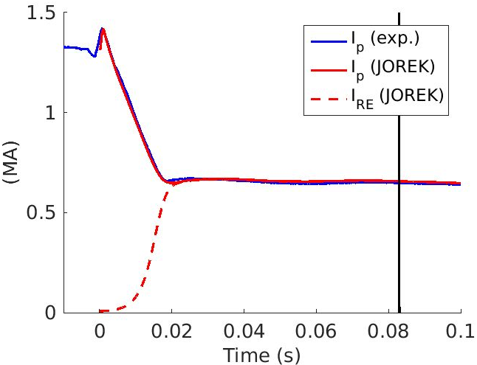
Current density
Argon density
T_{e}
RE density
Non-monotonic current profile develops during RE plateau. Also seen in ITER sims. [Bandaru NF 2024].
Reason? Link with Breizman’s theory [Breizman NF 2014]?
Max. 0.3 eV

Slide 22
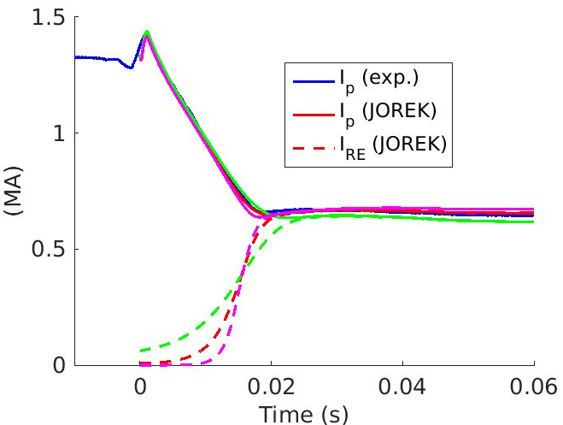
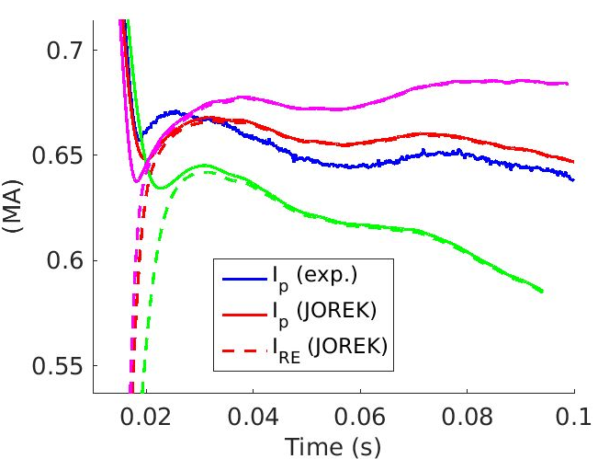
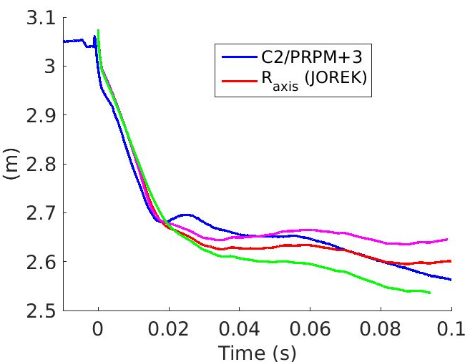
Falsifying Γ_{av}: true / x 2 / x 0.5
Seed RE current is adjusted to match plateau level: 6.6 kA / 57 A / 61 kA
True Γ_{av} looks better but not by a huge margin
The difference was larger before [Nardon REM 2023] [Nardon JOREK GM 2024]
T12em6_Dpp1em6_MGICQ2p0e22_Zkpp1em5_reg0p75_rego0p0_regw10_Drei5em9_IP4adj500
T12em6_Dpp1em6_MGICQ2p0e22_Zkpp1em5_reg0p75_rego0p0_regw10_Drei5em9_IP4adj500_avx2
T12em6_Dpp1em6_MGICQ2p0e22_Zkpp1em5_reg0p75_rego0p0_regw10_Drei5em9_IP4adj500_avo2

Slide 23
A look at synchrotron data
4

Slide 24
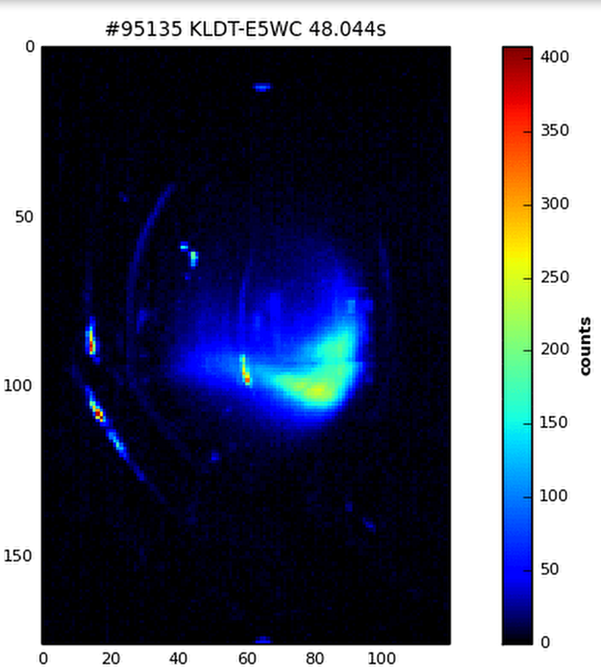
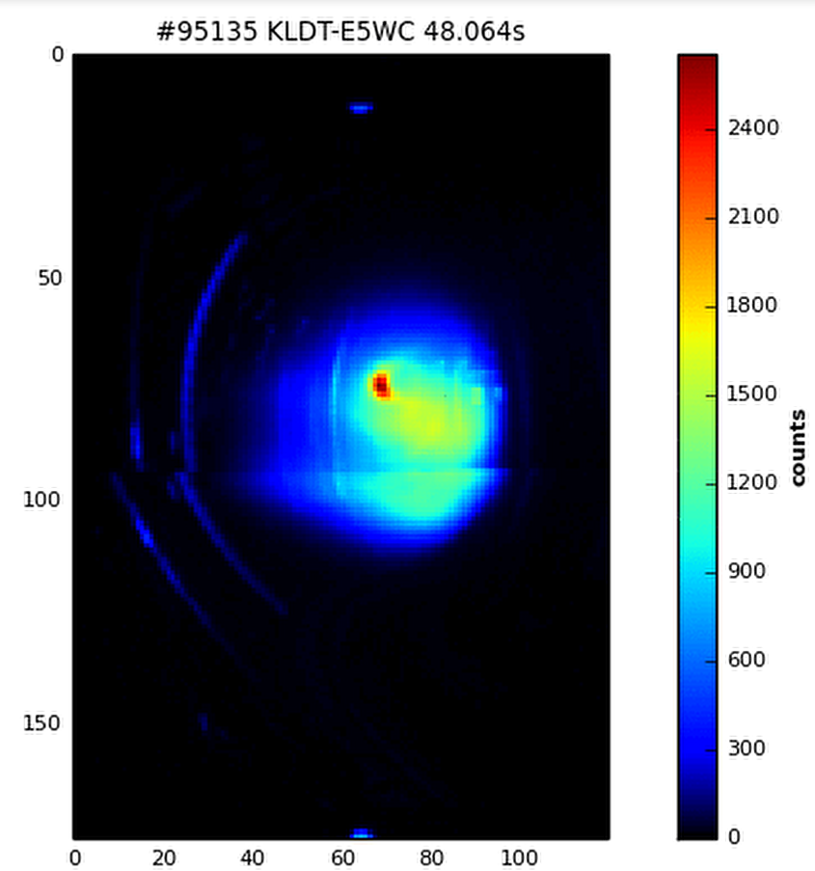
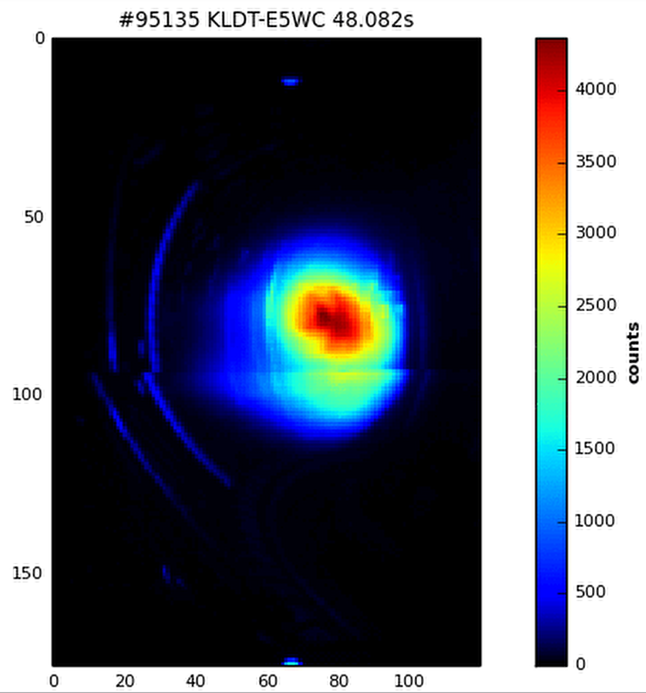
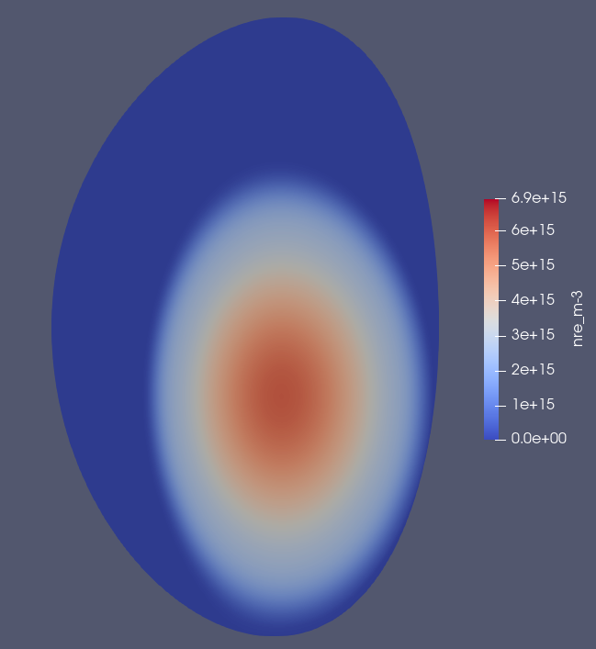
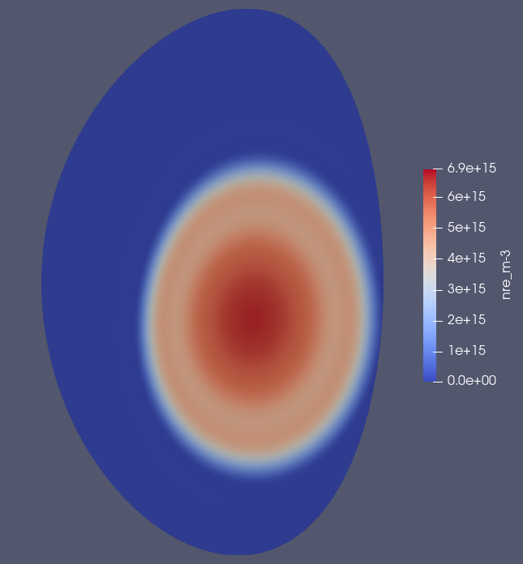
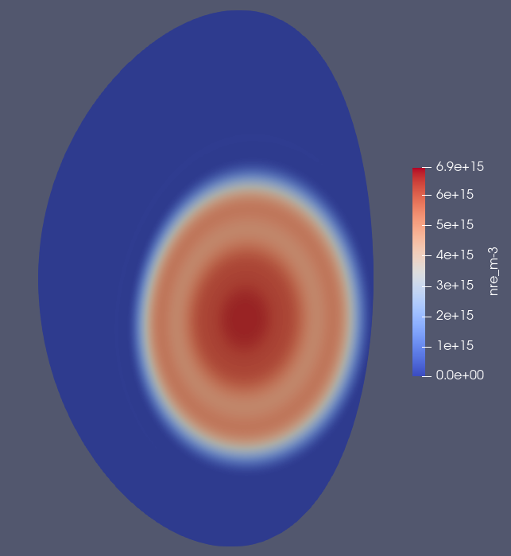
IR camera images vs. simulated RE density
23 ms
18.5 ms
39.5 ms
57.5 ms
≈250
≈1200
≈2000
Exp. pattern initially localized at edge-bottom-HFS whereas simulated n_{RE} peaked in the core
Compatible? → To be assessed with JOREK synthetic synch. camera [Sommariva EPS 2023]
Strong core peaking during plateau in exp. is not observed on simulated n_{RE}
Core peak suddenly disappears, likely due to a reconnection event
Remindful of ASDEX Upgrade [Hoppe JPP 2021]
Intensification of experimental emission over time

Slide 25
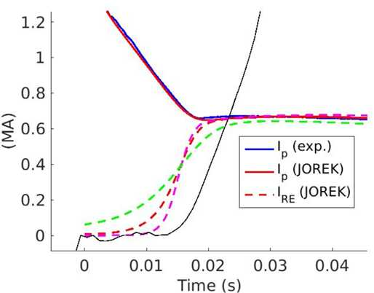
IR intensity vs. simulated I_{RE}
Space-integrated IR intensity
G_{av}x2
G_{av}x0.5
IR intensity lags behind n_{RE}
IR intensity keeps rising during RE plateau
Likely due to pitch angle scattering, as in ASDEX Upgrade [Hoppe JPP 2021]
More modelling (synthetic synch.) is needed to interpret this data and use it for validation

Slide 26
Issues
5

Slide 27
Too small n_{e} rise
n_{e} rise seems too small in sim. compared to interferometry data
By a factor ~2 (to be confirmed)
But a larger injected Ar quantity in the simulation would give a too fast I_{p} decay
A matter of Ar profile? → Inject more Ar at the edge?
D outgassing from the wall after TQ? → Inject D?

Slide 28
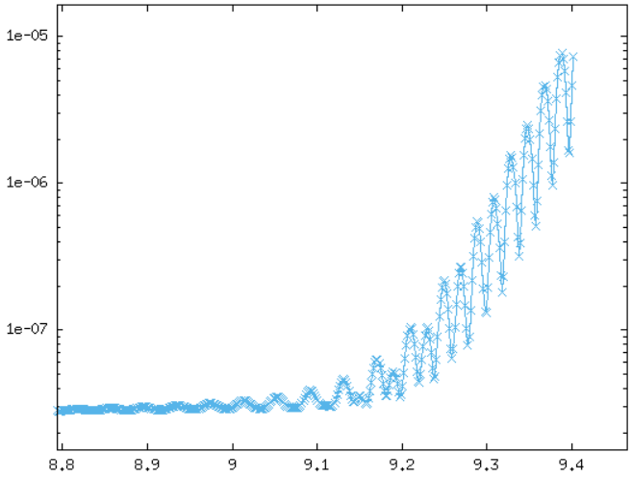
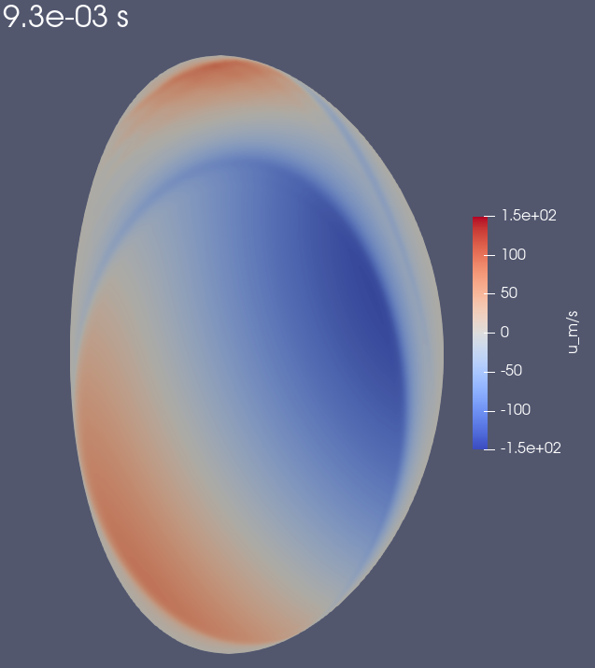
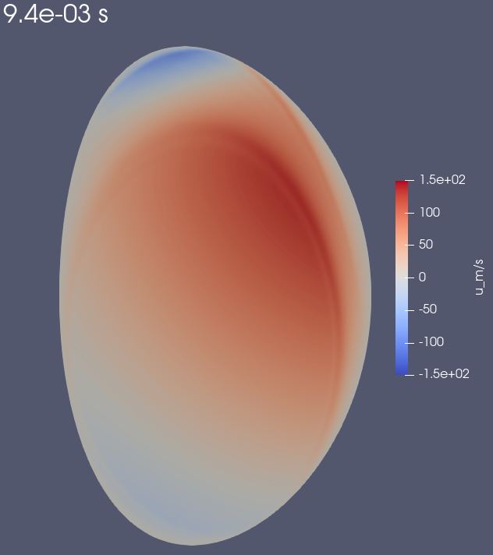
Numerical instabilities
Seem related to the coupled dynamics {REs ↔ electric/flow potential}
j_{RE} (= e·c·n_{RE}) impacts ExB flow via ∇||j term in vorticity equation
ExB flow impacts n_{RE} via ExB advection
Electric/flow potential
Kinetic energy (A.U.)
9.3 ms
9.4 ms
Time (ms)
rego0p4w0p1f0p02_nsamp9.43e+24_MGIinCQ3e22_readv1dm1_Drepar0
Instability tends to occur when using RE || advection, even at v_{||RE} << c
→ Lately, I have been using v_{||RE}=0, treating RE || transport as diffusive
Even with pure diffusion, numerical instability appears when using a too *small* time step

Slide 29
More technical issues
Had to set a floor value (4 eV) for the T_{e} used in the calculation of p*
Otherwise p* calculation fails
Had to kill the avalanche when n_{e} < 5·10¹⁸/m³
Otherwise may get very strong RE generation near LCFS at some point
These ‘patches’ probably do not affect simulation results
Needs investigation and discussion with JOREK colleagues

Slide 30
Summary and future work
6

Slide 31
Summary and future work
Match to exp. I_{p} has improved and is now quite good
Mainly as a result of reducing D_{RE,perp} and removing SOL currents
The inferred assimilated Ar quantity is plausible (~20% of total Ar)
Looks like real validation and not a fancy fit: when falsifying Γ_{av}, the match in I_{p} degrades
…Not by a lot though
A non-monotonic current profile develops during RE plateau
Reason to be investigated
Future work:
Compare with DREAM simulations by Aaro
Model synchrotron radiation (Cristian)
Exploit other data (interferometry, HXR monitor, fission chambers, …)
Investigate issues
Too small n_{e} rise → Try D injection or more edge-peaked Ar injection
Numerical issues → Investigate more and discuss with JOREK colleagues

Slide 32
Backup slides

Slide 33
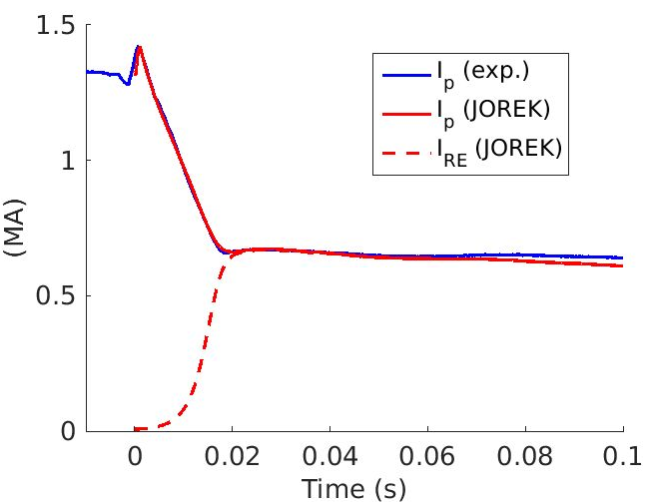
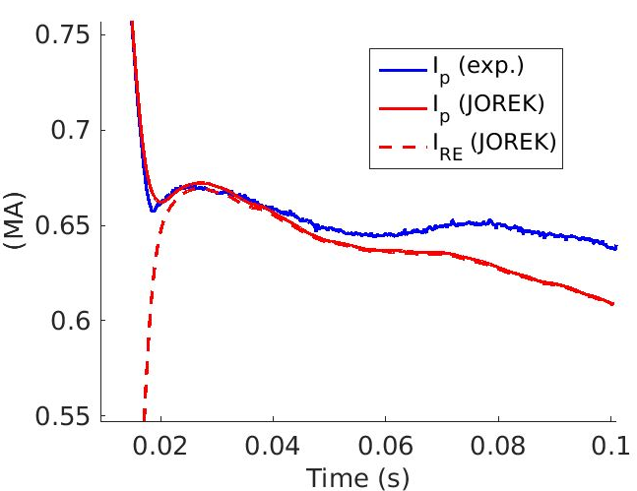
‘Best match’ simulation w/o adjusting P4 currents
T12em6_Dpp1em6_MGICQ2p0e22_Zkpp1em5_reg0p75_rego0p0_regw10_Drei5em9

Slide 34
Flux loop data: exp. (plain) vs. sim. (dashed)
FL05
FLRRU
FLRRL
FLD3
FLD2
FL11
Note that flux variation in the first 20 ms (≈CQ) is much larger at LCFS than at flux loops

Slide 35
How much argon gets into the plasma?
Injection of 8·10²⁰ Ar atoms from DMV 3
Ar enters vessel over ~9 ms
I_{p} spike only ~4 ms after gas arrival at plasma edge
→ At beginning of CQ, only ~23 % of the Ar has entered the vessel
More Ar comes into the vessel during the CQ
All Ar should be in vessel by the beginning of the RE plateau
But how much of the Ar penetrates into the plasma?
~20%?
(Figure produced with M. Lehnen’s tool)
(Note: t=0 is not the same in these 2 plots!)

Slide 36
Argon quantity scan
N_{Ar} x 1.5
N_{Ar} x 1
N_{Ar} x 0.6
JET95135_FB_PS_ZexpmFBinitGpm50Gdm2000_tshift48p0253_REjx4em3_MGI1d25u210_ZKperp1em3Ipspikeu3140_REadv1dm1Dpar1dm2_dtCQ50_n0
JET95135_FB_PS_ZexpmFBinitGpm50Gdm2000_tshift48p0253_REjx4em3_MGI1d25u90_ZKperp1em3Ipspikeu3140_REadv1dm1Dpar1dm2_dtCQ50_n0

Slide 37
Effect of RE seed shape
j_{REseed} = α_{REseed} j₀
Homogeneous seed (level adjusted to match plateau value)
Avalanche gain: 120 vs 53
JET95135_FB_PS_ZexpmFBinitGpm50Gdm2000_tshift48p0253_REjx4em3_MGI1d25u140_ZKperp1em3Ipspikeu3140_REadv1dm1Dpar1dm2_dtCQ50_n0
JET95135_FB_PS_ZexpmFBinitGpm50Gdm2000_tshift48p0253_REgauss_MGI1d25u140_ZKperp1em3Ipspikeu3140_REadv1dm1Dpar1dm2_dtCQ50_n0

Slide 38
Fixed- vs. free-boundary with realistic or ideal wall
(Kept the same seed)
JET95135_FixedB_tshift48p0253_REjx4em3_MGI1d25u140_ZKperp1em3Ipspikeu3140_REadv1dm1Dpar1dm2_dtCQ50_n0
JET95135_FB_PS_ZexpmFBinitGpm50Gdm2000_tshift48p0253_REjx4em3_MGI1d25u90_ZKperp1em3Ipspikeu3140_REadv1dm1Dpar1dm2_dtCQ50_n0
JET95135_FB_PS_ZexpmFBinitGpm50Gdm2000_tshift48p0253_REjx4em3_MGI1d25u90_ZKperp1em3Ipspikeu3140_REadv1dm1Dpar1dm2_dtCQ50_wrf1em6_n0

Slide 39
Introduction to Bayesian approach for validation
Explained in [Järvinen JPP 2022], where the approach is presented as a way to identify uncertain input parameters given observed experimental measurements
Here, we use it in another way: validate a model by showing that the best match to experimental data degrades when ‘falsifying’ the model
General idea: run sims. with different values of input parameters to try and maximize an objective function
A standard BO algorithm consists of 2 main components:
(i) A probabilistic model for the objective function
= Low evaluation cost surrogate model for the objective function
Here, use Gaussian Process regression with the Python GP framework
(ii) An acquisition function for recommending the next sampling point(s)
Uses the mean and variance of the probabilistic model to balance exploitation and exploration
Here, use qExpectedImprovement
Parallel acquisition of several samples (5 here)
BO algorithm = Loop: collect samples, update probabilistic model, collect samples, …

Slide 40
Example
DREAM simulations of RE generation in JET 95135 (i.e. the same case that we are studying here)
Simple example: try to guess T_{e} during the CQ
Only 1 input parameter to optimize
[Järvinen JPP 2022]

Slide 41
Setting up the BO framework for our study
Note: There is a quite direct 1-to-1 relation between some input parameters and some output quantities:
Input:
TQ transport coefficients (χ┴, η_{h})
Ar quantity
Size of RE seed
Output:
I_{p} spike timescale
I_{p} decay during CQ
I_{RE} plateau value
~
→ Not so hard to optimise by hand, but Bayesian optimisation is more convenient and objective
Here, we will ask the BO framework to optimise 2 input parameters:
Ar quantity
Size of the RE seed
Could add more in the future, e.g. RE seed spatial shape
Objective function: -log(∫|I_{p,sim}-I_{p,exp}|dt)
(time integral from I_{p} spike until 40 ms later)

Slide 42
If you are curious…
The files are on Marconi: /marconi_work/FUA37_REDIS/enardon0/JET95135_RE_generation_BO
Python script = botorch_jorek_test.py
Uses Python BO libraries
Iterates the following loop:
surrogate_model_steup: Updates probabilistic model based on result_dictionary
acquire_candidates: Generates a batch of candidate values of input_params
execute_batch: Creates associated simulation folders and files in run_folder, launches simulations, once finished calculates objective function
append_result_dictionary: Updates result_dictionary

Slide 43
Preliminary results: true Γ_{av}
Order in which simulations have been run
Value of objective
function at simulated points
Surrogate model for objective function
Ar quantity (A.U.)
Best sim.: -18.13
Ar quantity (A.U.)
New candidates
Ar quantity (A.U.)
Initial RE current fraction
Initial RE current fraction
Initial RE current fraction
Acquisition function keeps generating candidates in region where simulations fail, maybe because it thinks the objective function is large there
Failed simulations: don’t reach 40 ms (need to investigate why but probably related to I_{p} going down too fast)

Slide 44
Preliminary results: Γ_{av} x 2
NB: Changed range of initial RE current fraction to smaller values, consistently with stronger avalanche
Order in which simulations have been run
Value of objective
function at simulated points
Surrogate model for objective function
Best sim.: -19.15
Ar quantity (A.U.)
Ar quantity (A.U.)
Ar quantity (A.U.)
New candidates
Initial RE current fraction
Initial RE current fraction
Initial RE current fraction
Failed simulations: don’t reach 40 ms (need to investigate why but probably related to I_{p} going down too fast)

Slide 45
Preliminary results: Γ_{av} x 0.5
NB: Changed range of initial RE current fraction to larger values, consistently with weaker avalanche
Order in which simulations have been run
Value of objective
function at simulated points
Surrogate model for objective function
Best sim.: -18.51
Ar quantity (A.U.)
Ar quantity (A.U.)
Ar quantity (A.U.)
New candidates
Initial RE current fraction
Initial RE current fraction
Initial RE current fraction
Failed simulations: don’t reach 40 ms (need to investigate why but probably related to I_{p} going down too fast)

