Slide 1
Runaway electron beam termination and wall loads in DEMO
F. Vannini¹, V. Bandaru², H. Bergstroem¹, N. Schwarz¹, F.J. Artola³, M . Hoelzl¹, G. Pautasso¹, E. Nardon⁴, F. Maviglia⁵, M. L. Richiusa⁷ ,E. Emanuelli⁴ and the JOREK team⁸.
¹Max Planck Institute for Plasma physics, ²IIT Guwahati, ³ITER Organization, ⁴CEA/IRFM, ⁵EUROFusion Consortium, ⁶UK Athomic Energy Authority, ⁷Politecnico di Torino, ⁸Please refer to [M. Hoelzl et al, Nuclear Fusion 61, 065001 (2021)]

Slide 2
Table of contents
Introduction & Model.
Scenario & Equilibrium
Study and prediction of the RE impact on the sacrificial limiter.

Slide 3
Table of contents
Introduction & Model.
Scenario & Equilibrium
Study and prediction of the RE impact on the sacrificial limiter.

Slide 4
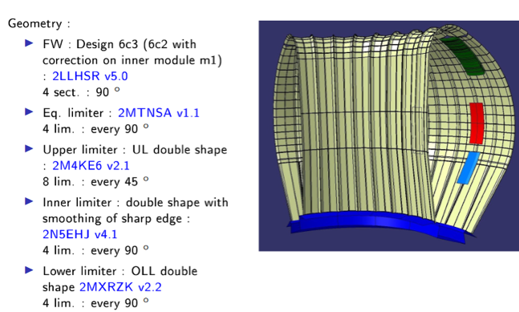
INTRODUCTION & MOTIVATION
In view of building a “European DEMOnstration fusion power plant” (EU-DEMO or DEMO), a solid physics basis of plasma disruptions has to be developed.
Runaway electrons (RE) can form beams carrying a large fraction of the pre-disruption current $⟹$ localized damage to the wall.
Methods to avoid, control and suppress RE losses need to be investigated.
Additionally, “sacrificial” limiters need to be used. These are discrete plasma-facing components that aim to absorb most of the load to protect the first wall (FW) in the event of catastrophic failure.
The impact of the REs on the upper sacrificial limiter (UL) and onto the plasma facing components is here investigated.
Figure courtesy of F. Maviglia

Slide 5
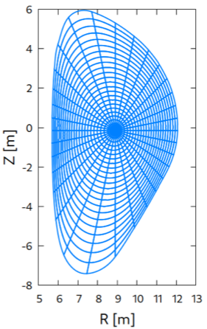
MODEL
In JOREK different physics models are available (reduced/full MHD, hybrid kinetic-fluid). Here:
single temperature reduced MHD without $v_{∥}$.
RE fluid model self-consistently coupled to the MHD [1,2].
Coupled to STARWALL to capture the vertical plasma motion.
Polar grid with: $250$ radial and $256$ poloidal grid points.
The study closely follows previous ITER simulations presented by Vinodh [3]:
The disruption mitigation and initial vertical motion is simulated in a simplified axisymmetric way (2D).
We switch to 3D simulations for the MHD burst leading to RE beam termination.
RE loads onto the wall are calculated by kinetic RE test particles (markers) [4].
[1] V. Bandaru et al., Phys. Rev. E99, 063317 (2019); [2] V. Bandaru et al., Plasma Physics and Controlled Fusion 63, 035024 (2021).
[3] V. Bandaru et al., Assessment of runaway electron beam termination and impact in ITER, Nuclear Fusion (submitted).
[4] H. Bergström et al., Assessment of RE current limits for ITER based on heat flux estimates to 3D walls, Physics of Plasmas (in preparation)

Slide 6
Table of contents
Introduction & Model.
Scenario & Equilibrium
Study and prediction of the RE impact on the sacrificial limiter.

Slide 7
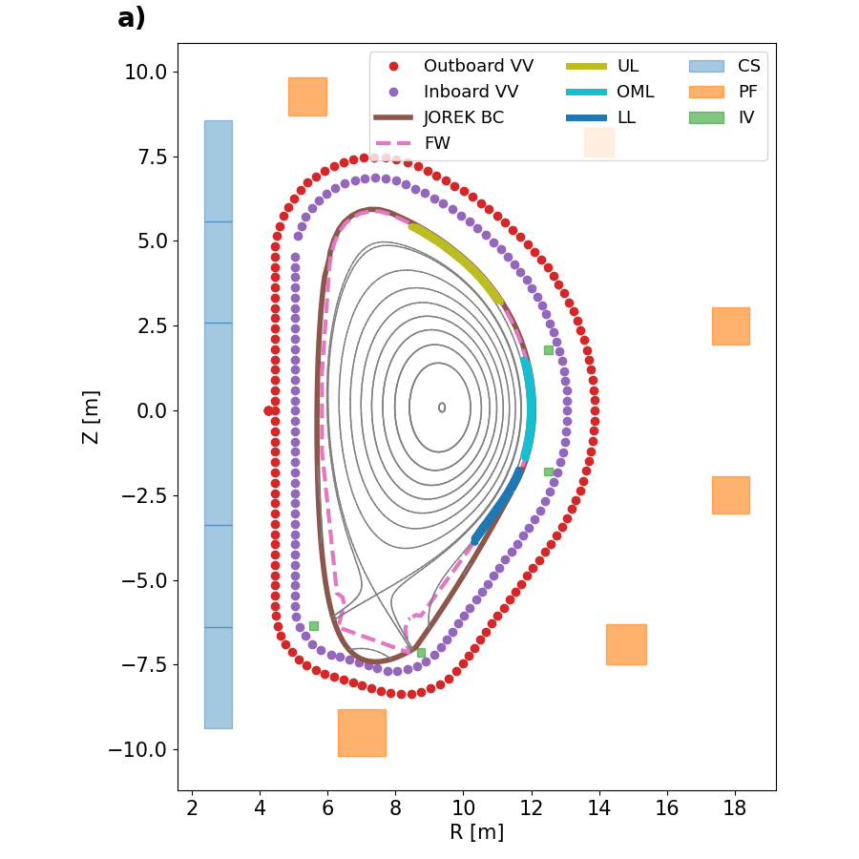
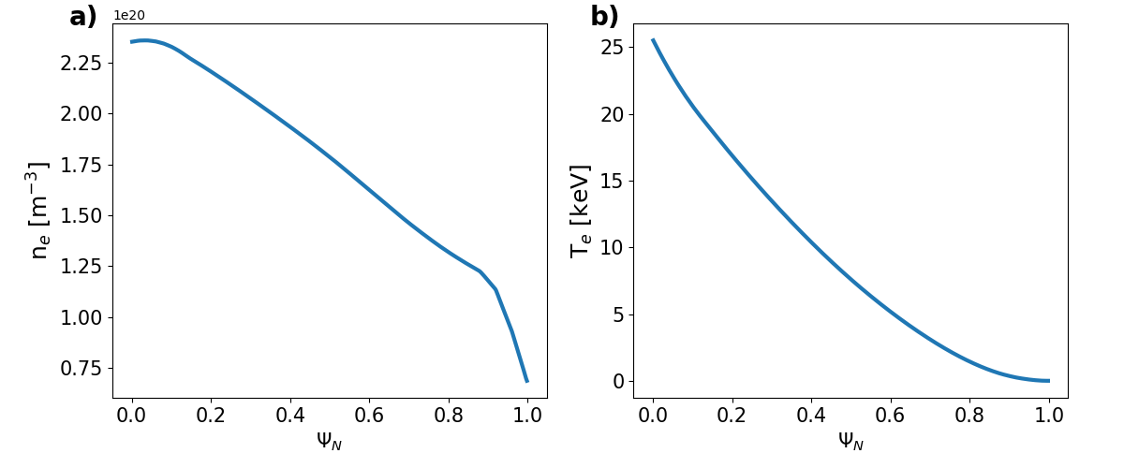
SCENARIO & EQUILIBRIUM
DEMO Single Null (SN) variant 2021 [5] ,provided by the DEMO team. VV made of stainless steel, with: $η_{w}=0.76×{10}^{−6}Ω m$.
Limiter positions: courtesy of F. Maviglia and M. L. Richiusa. Protrusion of $ΔR=70 mm$.
[5] See report by: R. Ambrosino, A. Castaldo and the CREATE TEAM, DEMO SN baseline 2021, 14th May 2021

Slide 8
Table of contents
Introduction & Model.
Scenario & Equilibrium
Study and prediction of the RE impact on the sacrificial limiter.

Slide 9
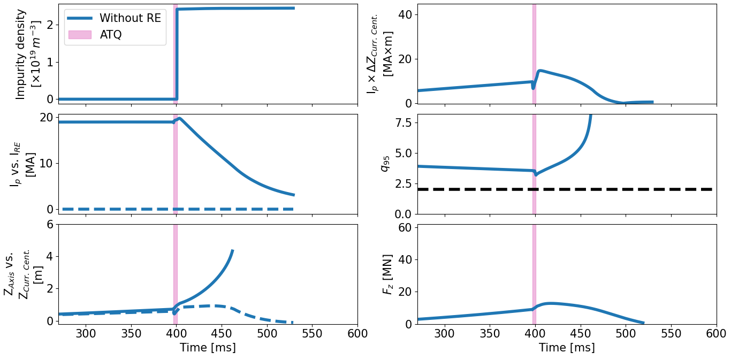
MITIGATED VDE
2D simulations: $n∈[0]$-only retained for simplicity. VDE triggered with current perturbation into in-vessel coil $δI=20 kA$.
Plasma drifts of $δZ≈0.7 m$. To mimic massive material injection:
spatially uniform density of impurities (Ne) introduced.
Artificial thermal quench (ATQ, $∆t≈4 ms$).
CQ with pre-ATQ physics plasma parameters.
NO RE included.
Consistently with studies presented in [6]:
$F_{z}∝I_{Plasma}×∆Z_{Curr. Cent}$ ([7]),
with $Z_{Curr. Cent}=\frac{\int{j_{φ}Z dZ dR}}{I_{Plamsa}}$.
Current centroid ($Z_{Curr. Cent.}$) stagnates: large portion of $I_{Plasma}$ is induced in the Halo region.
[6] N. Schwarz et al, Nuclear Fusion 63, 126016 (2023); [7] O. Gruber et al, Plasma Phys. Control. Fusion 35, B191 (1993).

Slide 10
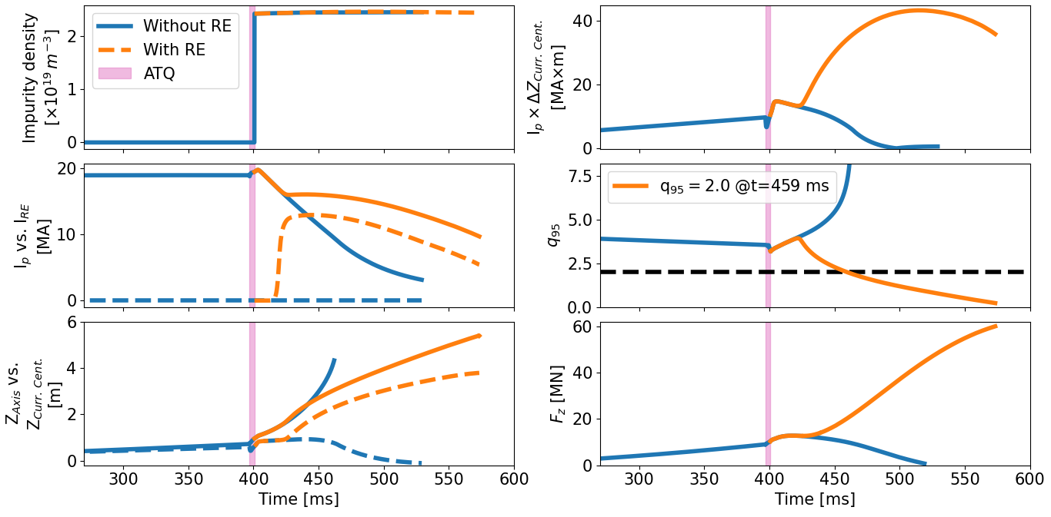
MITIGATED VDE
2D simulations: $n∈[0]$-only retained for simplicity. VDE triggered with current perturbation into in-vessel coil $δI=20 kA$.
Plasma drifts of $δZ≈0.7 m$. To mimic massive material injection:
spatially uniform density of impurities (Ne) introduced.
Artificial thermal quench (ATQ, $∆t≈4 ms$).
CQ with pre-ATQ physics plasma parameters.
RE included through current seed.

Slide 11
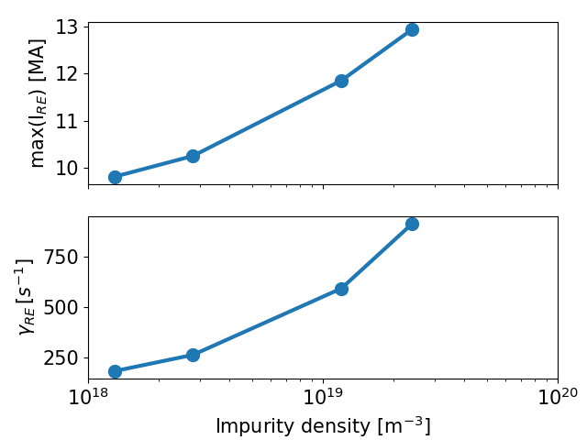
MITIGATED VDE & RE beam formation
2D simulations: $n∈[0]$-only retained for simplicity. VDE triggered with current perturbation into in-vessel coil $δI=20 kA$.
Plasma drifts of $δZ≈0.7 m$. To mimic massive material injection:
spatially uniform density of impurities (Ne) introduced.
Artificial thermal quench (ATQ, $∆t≈4 ms$).
CQ with pre-ATQ physics plasma parameters.
RE included through current seed.
Scan against the introduced impurity density.
We focus here on the case at highest impurity injection: worst case scenario with highest produced RE current beam.

Slide 12
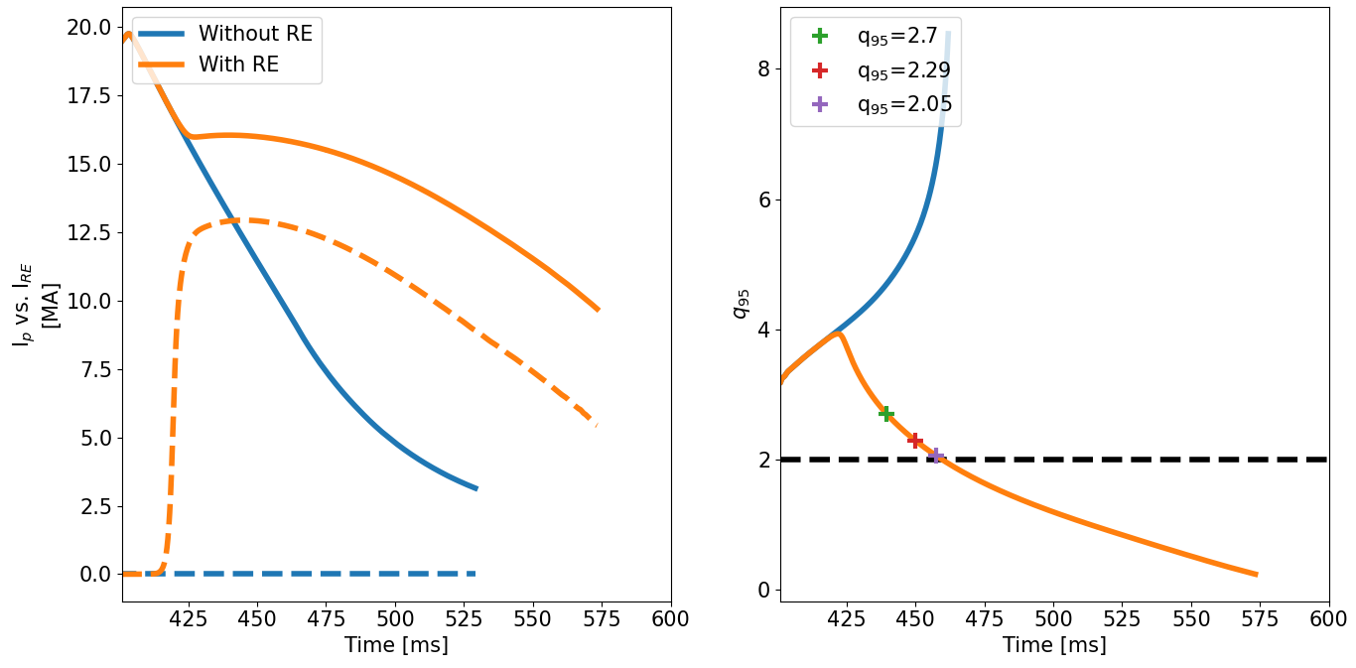
3D restart @$q_{95}≈2$
2D simulation restarted with higher toroidal harmonics when $q_{95}≈2$.
Several 3D simluations performed.
Restart of the 2D simulation at 3 different times, corresponding to different values of $q_{95}: 2.05, 2.29 , 2.7$.
3D restart with different toroidal harmonics retained:
$n∈\left[0;3\right],$
$n∈\left[0;5\right],$
$n∈\left[0;7\right]$.
However, the more $n$ one chooses to keep and the earlier the simulation is switched to 3D, the more computationally expensive the simulation becomes.
Here I present the results for:
3D simulation restarted at $q_{95}=2.29$, with $n∈\left[0;7\right]$.

Slide 13
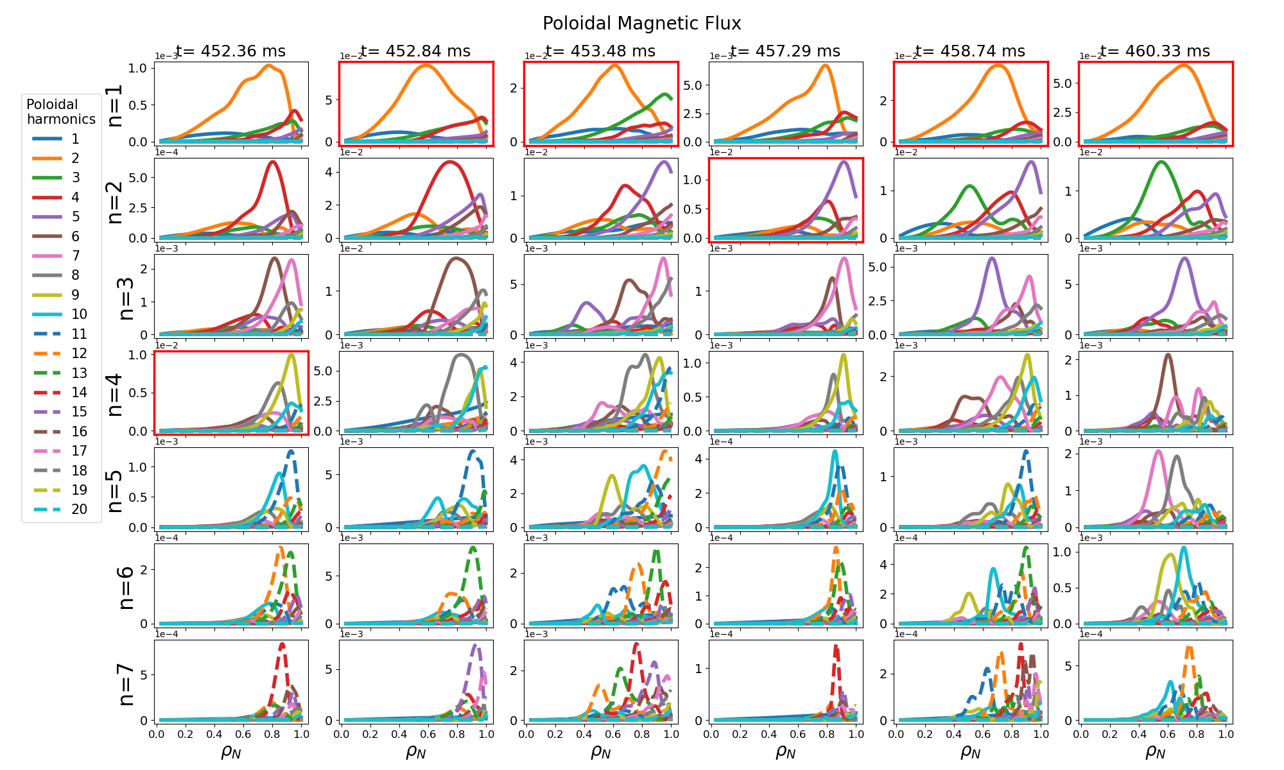
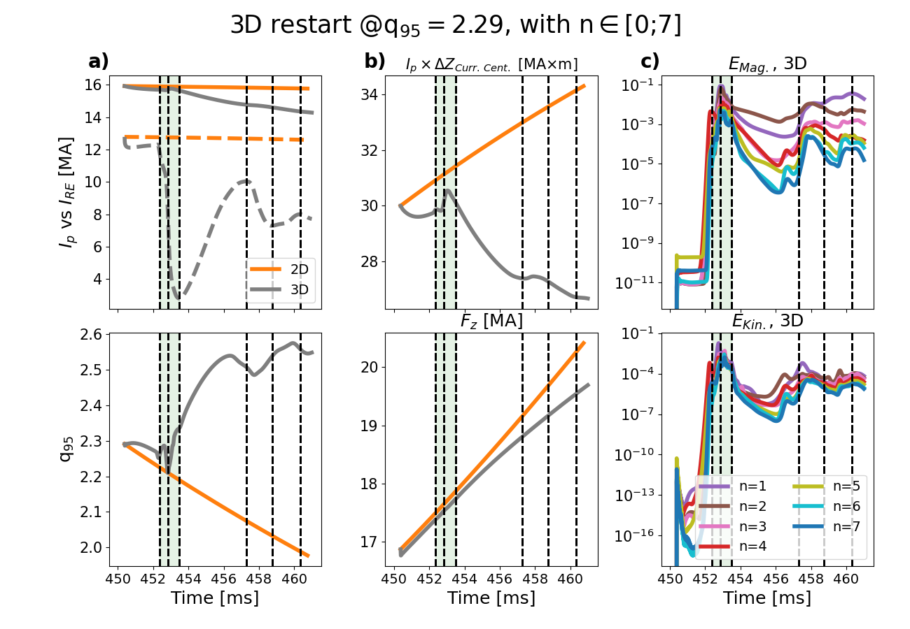
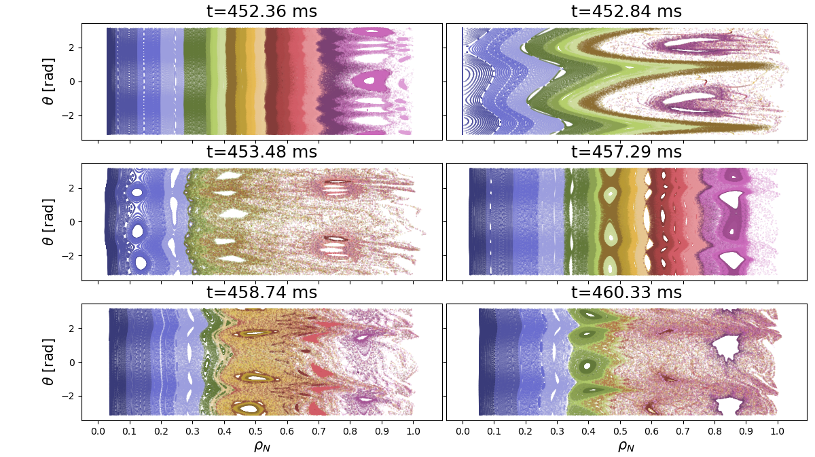
RE beam termination
At six chosen times, the Fourier decomposition and poincaré plots are presented.
The initial three chosen times fall inside the termination phase (green time window).

Slide 14
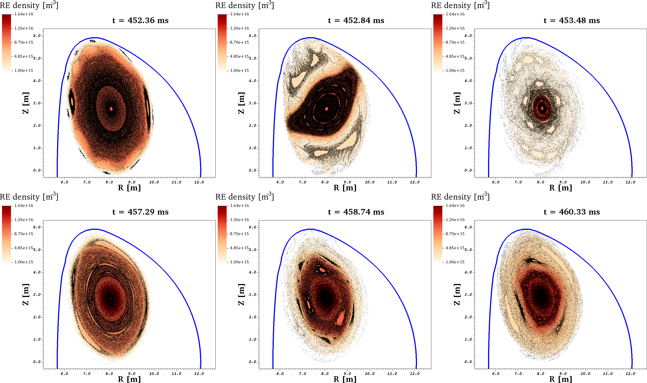
RE beam termination
At six chosen times, the Fourier decomposition and poincaré plots are presented.
The initial three chosen times fall inside the termination phase (green time window).

Slide 15
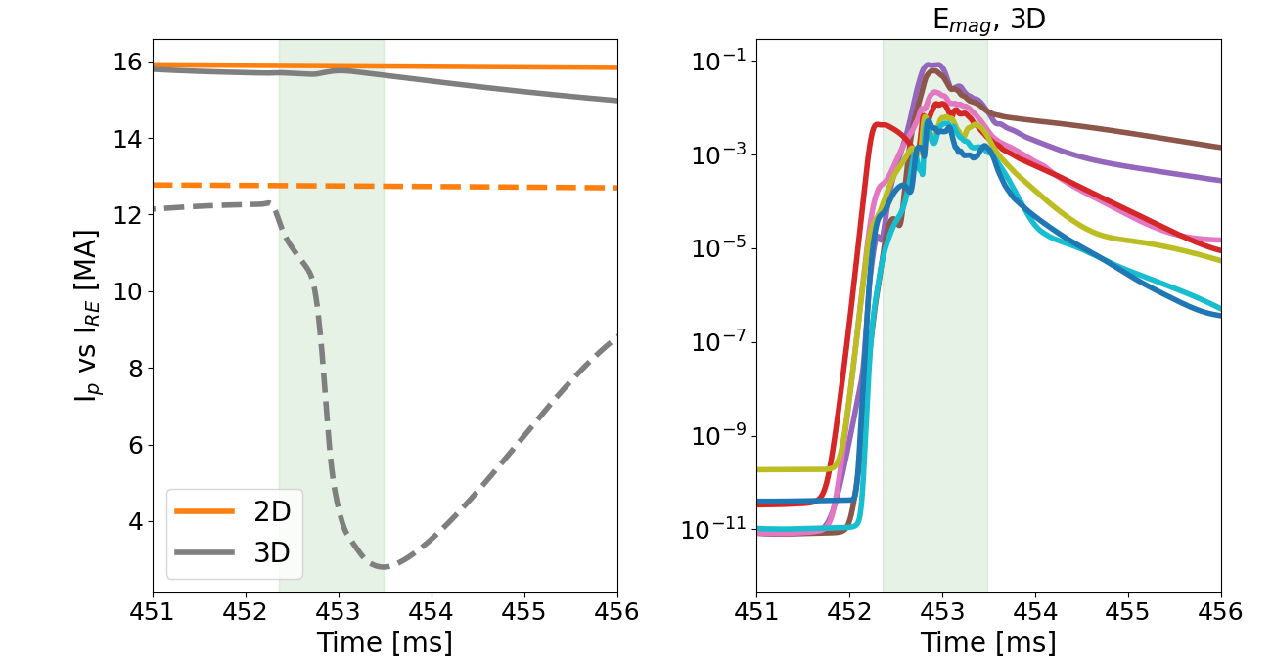
POWER DEPOSITION
$I_{RE}=12.3 MA$ at the beginning of the termination phase.
The kinetic energy of all the RE particles equals the total magnetic energy ($W_{tot}=35$ MJ) channeled to the RE from the poloidal magnetic field. Here, $W_{tot}=35$ MJ.
Every RE particle has $ℰ=17.6 MeV$. Reference case: ${10}^{6}$ markers initialized inside the computational domain.
Markers follow the magnetic field lines calculated through the previous 3D simulation.
Markers evolve in the temporal domain where the RE current decays (markers dynamics stopped before RE current reformation).
Power deposition of the markers in absence/presence of the upper sacrificial limiter (UL ) evaluated

Slide 16
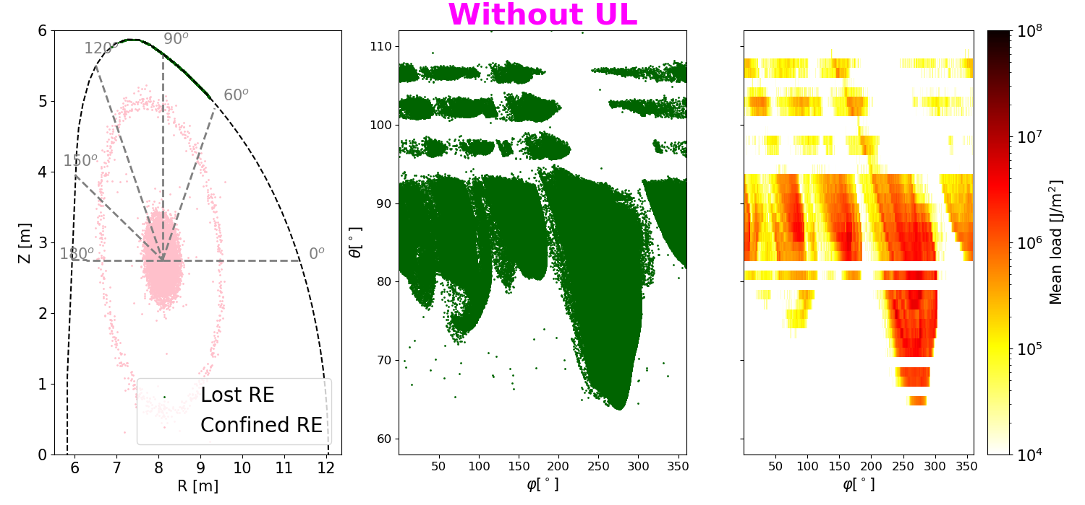
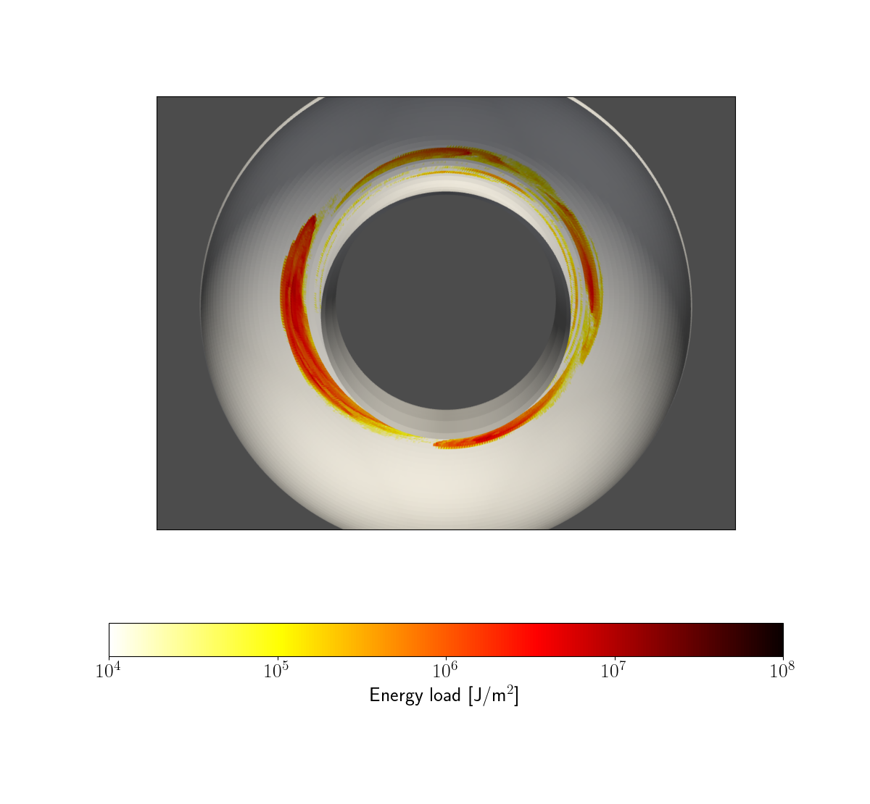
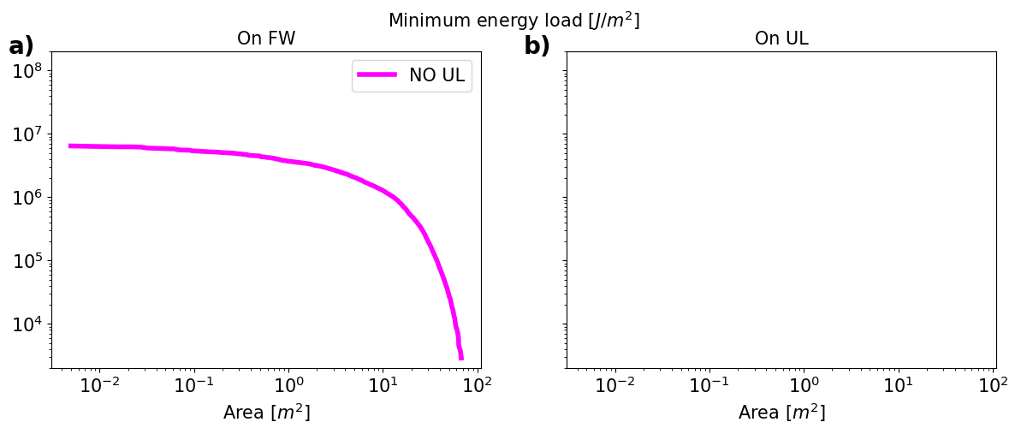
heat loads on first wall – NO Upper limiter

Slide 17
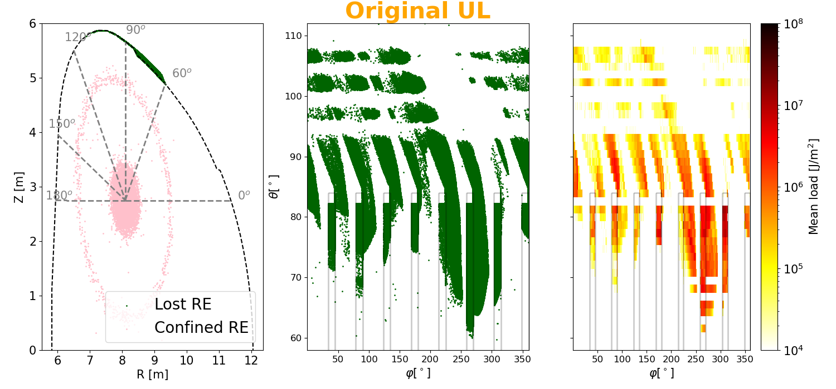
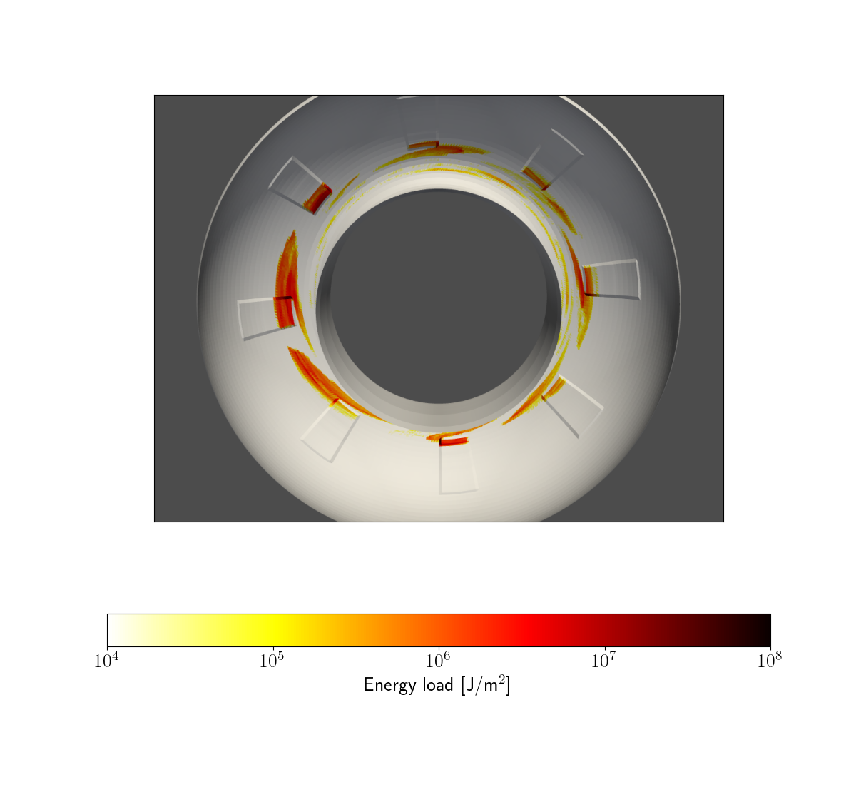
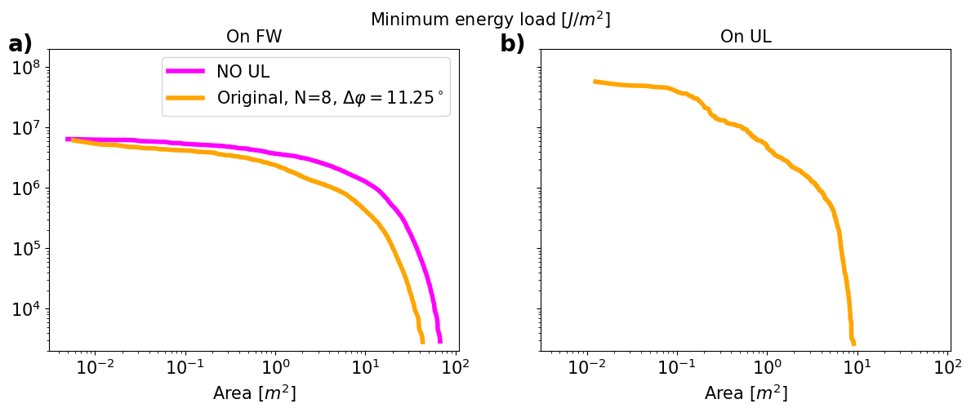
heat loads on first wall – Original Upper limiter

Slide 18
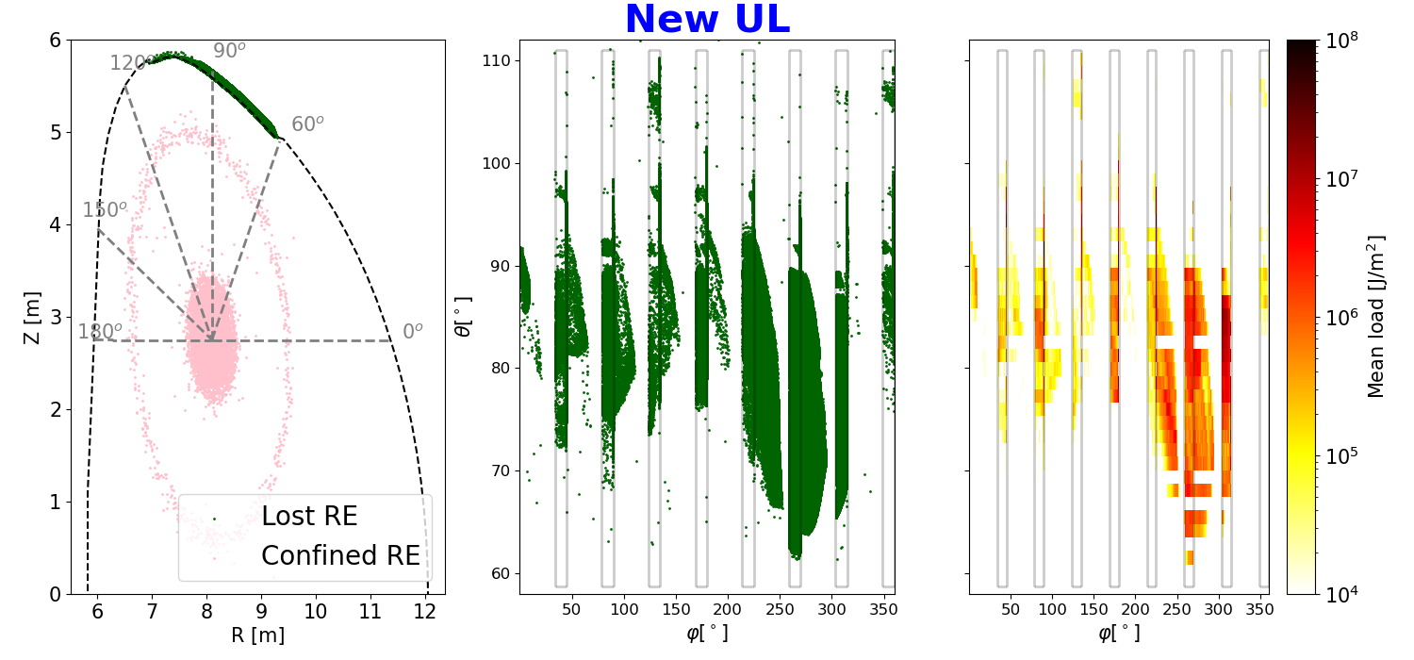
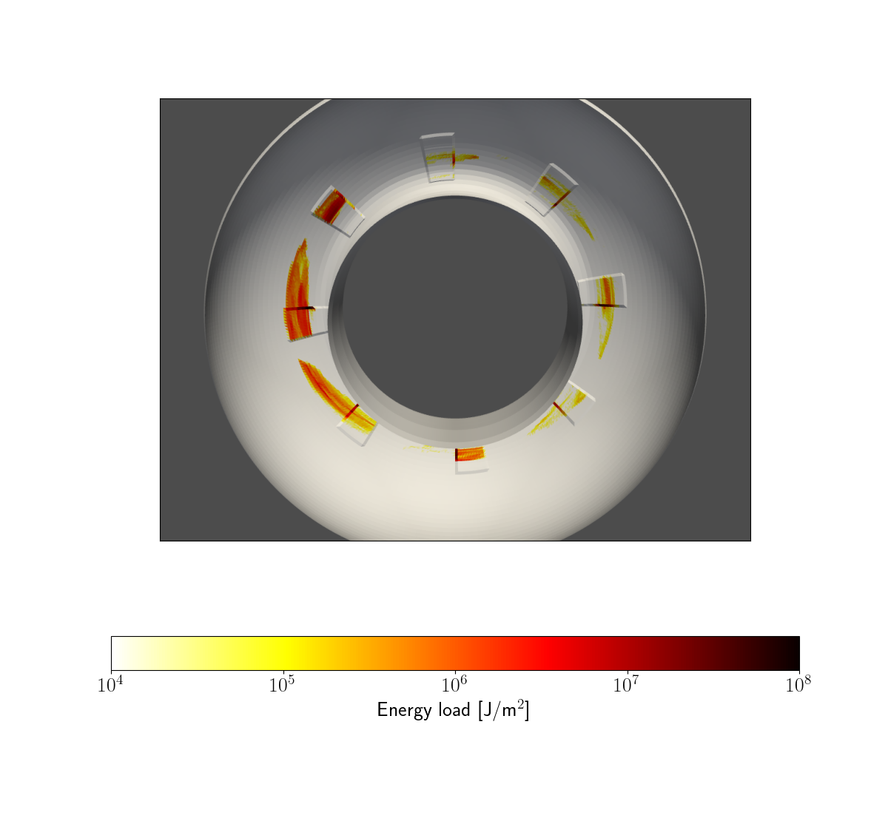
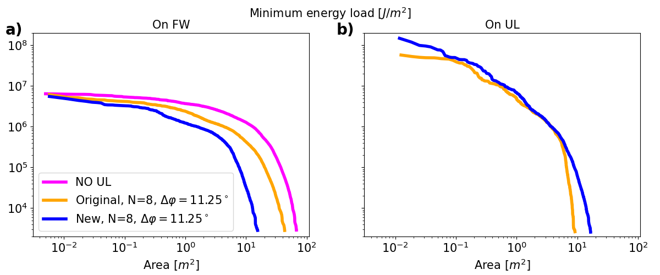
heat loads on first wall – Moved Upper limiter
Thanks to the presence of the UL, a smaller area of the first wall is affected by the REs.
The power deposited by the REs in presence of UL is consistently increased.
Qualitative similar results using different plasma-wall configurations.

Slide 19
Future steps
REs heat load on the UL limiter of EU-DEMO estimated in 3D simulations, with markers initialized in postprocessing. Many REs hit the UL, but the power deposition is excessively increased.
Further studies can be found in our paper recently put on Eurofusion pinboard.
In progress:
Study of the RE reformation current phase.
Tests with detailed CAD model for UL and FW are planned.
Simulation of 3D natural thermal quench.

