Slide 1
Runaway Electrons benign termination in JET pulse 95135
Joint Runaway Electron Modelling (REM) and JET SPI Analysis meeting
L. Singh¹, V. Bandaru², M. Hoelzl³, E. Nardon⁴, C. Sommariva⁵, JET contributors
¹Dipartimento Energia, Politecnico di Torino, Torino, Italy
²Indian Institute of Technology, Guwahati
³Max Planck Institute for Plasma Physics, Garching
⁴ CEA, IRFM, F-13108 Saint-Paul-lez-Durance, France
⁵ EPFL, SPC, CH-1015 Lausanne, Switzerland

Slide 2
Background and motivation
Built on the work done by V. Bandaru (Bandaru et al 2021 Plasma Phys. Control. Fusion 63 035024):
Non linear MHD simulations were performed using JOREK RE fluid model
Numerical demonstration of the plasma MHD activity role in benign RE termination in JET #95135
The simulations were started from an unstable equilibrium which lead to magnetic field stochastization causing RE losses
Background plasma electron temperature $T_{e}=10 eV$ and electron density $n_{e}=1e19 m^{−3}$
RE transport described by parallel diffusion and no parallel advection. Even if it has been shown that the transport mechanism does not have a significant effect on the system evolution
Notes:
Per quanto riguarda una corrente piu’ alta cosa dire?

Slide 3
Background and motivation
The simulation was started from a reconstructed magnetic equilibrium leading to the formation of two m=4 magnetic island chain in the inner region and one m=5 magnetic island chain in the outer region.
The interaction of the island chains corresponding to m=5 and m=4 causes the stochastization of the magnetic field lines
While the stochasticity is moving inward we have a continuous loss of the RE population
At the end, we have the reformation of the magnetic flux surfaces and a nearly complete loss of RE
Bandaru et al, PPCF 63 (2021)

Slide 4
Background and motivation
The benign effect of the field stochasticity depends on the plasma resistivity and ion density.
Not fully clear yet how do we arrive at an unstable situation responsible for the RE crash
Scan in resistivity and ion density to study the stochasticity evolution and its effects on RE losses and damage to the wall
Modeling the plasma MHD and RE evolution starting from a stable situation

Slide 5
Background and motivation
The benign effect of the field stochasticity depends on the plasma resistivity and ion density.
Not fully clear yet how do we arrive at an unstable situation responsible for the RE crash
Scan in resistivity and ion density to study the stochasticity evolution and its effects on RE losses and damage to the wall
Modeling the plasma MHD and RE evolution starting from a stable situation
WORK IN PROGRESS

Slide 6
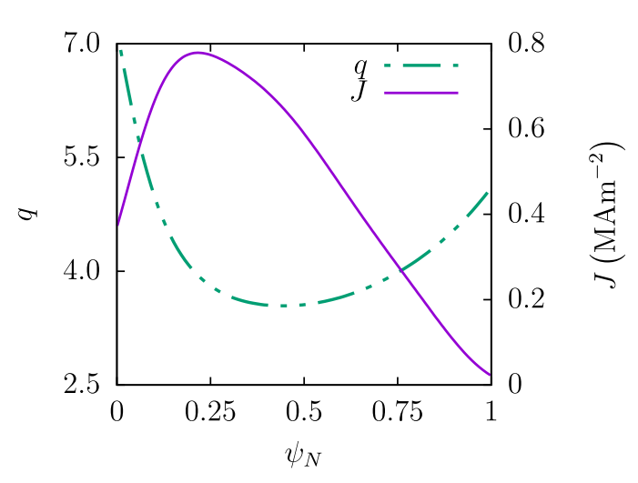
Scan in resistivity and ion density
T [eV] | $η [ Ωm]$ | $$n_{i } {[m}^{−3}]$$
$\sim$30 | $$6.1e−6$$ | $$1e19$$
$\sim$10 | $$3.3e−5$$
$\sim$3.18 | $$1.84e−4$$
$\sim$1.42 | $$6.13e−4$$
T [eV] | $η [Ωm]$ | $$n_{i }[ m^{−3}]$$
 |  | $$1e20$$
$\sim$10 | $$3.3e−5$$ | $$1e19$$
 |  | $$1e18$$
 |  | $$1e17$$
 |  | $$1e16$$
Same input profiles as Vinodh’s study
RE transport simulated through parallel advection + parallel diffusion (for numerical stability)
Bandaru et al, PPCF 63 (2021)

Slide 7
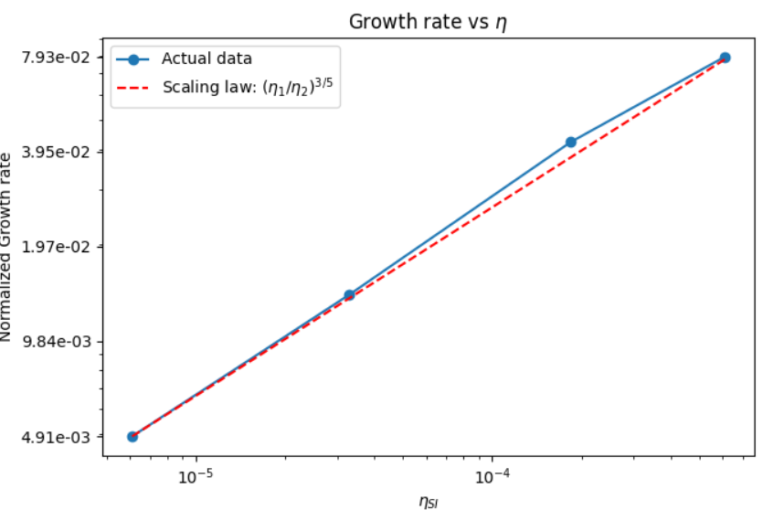
n=1 linear growth rates
Comparing the normalized linear growth rate of n=1 with FKR to understand if the model is capable of simulating correctly such a wide interval of ion density and resistivity
The growth rates with resistivity scales almost perfectly
The growth rates with density do not scale well below $1e18$ where $v_{A}≈c$
For the density I will consider only $1e18−1e20 m^{−3}$

Slide 8
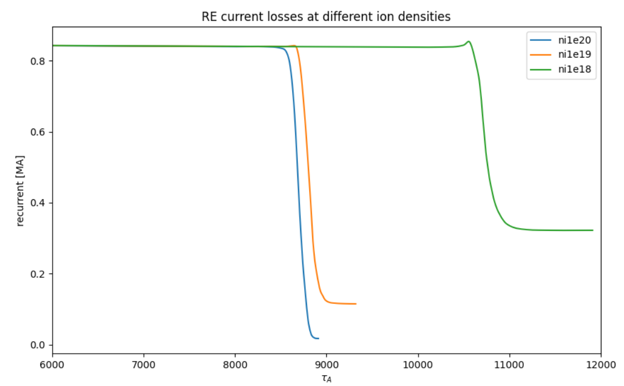
RE losses: scan in ion density
Higher RE losses with higher ion density
With decreasing ion density we have a more pronounced peak in the RE current before the loss
Haven’t yet analyzed the causes of such a behavior

Slide 9
RE losses: scan in resistivity
Final RE current intensity does not show a clear trend with respect to the resistivity
With $η=6.13e−4$ after an intermediate halt, the RE current goes to zero. Probably, due to changes in radial force balance
From now on, the analysis will be focused on the resistivity scan

Slide 10
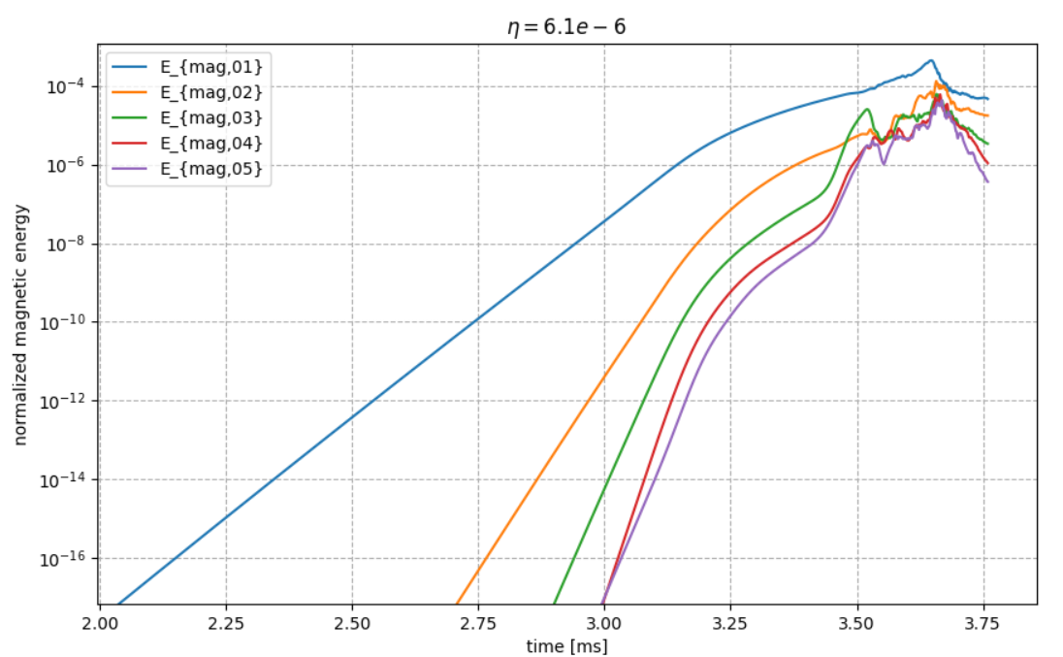
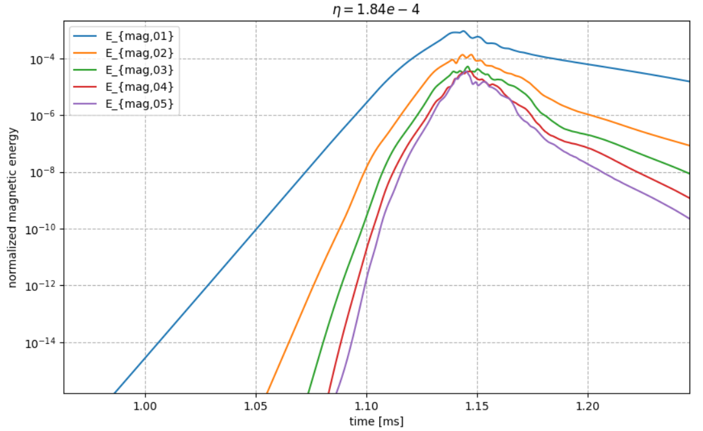
Modes magnetic energies growth
Comparison between the cases showing similar final RE current intensity:
the n=1 mode is the most unstable in both cases
For the lower resisitivity case, the secondary modes grow faster with respect to the primary mode n=1 (Nardon et al, Phys. Plasmas 30, 092502 (2023))
For the higher resistivity case, this does not occur
The radial diffusion of magnetic field lines $\left(\frac{∂B}{B}\right)$ is higher at high resistivity

Slide 11
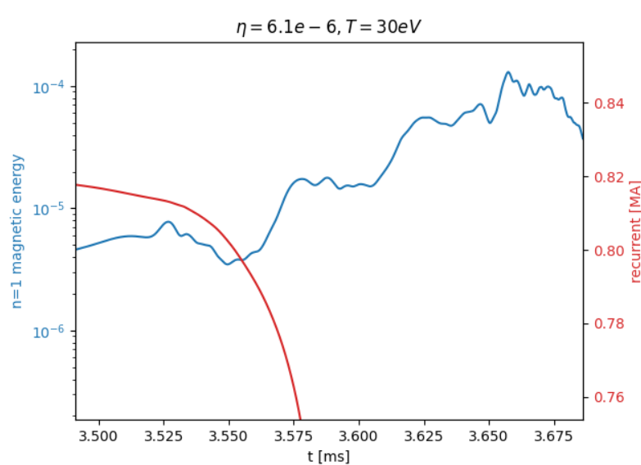
RE losses and n=1 magnetic energy

Slide 12
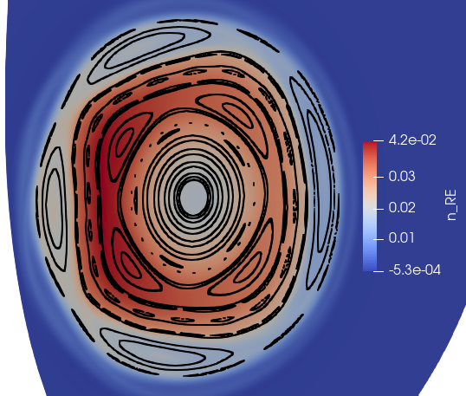
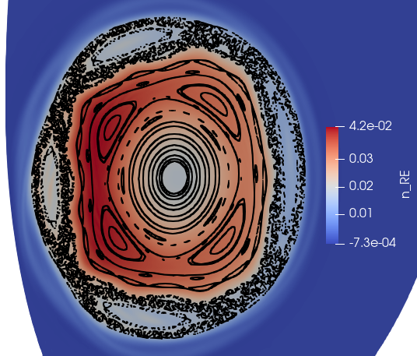
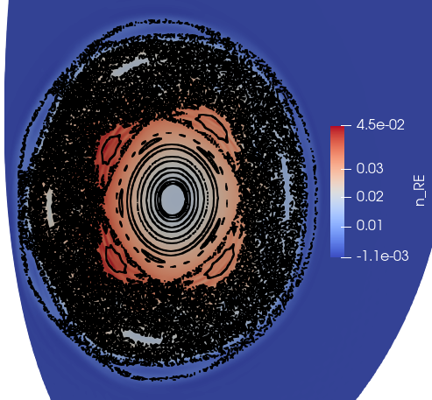
Poincare plots for $η=6.1e−6, T≈30 eV$
3.4 ms, 0.825 MA
3.45 ms, 0.821 MA
Like in all the simulations, the stochasticity starts at the plasma edge through the interaction between m=4 island and m=5 island chain. Afterwards, the stochasticity moves inward.
At t=3.5 ms, when we have a strong interaction between the modes, the plasma outer region becomes fully stochastic. However, we do not have a strong radial diffusion of the magnetic field lines
3.5 ms, 0.816 MA
3.55 ms, 0.802 MA

Slide 13
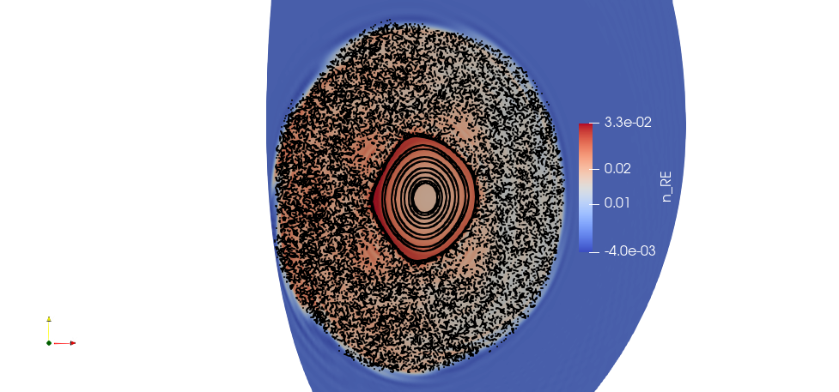
Poincare plots for $η=6.1e−6, T≈30 eV$
3.58 ms, 0.744 MA
3.63 ms, 0.345 MA
Half of the RE current is lost between 3.58 and 3.63 ms (50 $μs)$when the radial diffusion of the magnetic field lines is still low $→$This might result in a smaller RE footprint on the wall
At 3.66 ms a higher radial diffusion take place, however, at this stage 90% of the initial RE current is already lost
3.66 ms, 0.124 MA
3.69 ms, 0.044 MA

Slide 14
Poincare plots for $η=6.1e−6, T≈30 eV$
3.4 ms, 0.825 MA
3.45 ms, 0.821 MA
3.5 ms, 0.816 MA
3.55 ms, 0.802 MA
3.58 ms, 0.744 MA
3.63 ms, 0.345 MA
3.66 ms, 0.124 MA
3.69 ms, 0.044 MA

Slide 15
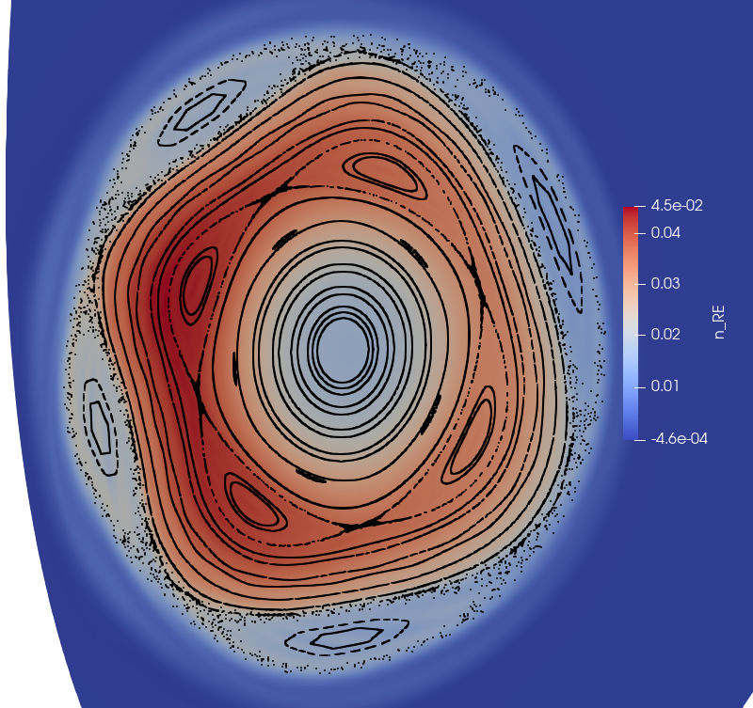
Poincare plots for $η=1.84e−4, T≈3 eV$
With respect to the lower resistivity case, when the magnetic field gets stochastic, a high radial diffusion of the magnetic field lines occur
Around t= 1.13ms, when we have a strong interaction between the modes, the plasma outer region becomes fully stochastic accompanied by a strong radial diffusion of the magnetic field lines
Around 60% of the RE current is lost between 1.133 and 1.144 ms (11 $μs) →$This might result in a large RE footprint on the wall
1.115 ms, 0.843 MA
1.124 ms, 0.844 MA
1.133 ms, 0.843 MA
1.144 ms, 0.348 MA

Slide 16
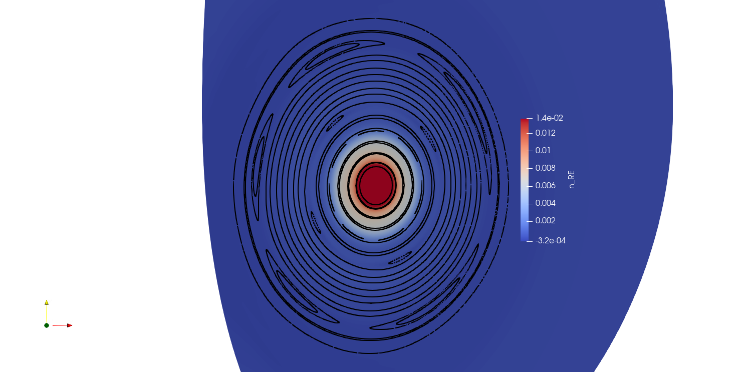
Poincare plots for $η=1.84e−4, T≈3 eV$
1.156 ms, 0.074 MA
1.168 ms, 0.028 MA
Almost of the RE current is lost in 35 $μs$ and is accompanied by a large radial diffusion of field lines. However, we have to verify that the increase rate of the RE footprint is higher than the time scale on which the RE loss occur. In this case, we can talk about «fully» benign termination of RE
After the RE loss the reformation of the magnetic flux surfaces
1.19 ms, 0.023 MA
1.333 ms, 0.023 MA

Slide 17
Poincare plots for $η=1.84e−4, T≈3 eV$
1.115 ms, 0.843 MA
1.124 ms, 0.844 MA
1.133 ms, 0.843 MA
1.141 ms, 0.542 MA
1.144 ms, 0.348 MA
1.149 ms, 0.187MA
1.156 ms, 0.074 MA
1.168 ms, 0.028 MA

Slide 18
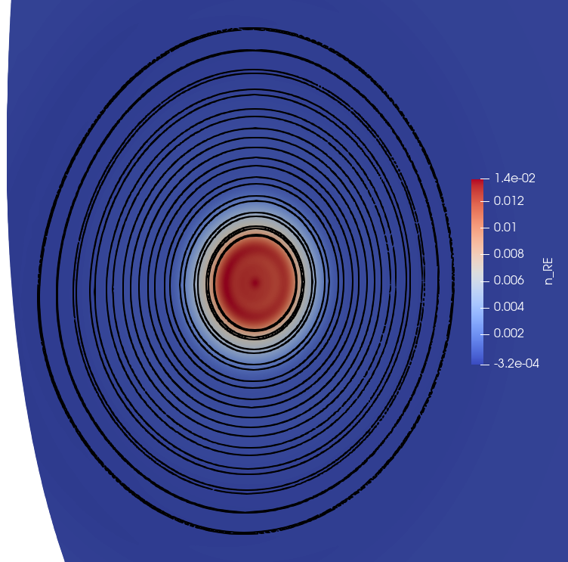
Poincare plots for $η=1.84e−4, T≈3 eV$
1.180 ms, 0.023 MA
1.19 ms, 0.023 MA
1.333 ms, 0.023 MA
1.64 ms, 0.023 MA

Slide 19
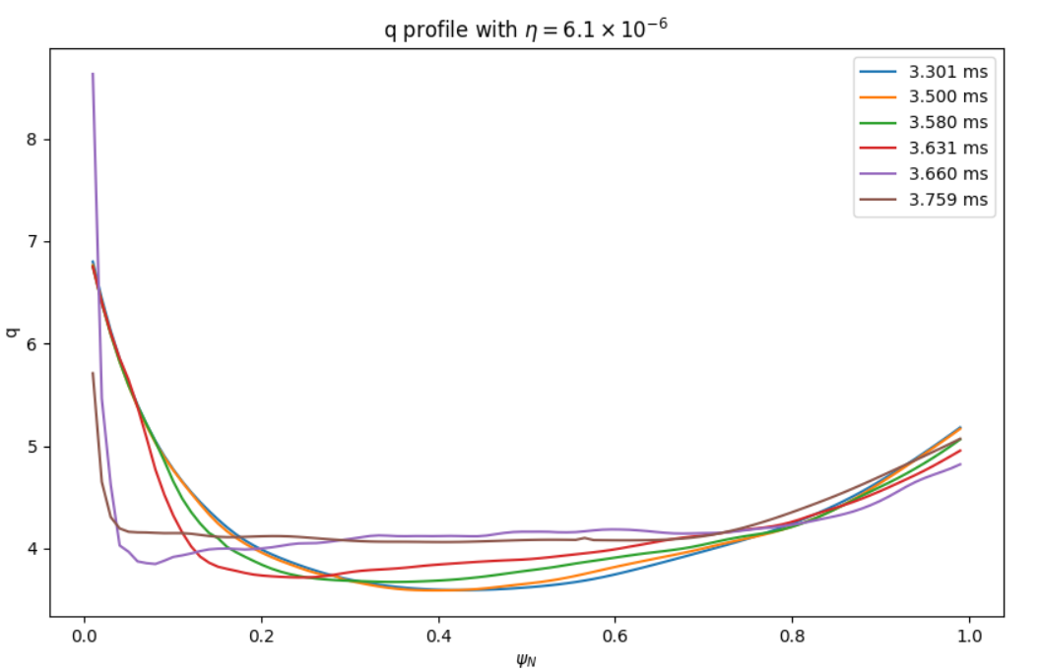
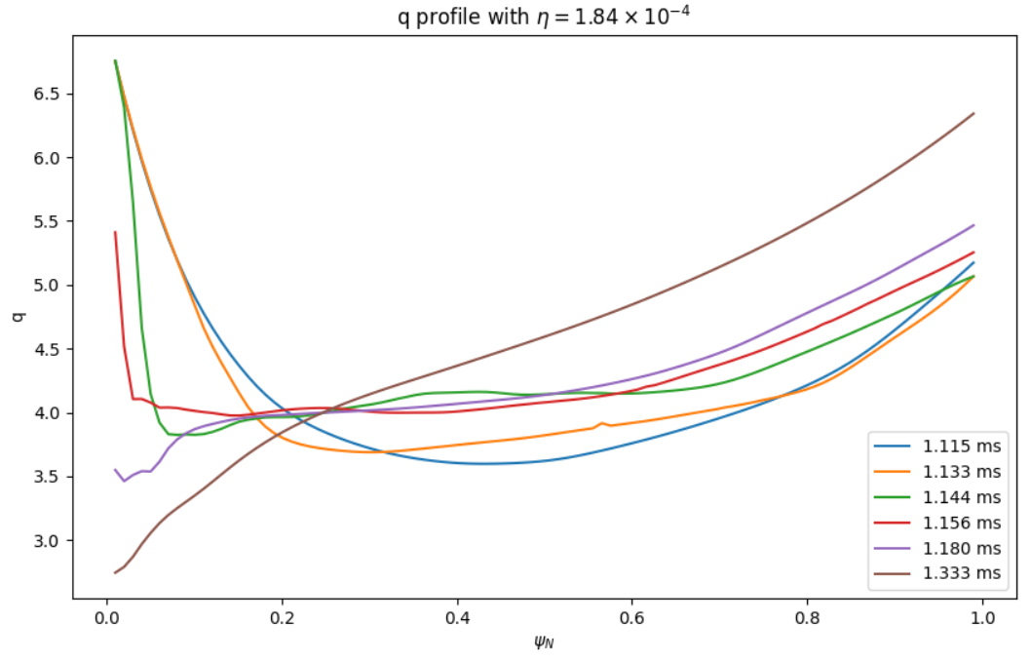
Safety factor profiles
In the lower resistivity case, we have a flattening of the q profile over time due to the fast magnetic reconnection
In the higher resistivity case, after a flattening occuring at intermediate times, the q profile shows a monotonically increasing behavior

Slide 20
RE density cross section

Slide 21
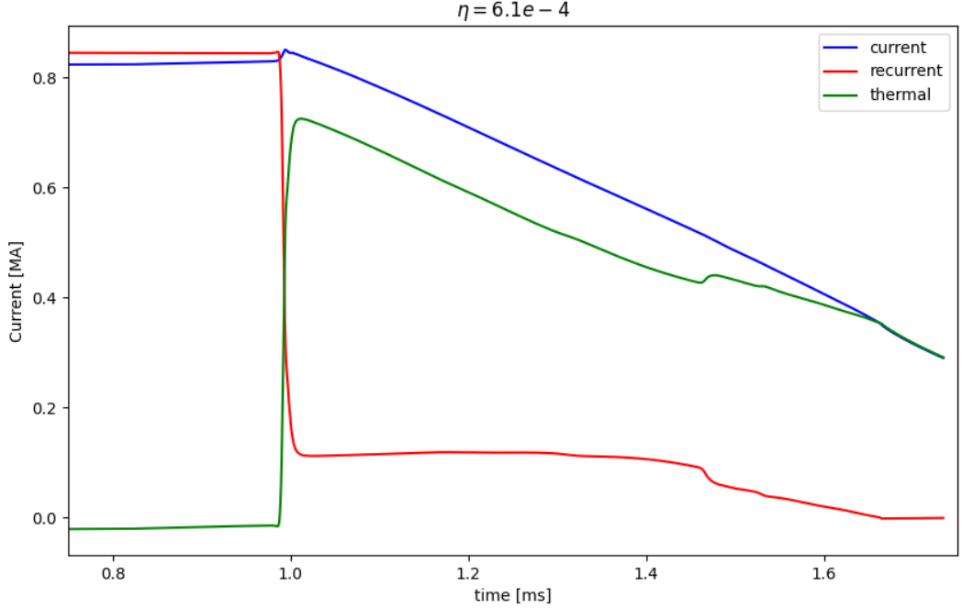
Current profiles
In case almost all the RE current is lost during the stochastization phase, the beam scrape off does not occur. The whole current is carried by the thermal current.
In case of a non negligeable final RE current intensity, the current is carried by both RE and thermal electrons which might change the radial force balance leading to beam scrape off

Slide 22
Outlook
The benign effect of the magnetic field stochastization depends on the ion density and resistivity
A lower resistivity leads to a lower radial diffusion of magnetic field lines when the majority of RE is lost -> Smaller footprint of the RE impact -> possible damage
At higher resisitivity, almost the whole current is lost with high radial diffusion of magnetic field lines. However, the benign effect depends on the time scale of footprint increase (has to be larger than the time scale on which the RE current is lost)
If the final RE current intensity is not negligeable the beam is scrapped off due to changes in the radial force balance
Particle tracing postprocessing tool will be used to asses the footprint of the RE beam

Slide 23
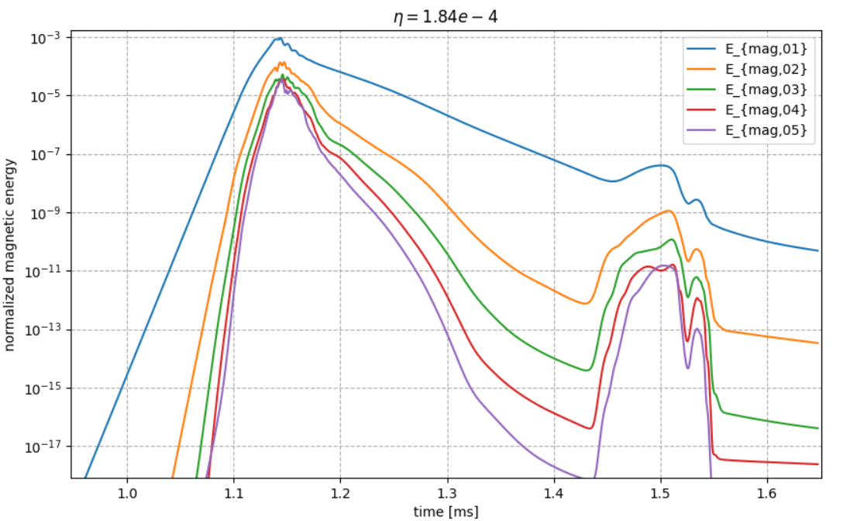
Modes magnetic energies growth
Comparison between the cases with high resistivity:
Similar behavior for the magnetic energies growth during the stochastic phase of the magnetic field lines
After the reformation of the magnetic flux surfaces, a growth in the magnetic energies occur
This growth is higher for the higher resistivity case

Slide 24
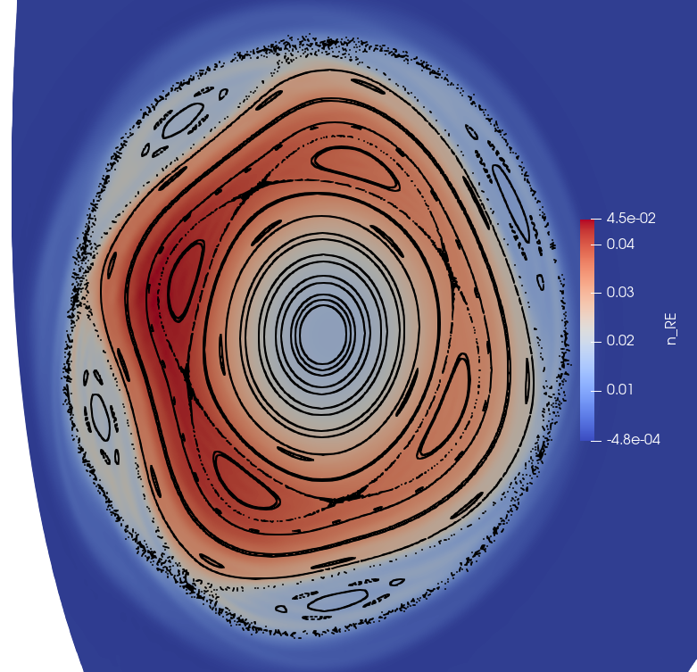
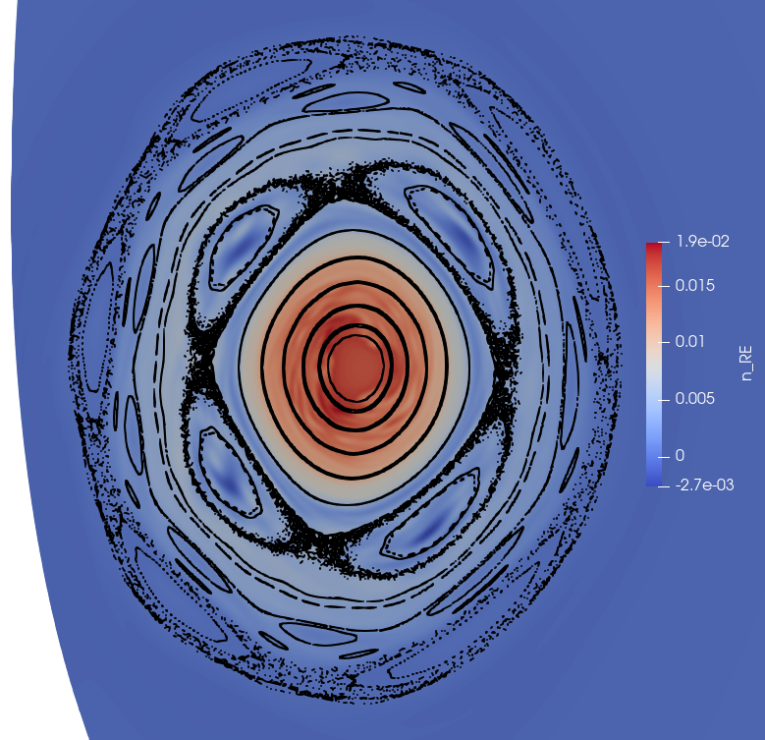
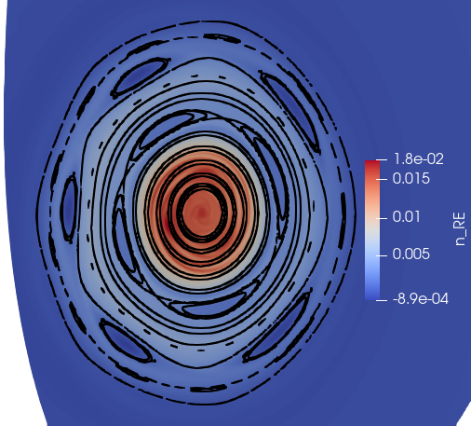
Poincare plots for $η=6.13e−4, T≈1.4 eV$
0.978 ms, 0.844 MA
0.984 ms, 0.846 MA
0.989 ms, 0.803 MA
0.991 ms, 0.610 MA
0.997 ms, 0.243 MA
1.003 ms, 0.143 MA
1.03 ms, 0.112 MA
1.075 ms, 0.113 MA

Slide 25
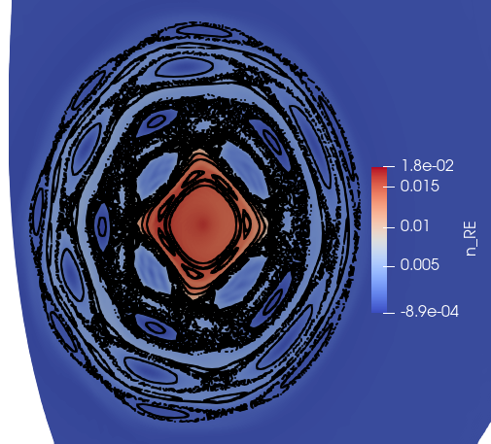
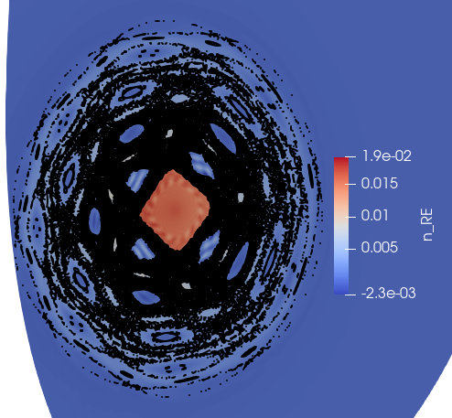
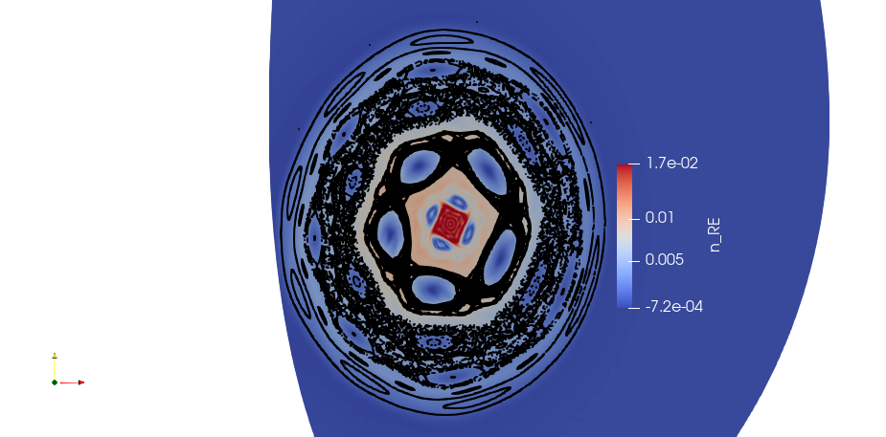
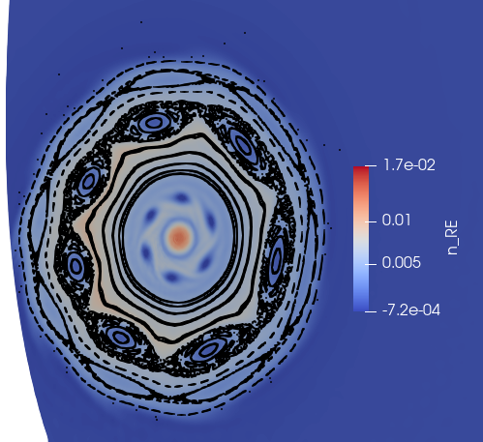
Poincare plots for $η=6.13e−4, T≈1.4 eV$
1.157 ms, 0.118 MA
1.186 ms, 0.118 MA
1.238 ms, 0.118 MA
1.30 ms, 0.115 MA
1.41 ms, 0.103 MA

Slide 26
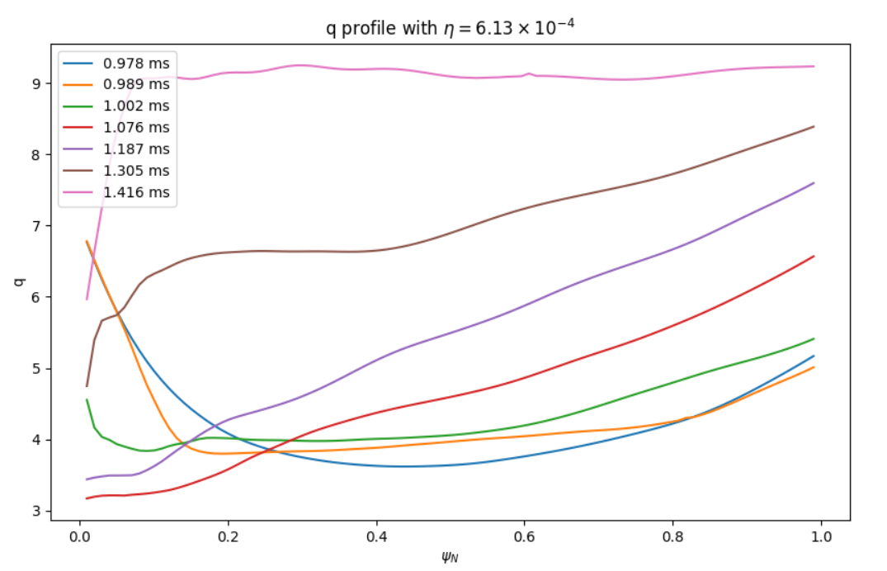
q profiles
In the highest resistivity case, at intermediate times the q profile gets montonic
With $η=6.13e−4$ the beam scrape off causes the q profile to shift to higher values and gets flat around q=9

