Slide 1
Design of the TCV Runaway Electron Mitigation Coil
A. Battey, U. Sheikh, F. Crisinel, J. Decker, D. Fasel and, Y. Liu
REM – 5th June 2025

Slide 2
OUTLINE
Introduction
Design
Resistance Scan
Scenario Scan
Position Scan
Conclusions and Future Work

Slide 3
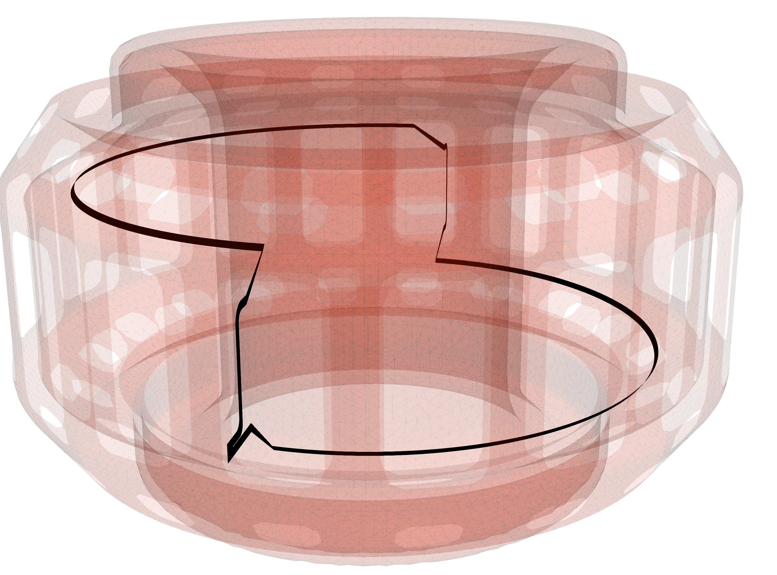
Basics: Runaway Mitigation Coil
REMCs have the added advantage of being passively driven and therefore do not require disruption prediction
Current in the coil is driven by the loop–voltage produced during the CQ
Runaway electron mitigation coil (REMC) is a promising tool for mitigating runaway electrons (REs)
Prevents runaway electrons by deconfining the seed population
Deconfines existing REs
REMCs have been designed for several tokamaks
Installed: HBT-EP
Planned: TCV, SPARC, and DIII-D
SPARC
DIII-D
TCV

Slide 4
REMC Currently Under Development for the TCV Tokamak
The TCV REMC aims to be the first to operate in the presence of a runaway electron beam
Installation planned for later this year
TCV REMC will have less constraints that future high-field or high plasma current tokamaks
Less mechanical forces due to lower field
Less current carried in coil

Slide 5
REMC Currently Under Development for the TCV Tokamak
The small size and flexibility of TCV also allow for the possibility of testing multiple coil geometries
1St: Max $δB$
2nd: Maximize resonance with rational surfaces?
Coil will be designed to drive maximum n=1 field amplitude to allow for maximal radial extent
Made of copper with a rectangular cross-section
Behind the plasma-facing tiles on the HFS

Slide 6
REMC Currently Under Development for the TCV Tokamak
Due to the lower Ip, the biggest challenge will be coupling to sufficient plasma current
Limited space behind the plasma-facing tiles is a major constraint on the maximum cross-section of the coil
The contact resistance of the coil elbows will need to be minimized
Looking into techniques to keep the coil resistivity as low as possible
Possibly using polished gold/silver joints
Expanding coil cross-section where possible
The coil will be insulated from the nearby wall/tiles with spray-on insulating coating
Kapton or Al₂O₃
Currently testing Kapton samples for outgassing

Slide 7
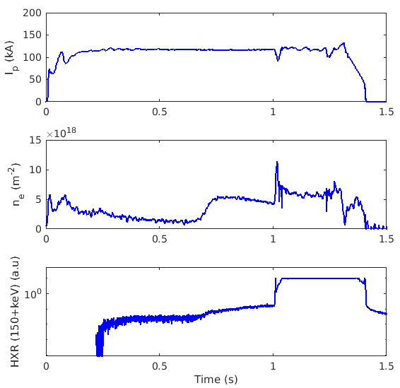
Special Runaway Scenario Being Developed for TCV REMC
Typical RE scenario on TCV relies on low-density to produce seed runaway populations

Slide 8
Special Runaway Scenario Being Developed for TCV REMC
Typical RE scenario on TCV relies on low-density to produce seed runaway populations
Step 1: Density is lowered by reducing fueling

Slide 9
Special Runaway Scenario Being Developed for TCV REMC
Typical RE scenario on TCV relies on low-density to produce seed runaway populations
Step 1: Density is lowered by reducing fueling
Step 2: Low critical electric field allows for a seed RE population to grow

Slide 10
Special Runaway Scenario Being Developed for TCV REMC
MGI
Typical RE scenario on TCV relies on low-density to produce seed runaway populations
Step 1: Density is lowered by reducing fueling
Step 2: Low critical electric field allows for a seed RE population to grow
Step 3: MGI triggers current quench
Avalanche mechanism results in full conversion to RE current

Slide 11
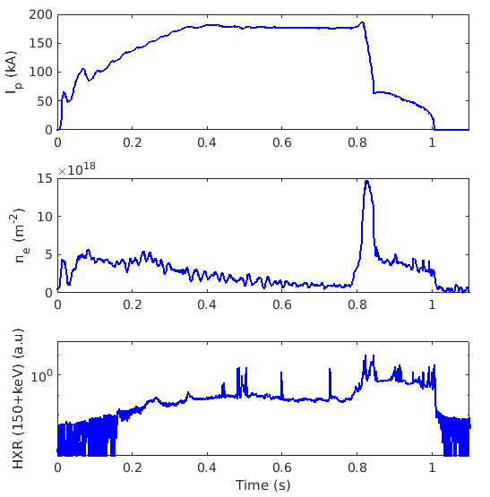
Special Runaway Scenario Being Developed for TCV REMC
A new scenario has recently been developed that induces a current quench in the presence of a RE beam
NBI is used to trigger CQ

Slide 12
Special Runaway Scenario Being Developed for TCV REMC
A new scenario has recently been developed that induces a current quench in the presence of a RE beam
NBI is used to trigger CQ

Slide 13
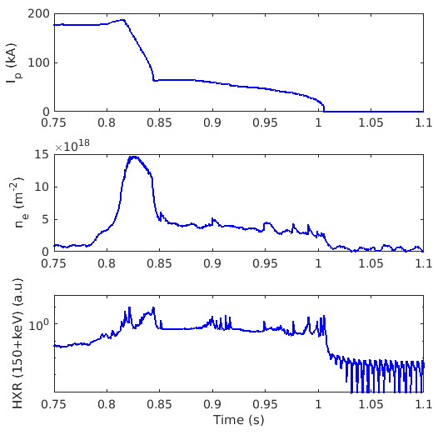
Special Runaway Scenario Being Developed for TCV REMC
A new scenario has recently been developed that induces a current quench in the presence of a RE beam
NBI is used to trigger CQ
Scenario with partial current quench used for simulations
This is very likely to improve in the future
Experimental time is also scheduled to develop a DIII-D/AUG type disruption scenario
Where REs are produced primarily through hot-tail mechanism

Slide 14
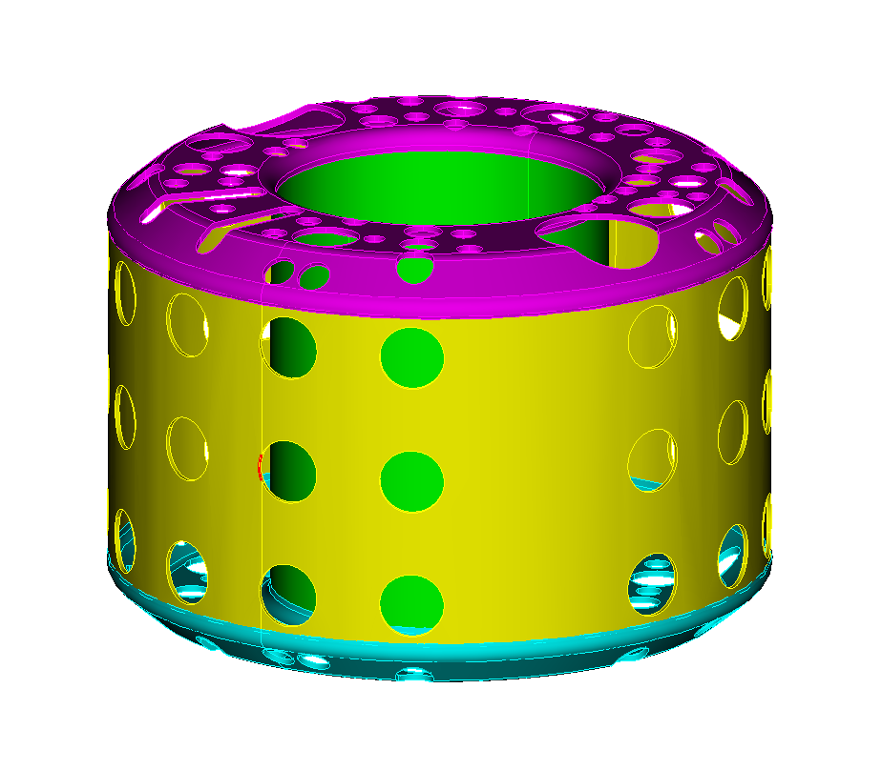
ThinCurr Model Models 3D Conducting Structures as a Series of Coupled Circuit Equations
Workflow begins with a CAD model of the tokamak conducting structures
These models are then defeatured to reduce computational time
Important details such as portholes, stability plates, or structural elements are retained
These surfaces are then meshed to the desired resolution
Different components can have higher/lower resolution
Different materials or thicknesses can all be captured in a single model
TCV has 2 resistivities
DIII-D model has 4 resistivities
TCV

Slide 15
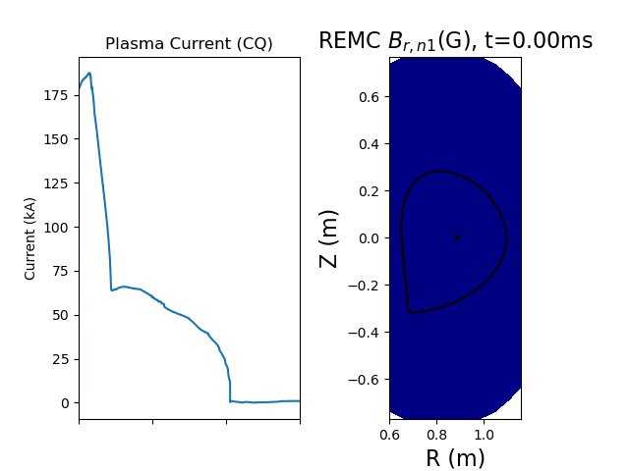
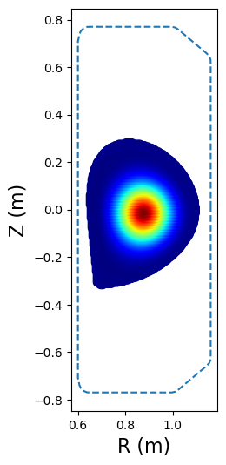
ThinCurr Model Models 3D Conducting Structures as a Series of Coupled Circuit Equations
Physics governed by inductance/resistance
$$L_{i,j}\frac{∂I_{i}}{∂t}+R_{i,j}I_{i}=V_{j}(t)$$
Additional currents/voltages can be included
Filament coils ($I(t)$ or $V(t)$ )
Plasma “modes” (eg. DCON)
Magnetic fields can be calculated anywhere in space or time
Sensor signals with eddy currents
Lorentz forces on structures
Discontinuities in $B×\hat{n}$ at surfaces

Slide 16
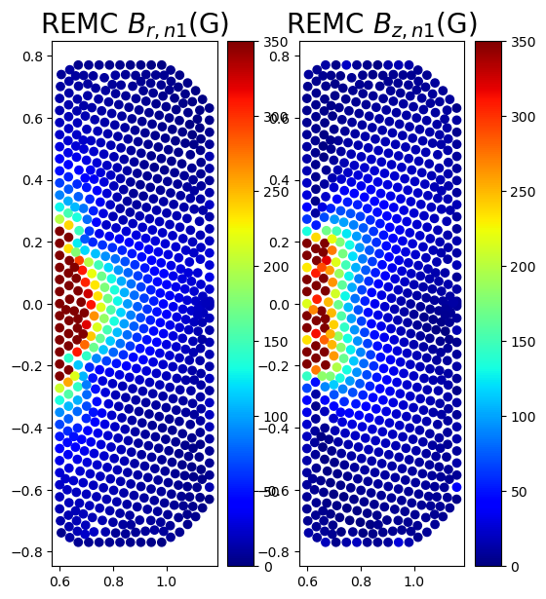
REMC Geometries Evaluated Using ThinCurr and MARS Codes
Step 1: ThinCurr will be used to evaluate all possible coil shapes
Enabled by its quick/inexpensive run-time
This step will allow use to select several leading coil candidates using performance metrics:
Maximum induced coil current
Coils with < 10% Ip will be eliminated
Applied n=1 field at plasma surface
DIII-D studies highlighted the benefits of both maximum amplitude and broadness of perturbation

Slide 17
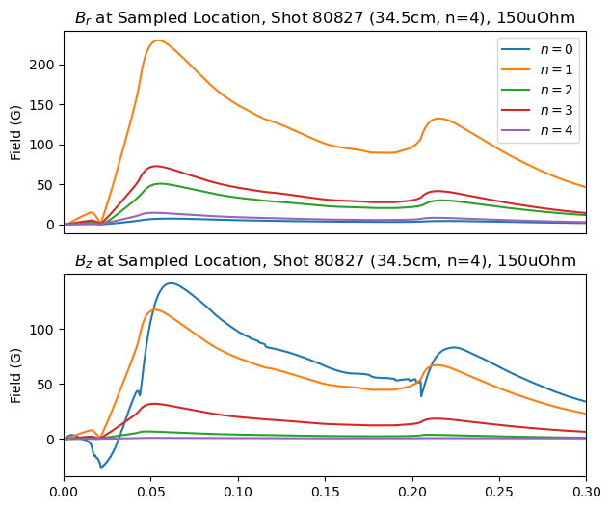
REMC Geometries Evaluated Using ThinCurr and MARS Codes
Step 2: The top three candidates will be modeled with the MHD code MARS-Q to determine their ability to drive beneficial MHD
A workflow was developed to allow the 3D fields from ThinCurr to be passed into MARS
Relativistic test particles will then be used to assess the effect of the coil

Slide 18
OUTLINE
Introduction
Design
Resistance Scan
Scenario Scan
Position Scan
Conclusions and Future Work

Slide 19
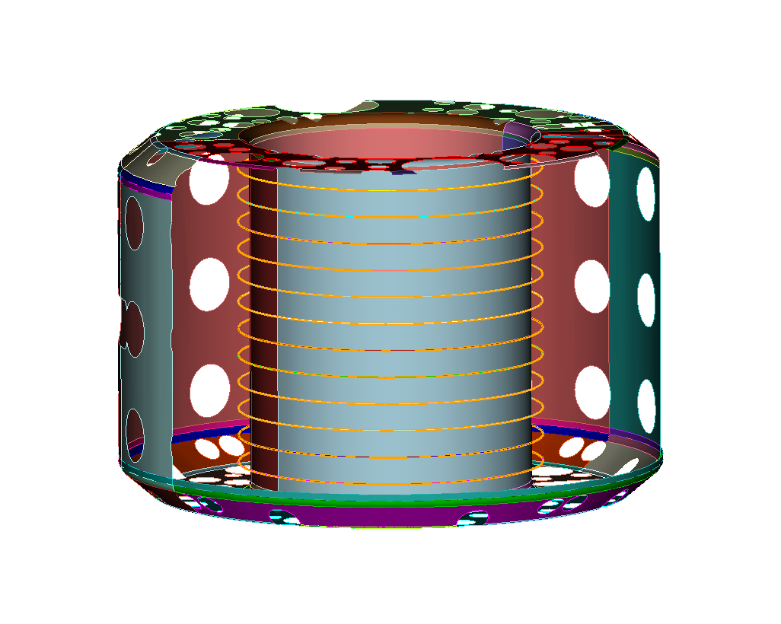
Mounting Location Limits Possible to Geometries
Horizontal channels exist behind the tiles at 12 vertical locations
Vertical coil legs can then be added between any of the 16 vessel sections
Assuming a symmetric coil, this allows for a total of 9 coil designs
Coils are parameterized based on their vertical height and number of horizontal segments
x6 2-segment coils
x2 4 segment coils
x1 8-segment coils

Slide 20
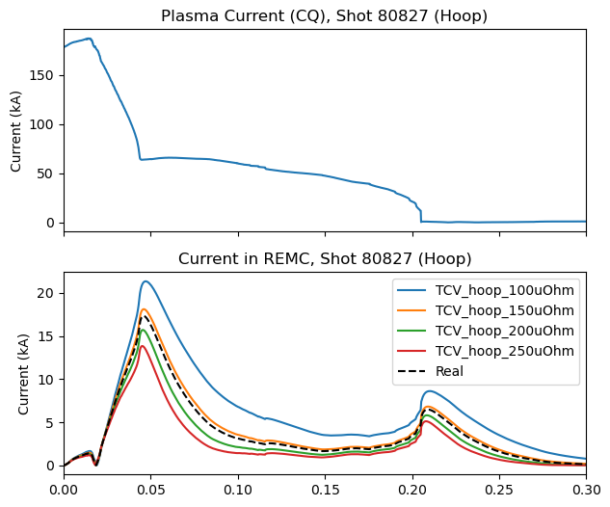
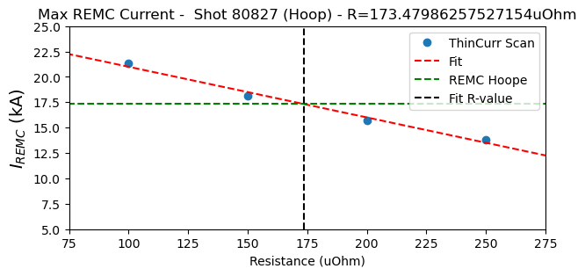
ThinCurr Studies Explore the Effect of Coil Resistivity on Coil Performance
Due to pre-disruption plasma current of TCV the success of the coil will rely keeping the resistivity as low as possible
Difficult with the limited space behind tiles
Installation limitations also prevent the coil from being one solid piece
Therefore, low-resistance joints are essential
ThinCurr estimates the minimum possible coil resistivity of $175 μOhm$ assuming a simple hoop at the HFS midplane
Assume a cross-section of 4cm x 1cm behind tile

Slide 21
Coil Resistivity Explored for All Possible Geometries
The resistivity of all possible coil geometries was explored (50-500 $μOhm$)
Determined limits will then be shared with the engineering team

Slide 22
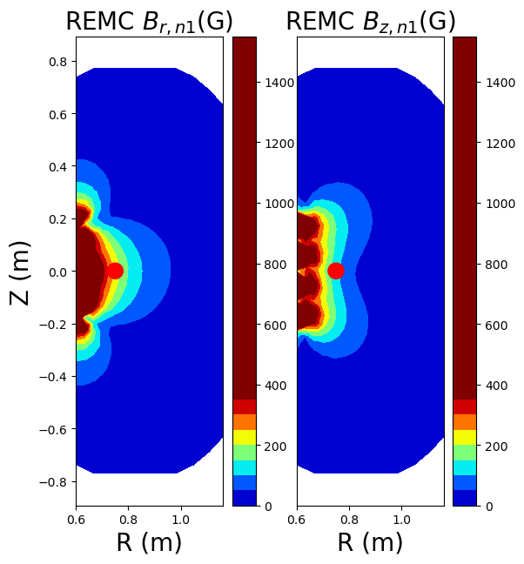
Coil Resistivity Explored for All Possible Geometries
The resistivity of all possible coil geometries was explored (50-500 $μOhm$)
Determined limits will then be shared with the engineering team
Example: 4-segment coil with vertical height 34.5cm
Top candidate due to its ability to couple to the CQ and drive broad perturbation

Slide 23
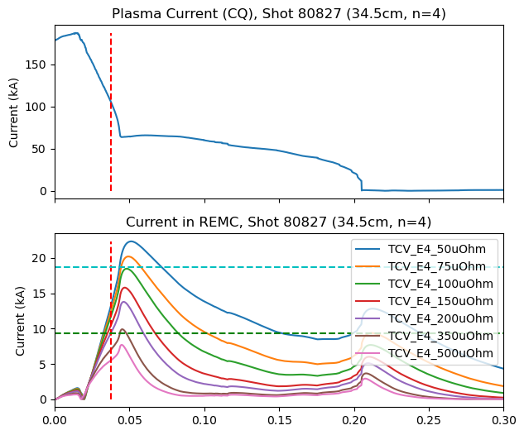
Coil Resistivity Explored for All Possible Geometries
The resistivity of all possible coil geometries was explored (50-500 $μOhm$)
Determined limits will then be shared with the engineering team
Example: 4-segment coil with vertical height 34.5cm
Top candidate due to its ability to couple to the CQ and drive broad perturbation
Resistivity affects both the maximum induced coil currents and the time response of the coil
10%
5%

Slide 24
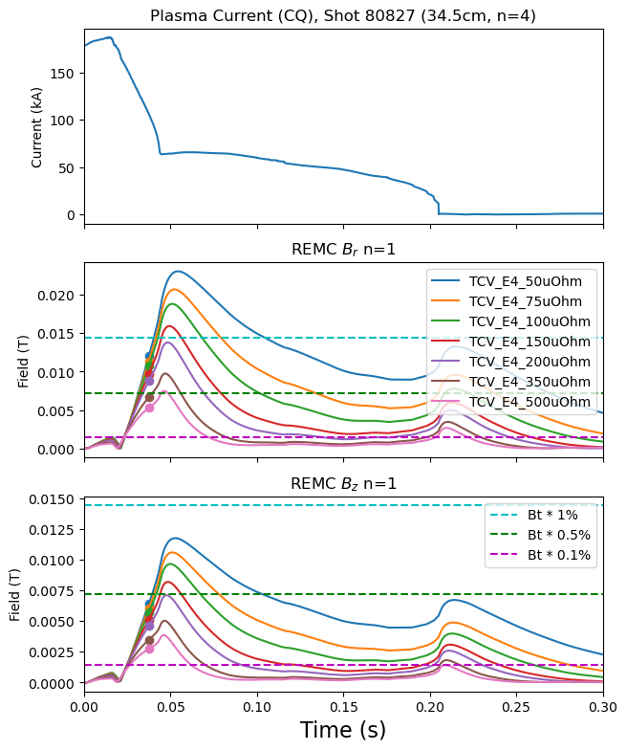
Coil Resistivity Explored for All Possible Geometries
Both the vertical and radial n=1 fields are then measured at the plasma surface

Slide 25
Coil Resistivity Explored for All Possible Geometries
Both the vertical and radial n=1 fields are then measured at the plasma surface
Predictions on $δB$ required to successfully mitigate REs vary in the literature

Slide 26
Coil Resistivity Explored for All Possible Geometries
Both the vertical and radial n=1 fields are then measured at the plasma surface
Predictions on $δB$ required to successfully mitigate REs vary in the literature
Boozer: $δB/B$ $\sim 10^{−2}$
Boozer 2011 PPCF

Slide 27
Coil Resistivity Explored for All Possible Geometries
Both the vertical and radial n=1 fields are then measured at the plasma surface
Predictions on $δB$ required to successfully mitigate REs vary in the literature
Boozer: $δB/B$ $\sim 10^{−2}$
Boozer 2011 PPCF
Helander: $δB/B$ $\sim 10^{−3}$
Helander 2002 PPCF

Slide 28
Coil Resistivity Explored for All Possible Geometries
Both the vertical and radial n=1 fields are then measured at the plasma surface
Predictions on $δB$ required to successfully mitigate REs vary in the literature
Boozer: $δB/B$ $\sim 10^{−2}$
Boozer 2011 PPCF
Helander: $δB/B$ $\sim 10^{−3}$
Helander 2002 PPCF
Important: Due to the inductance of the coil and eddy currents the maximum field is often applied after the CQ
The performance of the coil is evaluated using the field at $t= {0.75 ∗ τ}_{CQ}$

Slide 29
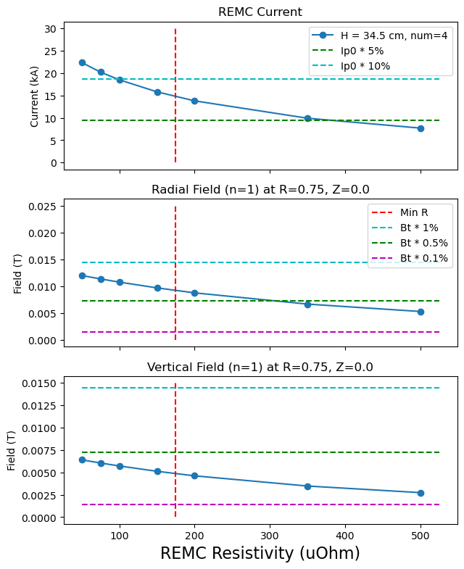
Coil Resistivity Explored for All Possible Geometries
The performance of 5 possible coil geometries is compared using:
Maximum REMC current
Vertical field at 75% of TQ time
Radial field at 75% of TQ time

Slide 30
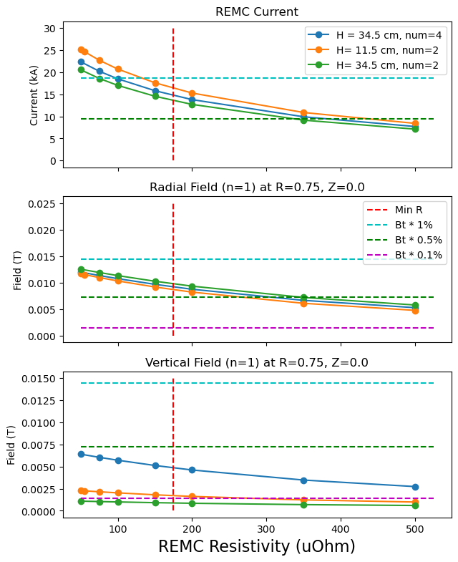
Several Coil Geometries Eliminated with Resistivity Scan
The performance of 5 possible coil geometries is compared using:
Maximum REMC current
Vertical field at 75% of TQ time
Radial field at 75% of TQ time
2-legged coils:
Getting close to midplane results
in more current
Comparable radial field
Less vertical field than 4-legged
These coils will have the lowest resistivity of all possible coils
11.5 cm coil will therefore couple to the most current

Slide 31
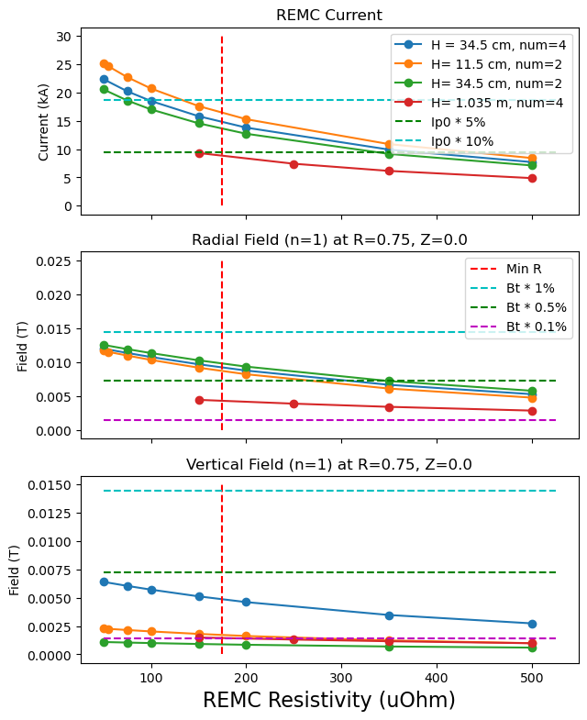
Several Coil Geometries Eliminated with Resistivity Scan
The performance of 5 possible coil geometries is compared using:
Maximum REMC current
Vertical field at 75% of TQ time
Radial field at 75% of TQ time
4-legged coil:
In order to keep the coil
symmetric height needs
to be 1.035 m
Making it the tallest coil
This large height results in low coupling to the CQ
Disqualified based on 0.05 * Ip evaluation parameter

Slide 32
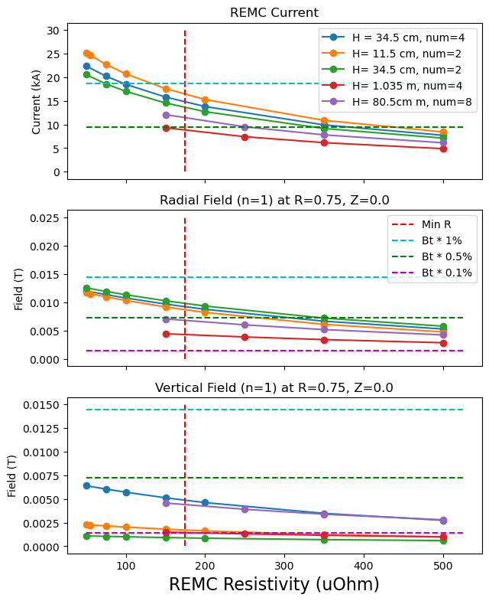
Several Coil Geometries Eliminated with Resistivity Scan
The performance of 5 possible coil geometries is compared using:
Maximum REMC current
Vertical field at 75% of TQ time
Radial field at 75% of TQ time
8-legged coil:
The average height of
horizontal legs determined
the induced current
Therefore, this coil is able to couple to a significant current at comparable resistivity
However, the resistivity of the coil increases with the number of joints
This, along with increased complexity, disqualifies this coil

Slide 33
OUTLINE
Introduction
Design
Resistance Scan
Scenario Scan
Position Scan
Conclusions and Future Work

Slide 34
ThinCurr Leveraged to Explore the Effect of Potential RE Scenarios
TCV scenario is still being developed and is likely to improve
ThinCurr studies completed to explore how these potential improvements will affect coil performance
Two parameters explored:

Slide 35
ThinCurr Leveraged to Explore the Effect of Potential RE Scenarios
TCV scenario is still being developed and is likely to improve
ThinCurr studies completed to explore how these potential improvements will affect coil performance
Two parameters explored:
Change in plasma current during the current quench
$$ΔI_{p}$$

Slide 36
ThinCurr Leveraged to Explore the Effect of Potential RE Scenarios
TCV scenario is still being developed and is likely to improve
ThinCurr studies completed to explore how these potential improvements will affect coil performance
Two parameters explored:
Change in plasma current during the current quench
The current quench time, $τ_{CQ}$

Slide 37
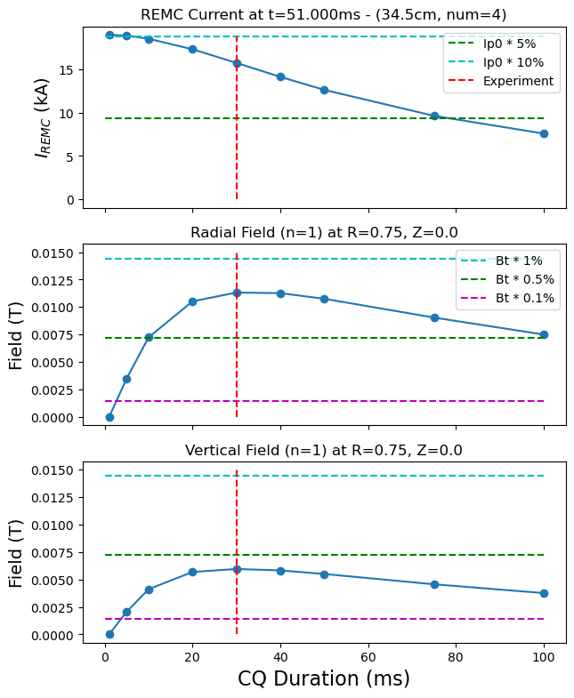
Current Quench Time Scan
Current quench is modeled as a linear ramp down of the current
The current profile is shifted down rigidly
As expected, the shorter current quench times results in greater maximum current
However, due to multiple effects, there is an optimal value of $τ_{CQ}$ to maximize the applied field during the CQ
Eddy currents
L/R time of coil
Luckily, this maximum is occurs around the $τ_{CQ}$of TCV scenario

Slide 38
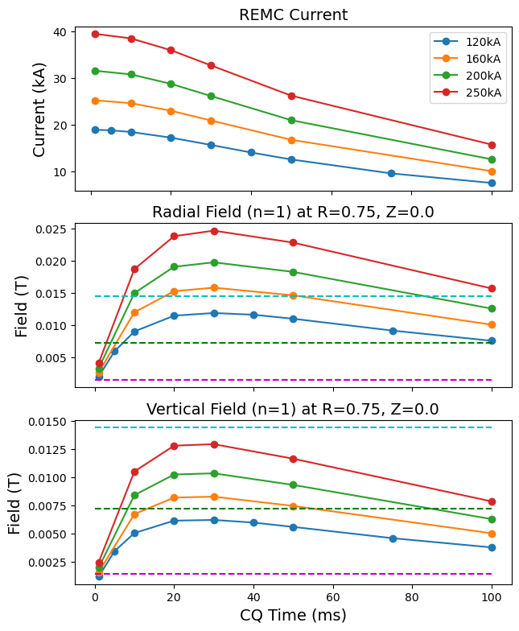
Plasma Current Scan
Increasing the change in current during the triggered CQ results in significant improvements to REMC performance

Slide 39
Plasma Current Scan
Increasing the change in current during the triggered CQ results in significant improvements to REMC performance
Fields above $δB/B$ ${\sim 10}^{−2}$ possible for $ΔI_{p}≥160 kA$
As expected, this change in current should be maximized during scenario development
The presence of the REMC is expected to improve both the $τ_{CQ}$and $ΔI_{p}$

Slide 40
OUTLINE
Introduction
Design
Resistance Scan
Scenario Scan
Position Scan
Conclusions and Future Work

Slide 41
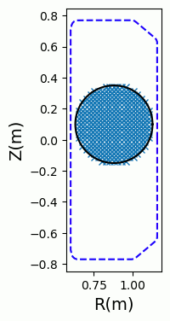
Plasma Position
Shaped tokamak plasmas are susceptible to vertical displacement events during the CQ
TCV shape control may allow this to be explored in an experiment
ThinCurr was used to explore the effect of the plasma vertical position on the effectiveness of the REMC
Plasma modeled as a circle with a flat current-profile
Total plasma current matched to experimentally measured value
Cross-section area designed to roughly match the experimental scenario

Slide 42
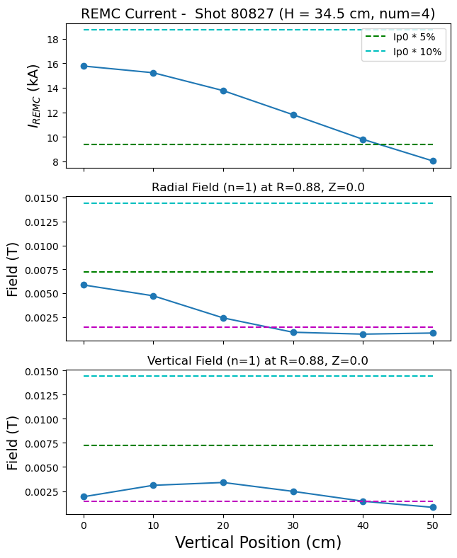
REMC Performance Sharply Drops off with Vertical Position
Induced current and radial field drop off rapidly with vertical height
The vertical field increases as the plasma approaches the horizontal legs
Maximized at Z=20cm
Above this height, performance degrades for all parameters
If VDEs are likely, there is an advantage to tall coils
As seen for SPARC (Battey et al 2024 Nucl. Fusion)
Tradeoff with overall less coupled current

Slide 43
OUTLINE
Introduction
Design
Resistance Scan
Scenario Scan
Position Scan
Conclusions and Future Work

Slide 44
Conclusions
REMC is currently being designed for TCV
Installation planned for later this year
Coils are being modeled using a combination of ThinCurr and MARS-Q
ThinCurr is used to evaluate induced current and vacuum field
MARS-Q will study driven MHD and RE deconfinement
Keeping the resistivity low will be crucial to the success of the coil
Maximizing cross-section where possible
Exploring low-resistivity joint options (polished silver/gold contacts)

Slide 45
Conclusions
Simulations also indicate the potential for significant coil performance with improvements to the TCV RE scenario
ThinCurr simulations indicate that coils with a vertical height above ~60cm will not couple to sufficient current
Similar to issues predicted for similar midplane coils (DIII-D), the performance of the TCV REMC will fall off steeply at positions above its vertical height

Slide 46
Thank you
Alex Battey
Postdoctoral Researcher

Slide 47
Bonus Slides

Slide 48
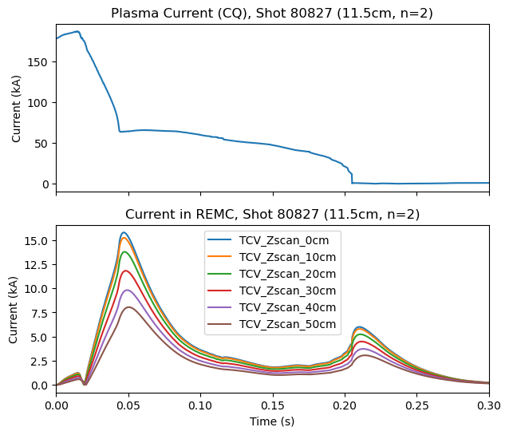
REMC Performance Sharply Drops off with Vertical Position

Slide 49
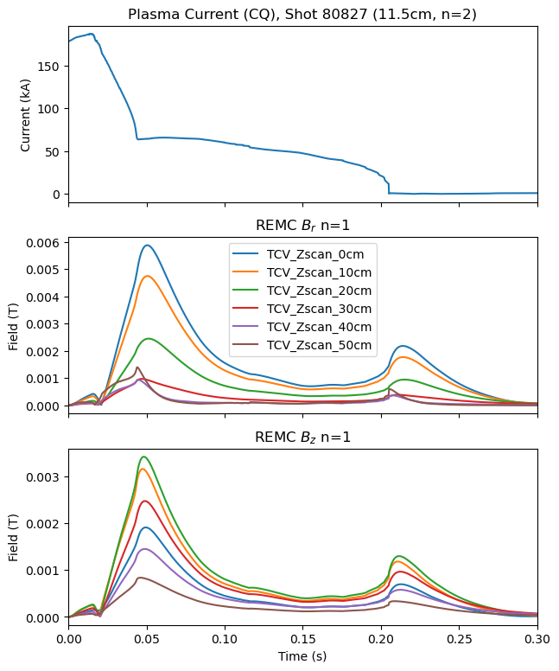
REMC Performance Sharply Drops off with Vertical Position

Slide 50
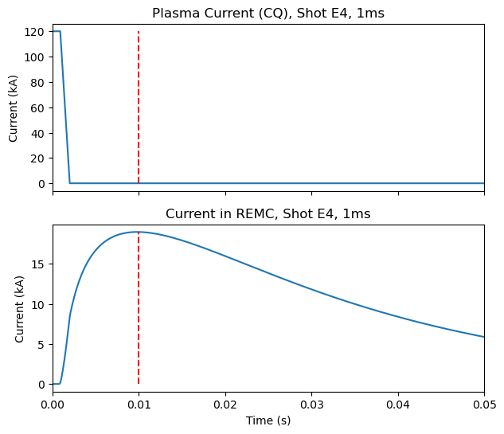
Current Quench Time Scan
Example of fast CQ

