Slide 1
REM 2024: Benchmarking the JOREK Hot Tail RE seed with DREAM
Louis PUEL (1st year PhD – IRFM/IO)
Supervisors: Éric NARDON (CEA) / Javier ARTOLA (IO)
Aknowledgements: Mathias HOPPE for his help on DREAM
10/06/2024

Slide 2
Outline
The PhD project
Simulation Environment
Benchmark DREAM vs JOREK
Trying to get better statistics
Next Steps

Slide 3
The PhD project
1

Slide 4
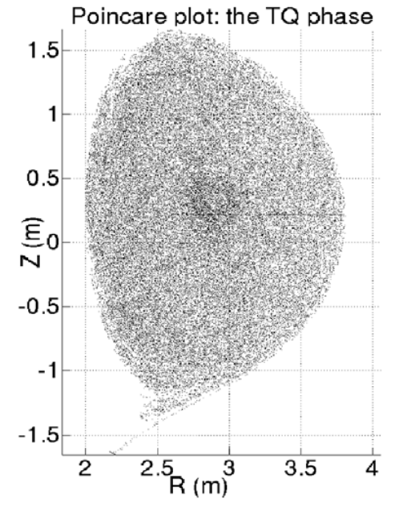
A prominent issue in ITER
Using ITER, DREAM simulations: $I_{Hot Tail }$~10 kA [1]
→ But, because of the avalanche mechanism,
the critical RE current $I_{RE,c}=$0.1 mA !
Impurity transport
But for now, not fully modeled for ITER because of 3D effects…
[2]
3D MHD Dynamics
(stochastization during TQ)
[1] : Svenningsson, Hot-tail runaway seed landscape during the thermal quench in tokamaks. Physical Review Letters, (2021).
[2] : Sommariva, Electron acceleration in a JET disruption simulation. Nuclear Fusion, (2018).

Slide 5
The PhD project
Shattered Pellet Injection
GOAL: Predict the Hot Tail generation during ITER disruption mitigated by SPI
HOW: Post-process MHD simulations with test electrons using JOREK
1st Year
Development / Verification of the integrated framework
+
Hot Tail seeds computation on 2D MHD simulation
2nd Year
3D calculation of Hot Tail seeds with existing ITER SPI simulations [3]
3rd Year
New ITER SPI simulations with the optimal SPI parameter range?
… will be defined later
Set appropriately the JOREK particle tracer
Set appropriately the JOREK particle tracer
Produce a set of TQ and pre-TQ simulations
Produce a set of TQ and pre-TQ simulations
…+ Validation of the Hot Tail model using JET data?
[3] : D. Hu, submitted to Nuclear Fusion

Slide 6
Simulation Environment
2

Slide 7
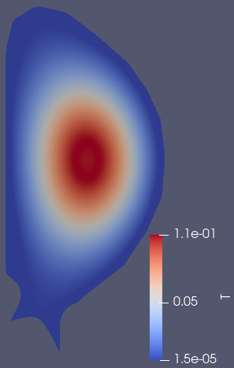
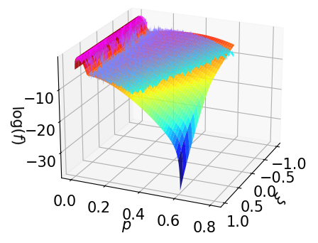
Simulation Environment
Local Post-Treatment Code
Probability Function Initializer
JOREK
Fields imported from MHD simulations
Trajectories
OR
Particle Tracker
Monte-Carlo Collision Operator [5]
PDF
Manually prescribed fields
[4] : Särkimäki, K. Adaptive time-stepping Monte Carlo integration of Coulomb collisions. Computer Physics Communications, (2018).
… and so on

Slide 8
DREAM vs JOREK
3

Slide 9
DREAM vs JOREK : Test case 1 $(E=0)$
Idea: Compare DREAM and JOREK on temperature drop simulation (0D in space, 2D in velocity)
Simulation of hot Maxwellian electron population ($T_{hot}=10 keV$) colliding with cold bulk ($n, T_{cold}$) with $E=0$ for now
$$n=1e19 m^{−3}$$
$T_{cold}\left(t\right)=T_{f}=cte$
with $T_{f}=10 eV$
Case A (instantaneous):
Scan in GC velocity phase space $(p, ξ)$
DREAM
$T_{cold}\left(t\right)=T_{0}+\left(T_{f}−T_{0}\right)max(\frac{t}{t_{max}};1)$
with $T_{0}=10 keV$| $T_{f}=10 eV$ | $t_{max}=1 ms$
Case B (linear):
$$p=|\left|\vec{p}\right||$$
$$ξ=\cos\left(θ\right)=p_{||}/p$$

Slide 10
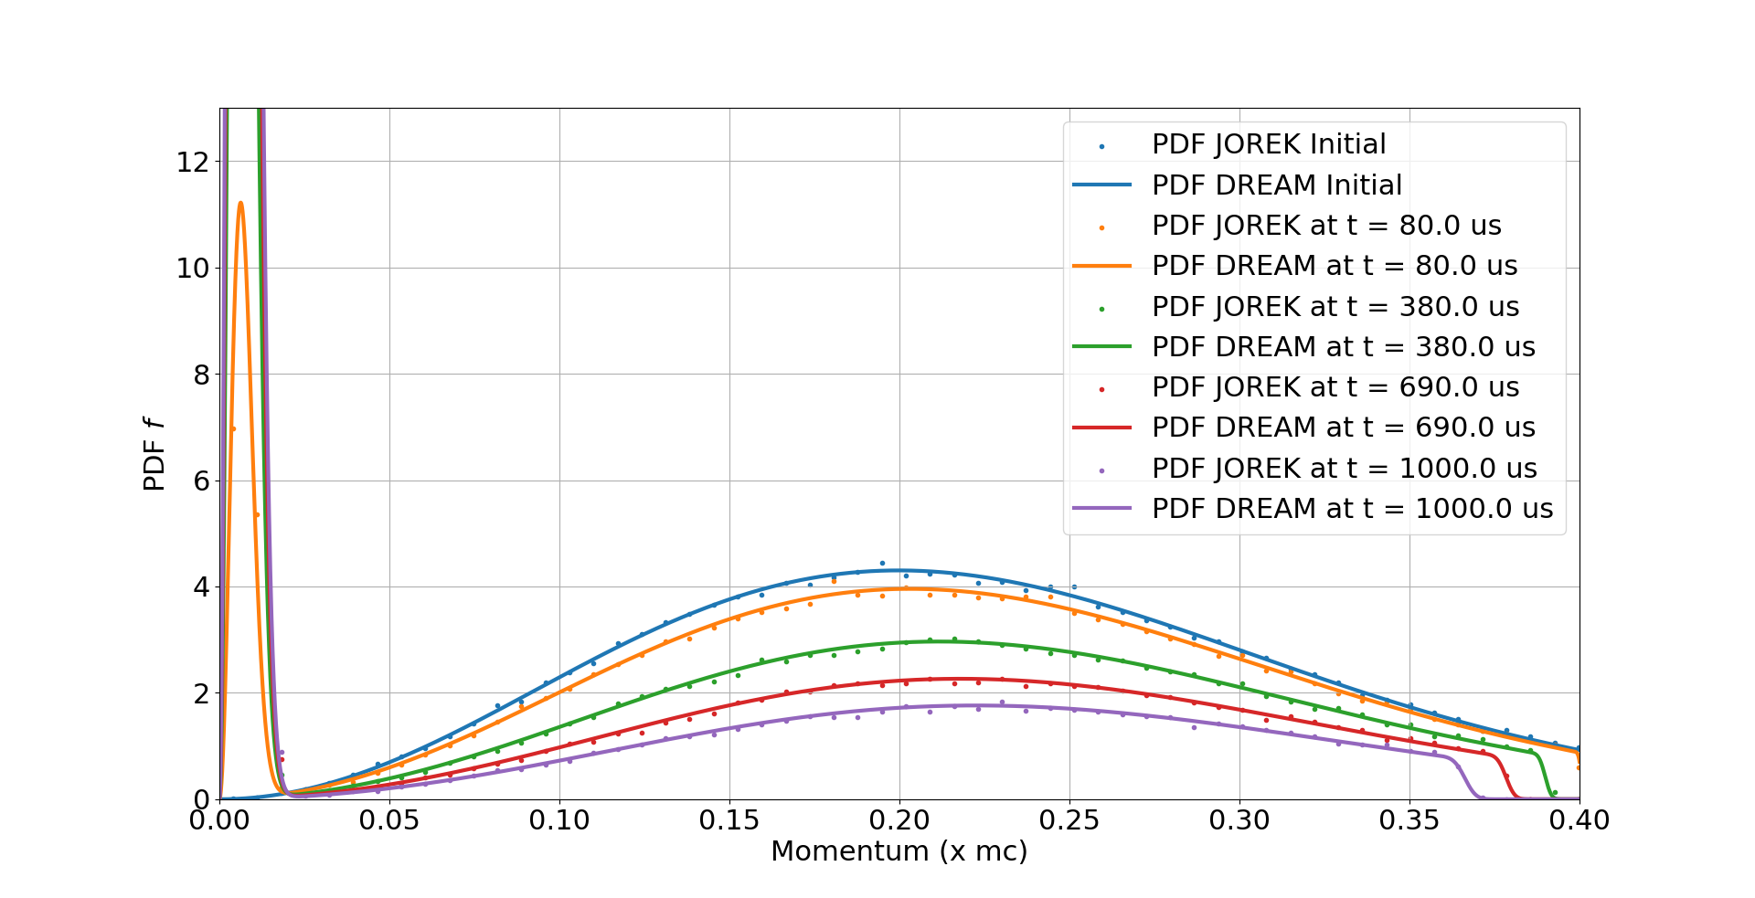
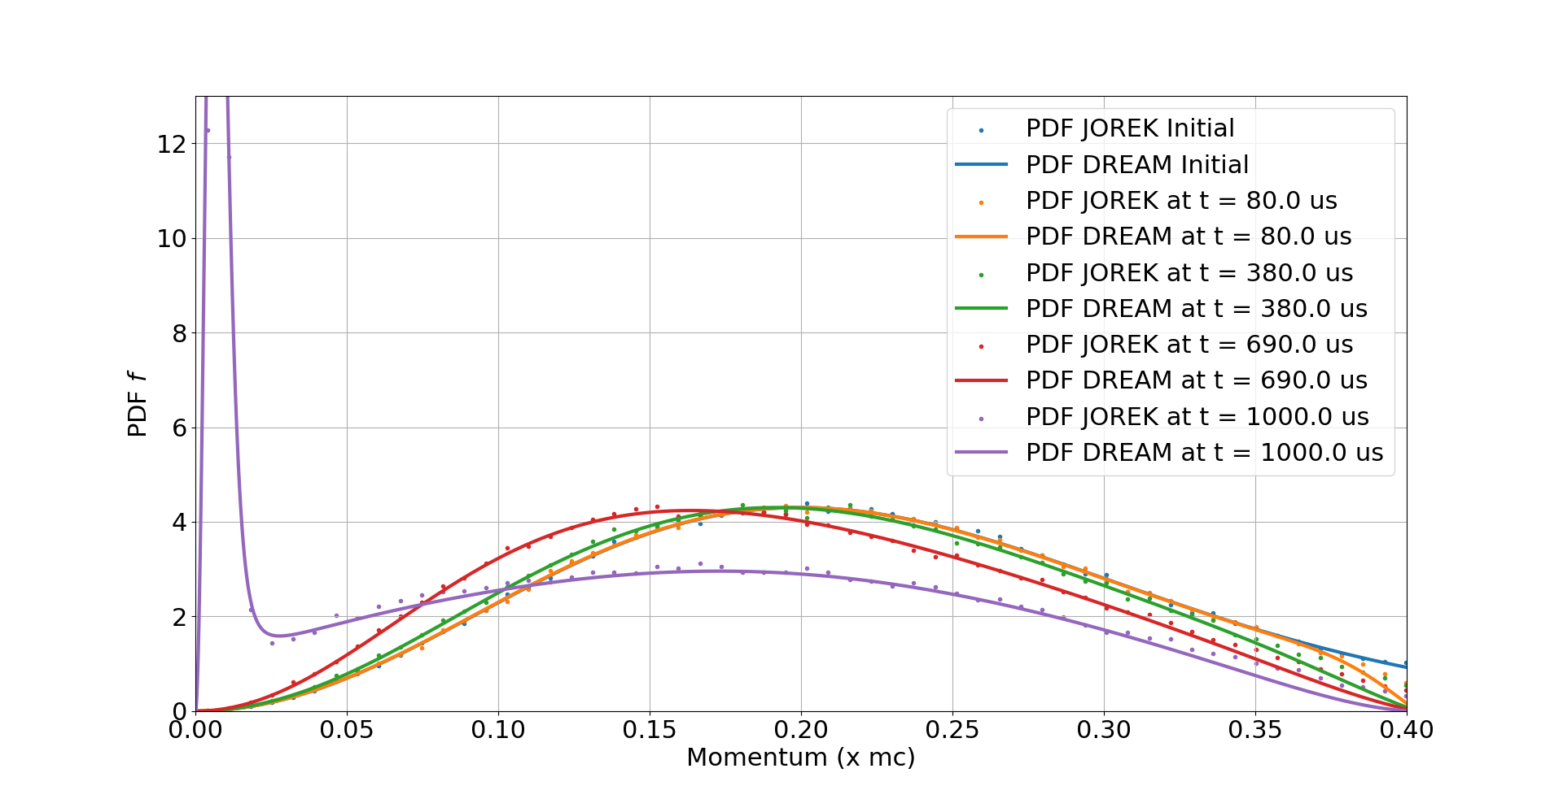
DREAM vs JOREK : Test case 1 $(E=0)$
Case A (instantaneous)
Case B (linear)
DREAM
Agreement between JOREK and DREAM ☺

Slide 11
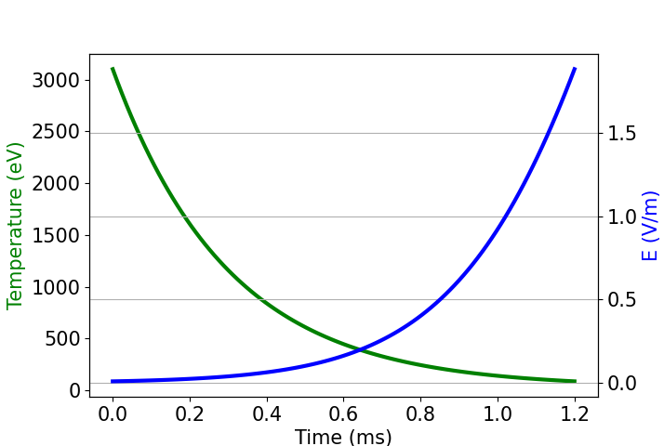
DREAM vs JOREK : Test case 2 $(E≠0)$
Test case presented in [5]: (0D in space, 2D in velocity)
[5] : Stahl, A. "Kinetic modelling of runaway electrons in dynamic scenarios." Nuclear Fusion 56.11 (2016)
Simulation of hot Maxwellian electron population ($T_{hot}=3.1 keV$) colliding with cold bulk ($n, T_{cold}$) with Spitzer-dependent electric field $E$
$$\frac{E(t)}{E_{D}}={\left(\frac{E}{E_{D}}\right)}_{0}\sqrt{\frac{T_{0}}{T(t)}}$$
$$n=2.8e19 m^{−3}$$
with $E_{D}$the Dreicer electric field |
${\left(\frac{E}{E_{D}}\right)}_{0}=1/510$
$T_{cold}\left(t\right)=T_{f}+\left(T_{0}−T_{f}\right)e^{−t/t_{⋆}}$
with $T_{0}=3.1 keV$| $T_{f}=31 eV$ | $t_{⋆}=0.3 ms$
Scan in GC velocity phase space $(p, ξ)$
DREAM
$$p=|\left|\vec{p}\right||$$
$$ξ=\cos\left(θ\right)=p_{||}/p$$

Slide 12
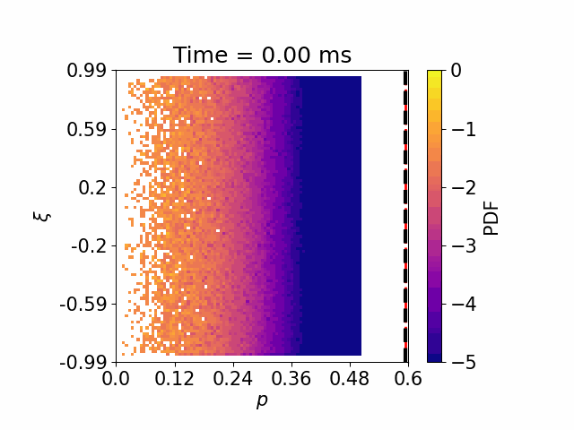
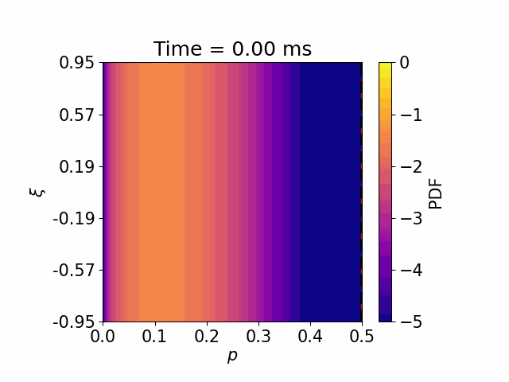
DREAM vs JOREK : $E\left(T\right)≠0$
: $p_{c}= \frac{1}{\sqrt{\frac{E}{E_{c}}−1}}$
: $p_{c}\left(ξ\right)= \frac{1}{\sqrt{\frac{(ξ+1)E}{{2E}_{c}}−1}}$
JOREK
DREAM
JOREK

Slide 13
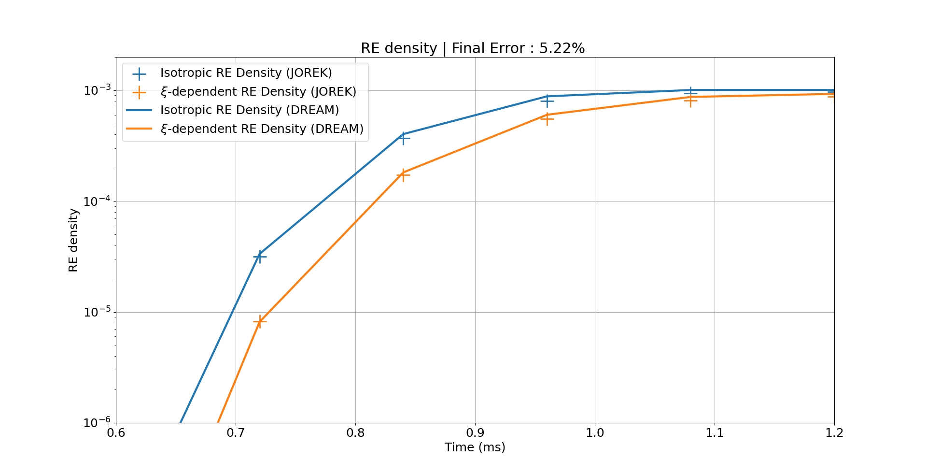
DREAM vs JOREK : RE density
The RE density (relative) is computable by integrating the PDF over the good surface:
$n_{RE, iso}\left(t\right)=\int_{−1}^{1 }{\int_{p_{c}}^{+∞}{f\left(t, p, ξ\right)dpdξ}}$ or $n_{RE, ξ}\left(t\right)=\int_{−1}^{1 }{\int_{p_{c(ξ)}}^{+∞}{f\left(t, p, ξ\right)dpdξ}}$
Agreement between JOREK and DREAM ☺
Agreement with the paper [5] ☺

Slide 14
Trying to get better statistics
4
→ In Progress…

Slide 15
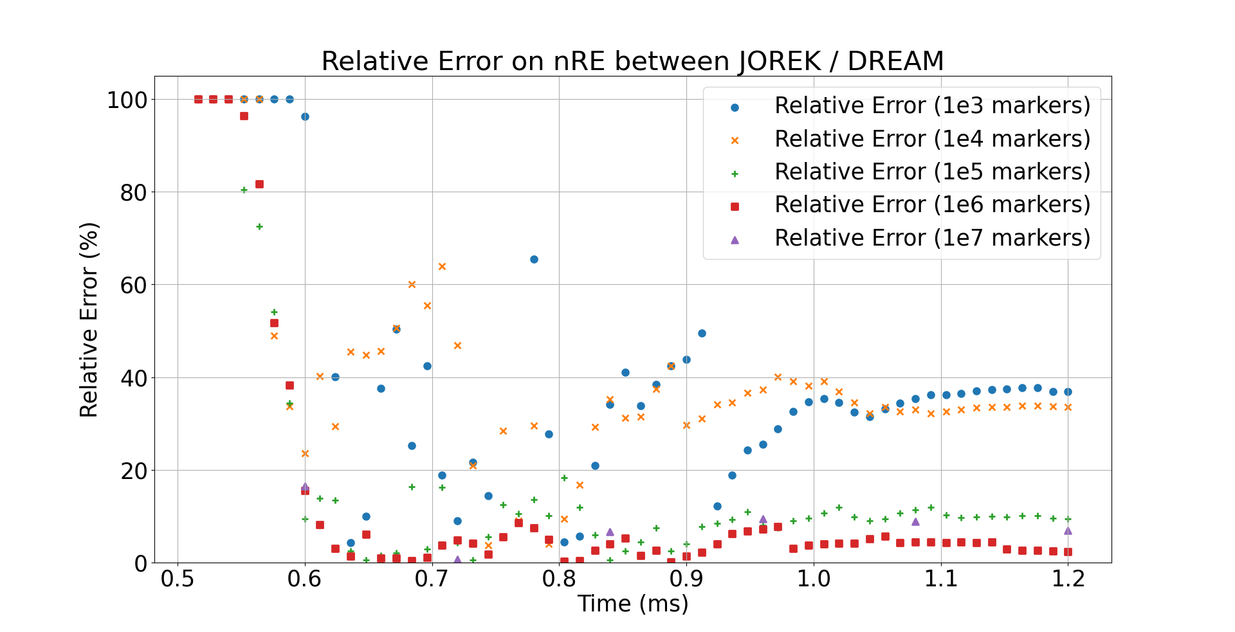
2nd Iteration Method: Why?
Main problem: Errors increase if we use less markers
But the goal is to scan 5D phase space …
Idea:
With an estimation of the RE seed,
let’s perform a 2nd iteration with an « optimized » input PDF

Slide 16
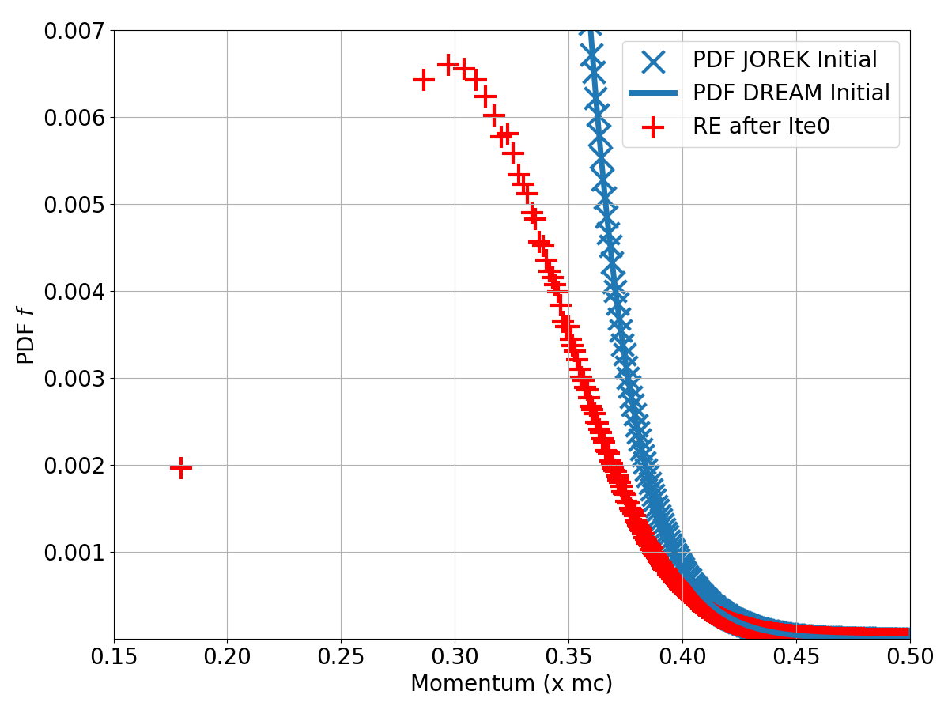
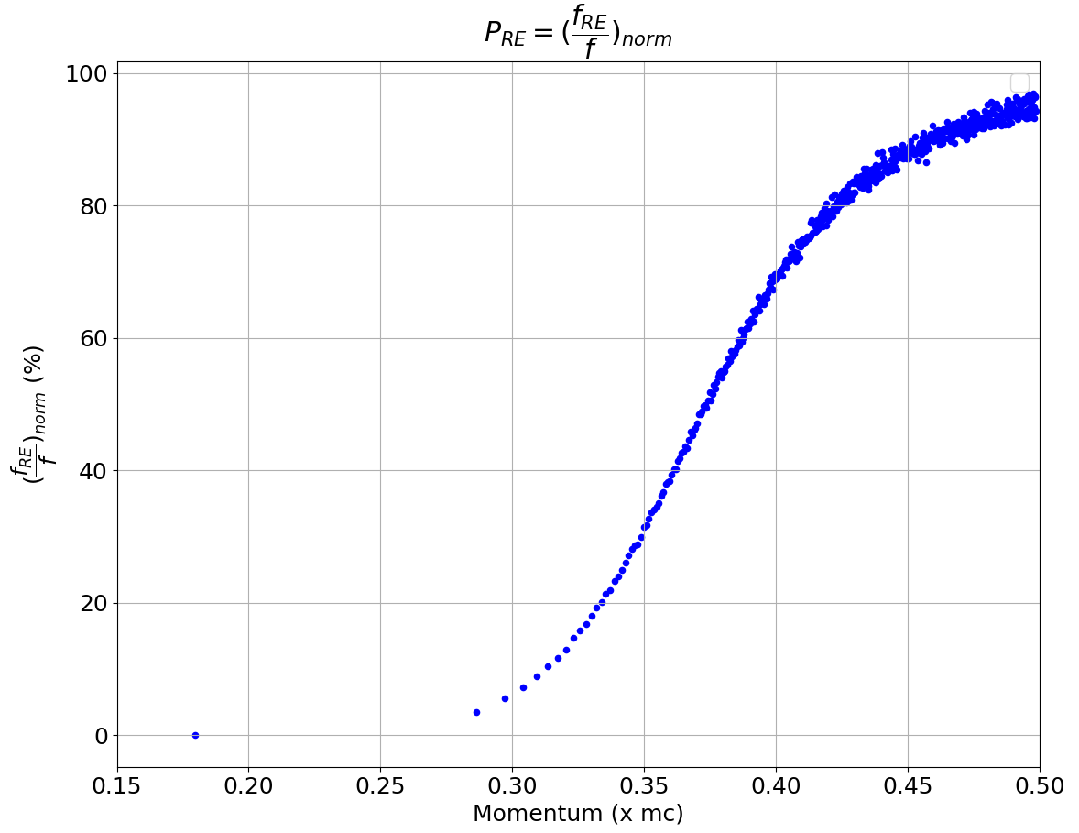
2nd Iteration Method: Principle
Let’s study the initial PDF of future REs:
* ${10}^{7}$ markers used here *
$f_{RE}/f_{MJ}$

Slide 17
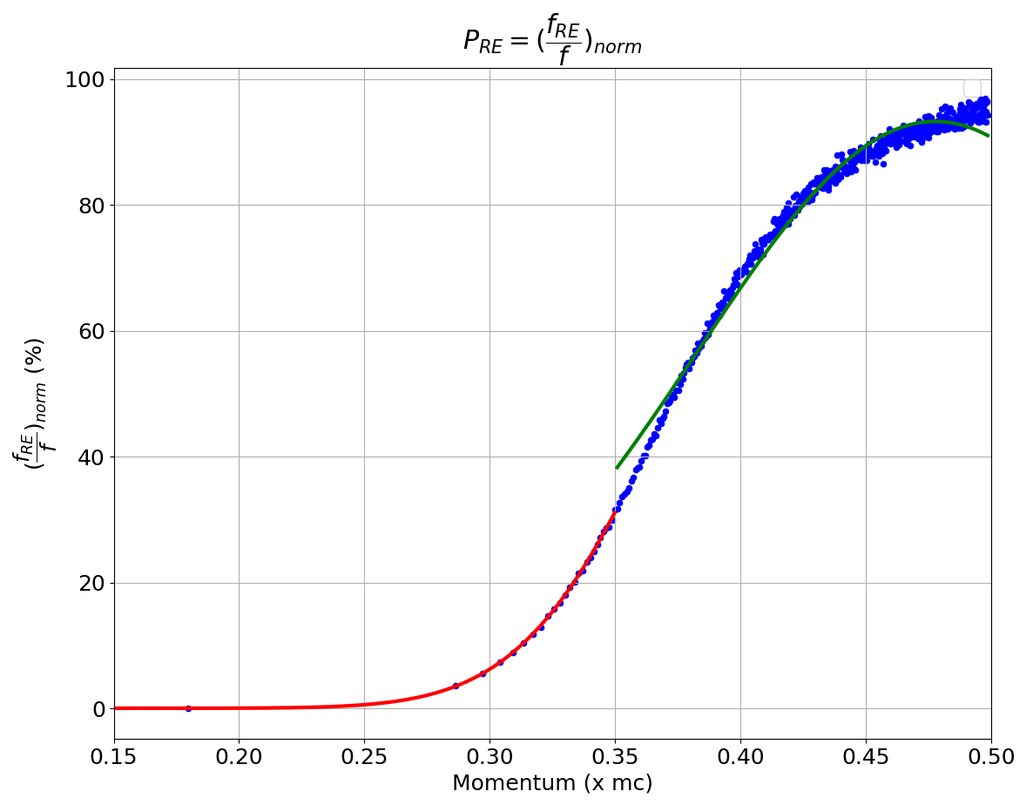
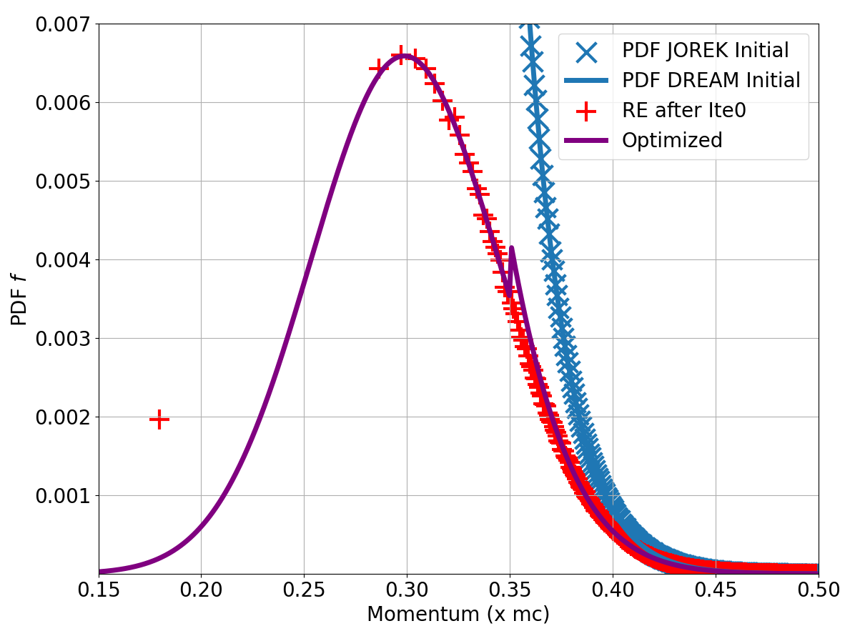
2nd Iteration Method: Principle
Then, we approximate $P_{RE}$ by left and right Gaussians:
* ${10}^{7}$ markers used here *
${G_{l+r}×f}_{MJ}$
$f_{RE}$ : the estimation of the RE PDF

Slide 18
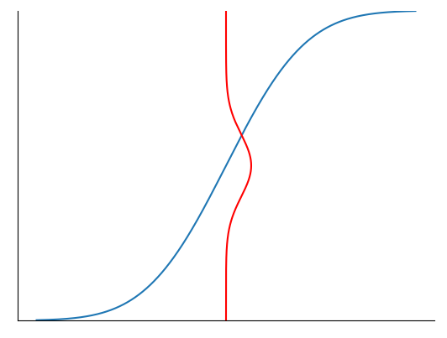
2nd Iteration Method: Principle
(*): Assuming the Central Limit Theorem true in each interval
The estimator of the RE density is:
→ Let’s minimize thus
With the constraint on the number of markers:
Problem of optimization under constraint
$$P_{RE}$$
$$1$$
(*)
$$σ_{j}$$
$${\frac{f_{RE}\left(p_{j}\right)}{f_{MJ}\left(p_{j}\right)}=μ}_{j}$$
$n_{j}^{test}=f^{test}\left(p_{j}\right)J\left(p_{j}\right)Δp_{j}$
x xx x xxx
$$p$$
$$p_{1}$$
$$p_{2}$$
$$p_{j}$$
$$p_{j+1}$$
$$p_{M+1}$$
Lagrange Multiplier Method
$$Δp_{j}$$

Slide 19
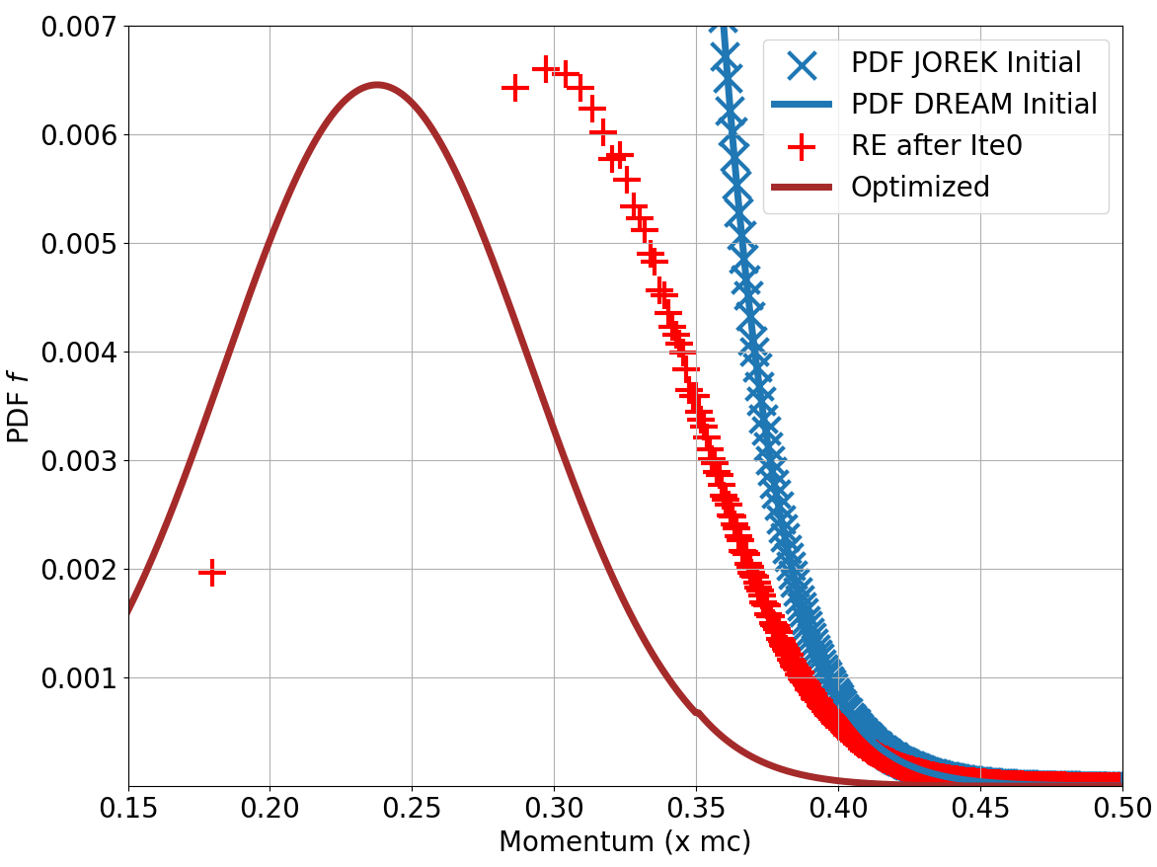
2nd Iteration Method: Principle
One can derive the « best » distribution to minimize the RE density deviation:
* ${10}^{7}$ markers used here *
$f_{RE}$ : the estimation of the RE PDF

Slide 20
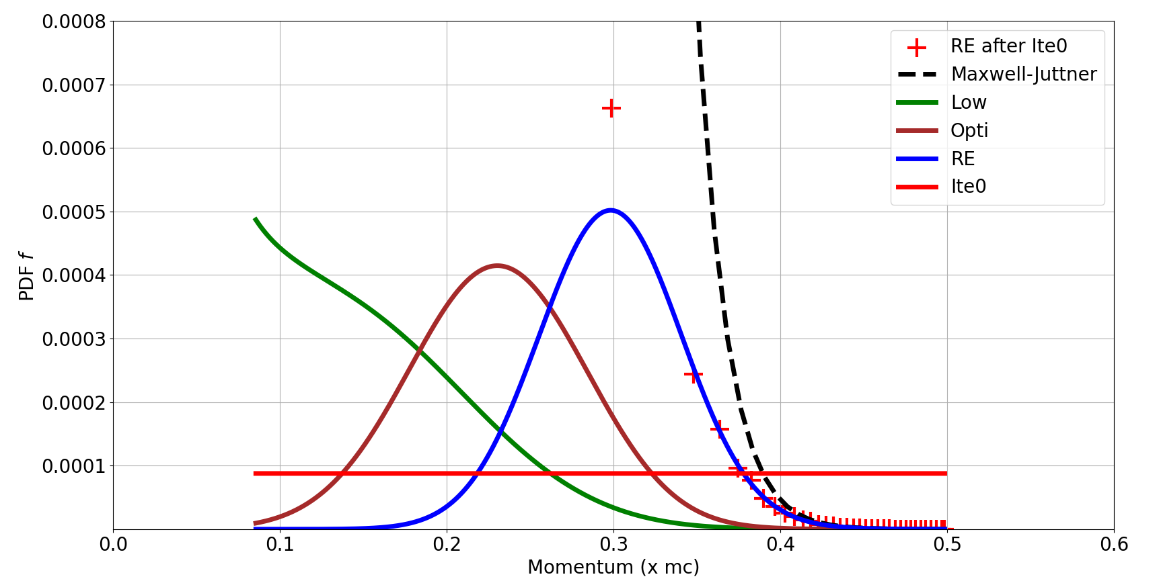
2nd Iteration Method: Test Case
Test: Estimation of $f_{RE}$ with ${10}^{4}$ markers, and perform the 2nd iteration with 3 different PDFs for markers
« Low » : Markers at low momentum values
« Opti » : Markers at low momentum values
Not so different… (factor $≈4$)
« RE » : Markers placed with the estimation of $f_{RE}$
« Ite0 » : Markers placed uniformly at the iteration 0

Slide 21
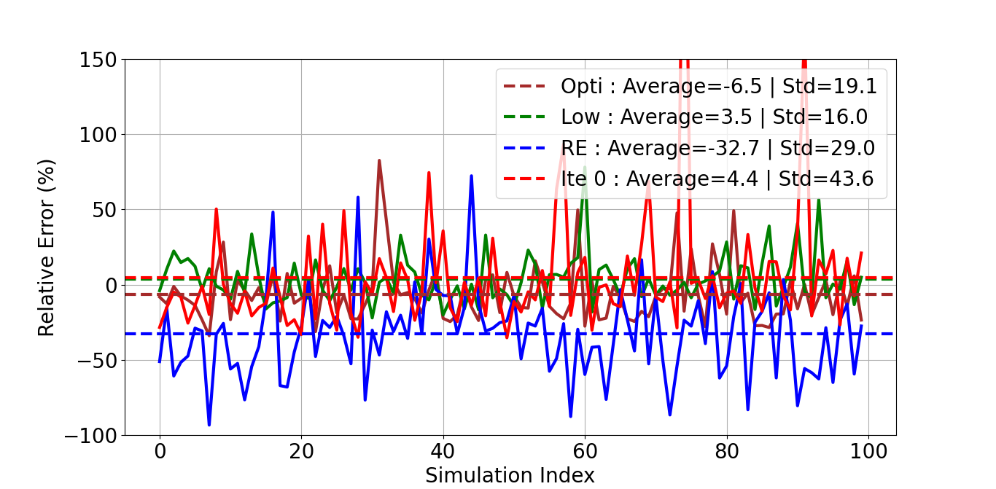
2nd Iteration Method: Results with ${10}^{4}$ markers
Errors (*) on relative RE density of 100 simulations which simulate ${10}^{4}$ markers
(*) : Compared to ${10}^{7}$ markers simulation as reference
2nd iteration = better accuracy ☺
« Opti » is not the best ☹
Improvements, but not spectacular…
Other ideas?
(Backward Monte-Carlo…)

Slide 22
Next Steps
Work on a « Hot Tail dominant » shot:
→ Assess if Dreicer is negligible compared to the Hot Tail
If yes, perform 2D/3D MHD simulations of the TQ
Quantify the Hot Tail RE seed ☺
Are you aware of any of them? ☺
Study the ITER TQ case:
→ Perform 2D MHD simulations of the TQ
Quantify the Hot Tail RE seed ☺

Slide 23
References

Slide 24
References
[1] : Svenningsson, Hot-tail runaway seed landscape during the thermal quench in tokamaks. Physical Review Letters, (2021).
[2] : Sommariva, Electron acceleration in a JET disruption simulation. Nuclear Fusion, (2018).
[3] : D. Hu, submitted to Nuclear Fusion
[4] : Särkimäki, K. Adaptive time-stepping Monte Carlo integration of Coulomb collisions. Computer Physics Communications, (2018).
[5] : Stahl, A. "Kinetic modelling of runaway electrons in dynamic scenarios." Nuclear Fusion 56.11 (2016)

Slide 25
Appendices

Slide 26
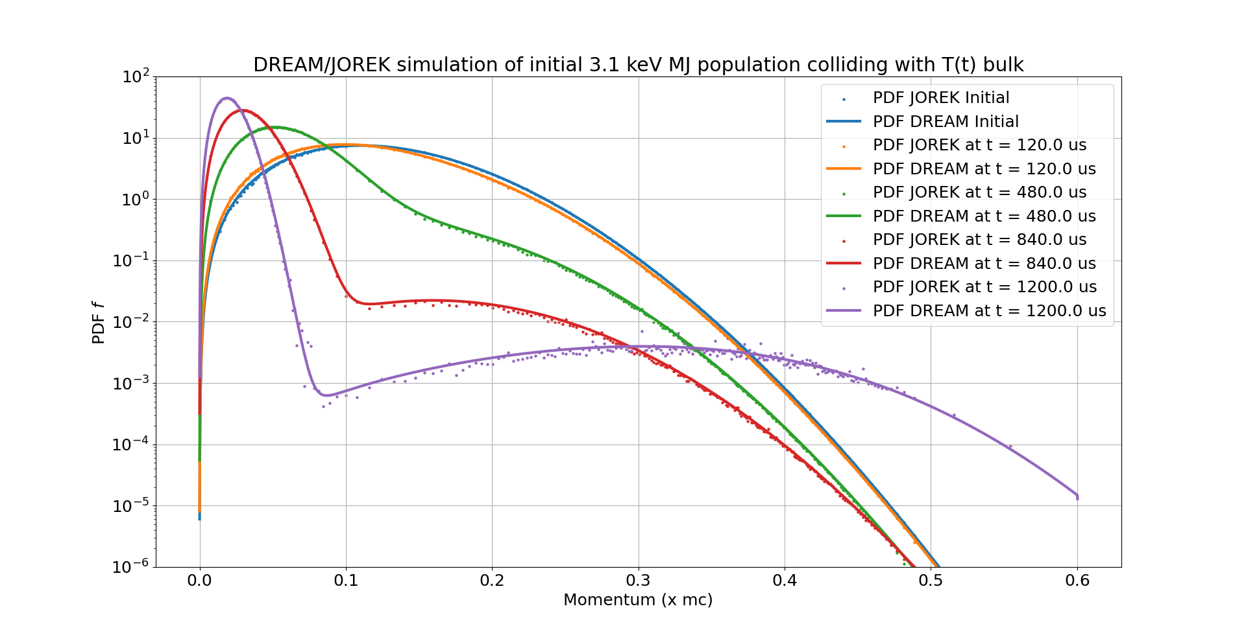
PDF evolution Test Case 2

Slide 27
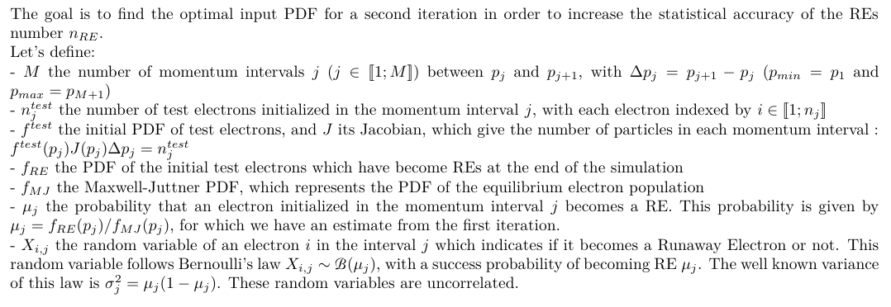
Optimized PDF Proof (1/3)
$$P_{RE}$$
$$1$$
$$σ_{j}$$
$${\frac{f_{RE}\left(p_{j}\right)}{f_{MJ}\left(p_{j}\right)}=μ}_{j}$$
$n_{j}^{test}=f^{test}\left(p_{j}\right)J\left(p_{j}\right)Δp_{j}$
x xx x xxx
$$p$$
$$p_{1}$$
$$p_{2}$$
$$p_{j}$$
$$p_{j+1}$$
$$p_{M+1}$$
$$Δp_{j}$$

Slide 28
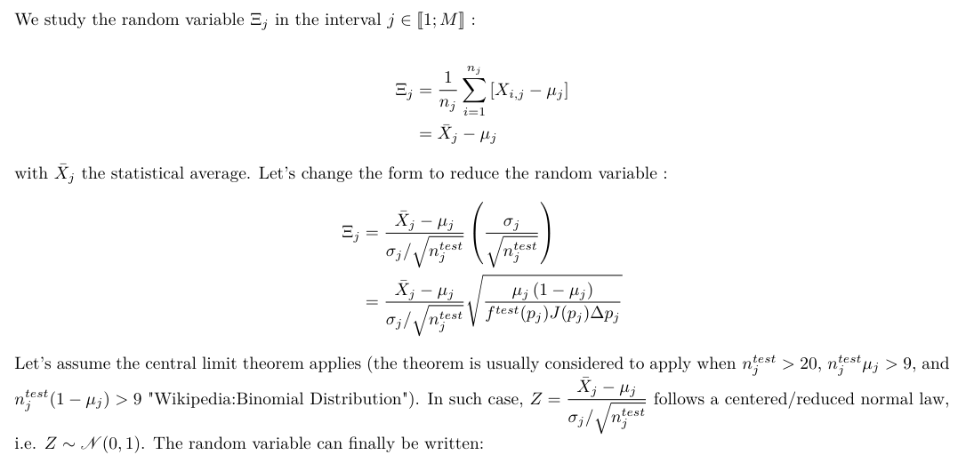
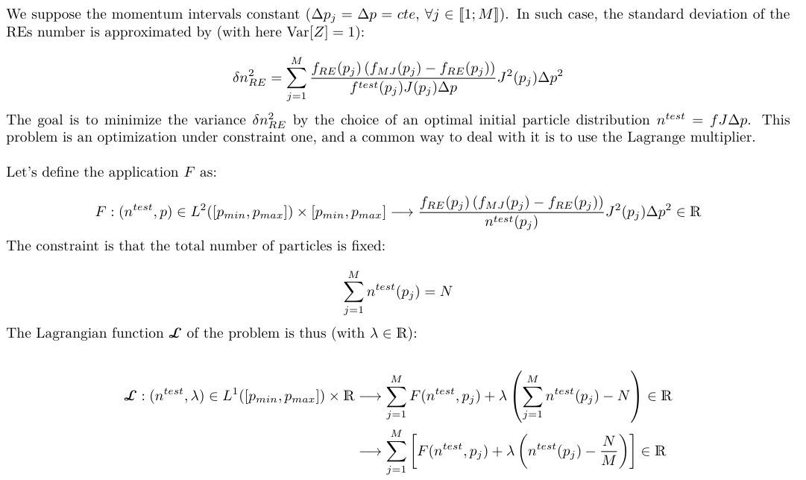
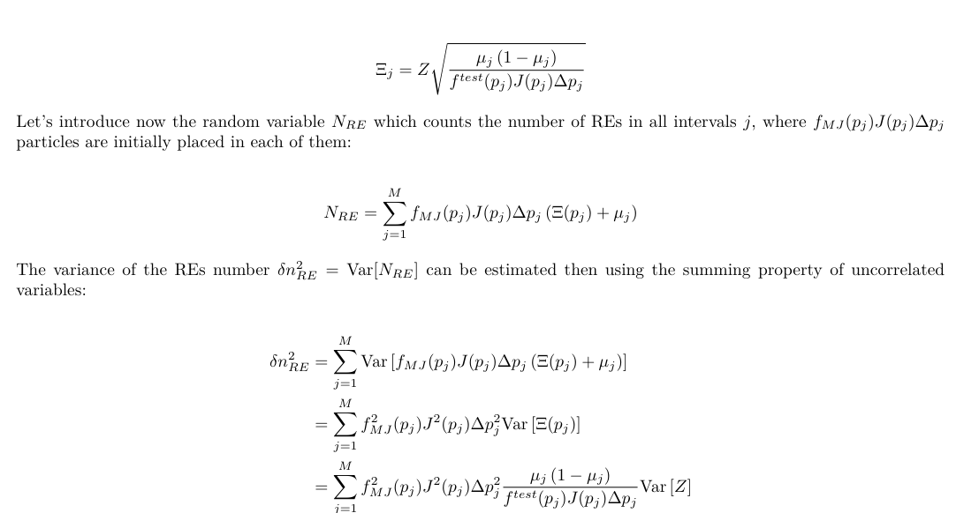
Optimized PDF Proof (2/3)

Slide 29
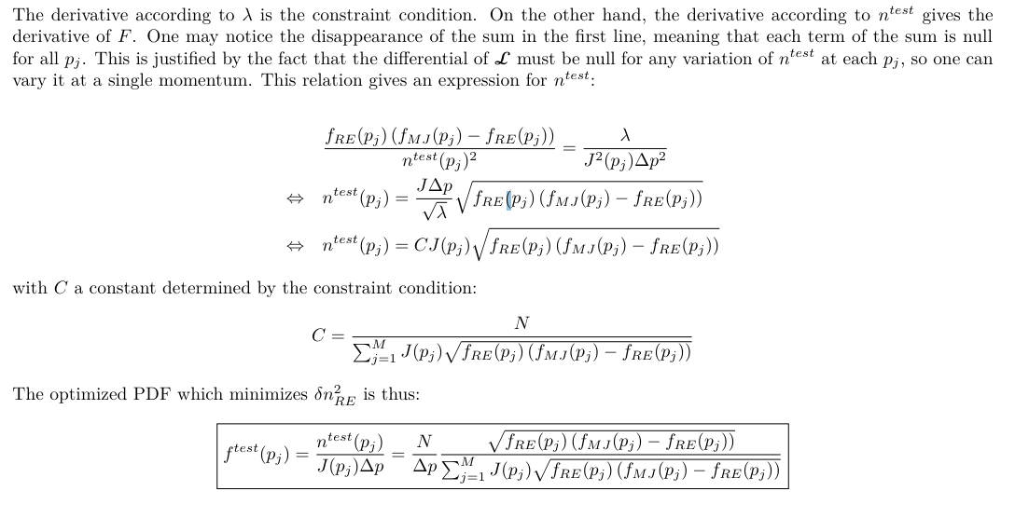
Optimized PDF Proof (3/3)

Slide 30
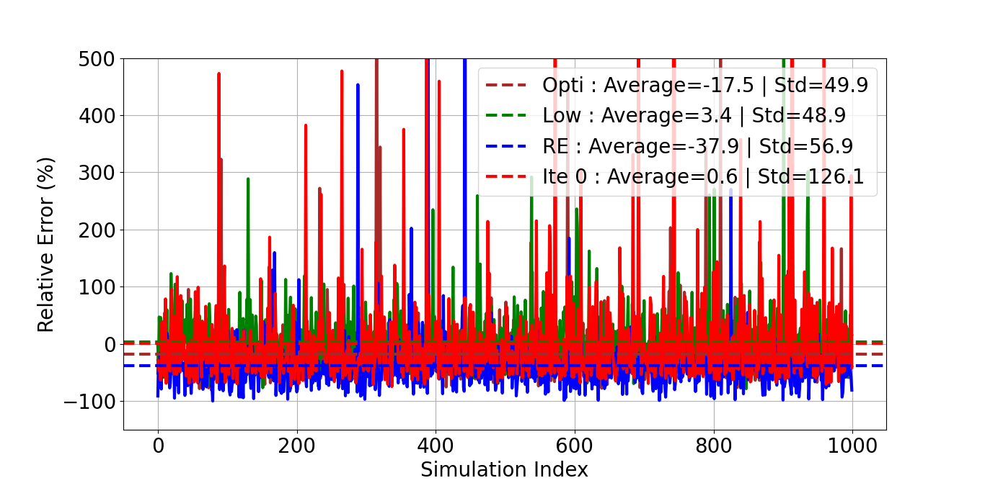
2nd Iteration Method: Results with ${10}^{3}$ markers
Errors (*) on relative RE density of 1000 simulations which simulate ${10}^{3}$ markers
(*) : Compared to ${10}^{7}$ markers simulation as reference
2nd iteration = better accuracy ☺
« Opti » is not the best ☹

Slide 31
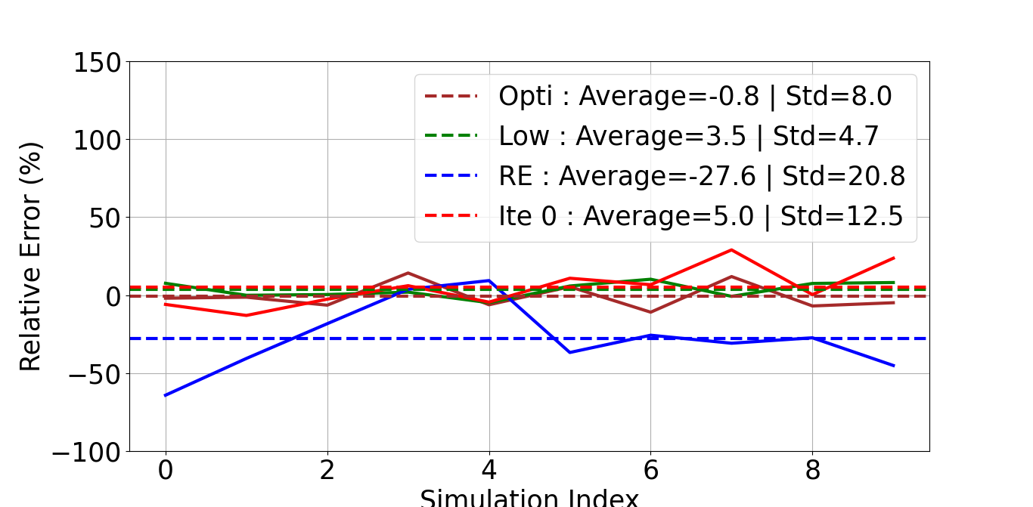
2nd Iteration Method: Results with ${10}^{5}$ markers
Errors (*) on relative RE density of 10 simulations which simulate ${10}^{5}$ markers
(*) : Compared to ${10}^{7}$ markers simulation as reference
« Opti » better with enough markers
2nd (smart) iteration = better accuracy ☺
$$≈$$
« RE » not better than « Ite0 » anymore!

Slide 32
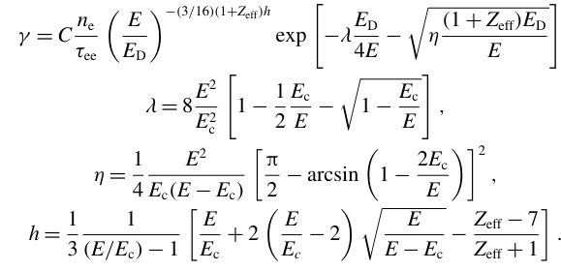
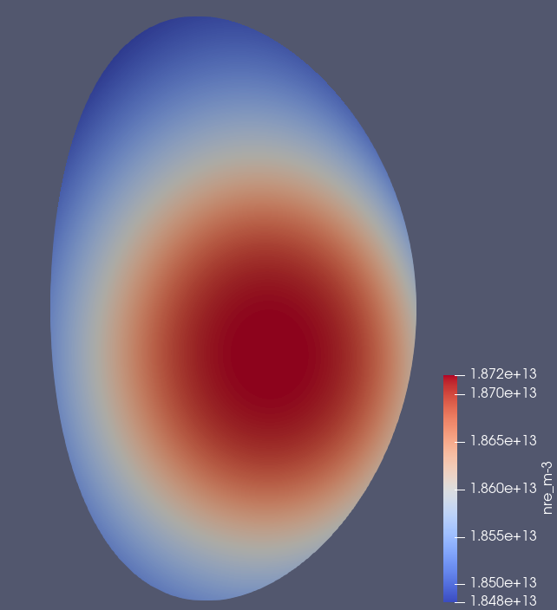
JET Shot n°95135: Dreicer dominates?
Dreicer’s flux model:
RE density from Éric simulation of the CQ: $≈{2.10}^{13}$ $m^{−3}$
Hesslow, L., Unnerfelt, L., Vallhagen, O., Embréus, O., Hoppe, M., Papp, G., & Fülöp, T. (2019). Evaluation of the Dreicer runaway generation rate in the presence of high-impurities using a neural network. Journal of Plasma Physics, 85(6), 475850601.

Slide 33
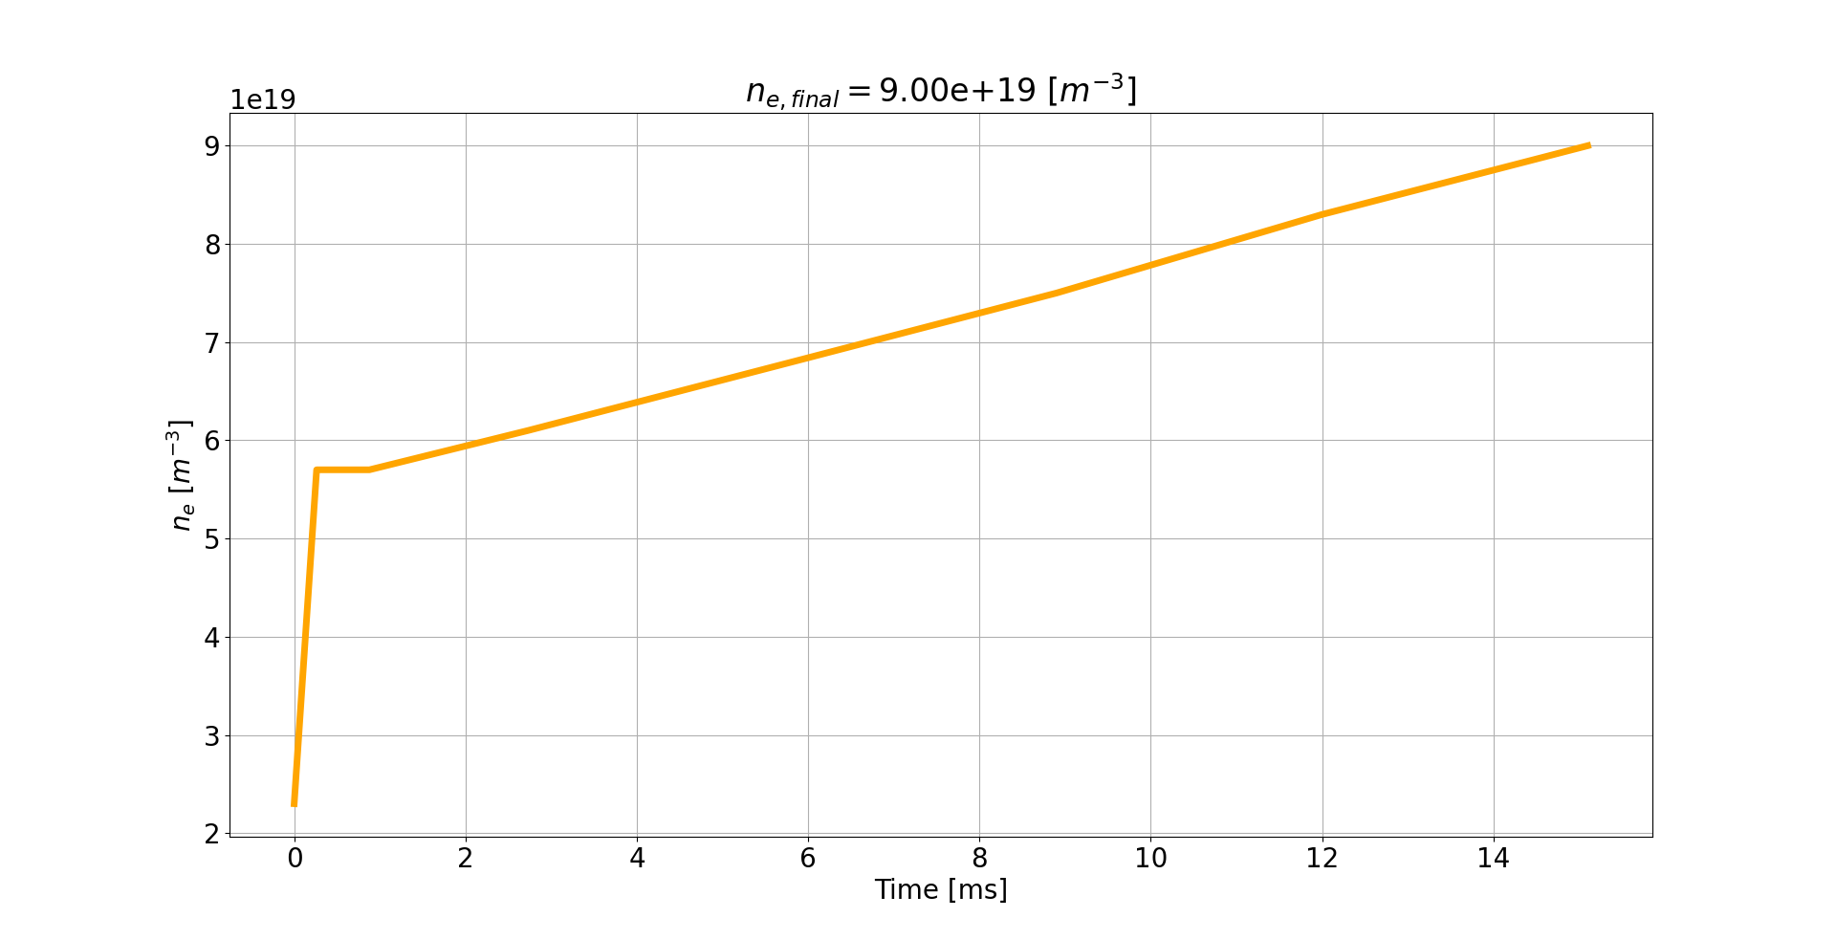
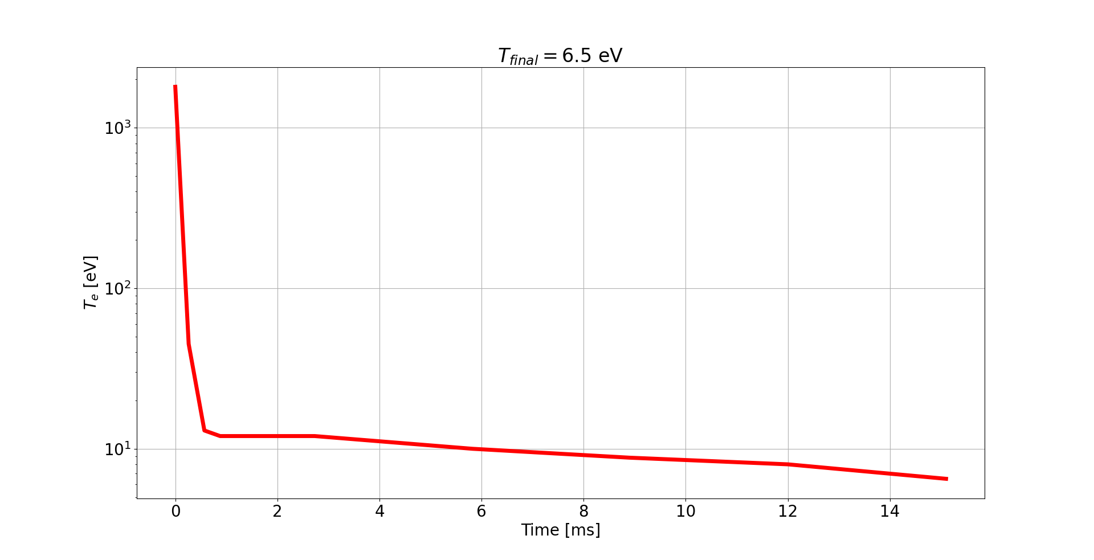
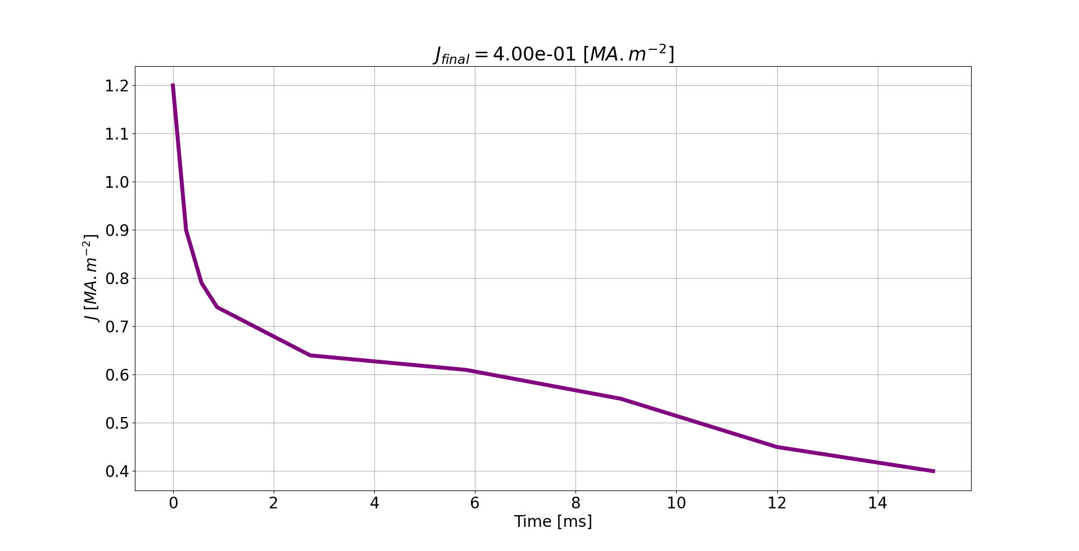
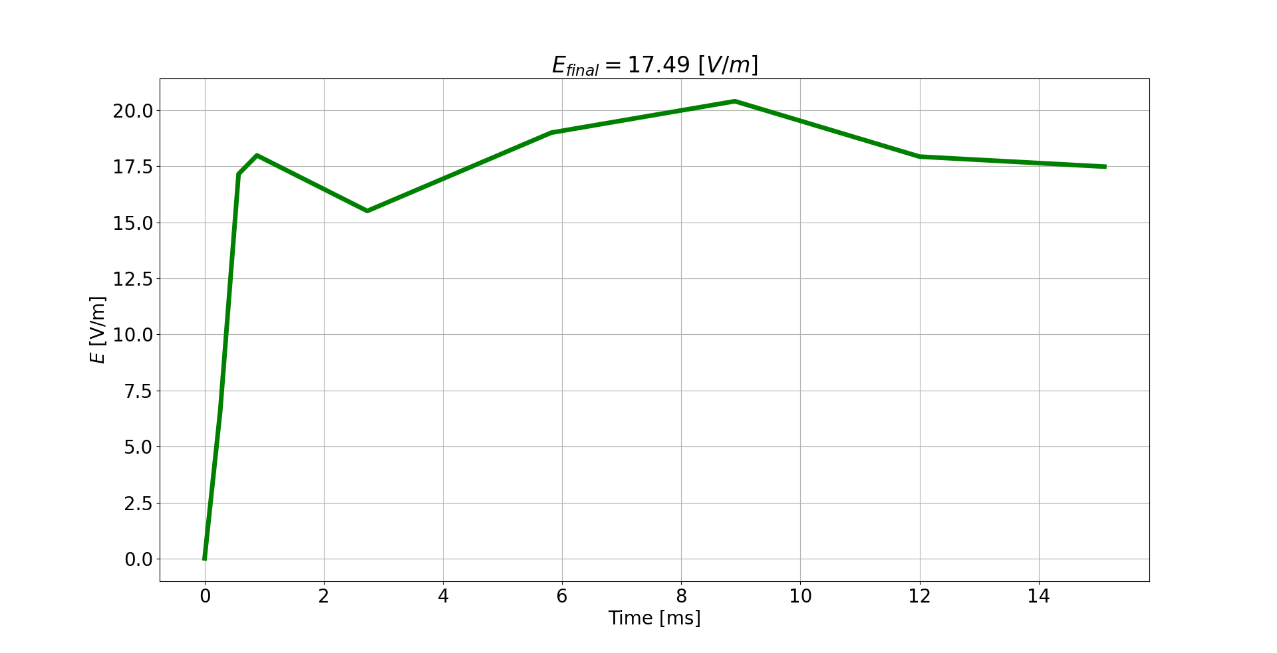
JET Shot n°95135: Dreicer dominates?

Slide 34
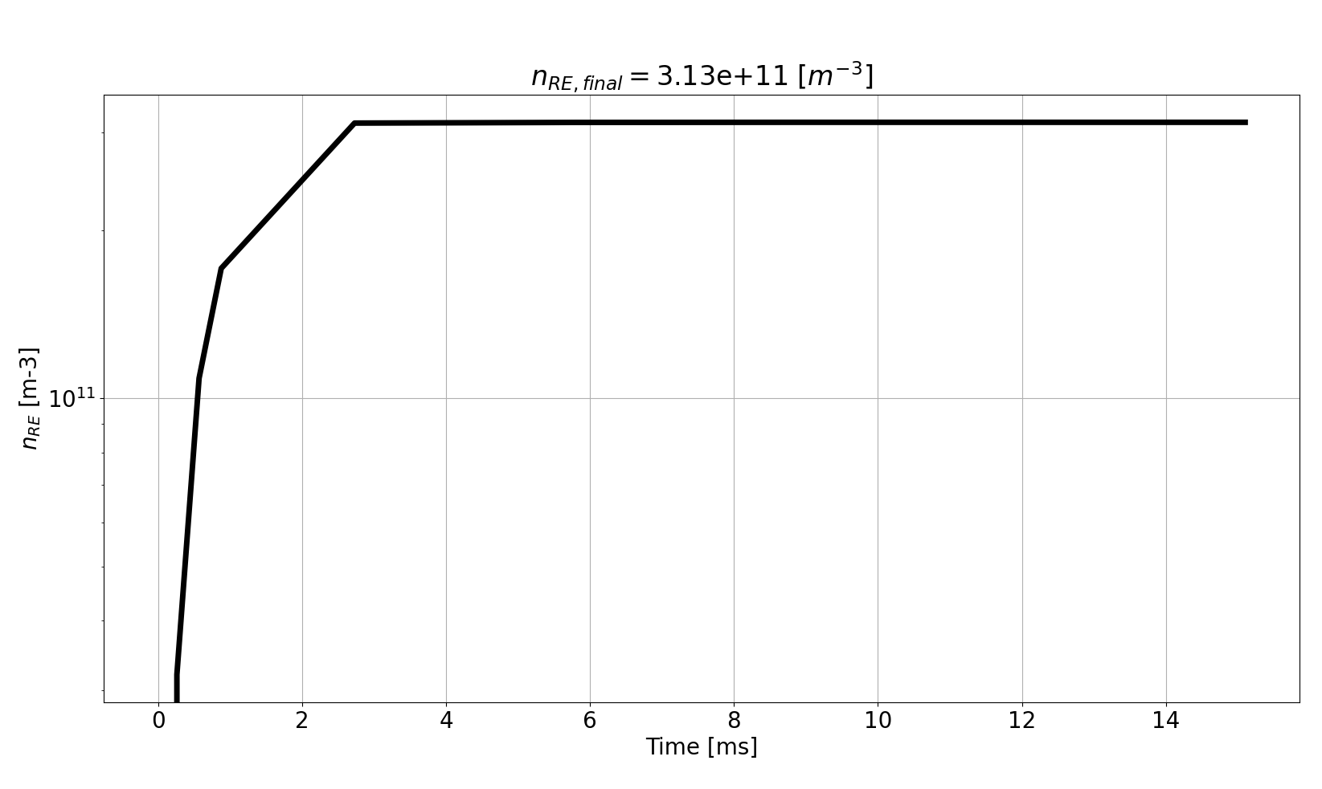
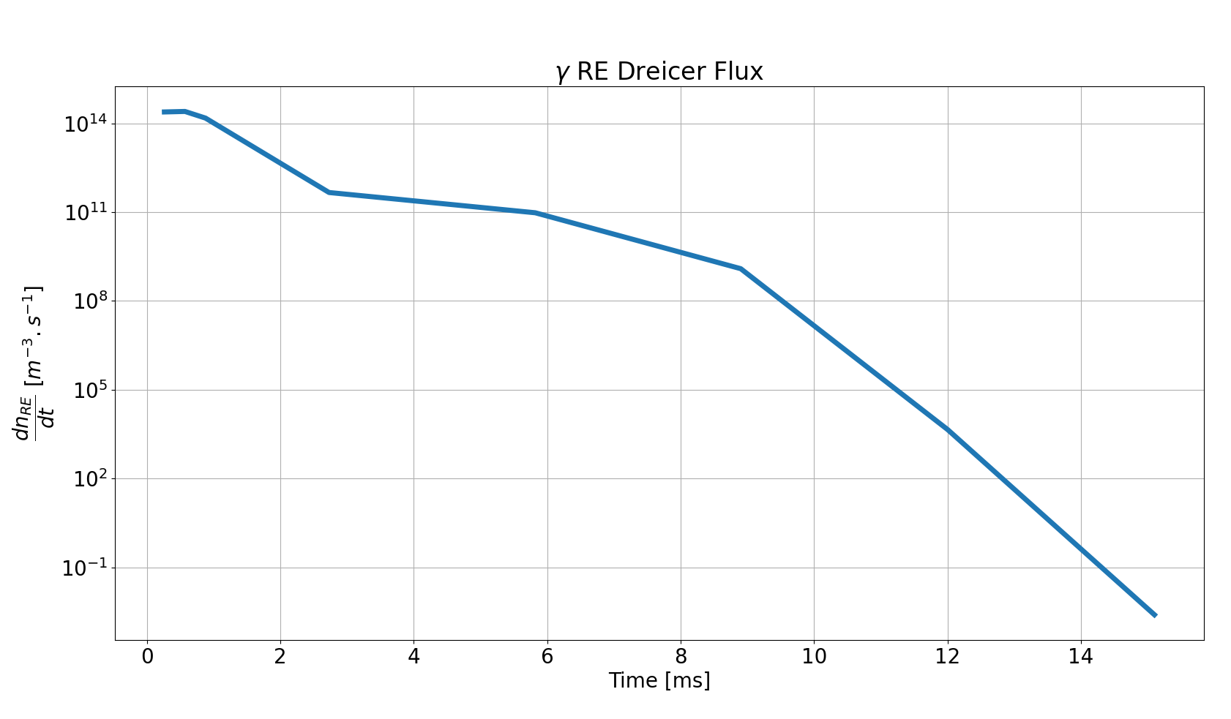
JET Shot n°95135: Dreicer dominates?

