Slide 1
Simulation of runaway electron generation during disruptions with vertical displacement in ITER using JOREK
Chizhou Wang, Eric Nardon, Javier Artola, Tim Driessen, Vinodh Bandaru, the JOREK team

Slide 2
Outline
Introduction
Simulation setup
Simulation results: general plasma dynamics
Simulation results: estimation of the avalanche gain
Summary and Outlook

Slide 3
Introduction
1

Slide 4
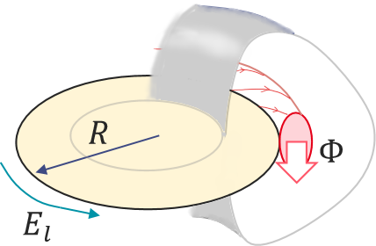
From magnetic flux to the avalanche gain
Evolution of RE population [1]:
$$E_{c}=4πr_{e}^{2}n_{b}\frac{m_{e}c^{2}}{e}lnΛ$$
$$\frac{dlnn_{RE}}{dt}=\frac{e(E_{l}−E_{c})}{2m_{e}clnΛ}=\frac{V_{l}−V_{c}}{ψ_{c}}≈\frac{V_{l}}{ψ_{c}}$$
where $ψ_{c}=4πR\frac{m_{e}c}{e}lnΛ≈2.32 V∙s$ for ITER
Induction law: $V_{l}=−dψ/dt$
The avalanche gain is then linked to Δψ
ln $\frac{n_{RE}}{n_{RE0}}=\frac{Δψ}{ψ_{c}}$
Avalanche gain is an exponential function of Δψ
$$ψ$$
FS (flux surface) is labelled by toroidal flux $Φ$
Poloidal flux embraced by a FS:$ψ(Φ)$

Slide 5
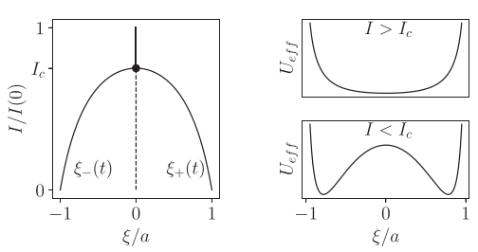
Vertical motion of the plasma
Vertical instability of the plasma
in a 3-loop model [2]
With an ideal wall and decaying I_{p}:
1) The plasma is vertically unstable on the axis when ${I_{p}<I}_{p}^{∗}$.
2) Stable solutions z± move from the axis to VV as I_{p} decreases.
F_{tot} = F_{induced} + F_{coil} is conservative for a fixed I_{p};
Force balance can be resolved.
I_{p} on the geometric axis,
with a vertical displacement ε:
$$f_{stabilize}={δF}_{induced}∝I_{p}^{2}$$
$$f_{destabilize}={δF}_{coil}∝I_{p}$$
I_{coil}
I_{induced}
ε
I_{p}
I_{coil}

Slide 6
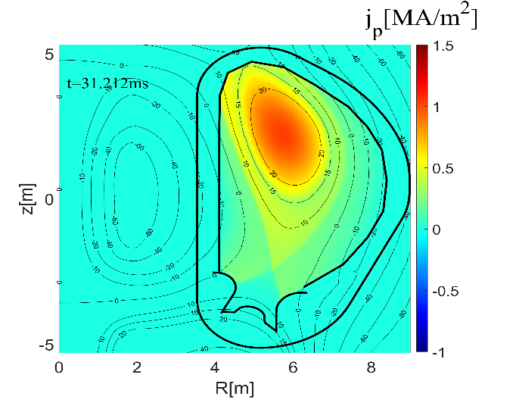
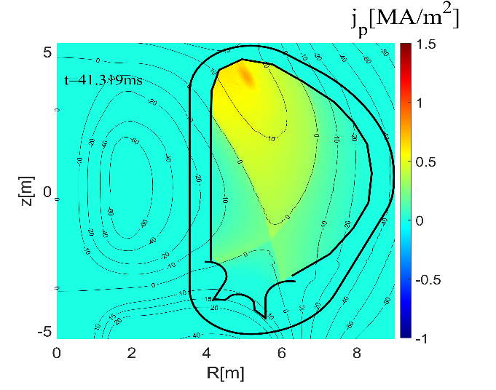
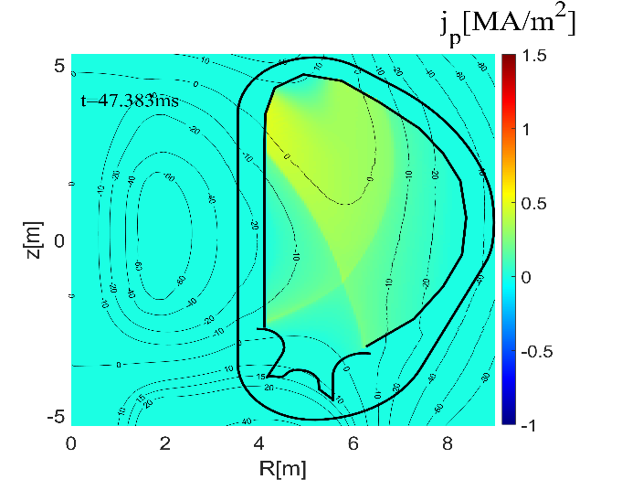
Vertical motion of the plasma
19.08ms
31.21ms
Influence on RE avalanche
1) Plasma gets to the wall, FS gets open.
2) Plasma current is conversed to halo current.
3) Electron acceleration stops, with part of the trajectory in the wall.
4) Remaining magnetic energy can’t be transferred to RE when all FS’s get open.
I_{p}
I_{halo}
41.31ms
47.38ms

Slide 7
Simulation setup
2

Slide 8
Description of the JOREK model
Reduced MHD model
Coronal equilibrium in ion distribution
Free boundary conditions
(JOREK-STARWALL coupling)
Single temperature
With impurities (Ne for our simulations)
Without parallel velocity
Without RE fluid in most cases
An artificial parallel heat conductivity κ||, higher than its real value, is used to simulate the losses from v||.
Different values of κ||(T_{e}=T) are tried to test the robustness of results.
2D model
Axisymmetric
No 3D MHD instabilities (less transport)
Dirichlet boundary conditions
Some variables (T_{e}, n_{e}, n_{IMP}, …) stay constant on boundaries
Homogeneous impurity source
No detailed simulation of SPI
Simplifications

Slide 9
5 phases in the simulation
equilibrium
1
TQ1
2
TQ2
3
IMP
4
CQ
5
Calculate the steady state of ITER plasma under H26 scenario
Artificial increase in heat conductivity
T_{e}=5keV to T_{e}~10eV in 2ms
Add hyper-resistivity, j profile flattens
Impurity injection
n_{Ne} = 10¹⁹m⁻³
Current quench; RE avalanche
Isotope | I_{p} | Core T_{e} | Core n₀ | B₀ | mode
hydrogen | 15MA | 5.1keV | 0.54x10²⁰m⁻³ | 5.3T | L-mode

Slide 10
Plasma pushed up or down by the PF coils
PF13 and PF14 inside the vessel are used to control the plasma dynamics.
δI_{coil} is introduced to push the plasma up or down:
ΔI_{PF13} = +δI_{coil}
ΔI_{PF14} = - δI_{coil}

Slide 11
Simulation results: general plasma dynamics
3

Slide 12
An example with δI_{coil}=20kA and κ||(T_{e}=50eV)

Slide 13
An example with δI_{coil}=20kA and κ||(T_{e}=50eV)

Slide 14
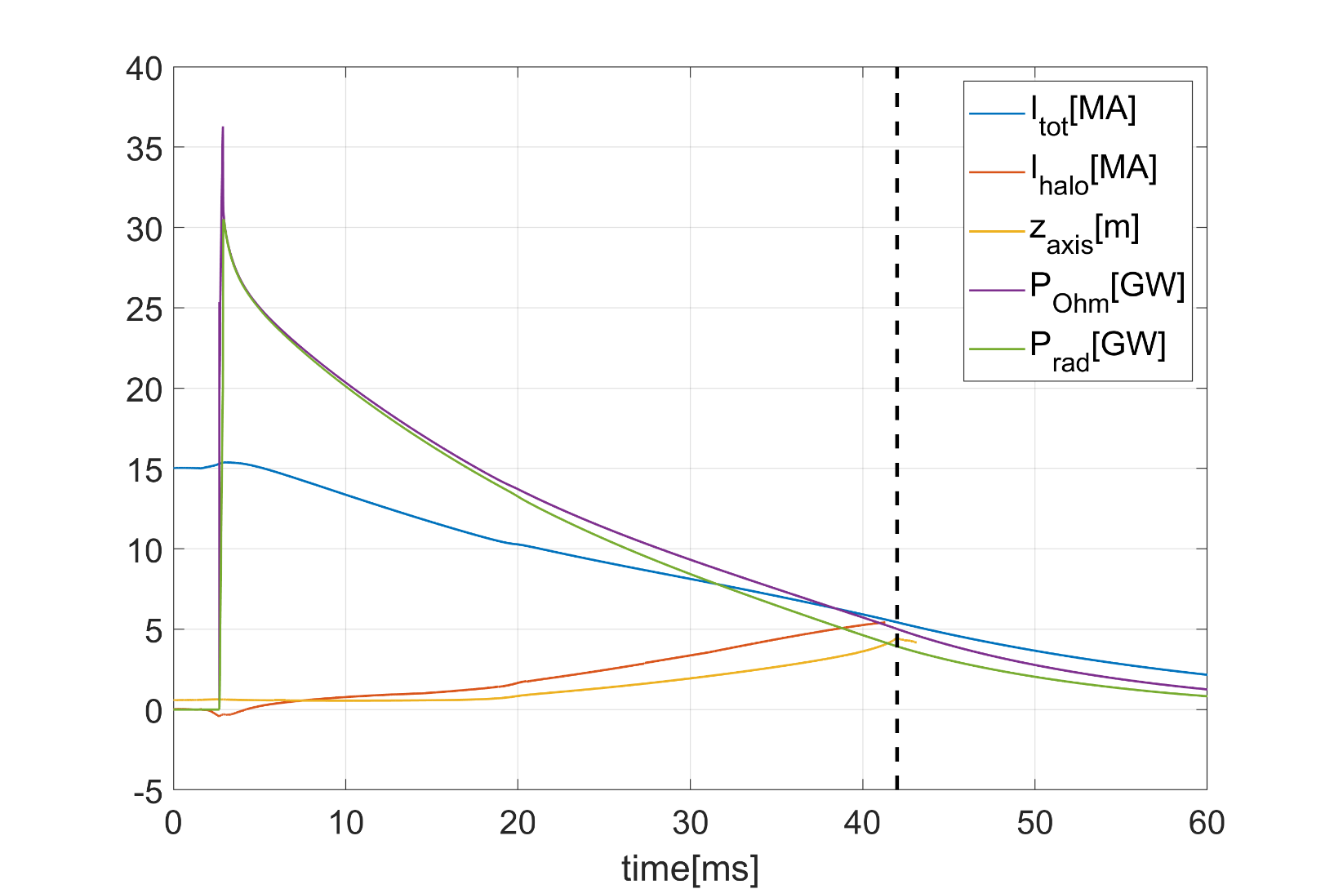
An example with δI_{coil}=20kA and κ||(T_{e}=50eV)
Balance between Ohmic heating and radiation losses;
Boundary transport negligible
Plasma axis touches the first wall;
all FS’s are open.
TQ1
TQ2
IMP
CQ

Slide 15
Vertical motion near the threshold of δI_{coil}
The threshold between upward and downward motion is δI_{coil} ≈ 8-9kA.
I_{p} follows similar curves in all cases.
Motion of the plasma axis:
The vertical motion starts earlier with larger perturbation.
Upward motions: plasma slows down at some point.
Downward motions: the plasma keeps accelerating.

Slide 16
Axis position as a funtion of I_{p}
Near the threshold:
the vertical motion starts from force balance as in the 3-loop model; I_{p}* ≈ 9MA.

Slide 17
Simulation results: estimation of the avalanche gain
4

Slide 18
Δψ(Φ) on each flux surface (δI_{coil}=40kA, upward motion)
A FS reaches the wall and gets open
Record the values of ψ and Φ on it
Get a list of ψ(Φ) at LCFS
Dot lines: κ||(T_{e}=300eV)
Dot-dash lines: κ||(T_{e}=100eV)
Solid lines with markers: κ||(T_{e}=50eV)
Dash lines: κ||(T_{e}=10eV)

Slide 19
Δψ(Φ) is similar in upward and downward motions
Dot lines: δI_{coil}=40kA
Dot-dash lines: δI_{coil}=10kA
(upward)
Solid lines: δI_{coil}=0kA
Dash lines: δI_{coil}=-5kA
(downward)

Slide 20
Why is ψ on the LCFS almost constant?
ψ is constant in the vacuum vessel (good conductor, t_{diffusion} >> t_{CQ}).
The LCFS is at least 0.5m away from the VV.

Slide 21
Why is ψ on the LCFS almost constant?
ψ is constant in the vacuum vessel (good conductor, t_{diffusion} >> t_{CQ}).
The LCFS is at least 0.5m away from the VV.

Slide 22
Why is ψ on the LCFS almost constant?
ψ is constant in the vacuum vessel (good conductor, t_{diffusion} >> t_{CQ}).
The LCFS is at least 0.5m away from the VV.

Slide 23
Why is ψ on the LCFS almost constant?
Disruptions with vertical motion
Disruptions without vertical motion
ψ_{cst} on the VV (blue) diffuses to the whole cross-section, ψ_{LCFS} decreases.
(ψ is not homogeneous on the VV in JOREK simulations)
The diffusion of ψ_{VV} to LCFS is compensated by the motion of the core plasma with high ψ.
low
diffusion
low
diffusion
motion
high
high

Slide 24
Comparison with the simulations with fixed plasma
Data from the DREAM code [3]
No inertia; Plasma/Φ profile fixed.
Closed FS never gets open.
Δψ taken from 2 time point over all FS (from LCFS over time for JOREK)
Ψ=0 on the wall
[3] Oskar Vallhagen, the DREAM team

Slide 25
Comparison with the simulations with fixed plasma

Slide 26
Simulations with RE
Reheating at low neon density, simulation crashed.
total current
halo
j_{REseed}=1e-36 j₀,
I_{RE}’s do not saturate.
Latest JOREK model600 with RE fluid
Artificial RE seeds. Tritium source, Compton source, etc are not considered.
Very small seed to get the maximum gain

Slide 27
RE avalanche gain grows with n_{NE}
[4]
0D, log(n_{RE}/n_{seed}) under fixed Δψ(value unknown)
n_{H} = 0.54x10²⁰m⁻³

Slide 28
Summary and Outlook
5

Slide 29
Summary
Δψ is linked to the maximum avalanche gain of RE.
Simulations using JOREK model600 without RE. Vertical motion is inevitable during disruptions.
Δψ is robust under different scenarios.
Vertical motion reduces the value of Δψ considerably.
JOREK vs DREAM with r_{w}=2.83m: reduce Δψ on axis by a factor of 2.
Large dependence of avalanche gain on Ne density, reminiscent of [4].

Slide 30
Next step
Repeat previous simulations using new JOREK code with RE fluid.
By adjusting Ne density and adding deuterium, find the lowest RE current with 50ms<t_{CQ}<150ms.
Use the same scenario with DREAM simulation, and compare the results.
Suggestion for DREAM: implement scraping-off.
Consider that FS’s with ψ< ψ_{LCFS, JOREK} are open.

Slide 31
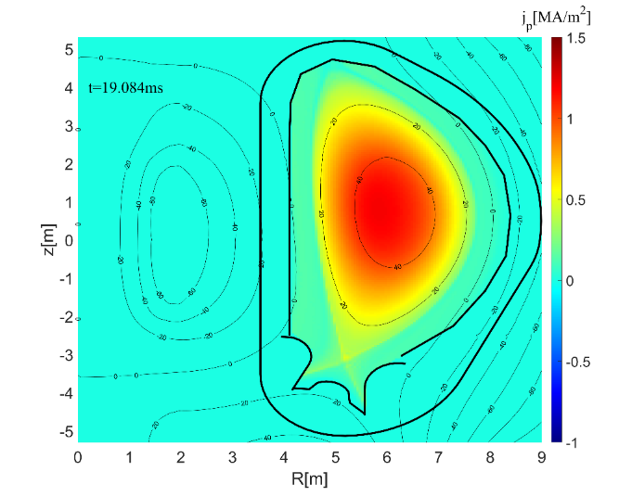
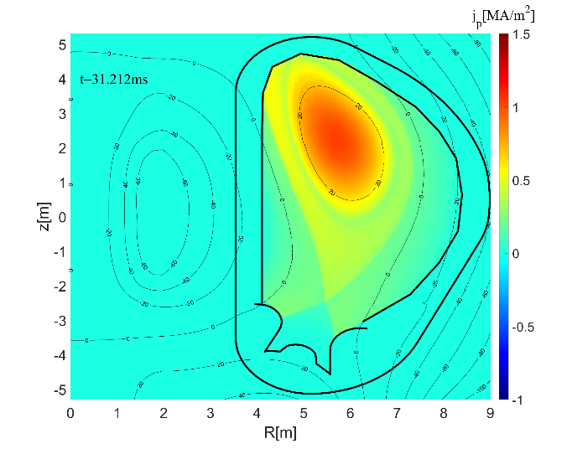
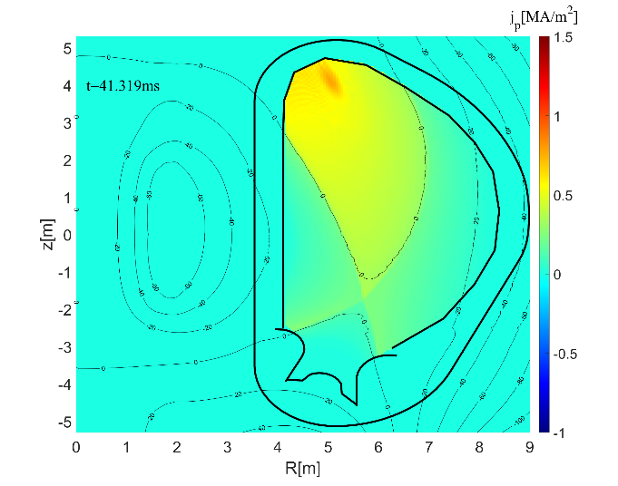
An example with δI_{coil}=20kA and κ||(T_{e}=50eV)
0.09ms
2.66ms
19.08ms
31.21ms
TQ1
TQ2
IMP
CQ
J profile flattens;
negative induced current on the edge
Radiative collapse
41.32ms

