Slide 1
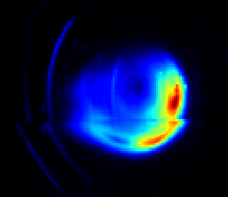
Benign termination of runaway electron beams at JET: Radiated power and bolometry during massive material injections
N. Schoonheere, C. Reux, H. Meister, P. Carvalho, I. Coffey, K. Lawson, P. Puglia, U. Sheikh, JET contributors, and the EUROfusion Tokamak Exploitation Team

Slide 2
Outline
The benign termination scheme
Spectroscopy study of mitigated runaway beams
Bolometry measurements after large gas injections
Conclusions and perspectives

Slide 3
Benign termination scenario
1
2
Argon injection to trigger a disruption and RE beam
D₂ (or H₂) injection with standard gas valve, MGI or SPI
Recombination of the companion plasma
Final collapse: Large MHD instability + absence of regeneration → benign termination Demonstrated on JET, TCV, DIII-D and AUG
4
3
Companion plasma
JPN 95135
Notes:
Show RE beam Ip
Explain companion plasma

Slide 4
Benign termination – Operational limits
Experimental observations:
Condition for benign termination:
Recombination of the companion plasma and stays recombined
Minimum amount of deuterium
Neutral D₂ provide heat transport to the walls
Maximum amount of argon or deuterium
Makes the companion plasma more resistive
Balance between runaway interaction with the companion plasma and energy loss mechanisms
The composition and power balance of the companion plasma matters!

Slide 5
Benign termination – radiated power
Ar trigger
D₂ injection
Before D₂:
Cold companion plasma ~12 eV [1]
After D₂ :
Recombined
We expect the radiated power to go down
But..
Several megawatts of radiated power measured
JPN 95135
[1] S.Sridhar, PhD thesis, 2020

Slide 6
Outline
The benign termination scheme
Spectroscopy study of mitigated runaway beams
Bolometry measurements after large gas injections
Conclusions and perspectives

Slide 7
JET diagnostics – spectrum coverage
Objective:
Find the origin of this radiated power
Lyman
γβ α
Balmer
γβ α
Observations after D₂ injection:
Bolometer
Visible
spectrometer
X
X
SXR
Gap
UV
spectrometer
Gap
X
X
?
SXR
UV diamond det.
Conclusions:
Some gaps remain but no obvious mechanism would explain the power in these ranges
Difference between the two UV detectors: Only the Lyman α
Notes:
Can be from diamond detector (with Lyman alpha, carrying most of the energy)

Slide 8
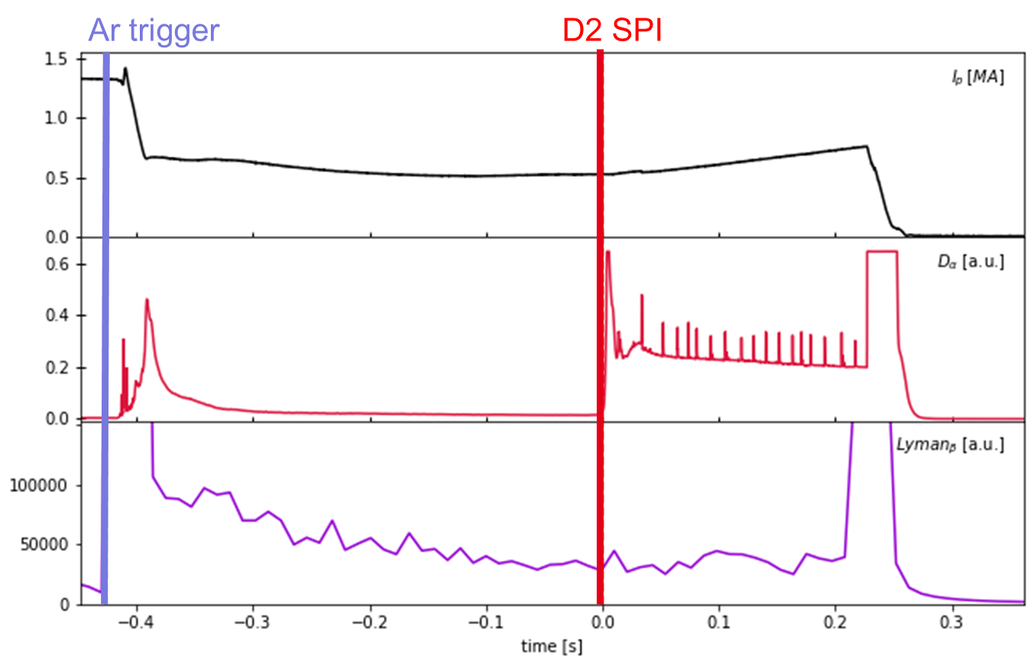
Opacity and the Lyman α
↑ Balmer α | Lyman β stay constant
both originate from n=3
These two lines should follow the same evolution
Balmer α (visible)
Lyman β (UV)
Strong opacity of the Lyman series from neutral D₂
Postulate to explain the diamond detector signal:
The Lyman α (carries most of the energy) is also absorbed by the neutral D but can only be re-emitted as a Lyman α and can eventually exit the neutral gas after a number of absorptions-emissions
Notes:
Lyman alpha carries the most energy

Slide 9
Estimate of the D radiated power
Total radiated power for all D lines
Neutral density $ρ_{D_{2}}$inside RE beam estimated with the power balance:
$P_{E−field}\left(E_{\text{∥}}\right)=P_{collisions, ESTAR}\left(ρ_{Ar},ρ_{D_{2}}\right)+P_{synchrotron}$
D cooling rates from the ADAS database
Electron density = 10¹⁸ m⁻³ (measurement floor)
Temperature for recombined D₂ ~ 1eV [1]
Conclusions
D thermal radiation power is negligible at these temperatures
But doesn’t rule out non thermal radiation from RE interactions
[1] E. Hollmann et al, POP (2020)
Notes:
Electron density: interferometer floor

Slide 10
Outline
The benign termination scheme
Spectroscopy study of mitigated runaway beams
Bolometry measurements after large gas injections
Conclusions and perspectives

Slide 11
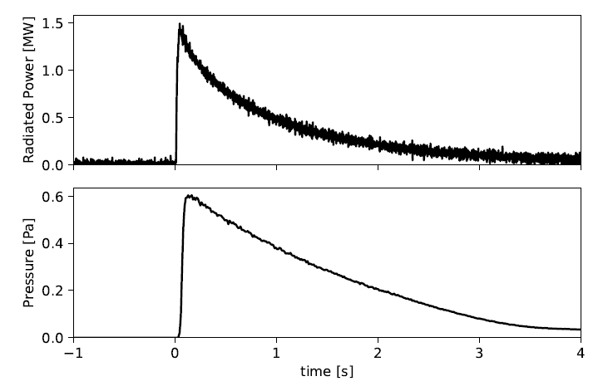
Radiated power measured in empty vessel
Massive D₂ gas injection (MGI) into the empty vacuum vessel
Radiated power [MW]
No plasma
No radiation expected
Signal interpreted as several megawatts of radiated power
Correlated with neutral pressure
Pressure [Pa]

Slide 12
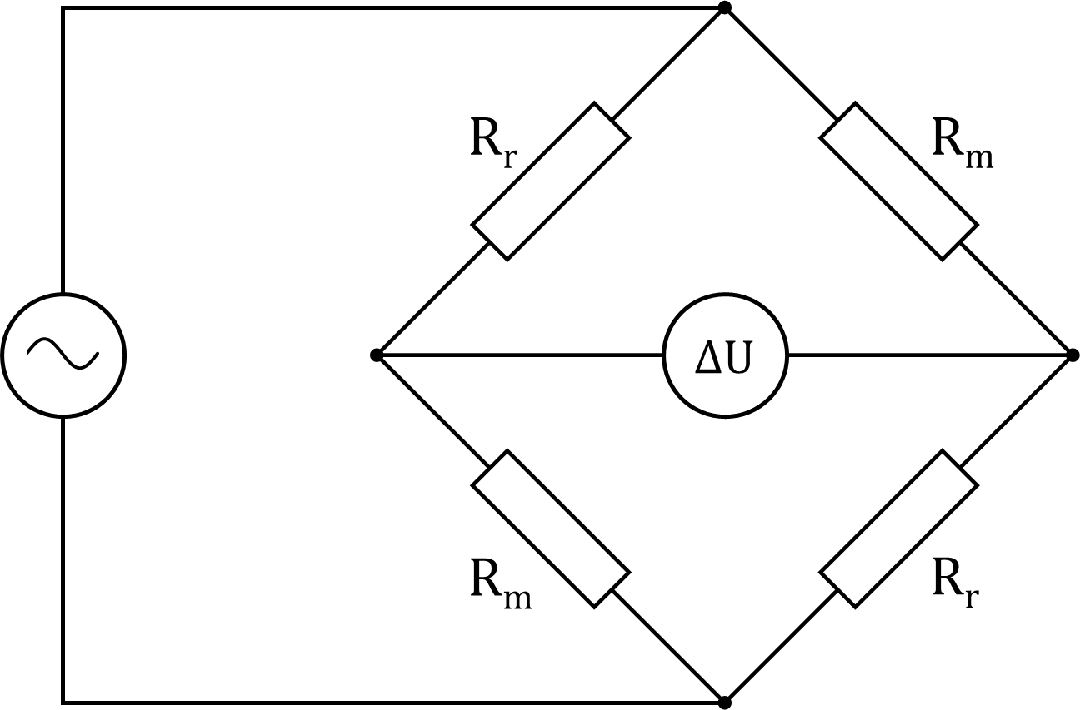
Resistive bolometers
Radiation incident on measurement absorber.
The temperature difference between measurement and reference sensor shielded from radiation is measured with thermistors in a Wheatstone bridge
Measured voltage ∆U interpreted as radiated power
$$P\left(t\right)= \frac{τ_{c}}{S}\left(\frac{d∆U\left(t\right)}{dt}+\frac{∆U\left(t\right)}{τ_{c}} \right)$$
Calibrated constants:
$τ_{c}$ : cooling time [ ms ]
$S$: Sensitivity [ V/W ]

Slide 13
Effect of neutral gas pressure
Conduction through the gas affects the thermal dynamics of the bolometer sensors
Thermal conductivity model (developed with the help of H. Meister [1])
Power balance of the sensor :
$$CV \frac{dT}{dt}=P − \frac{dQ_{tc}}{dt}− \frac{dQ_{gas}}{dt}$$
Different geometry → different cooling efficiency
Long conduction length
Short conduction length
[1] H.Meister et al, submitted to RSI (2024)

Slide 14
Cooling times
Nominal pressures
Pressures after injection
$$P\left(t\right)= \frac{τ_{c}}{S}\left(\frac{d∆U\left(t\right)}{dt}+\frac{∆U\left(t\right)}{τ_{c}} \right)$$
Difference in cooling times between the measurement and reference sensors
The changing cooling time affects the calculated incident radiated power
But doesn’t explain the measured power in the absence of radiation
$$τ_{c}$$

Slide 15
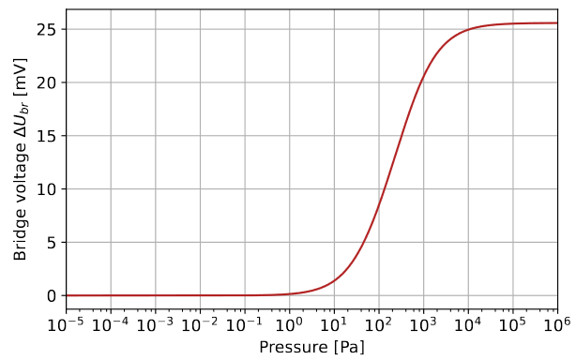
Equilibrium temperatures
Joule heating power from the excitation voltage of the Wheatstone bridge (40 V P2P)
$$CV \frac{dT}{dt}=P − \frac{dQ_{tc}}{dt}− \frac{dQ_{gas}}{dt}$$
$$P=P_{incident}+ P_{Ohm}$$
Different equilibrium temperature
Measured voltage = measured radiated power
Nominal pressures
Pressures after injection
Nominal pressures
Pressures after injection
$$∆U$$
Temperature [°c]

Slide 16
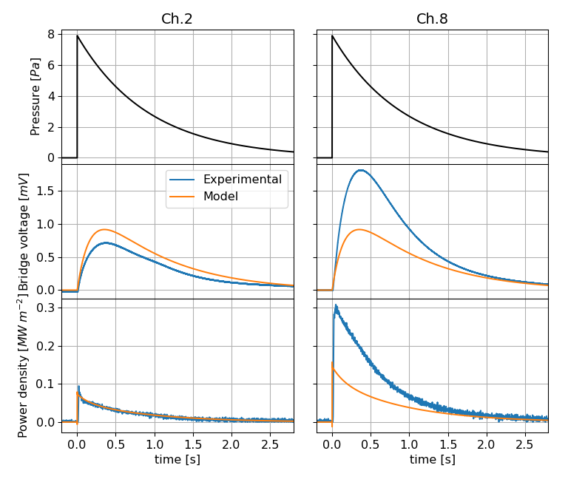
Modelled channel power
Pressure [Pa]
A bridge imbalance and measured voltage arises following the increase in neutral pressure
The « incident power » on the sensor is calculated with the code used to process bolometry measurements
Good quantitative agreement with some channels, qualitative for others
Voltage [mV]
Radiated power [MW m⁻²]

Slide 17
Total radiated power
We assume that all channels experience the same modelled voltage dependence
Total radiated power calculated from all channels using the algorithm used on JET real data (weighted sum of all channels)
Good reproduction of the time evolution

Slide 18
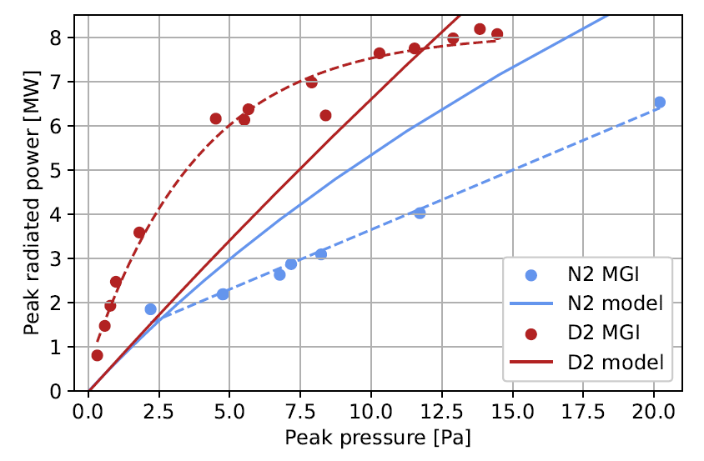
Total radiated power peak
The model captures the difference between D₂ and N₂ ,due to their respective cooling efficiencies, but to a lesser degree
The saturation effect at higher pressure for D₂ is not reproduced
Within the same order of magnitude as the measured radiated power

Slide 19
Outline
The benign termination scheme
Spectroscopy study of mitigated runaway beams
Bolometry measurements after large gas injections
Conclusions and perspectives

Slide 20
Conclusions and perspectives
The rise in radiated power cannot be due to thermal radiation
Unlikely to be due to UV deuterium lines due to strong opacity
Spurious radiated power at neutral pressures > 0.1 Pa up to several megawatts!
Represents the majority of the signal in runaway electron mitigation experiments
The magnitude of the effect depends on the gas species due to their individual cooling efficiencies
The change in calibrated constants can affect the calculated incident radiated power
Radiated power increase also for SPI in empty vessel
Radiation asymmetries: Vertical and horizontal bolometer cameras are affected differently

Slide 21
D₂ injection into RE beam
D₂ massive gas injection @ 48.044s
Reionisation event @ 48.125s
Notes:
We see an increase in the radiated power
Crashes on the limiter
No hotspots visible

Slide 22
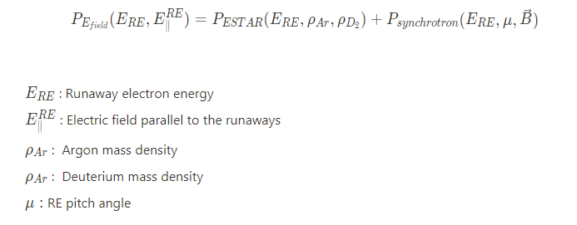
Backup : Power balance
Objective:
Estimate the radiated power emitted by D line radiation inside a RE beam using Photo emissivity coefficients (PEC)
But the D2 density inside the RE beam is unknown
Equating the power gain to the REs accelerated by the electric field to the power loss through collisions, Bremsstrahlung tabulated in the ESTAR database and synchrotron radiation
ESTAR:
Collision stopping power
Radiative stopping power: Bremsstrahlung
Assumptions:
Homogeneous neutral density inside RE beam
Mono-energetic RE population at 10 MeV
Ar : D2 ratio equal to ratio of initial quantities injected
No RE losses to the wall
Solve for deuterium density

Slide 23
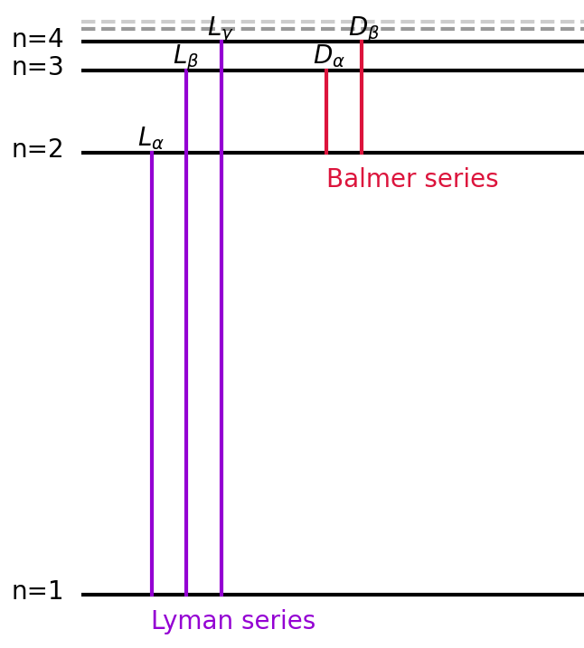
Backup : Deuterium

Slide 24
Backup: Lyman alpha
The suspicion was that the Lyman alpha could be absorbed by the neutral deuterium but could escape as it can only be re-emitted as a Lyman alpha.
However, a spectroscopy measurement available for a single pulse shows the Lyman alpha decreasing
Not responsible for the radiated power
No conclusion for the signal increase of the diamond UV detector

Slide 25
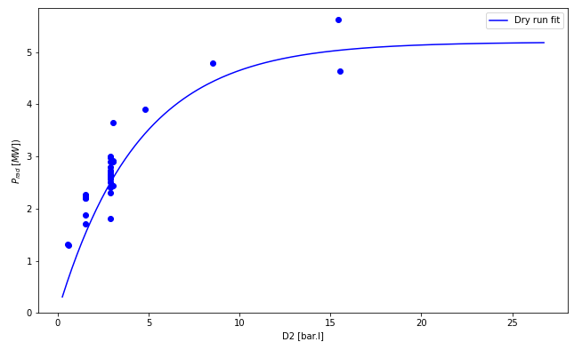
Backup : Comparing dry runs and real pulses
RE pulses:
The dependence on the amount of deuterium injected in dry runs matches what we observe in runway beams.
The magnitude is also comparable.
Some radiation appears to remain in real pulses
We want to be able to recover the “real” radiated power
High Ar content
Mean radiated power measured 0.17s after SPI / MGI arrival.

Slide 26
Backup : Neutral pressure dependence
D₂ MGIs into the empty vacuum vessel with cryopumps on and off
Cryopumps are responsible for the majority of the pumping on JET
When turned off, the “radiated power” takes a longer time to decrease
The bolometer response follows the neutral gas pressure evolution

Slide 27
Backup: Injection location

Slide 28
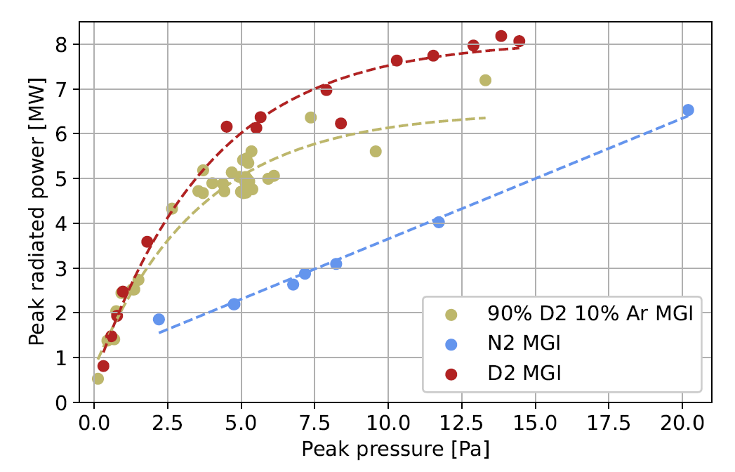
Backup : Peak radiated power after MGI
Peak “radiated power” dependence on peak neutral pressure reached after massive gas injection (MGI)
Spurious radiated power measured at neutral pressures > 0.1 Pa
Dependent on:
Quantity of gas injected
Gas species

Slide 29
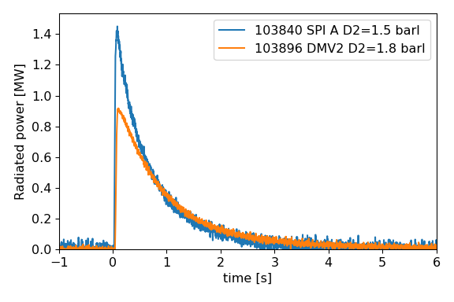
SPI into dry runs

Slide 30
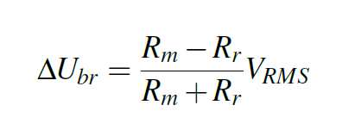
Backup : bridge voltage
V_{RMS} = 14.14 V

Slide 31
Backup: bolometer equations

Slide 32
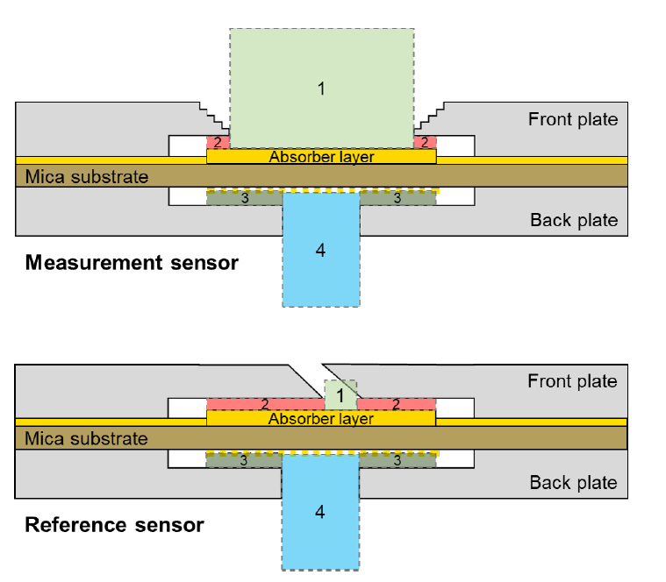
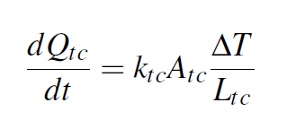
Backup : Model equations
Conductivity through solids:
Conductivity through gas:

Slide 33
Backup : cooling time constant

Slide 34
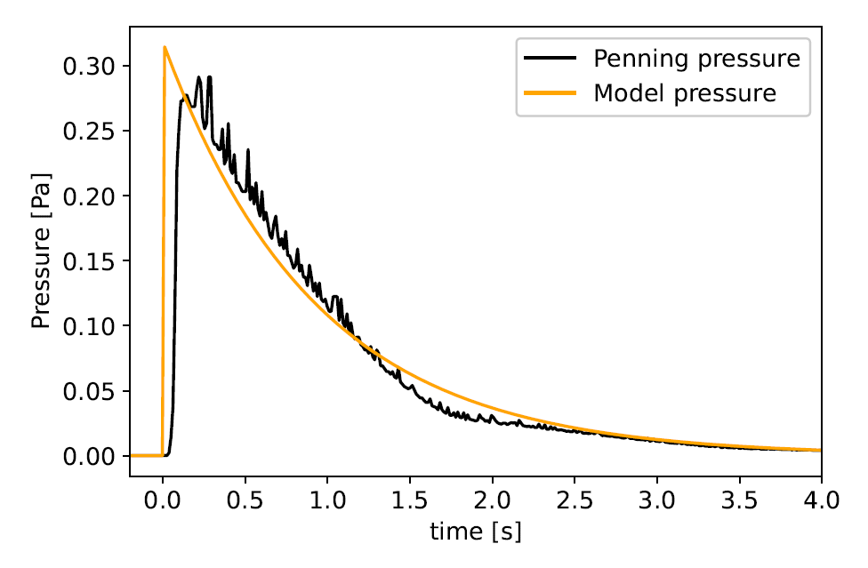
Backup : Pressure estimate
Saturation of the Penning gauges on JET at high pressures (> 1 Pa)
Dependent on gas species measured
Pumping model:
$\frac{ⅆP}{ⅆt}=\frac{1}{V}\left(F_{R}−s P\right)$
F_{R} : Flow rate (injection) = 0 Pa m³ s⁻¹
s : Pumping rate (D₂) [1] = 200 m³ s⁻¹
V : Vessel volume = 185 m³
Instantaneous gas dispersion
Isothermal expansion
Neutral pressure after MGI
A fairly good match is obtained with penning gauges measurements
[1] W. Obert, Proceedings of 16th International Symposium on Fusion Engineering, 1995

Slide 35
Backup : Modelled channel power
Pressure [Pa]
A bridge imbalance and measured voltage arises following the increase in neutral pressure
The « incident power » on the sensor is calculated with the code used to process bolometry measurements
Good quantitative agreement with some channels, qualitative for others
Voltage [mV]
Radiated power [MW m⁻²]

Slide 36
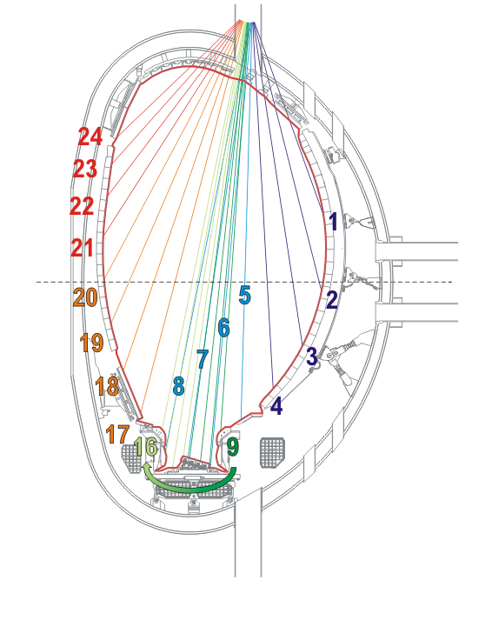
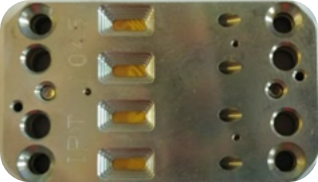
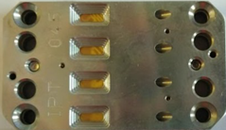
Backup : Channel responses
Normalised peak voltage measured across channels D₂ pulses:
Bolometer camera:
Lines of sight - vertical bolometer camera
Bolometer head 4 channels
Large discrepancies between channels
Adjacent channels can have very different responses: Not just caused by gas propagation effects
Depends on the channel’s individual characteristics

Slide 37
Backup : Why do we see such large variations?
The cooling time constants$τ_{c}$of each channel is determined (in vacuum) by thermal conductivity of the:
Thermal contact layer
Mica substrate
Variations in thermal conductivity arise due to manufacturing tolerances and ageing of the materials
Calibrated cooling times: 123 – 252 ms !
These can also vary between the measurement and reference absorber
The temperature coefficient of resistivity can also vary between each resistor
Difficult to model exactly without experimental measurements!

Slide 38
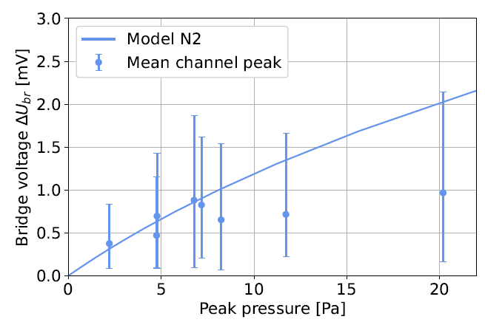
Backup : Peak channel voltage
Average peak voltage reached after MGI
Error bars show the minimum and maximum voltage across all channels
Modelled voltage within the same order of magnitude as the experimental results
But very large error bars, particularly at high pressures!

Slide 39
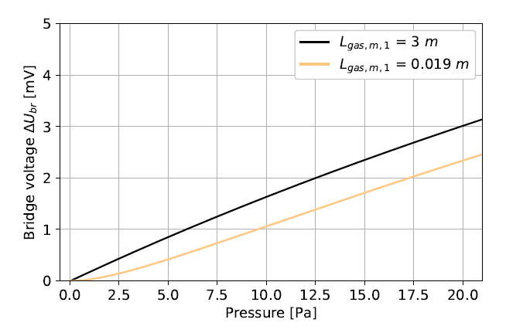
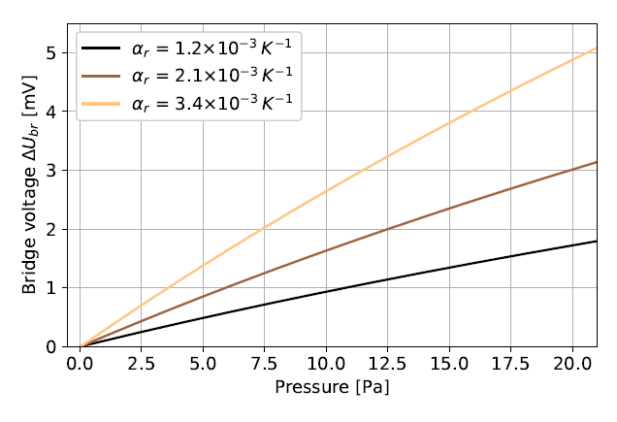
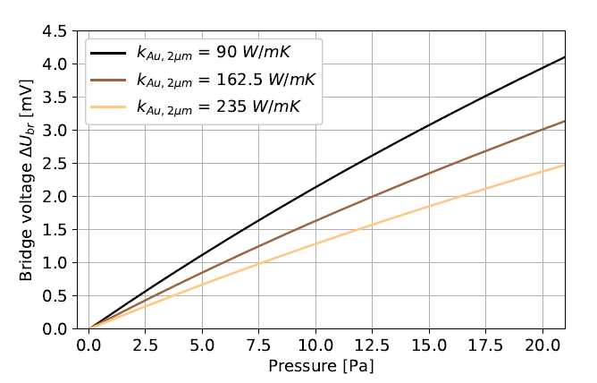
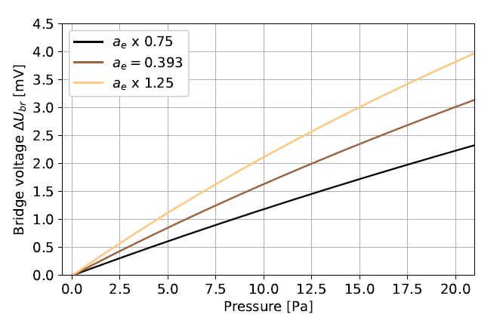
Backup: parameter study

