Slide 1
MHD simulations of runaway electron avalanche in ITER mitigated disruptions
Chizhou WANG
Jonathan GRAVES
Mengdi KONG
Javier ARTOLA
Eric NARDON

Slide 2
Runaway electron deconfinement in current quench
MHD stability during the current quench under different current profiles
Evaluation of runaway electron risk in two current quench simulations
Conclusions and outlook

Slide 3
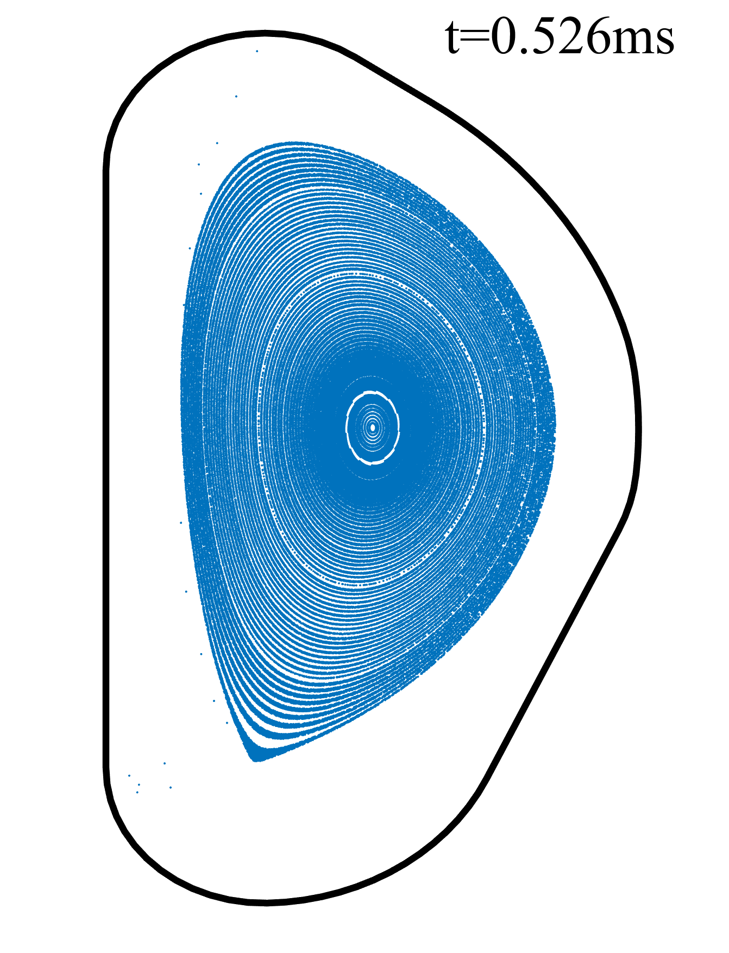
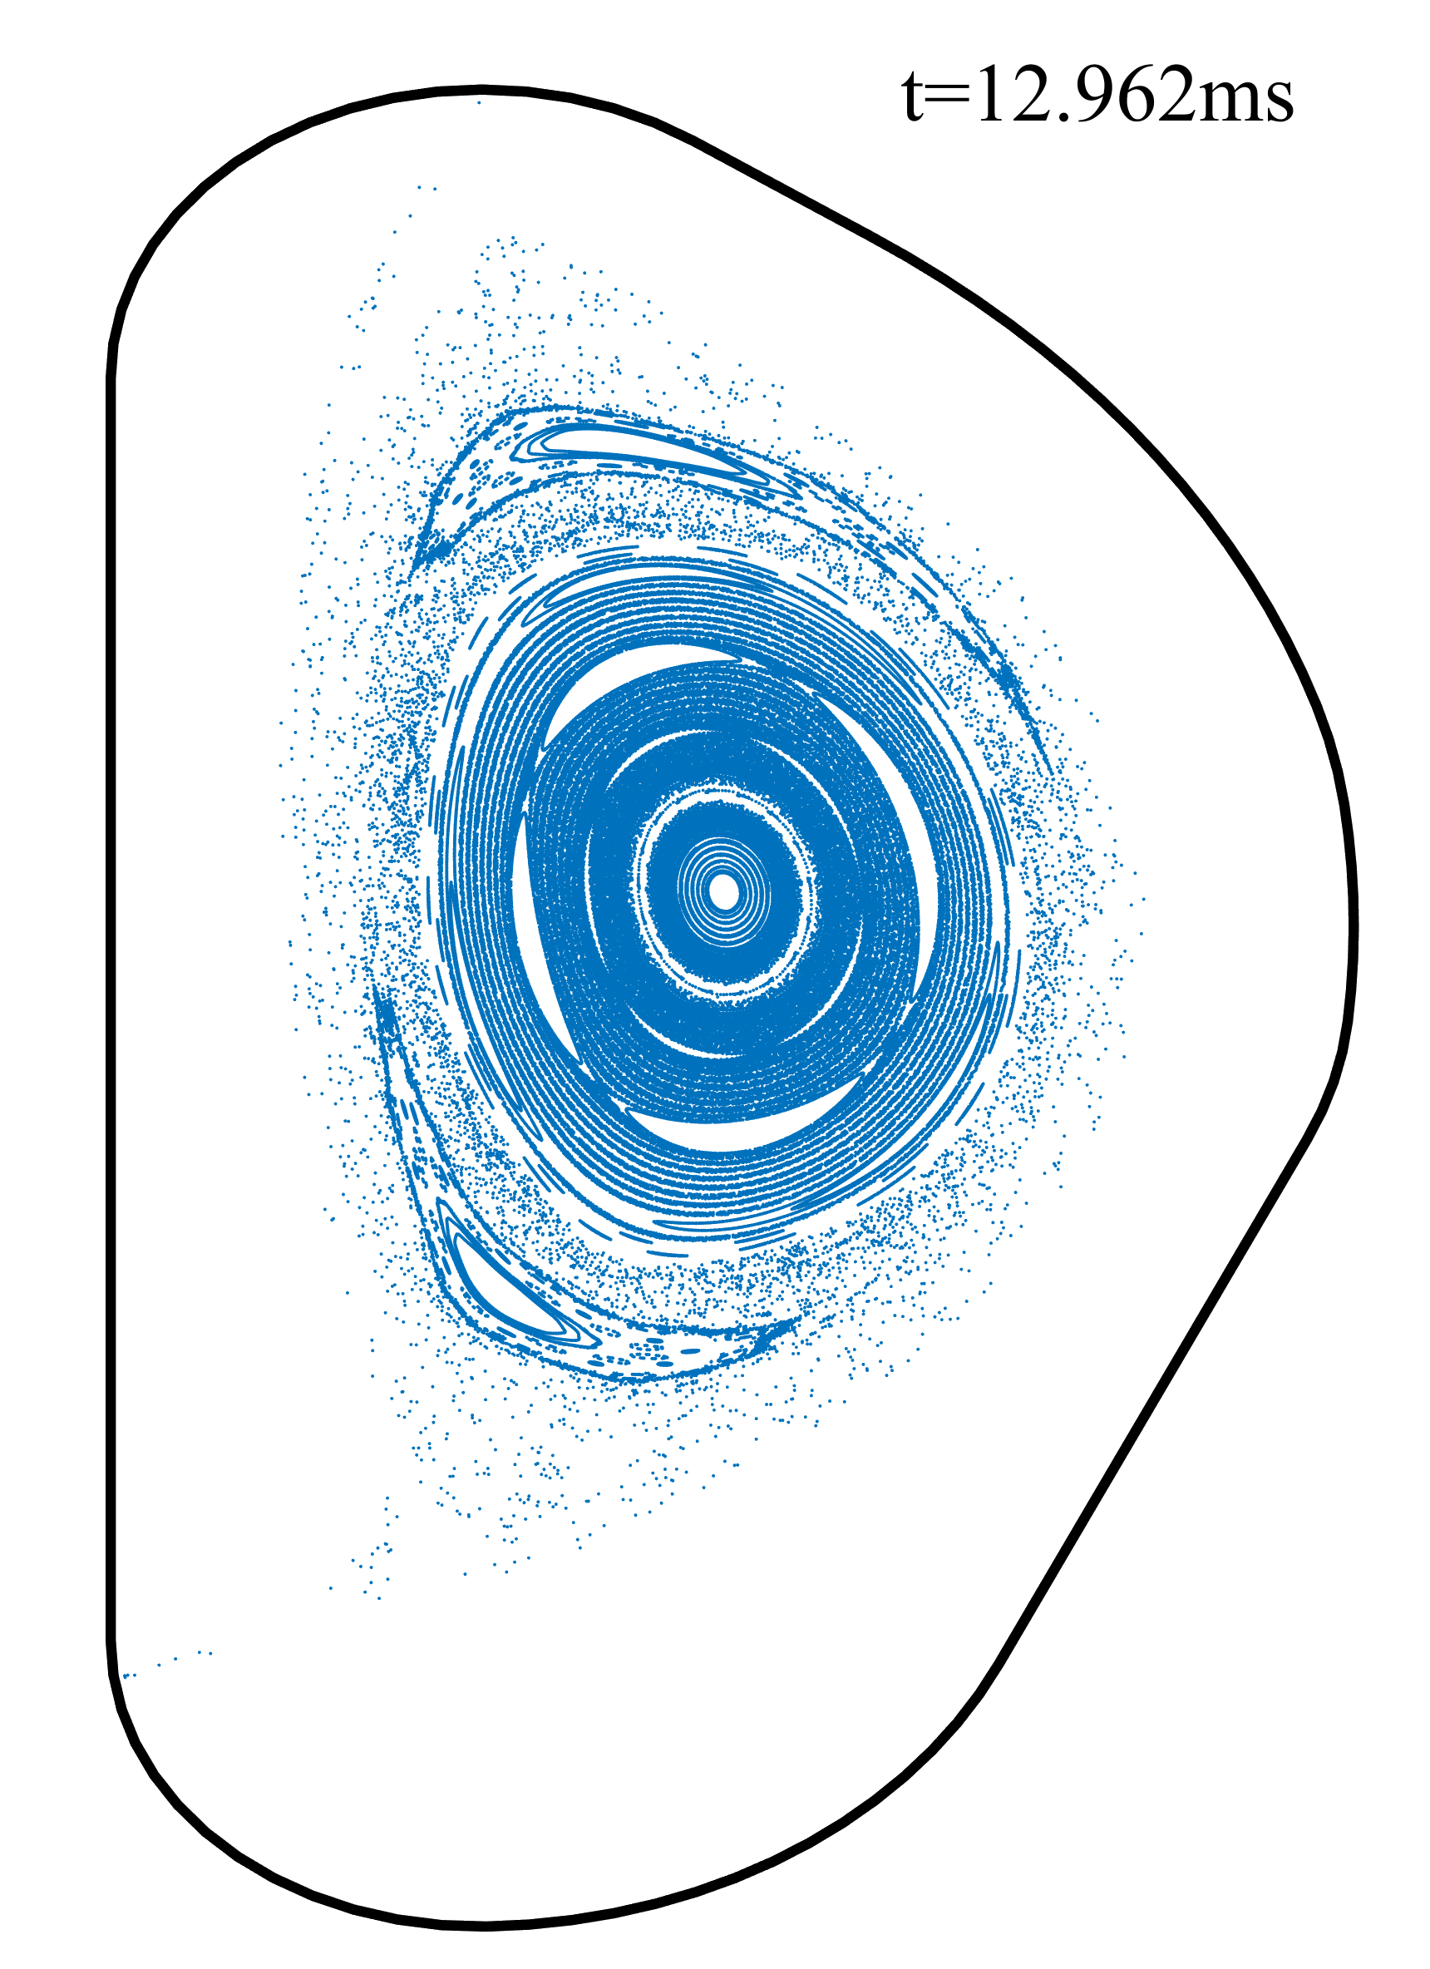
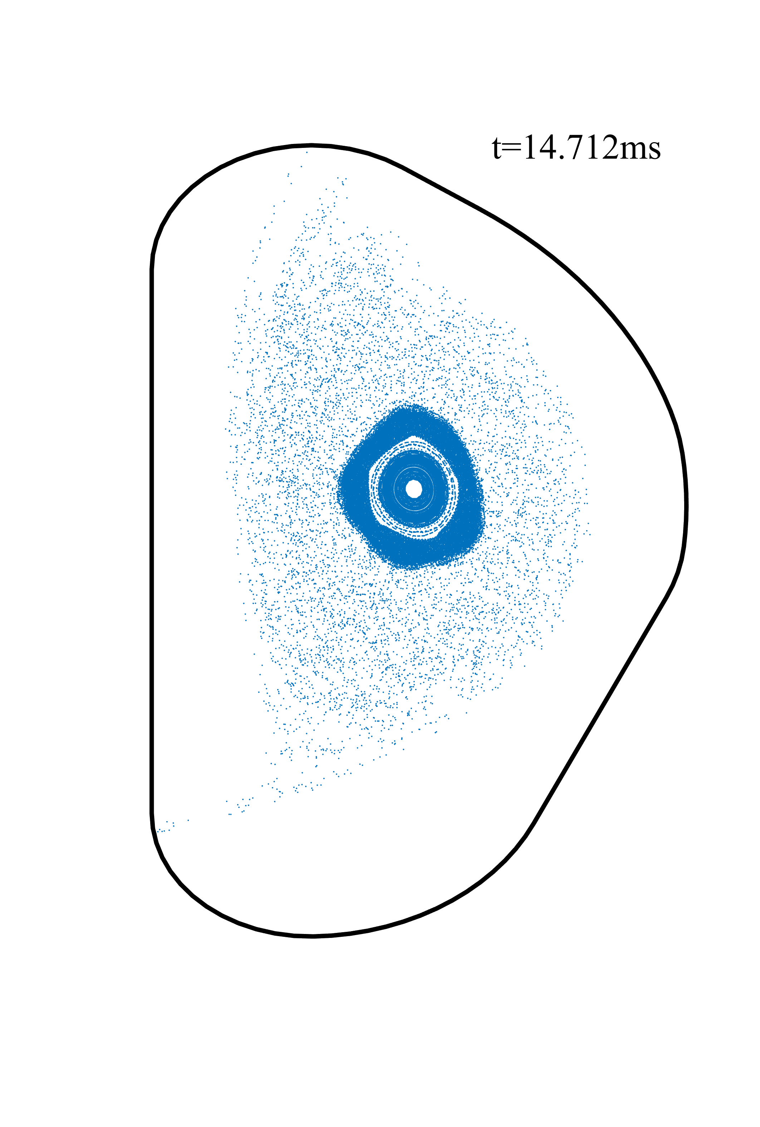
MHD instability in disruptions
[Growth rate goes up with resistivity]
During RE avalanche…
Some flux surfaces (FS) have recovered after thermal quench (TQ).
MHD instabilities (tearing/kink modes) might grow again in cold (~10 eV) plasma [1].
Overlapping modes lead to magnetic stochasticity. RE loss rate increases in stochastic field.
If RE avalanche is terminated by strong loss when I_{RE} is still small, damage from a large RE beam can be prevented.[2]
[1] F.J. Artola, et al. NF 2022.
[2] L. Carbajal, et al. PP 2020.

Slide 4
MHD instability in disruptions
Topic of this project: could the RE loss from MHD instabilities prevent the formation of a large I_{RE}(>150kA) in ITER disruptions from I_{p}=15 MA?
Problems:
Post-TQ plasma scenario is unknown.
3D simulation of entire CQ (~100ms) is expensive.
We investigate 2 scenarios:
Worst-case scenario where MHD activities are relatively mild. High RE risk.
MHD modes’ stability is decided by global j profile, while their growth rates are related to local j gradient.
Scan over j profile on simplified JOREK simulations for stable cases.
A relatively realistic post-TQ plasma scenario.

Slide 5
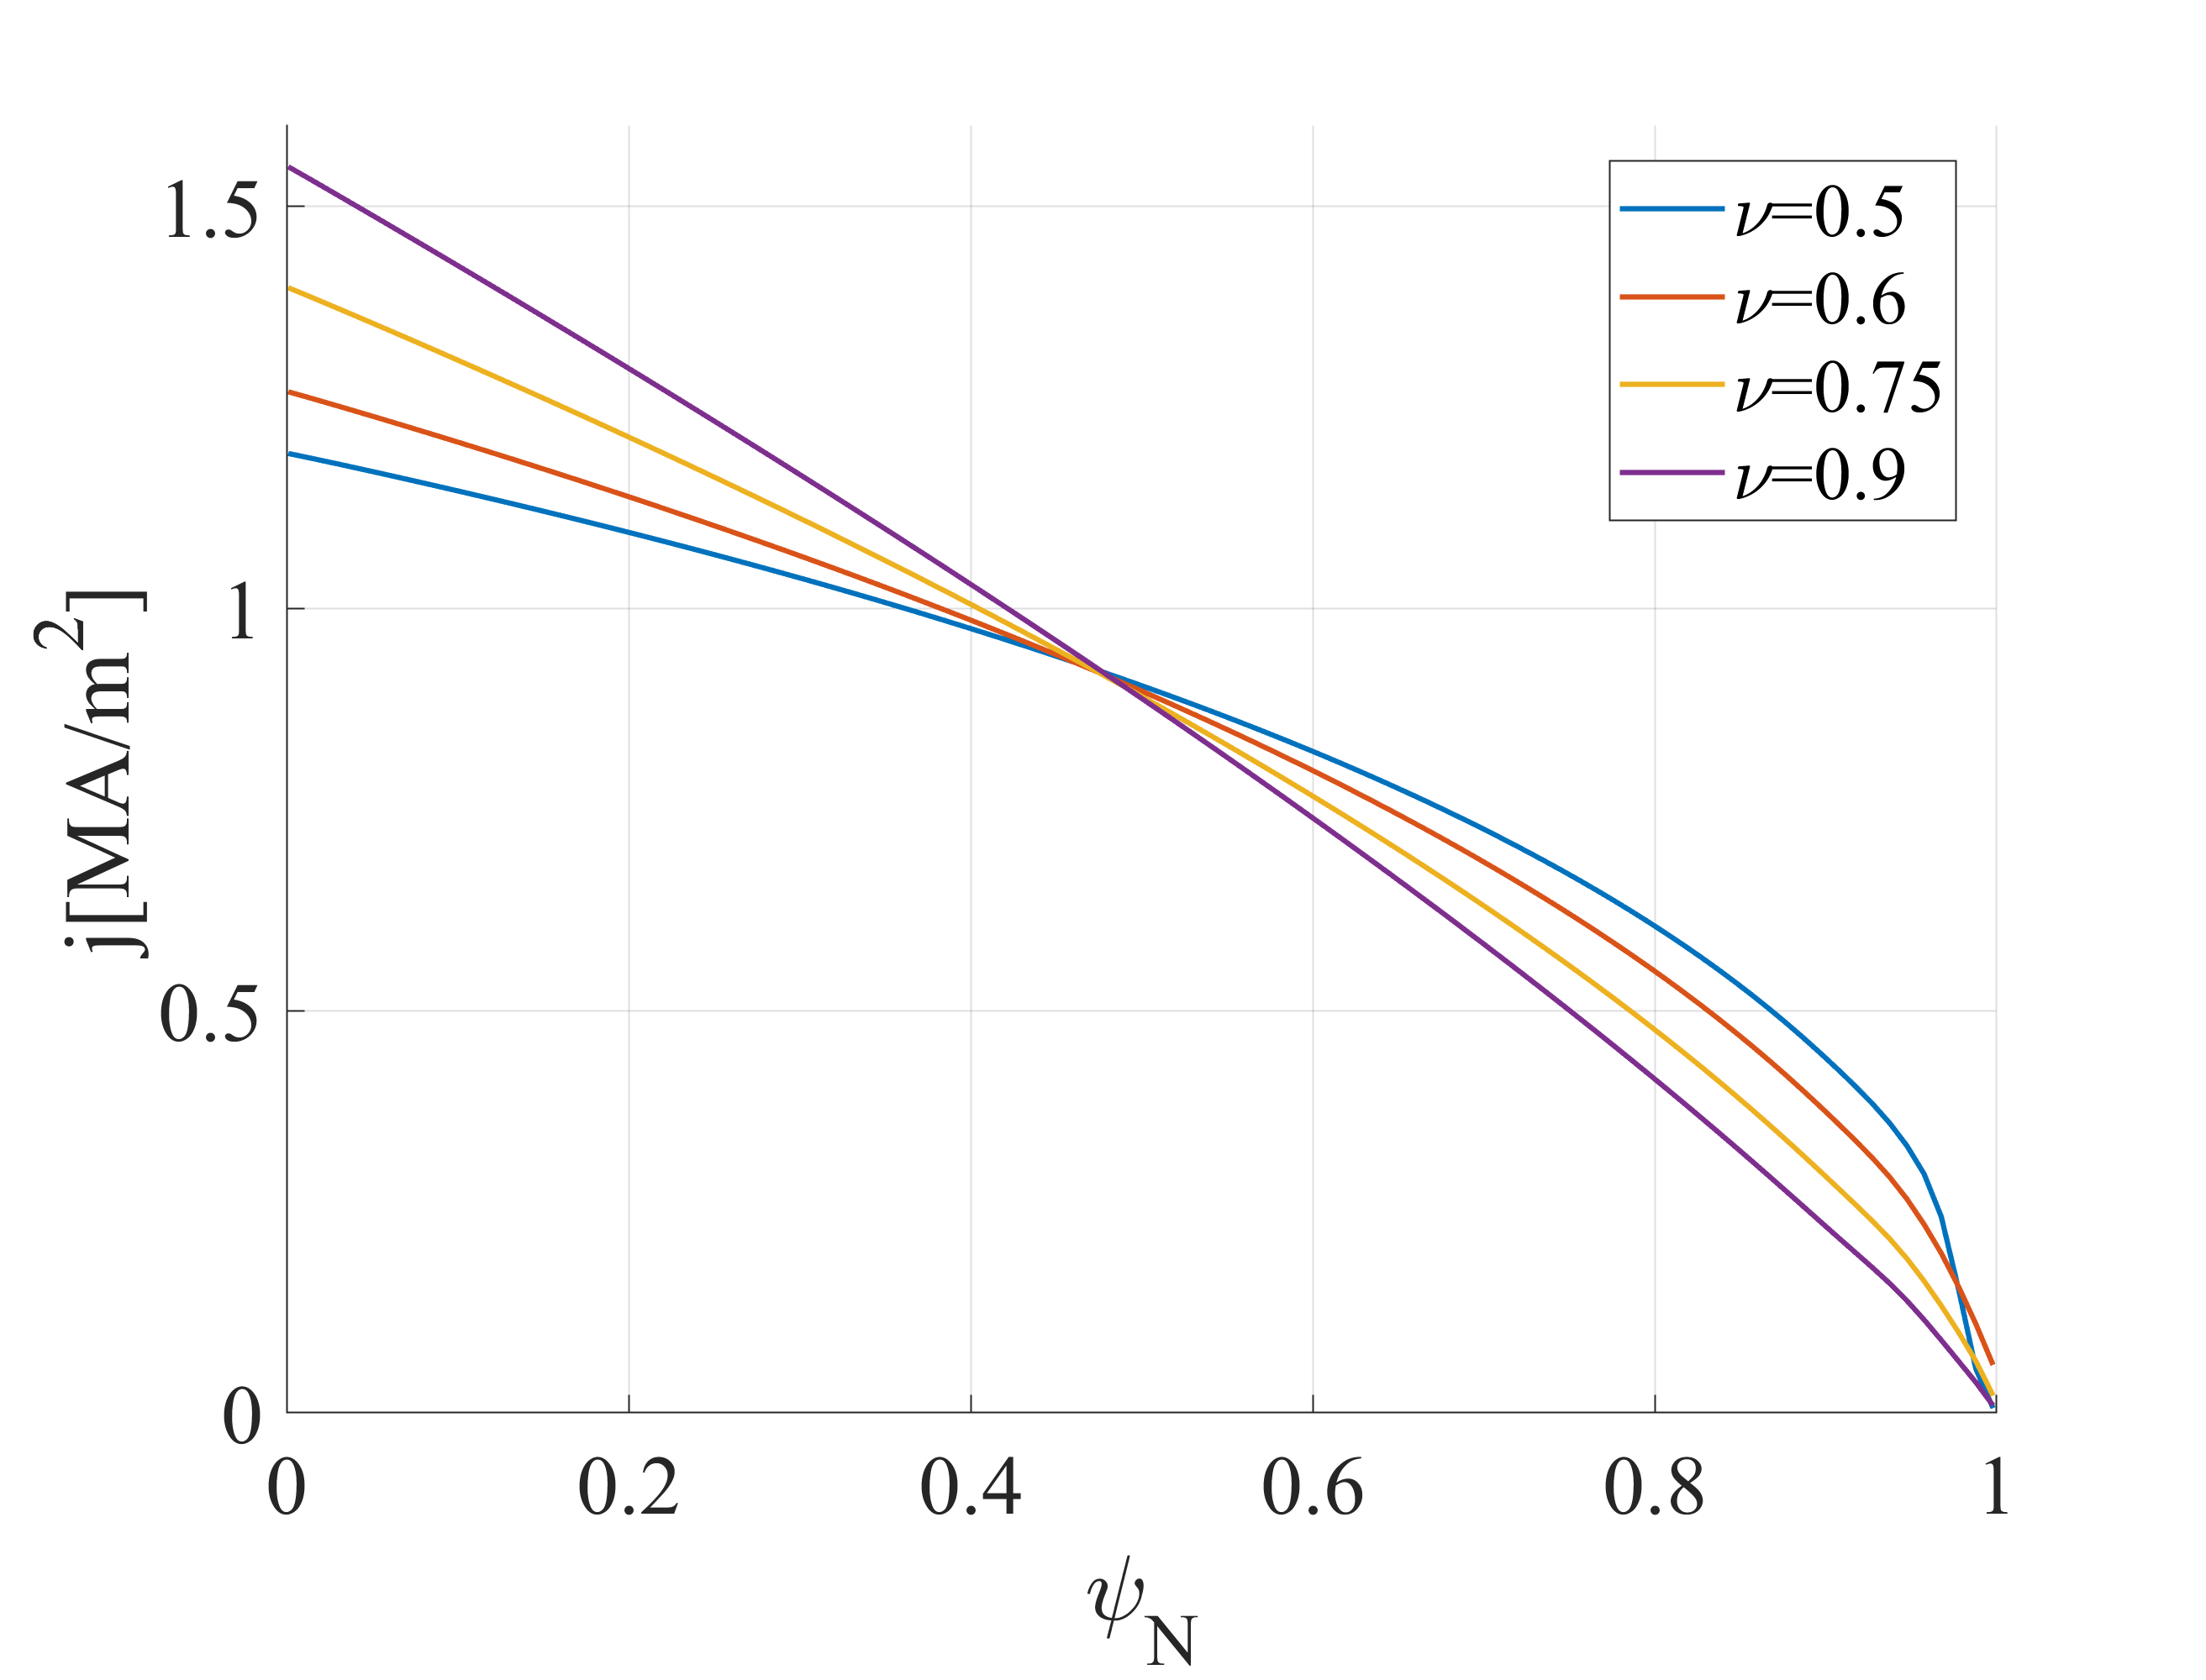
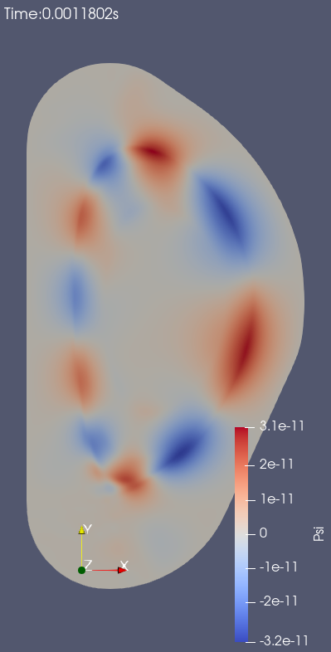
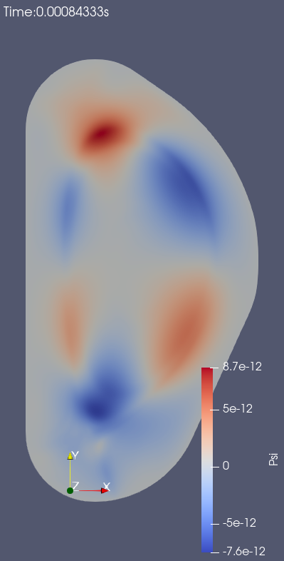
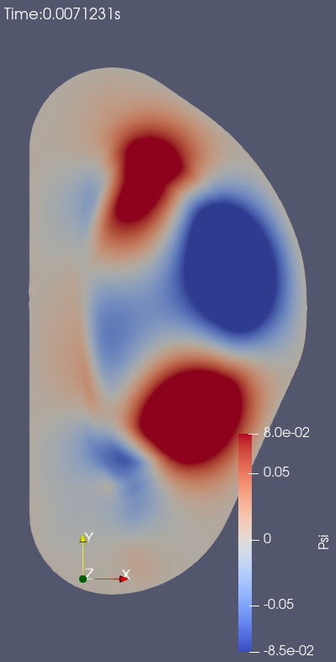
Growth of instabilities
Flat core j profile
j~0 outside LCFS
Steep j gradient on edge
Strong current drive on
edge rational surfaces
3/1 mode grows and widens
$$j=j_{0}{(1−{(r/a)}^{2})}^{ν}$$
From Wesson [3]
Edge modes widen, perturbate inner rational surfaces
n=2 plot, t=1.18ms
n=1 plot, t=0.84ms
n=1 plot, t=7.12ms
1) 5/2 and 3/1 modes driven on edge
2) 2/1 triggered by growing 3/1
[3] J. Wesson, D. J. Campbell. Tokamaks.

Slide 6
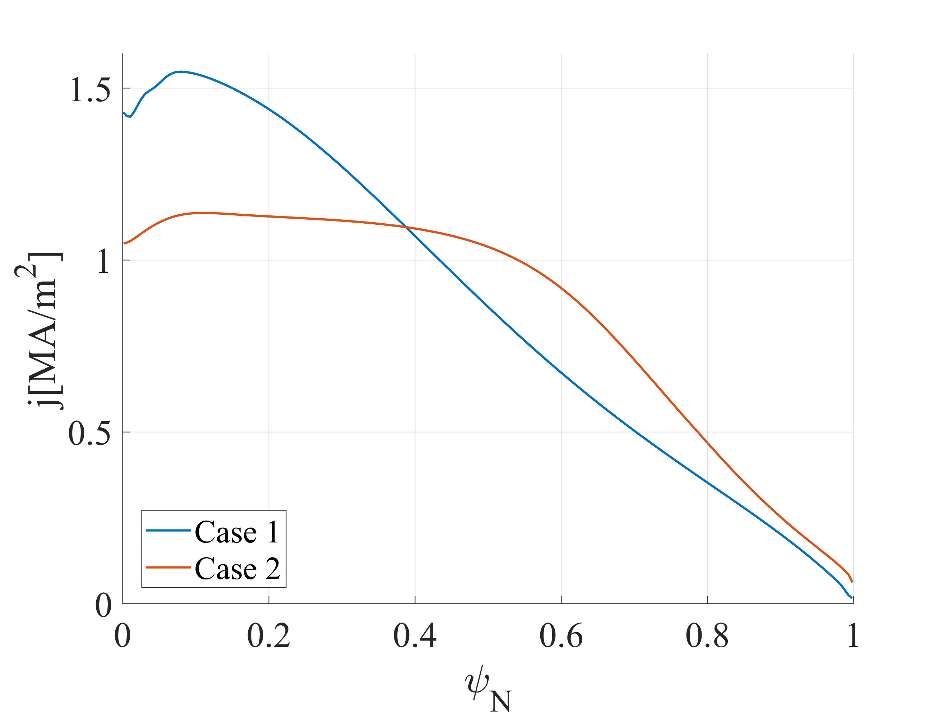
More detailed CQ simulations using 2 j profile examples
2 initial j profiles (more realistic than Wesson’s) based on previous scan:
Case 1: peaked, $ν=1$like, used as worst-case scenario
Case 2: flat, used as a more realistic reference
Simulation setup on JOREK code:
5 toroidal harmonics n=1-5, initial mode energies ~10⁻¹⁰E_{n=0} (<~ post-TQ reality)
Free-boundary conditions via JOREK-STARWALL coupling
Impurity radiation (P_{rad}) and Ohmic heating (P_{ohm}) added; Temperature from self-evolution
n_{e}=3.9*10²⁰ m⁻³, n_{Neon}= 6.1*10¹⁸ m⁻³, homogeneous.
RE fluid model:
Artificial I_{seed} = 10 mA at t=0
The only source: avalanche

Slide 7
RE fluid parallel transport
Most realistic: advection, $v_{||}=c$, typical loss time $τ_{RE,adv}\sim L/c$ (L: connection length to the wall)
Very small $dt$ (increase with stochasticity, eventually <0.005 jorek unit (JU)) is required. Unfeasible.
Simplified model: parallel diffusion, $D_{RE,||}$, typical loss time $τ_{RE,dif}\sim L^{2}/D_{RE,||}$
To simulation realistic RE loss with parallel diffusion, $D_{RE,||}\sim L∗c$
$D_{RE,||}$ ~ ${10}^{7}{ m}^{2}/s$ in open field lines (L~0.1 m)
$D_{RE,||}>{10}^{10}{ m}^{2}/s$ in stochastic field (L~100 - 10000 m), $dt<0.01$ required.
Compromise: instead of $τ_{RE,dif}{\sim τ}_{RE,adv}$, ensure that RE is lost fast enough
Realistic RE-MHD interaction: $τ_{RE,dif}≪τ_{res}\sim 0.1 ms$; unnecessary if $j_{RE}{≪j}_{p}$
Similar j_{RE} evolution to advection: $τ_{RE,dif}≪1/γ_{avalanche}\sim 10 ms$ on open or stochastic field lines - $D_{RE,||}≥{10}^{9}{ m}^{2}/s$ in stochasticity ($dt<0.1$), still a heavy computation load for ~10 ms simulations

Slide 8
RE fluid parallel transport
First stage simulations: $D_{RE,||}$=${1.54×10}^{6}{ m}^{2}/s$ to study RE population semi-quantitatively
$j_{RE}{≪j}_{p}$ is valid when I_{RE}<150 kA. REs’ feedback to MHD is negligible.
n_{RE} in stochastic region may be over-estimated (under-estimated loss).
n_{RE} in closed FSs (loss is negligible) could be well estimated.
Realistic RE transport in stochastic field is investigated by tracing particles ($τ_{loss}\sim L/c$)
Potential results:
I_{RE}<150kA when field lines become completely stochastic. All REs are lost under a safe I_{RE.}
I_{RE} reaches MA level with most of it in closed FSs (L$→∞$). High RE risk exists.
Intermediate case: more precise RE transport model is needed.

Slide 9
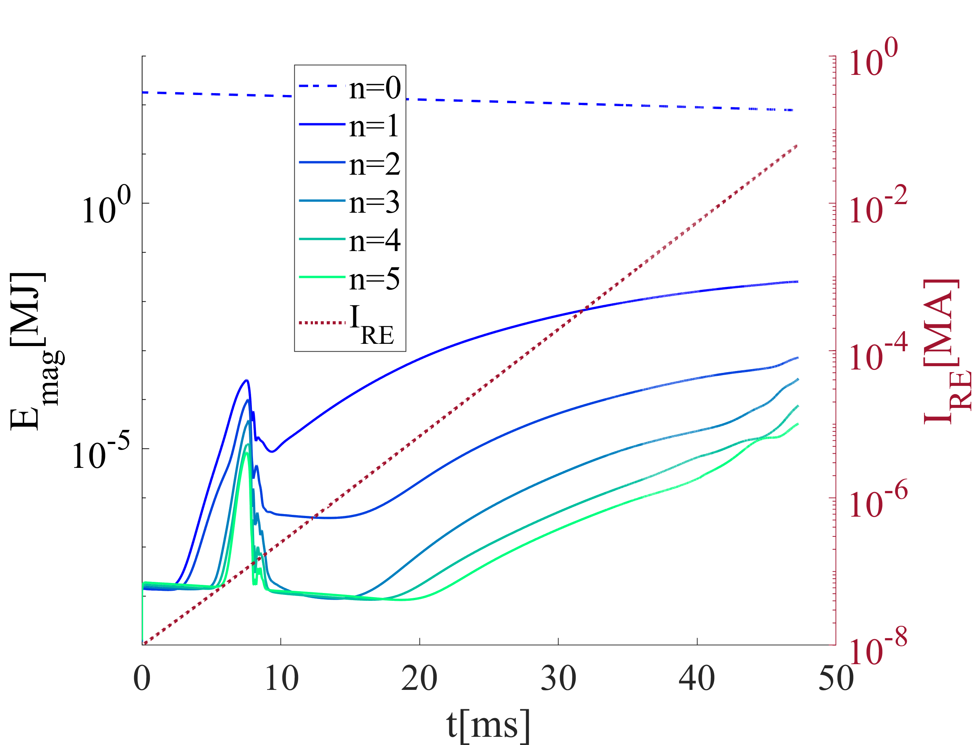
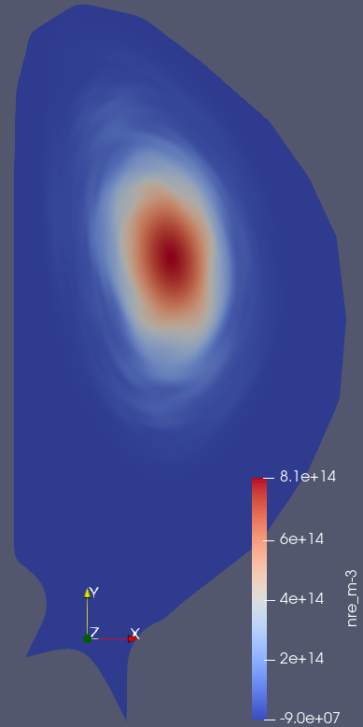
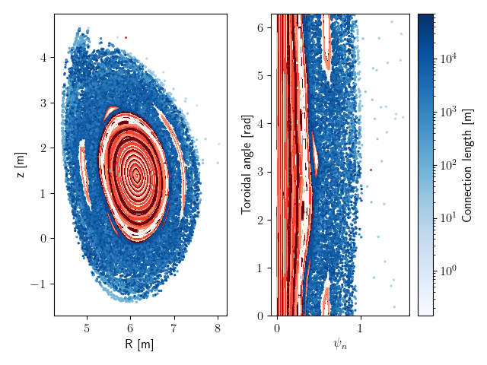
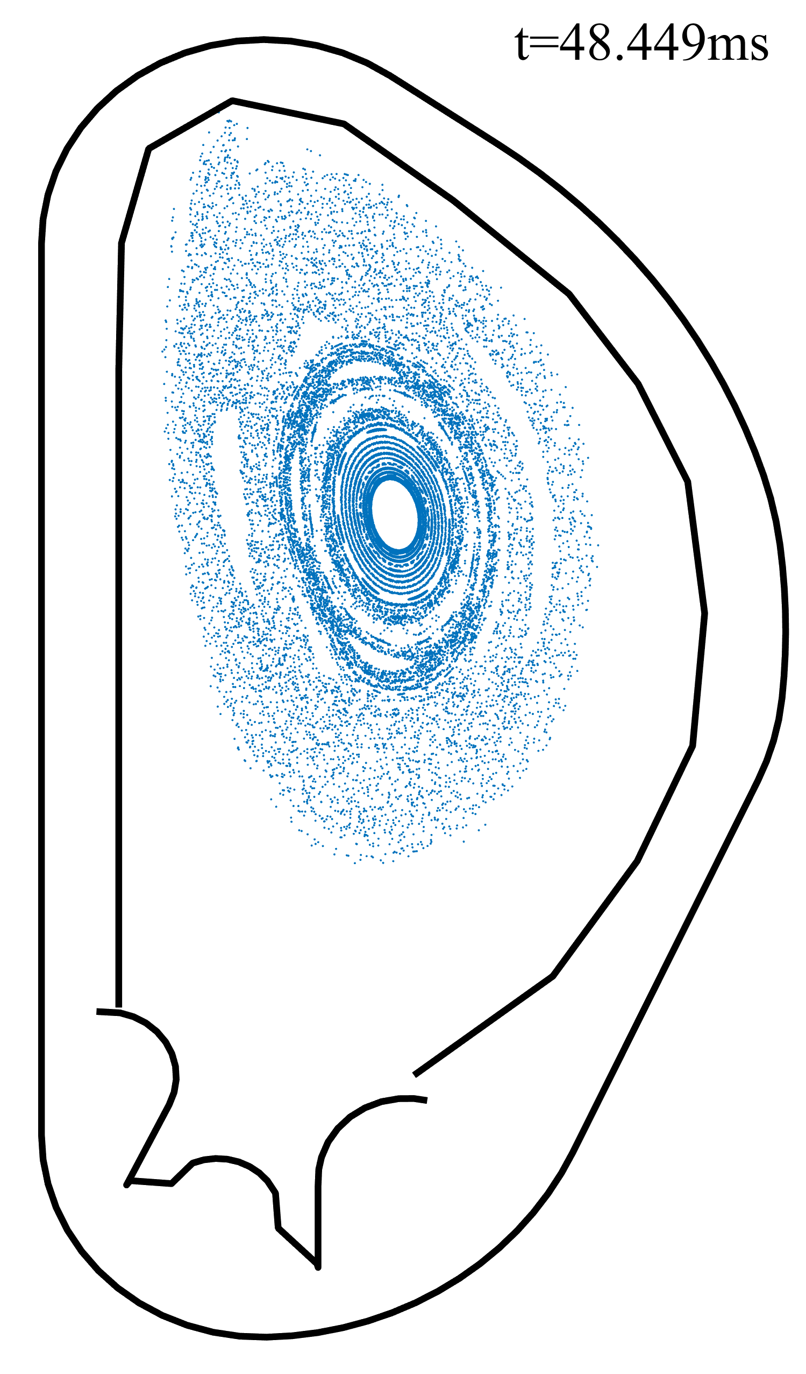
More detailed CQ simulations: Case 1
t=48.5ms
t=48.5ms
particle tracing: 10 MeV REs, 0.99 pitch
E_{mag} grows slowly after 1/1 kink mode decays. Core region is well confined after 48 ms.
I_{RE}~100kA, I_{p} = 10 MA by t=49 ms.
Underestimated stochasticity transport is not a problem with most REs in confined region.
I_{RE} is expected to saturate in another 10 ms if core FSs stay closed.

Slide 10
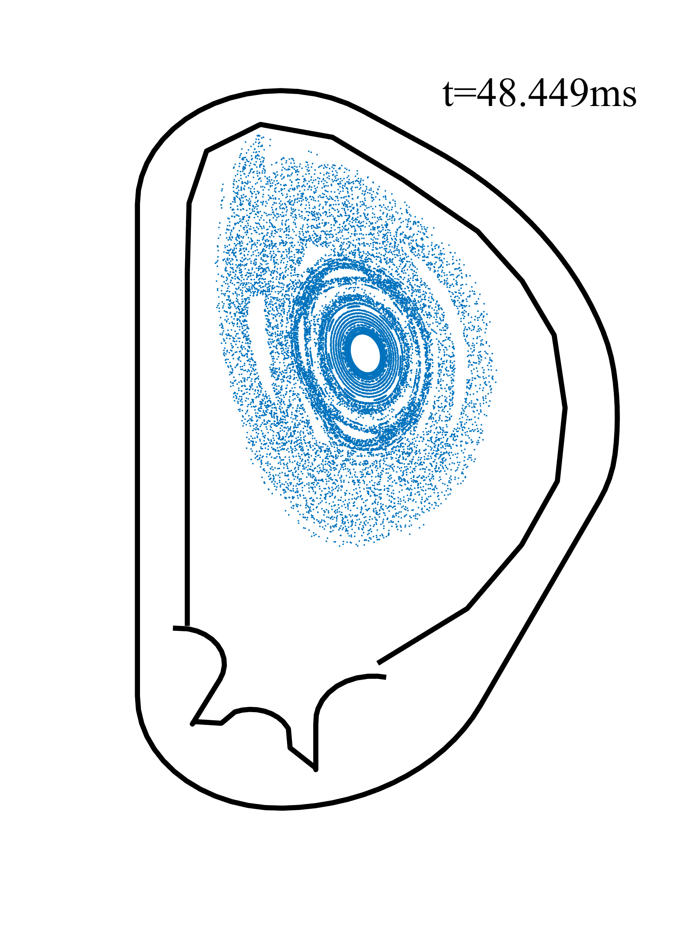
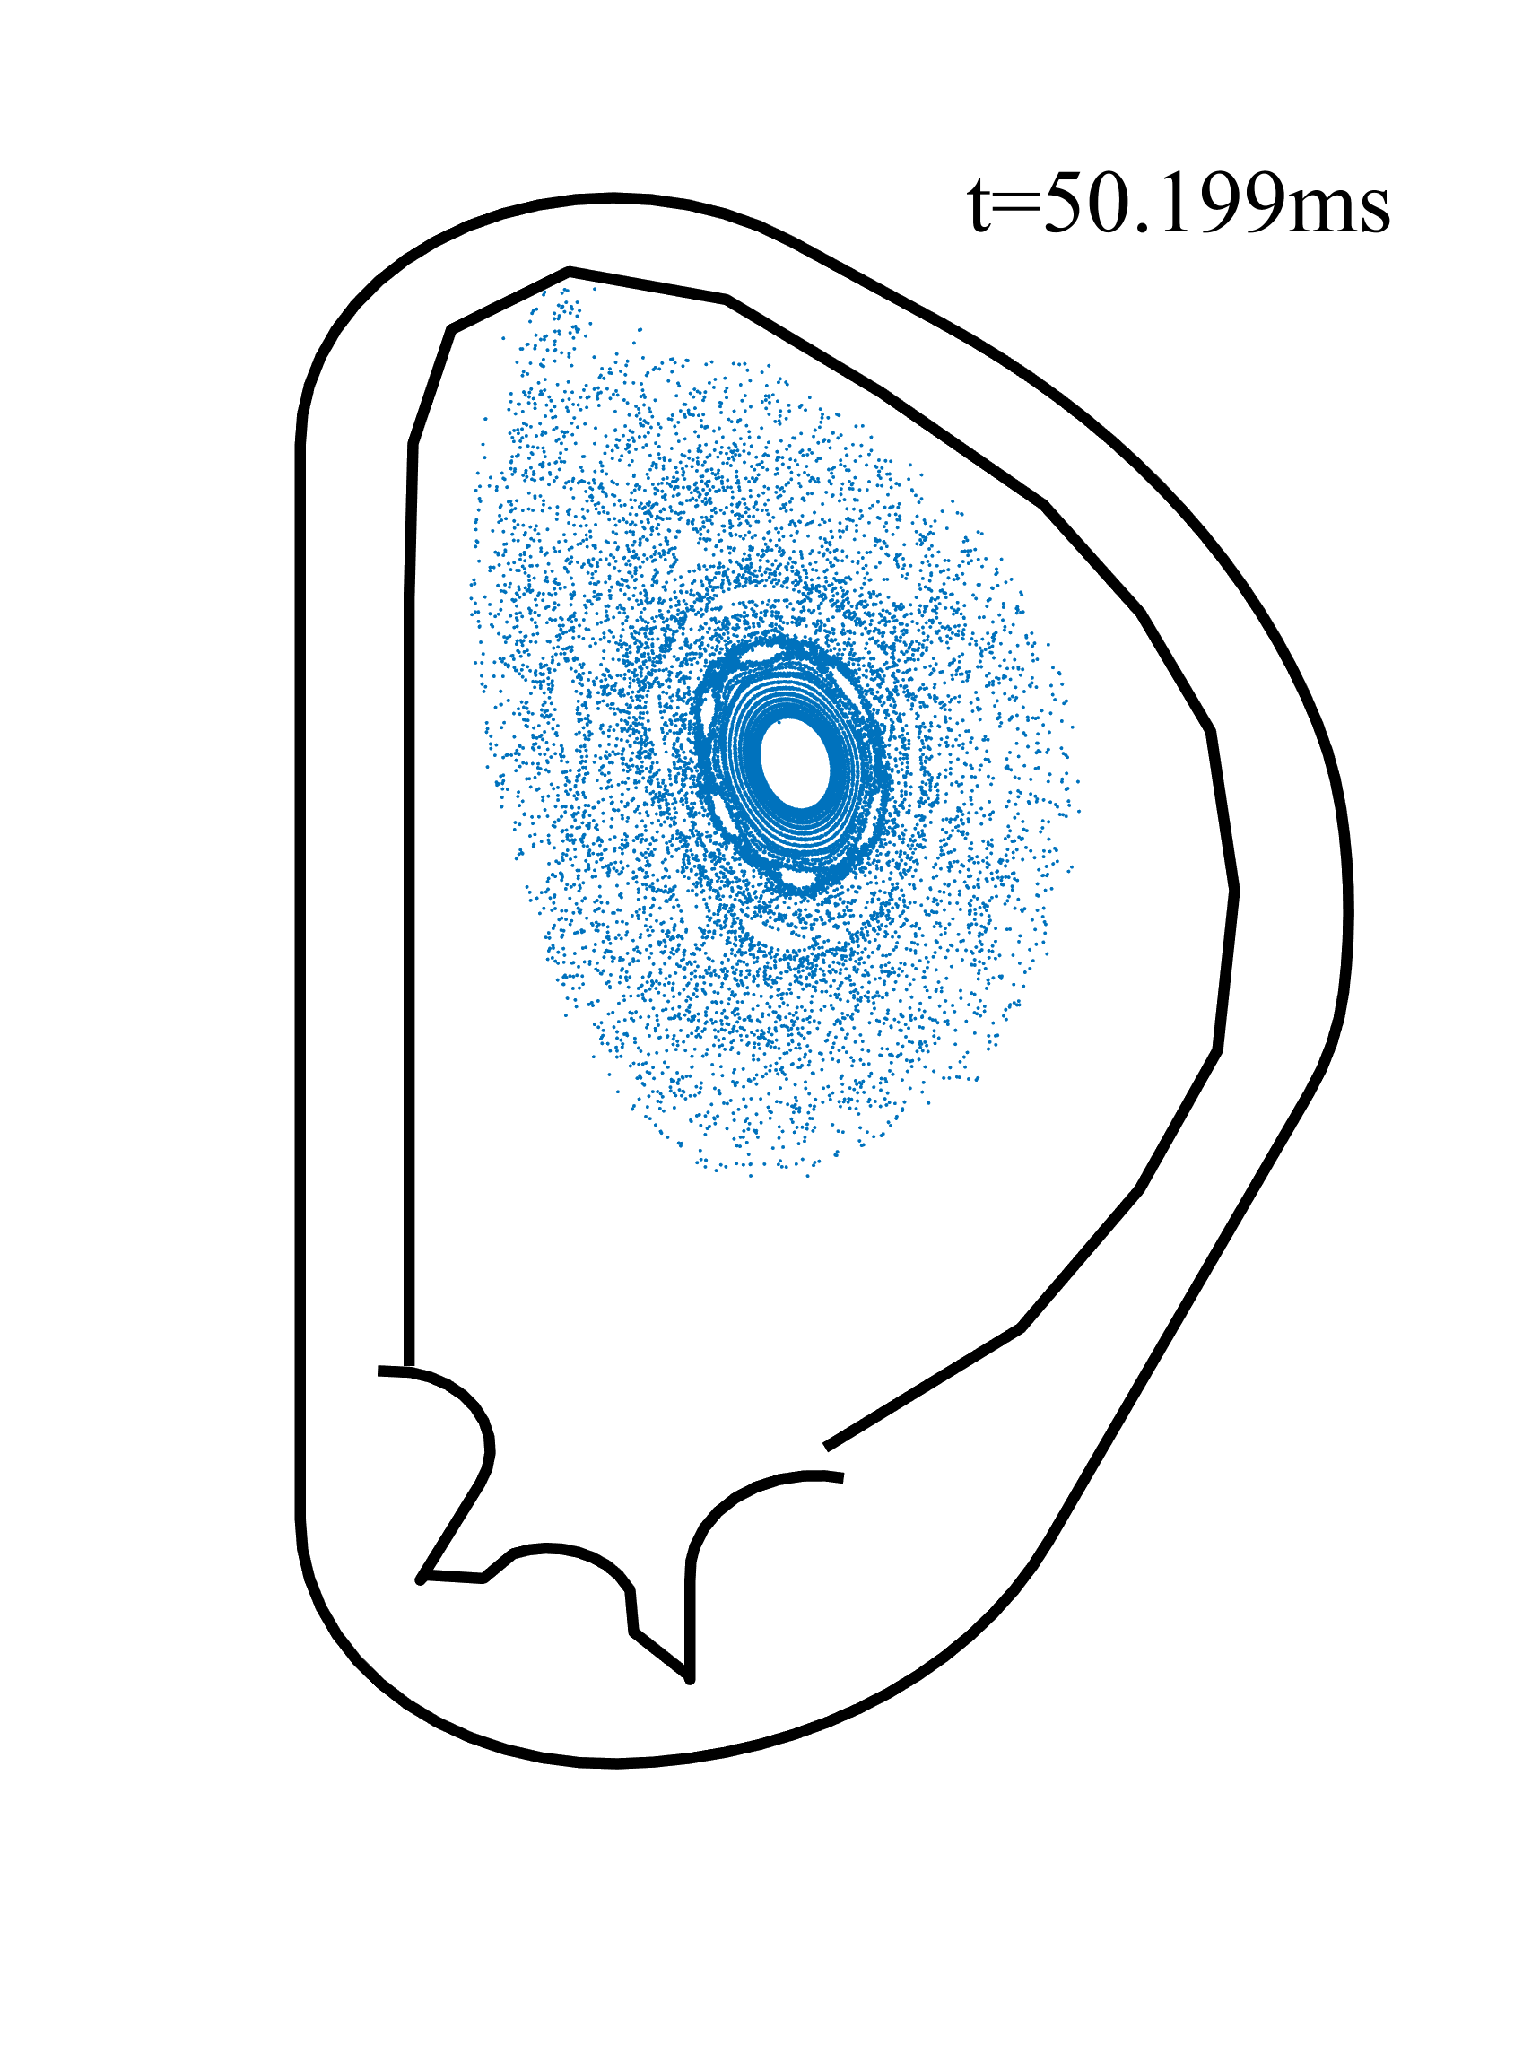
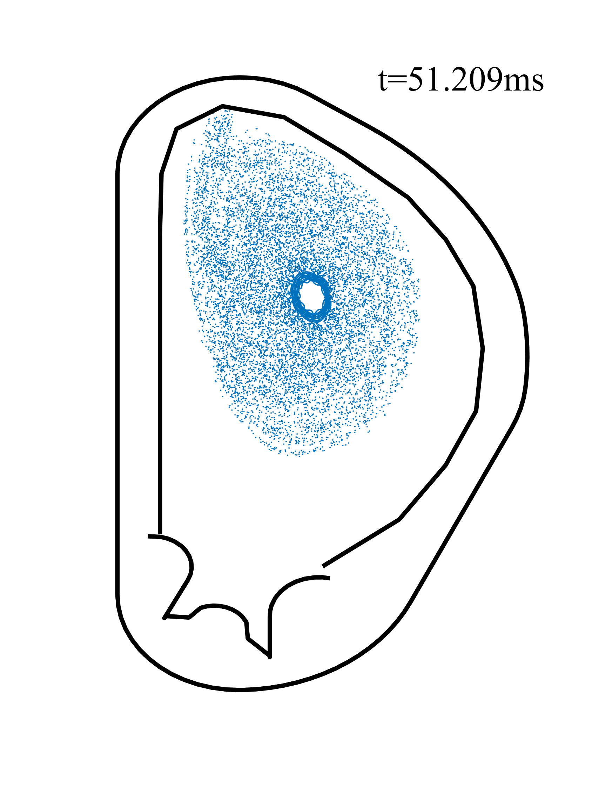
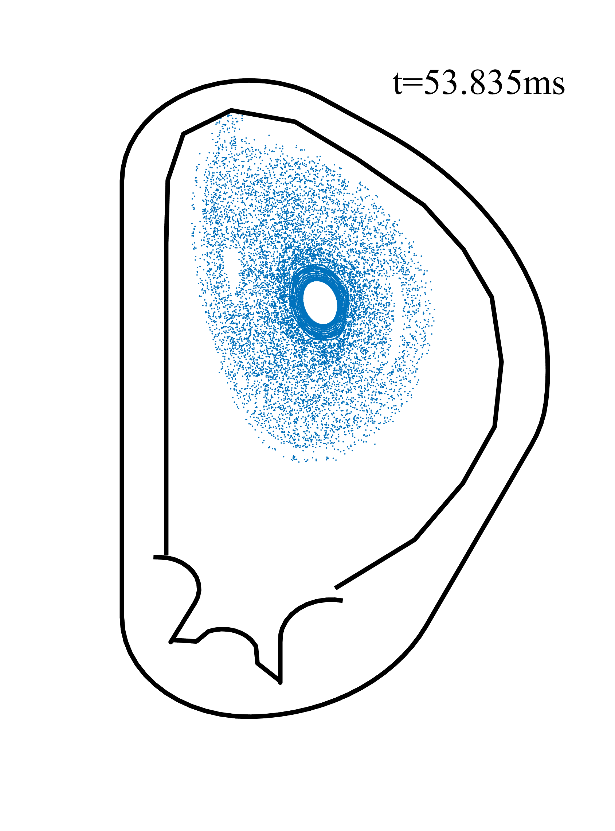
Push case 1 further?
More FSs collapse due to 2/1 mode
Boosted by slow RE transport?
Core FSs and 2/1 island recover
Due to ~1 MA I_{RE}?
RE-MHD interaction is unrealistic at this stage (j_{RE}~>j_{ohm} in the core) and beyond the goal of current project.

Slide 11
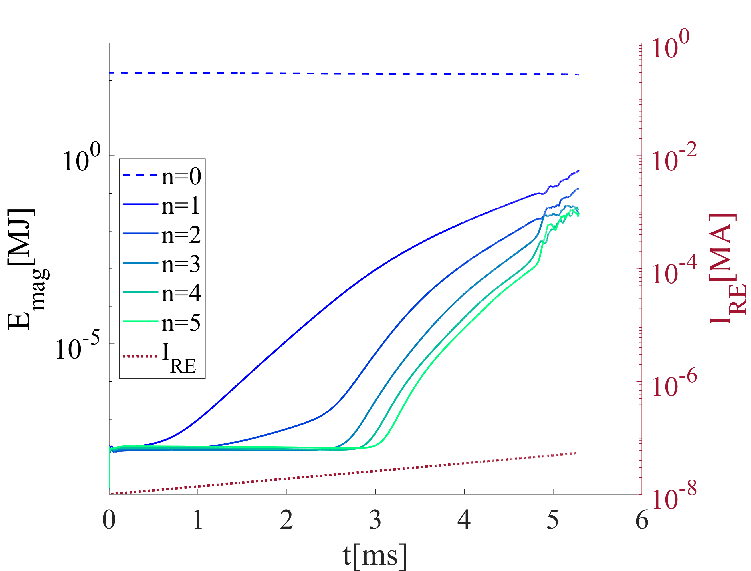
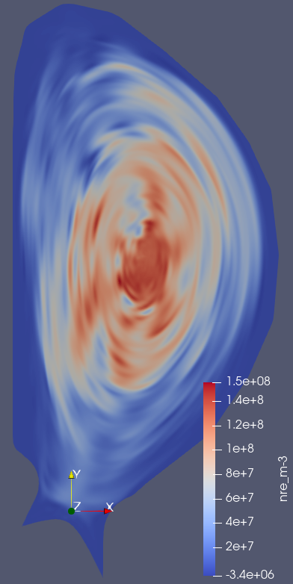
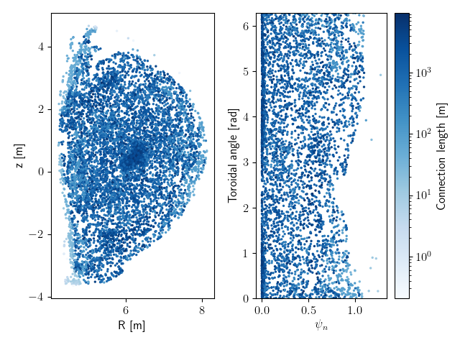
More detailed CQ simulations : Case 2
t=5.3ms
t=5.3ms
particle tracing: 10 MeV REs, 0.99 pitch
Fast mode growth. Global stochasticity after 5.3 ms.
L<10⁴ m. All REs should be lost within 0.03 ms when I_{RE} is still negligible.
RE loss rate underestimated in fluid model using $D_{RE,||}$=${1.54×10}^{6}{ m}^{2}/s$.

Slide 12
Conclusions
No linearly stable j profiles have been found so far in post-TQ ITER plasma: edge modes always grow.
Peaked j profiles are more stable, where REs have time to avalanche.
Under flat-plateau j profile (what we may expect in reality), magnetic lines get stochastic rapidly and REs are thus deconfined. RE avoidance on ITER could be more promising than expected.
Problems
Only a qualitative estimation of RE risk under different post-TQ current profiles is made. What happens under I_{RE}~>10² kA is not available without a refined transport model.
Since the temperature plays an important role in the mode growth rates and is determined by P_{ohm} and P_{rad}, homogeneous impurity density may not be proper.

Slide 13
Outlook: more realistic RE avalanche and transport
ITER disruption simulations:
More realistic plasma scenario: mode energies, profiles of current, density, impurity, and temperature from TQ simulations will be used [4].
RE transport:
After magnetic stochasticity grows to the high n_{RE} region (core plasma), D_{RE,//} will be increased to >10⁹ m²/s to mimic fast RE transport.
Stay on particle tracing if it is enough to evaluate the RE risk or 1) is proven to be too expensive.
Cooperation with BEST team:
First-principle RE modeling for BEST tokamak (EUROfusion & IPP-CN).
[4] D. Hu, et al. NF 2021.

Slide 14
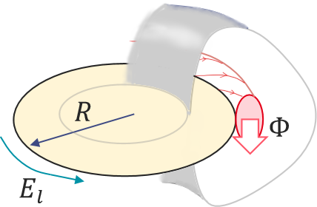
Runaway electrons in tokamak disruptions
During disruptions:
Runaway electrons (RE):
Very high energy electrons generated in tokamaks
[1]
Confinement lost
Confinement (partially) recovered
Current quench (CQ)
~10² ms
I_{p}
$$ψ$$
Thermal quench (TQ) ~1 ms
High current remains in cold, resistive plasma:
Strong loop electric field ($El=η∙j$)
(1)
(2)
(3)
RE
RE
RE
RE
Fast electrons with low collision rates (seeds);
$${e∙E}_{l}>F_{friction}$$
Avalanche via close collisions with thermal electrons.
[1] A. Boozer. PoP, 22(3), 03 2015.

Slide 15
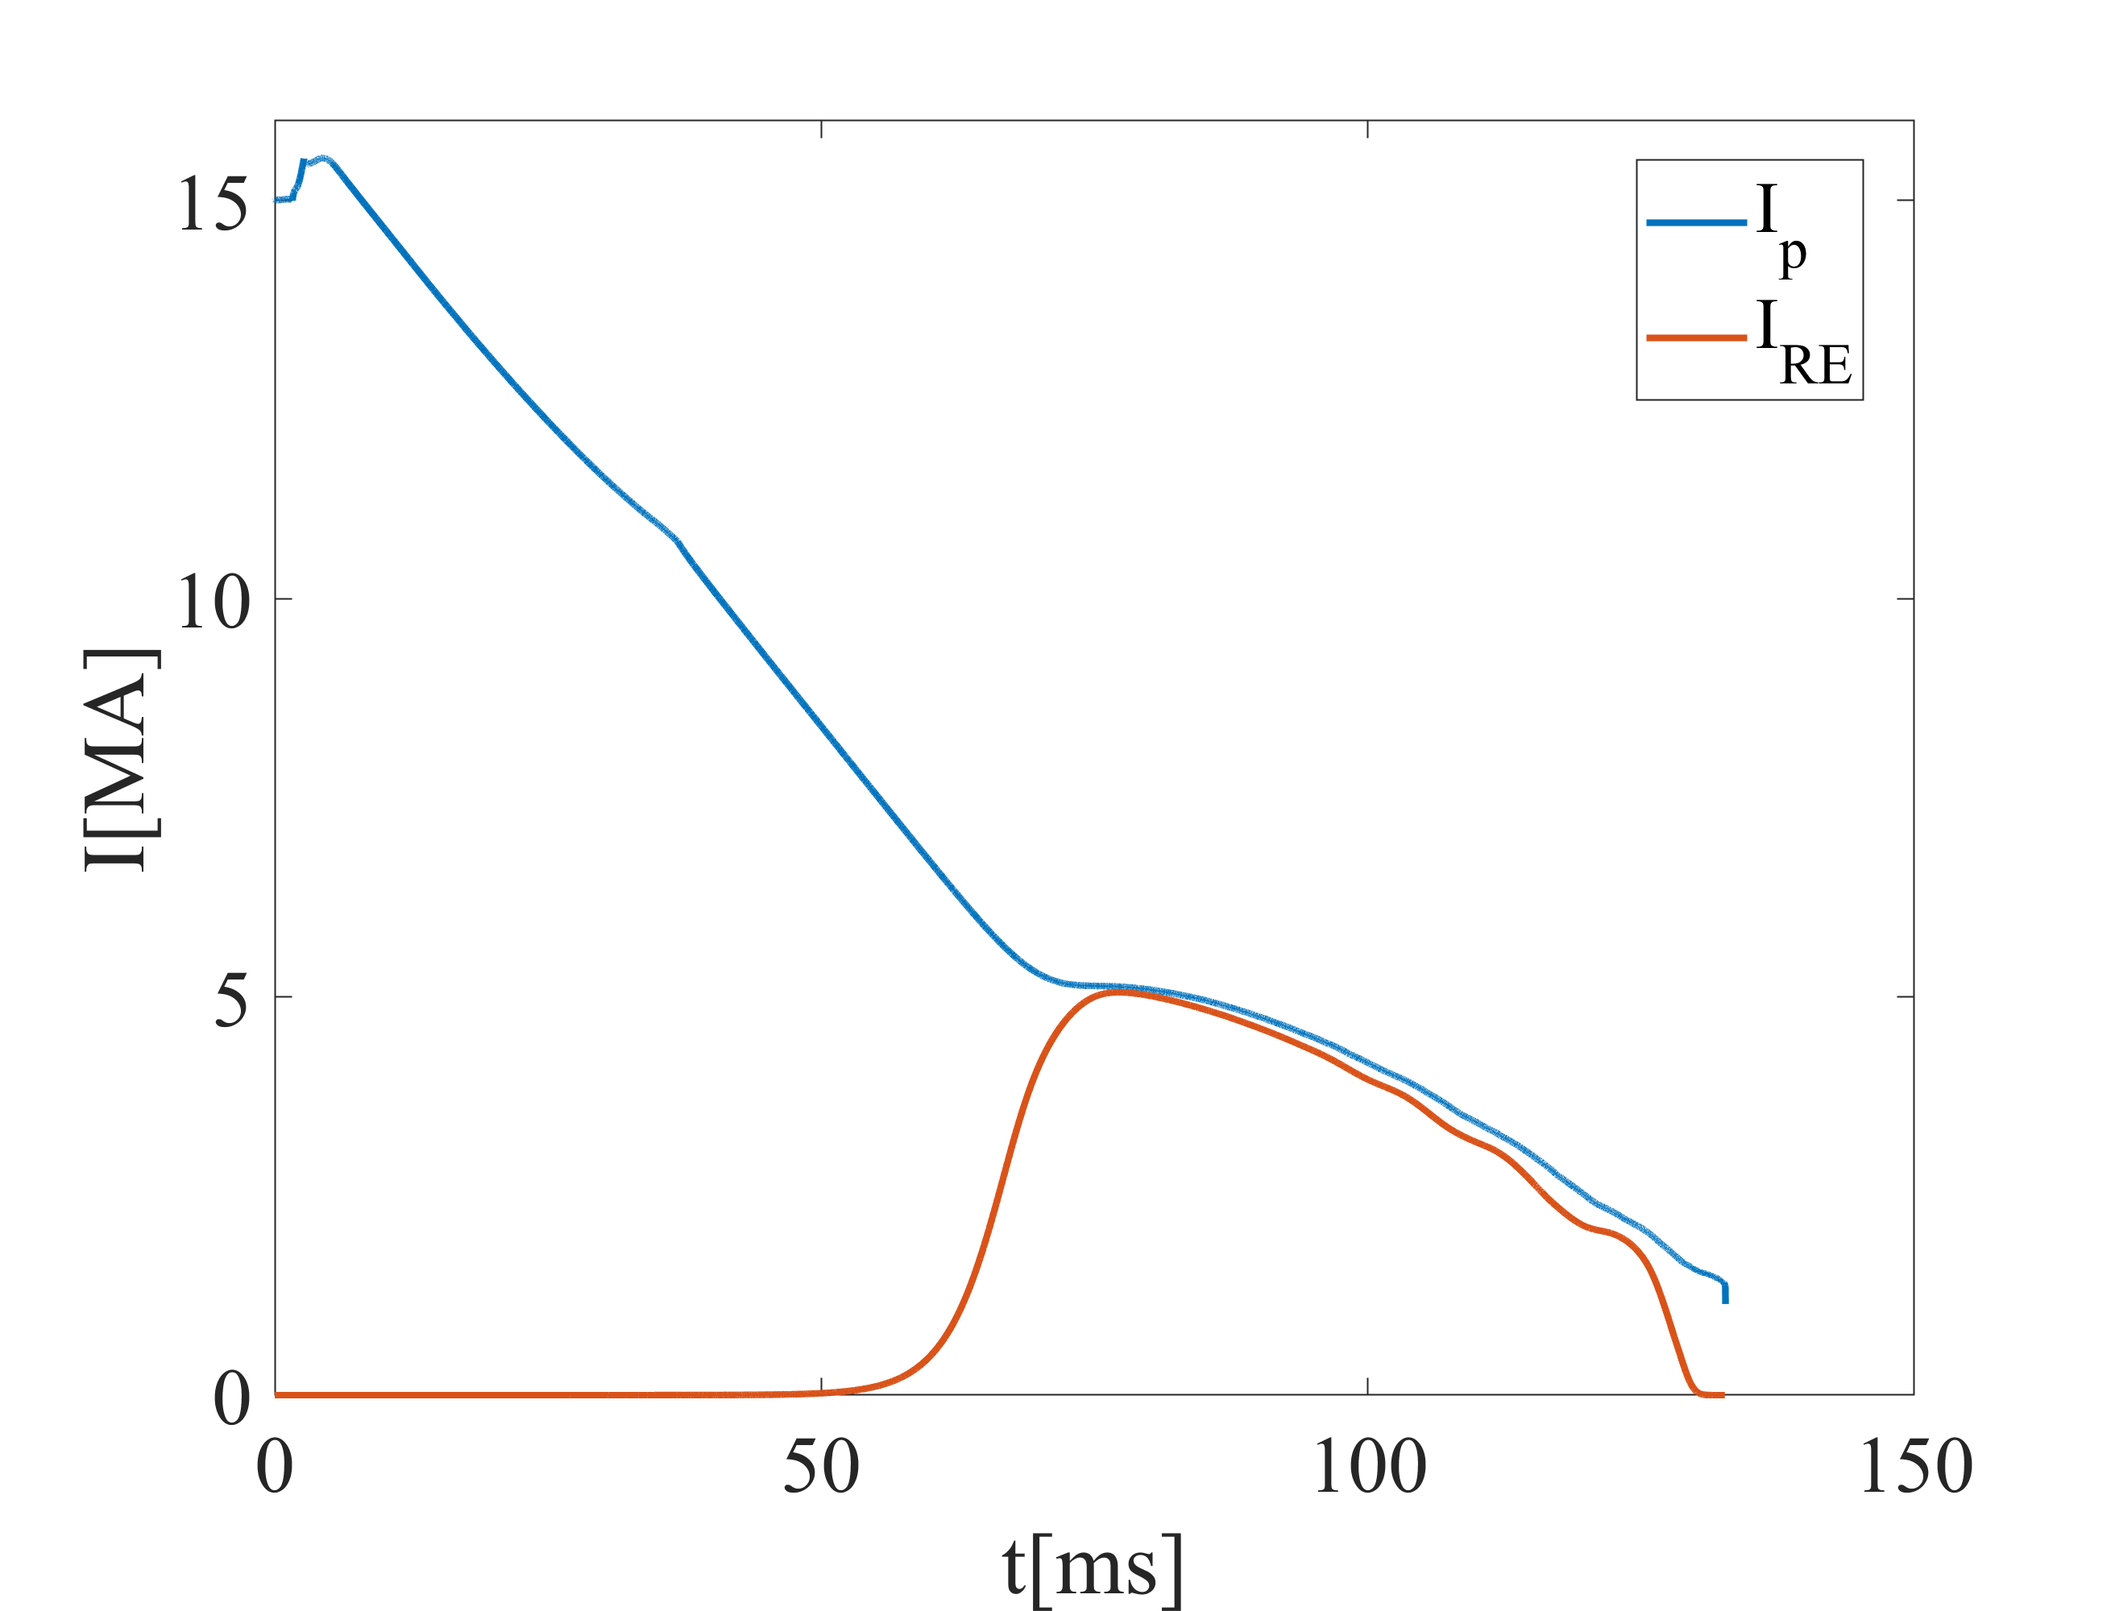
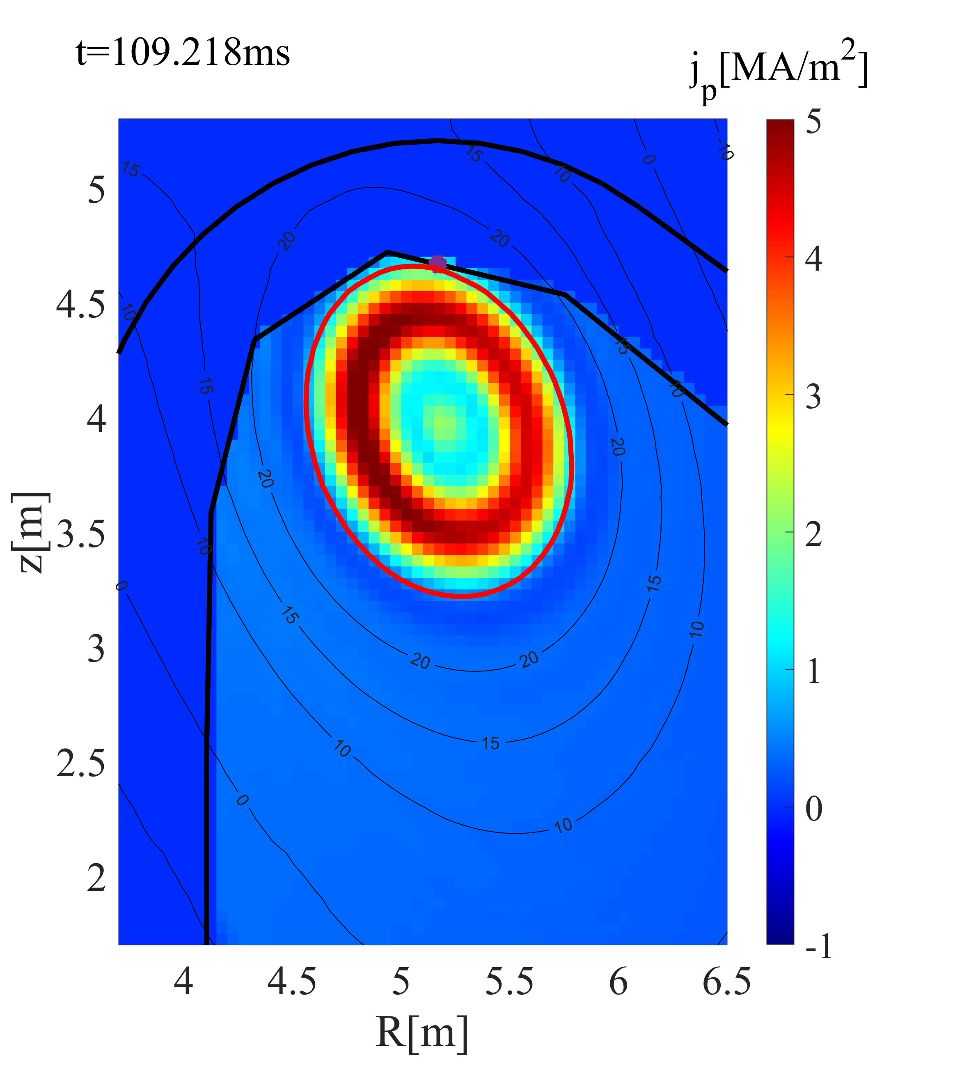
Runaway electrons in ITER disruptions
I_{RE}: the current carried by REs
(2) I_{RE} saturates. Majority of I_{p} carried by REs.
Majority of I_{p} carried by I_{Ohm}
RE avalanche gain:
$g_{RE}={I_{RE}}/{I_{RE,t=0}}=\exp\left({∆I_{p}}/{I_{c}}\right)$ >10¹⁶ in ITER disruptions with I_{p}=15MA
(1) Exponential growth of I_{RE}
(3) Termination on the wall.
Radiation
Ohmic heating
E_{mag} on I_{Ohm}
E_{mag} on I_{RE}
E_{k} of REs

Slide 16
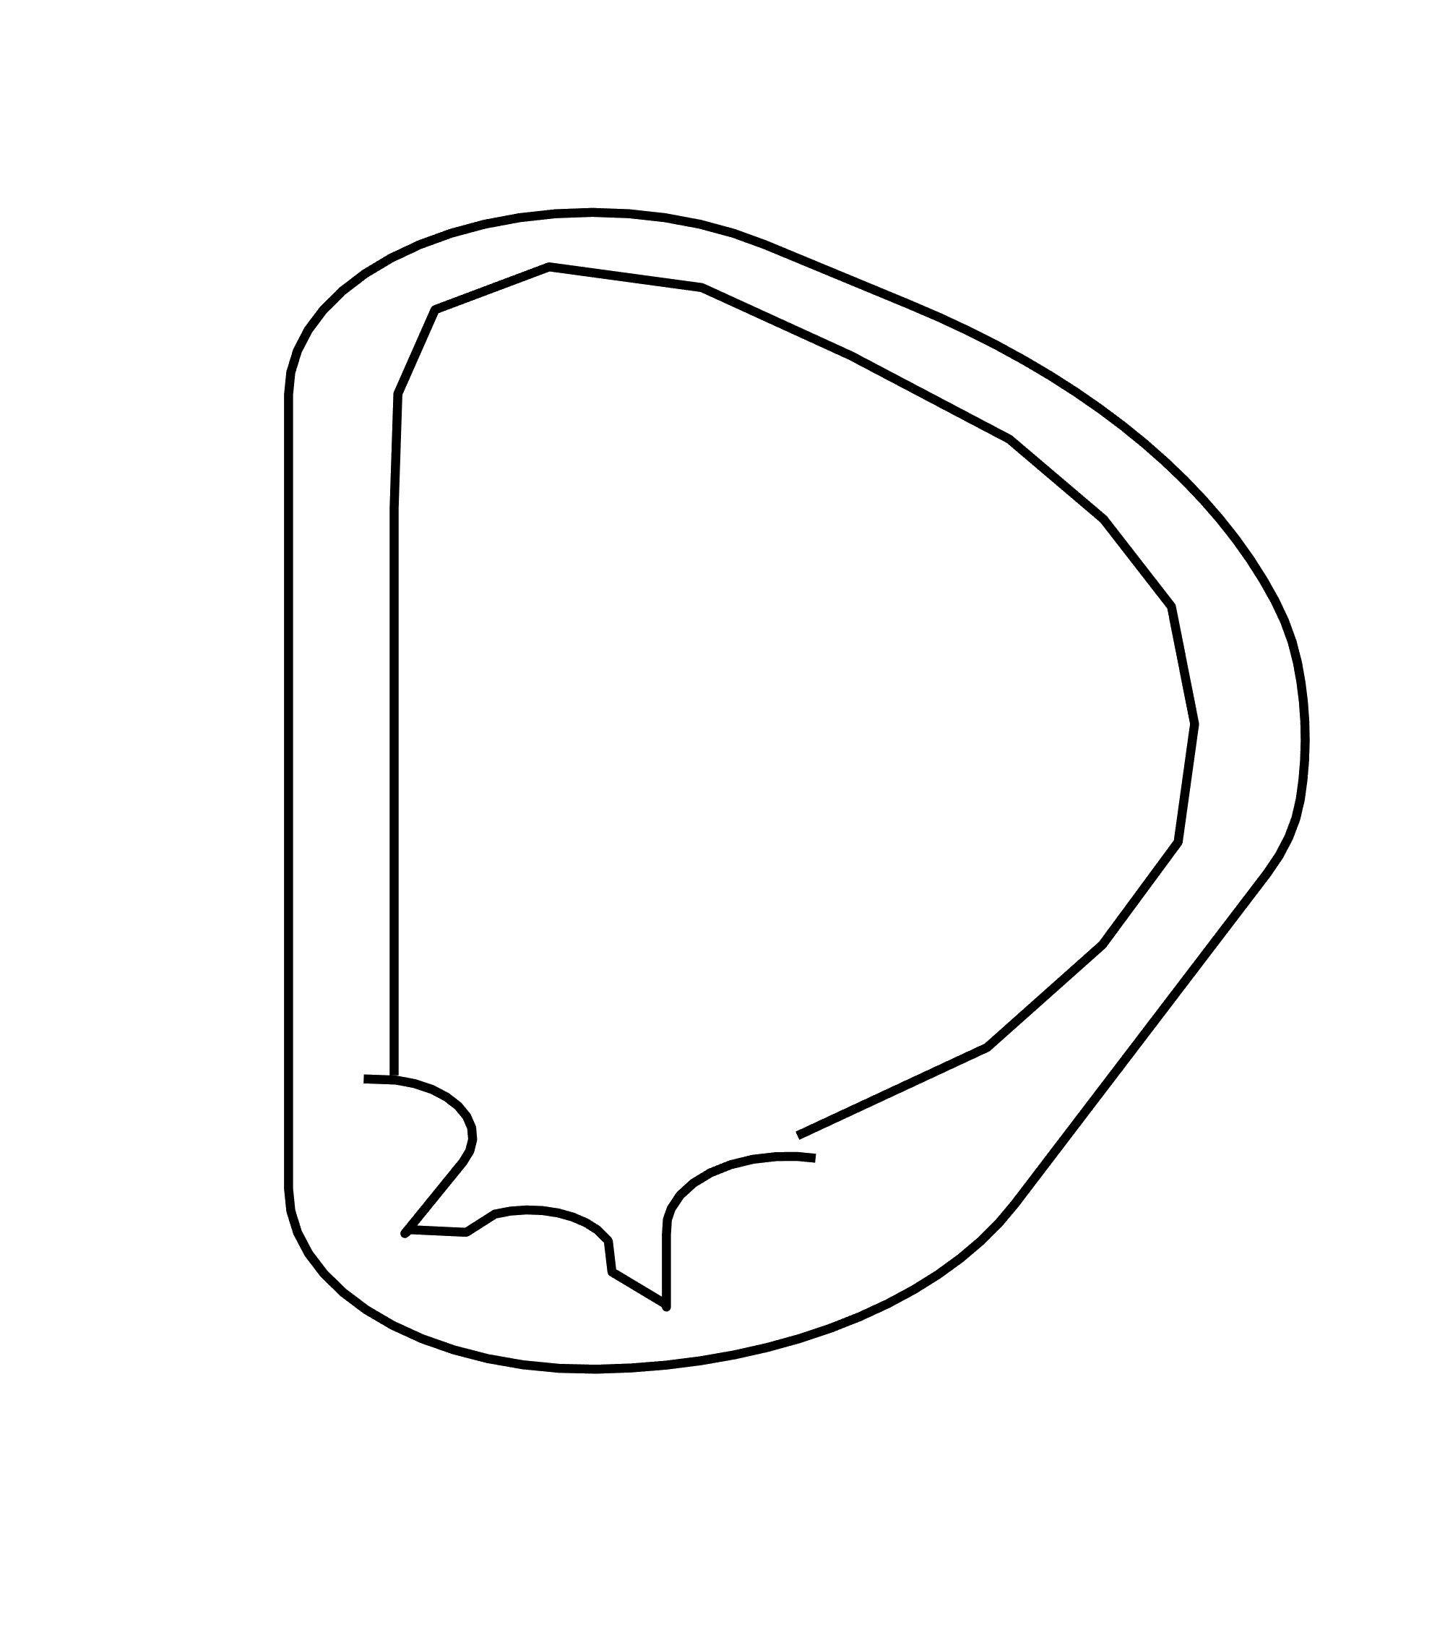
RE deconfinement in ITER current quench
If RE avalanche is terminated by strong loss when I_{RE} is still small, damage from a large RE beam can be prevented.
REs are lost once magnetic flux surfaces (FS) are opened or destroyed.
Plasma vertical motion
FSs open due to vertical motion
Plasma moves vertically in disruptions. REs are lost on opened field lines (halo region).
I_{RE} after avalanche can be greatly reduced [3,4], only ~kA in marginal cases.
A bit more RE loss may make RE avoidance work on ITER…
RE
I_{core}
RE
I_{halo}
[3] C. Wang, et al. NF 2025.
[4] V. Bandaru, et al. JPP 2025.

Slide 17
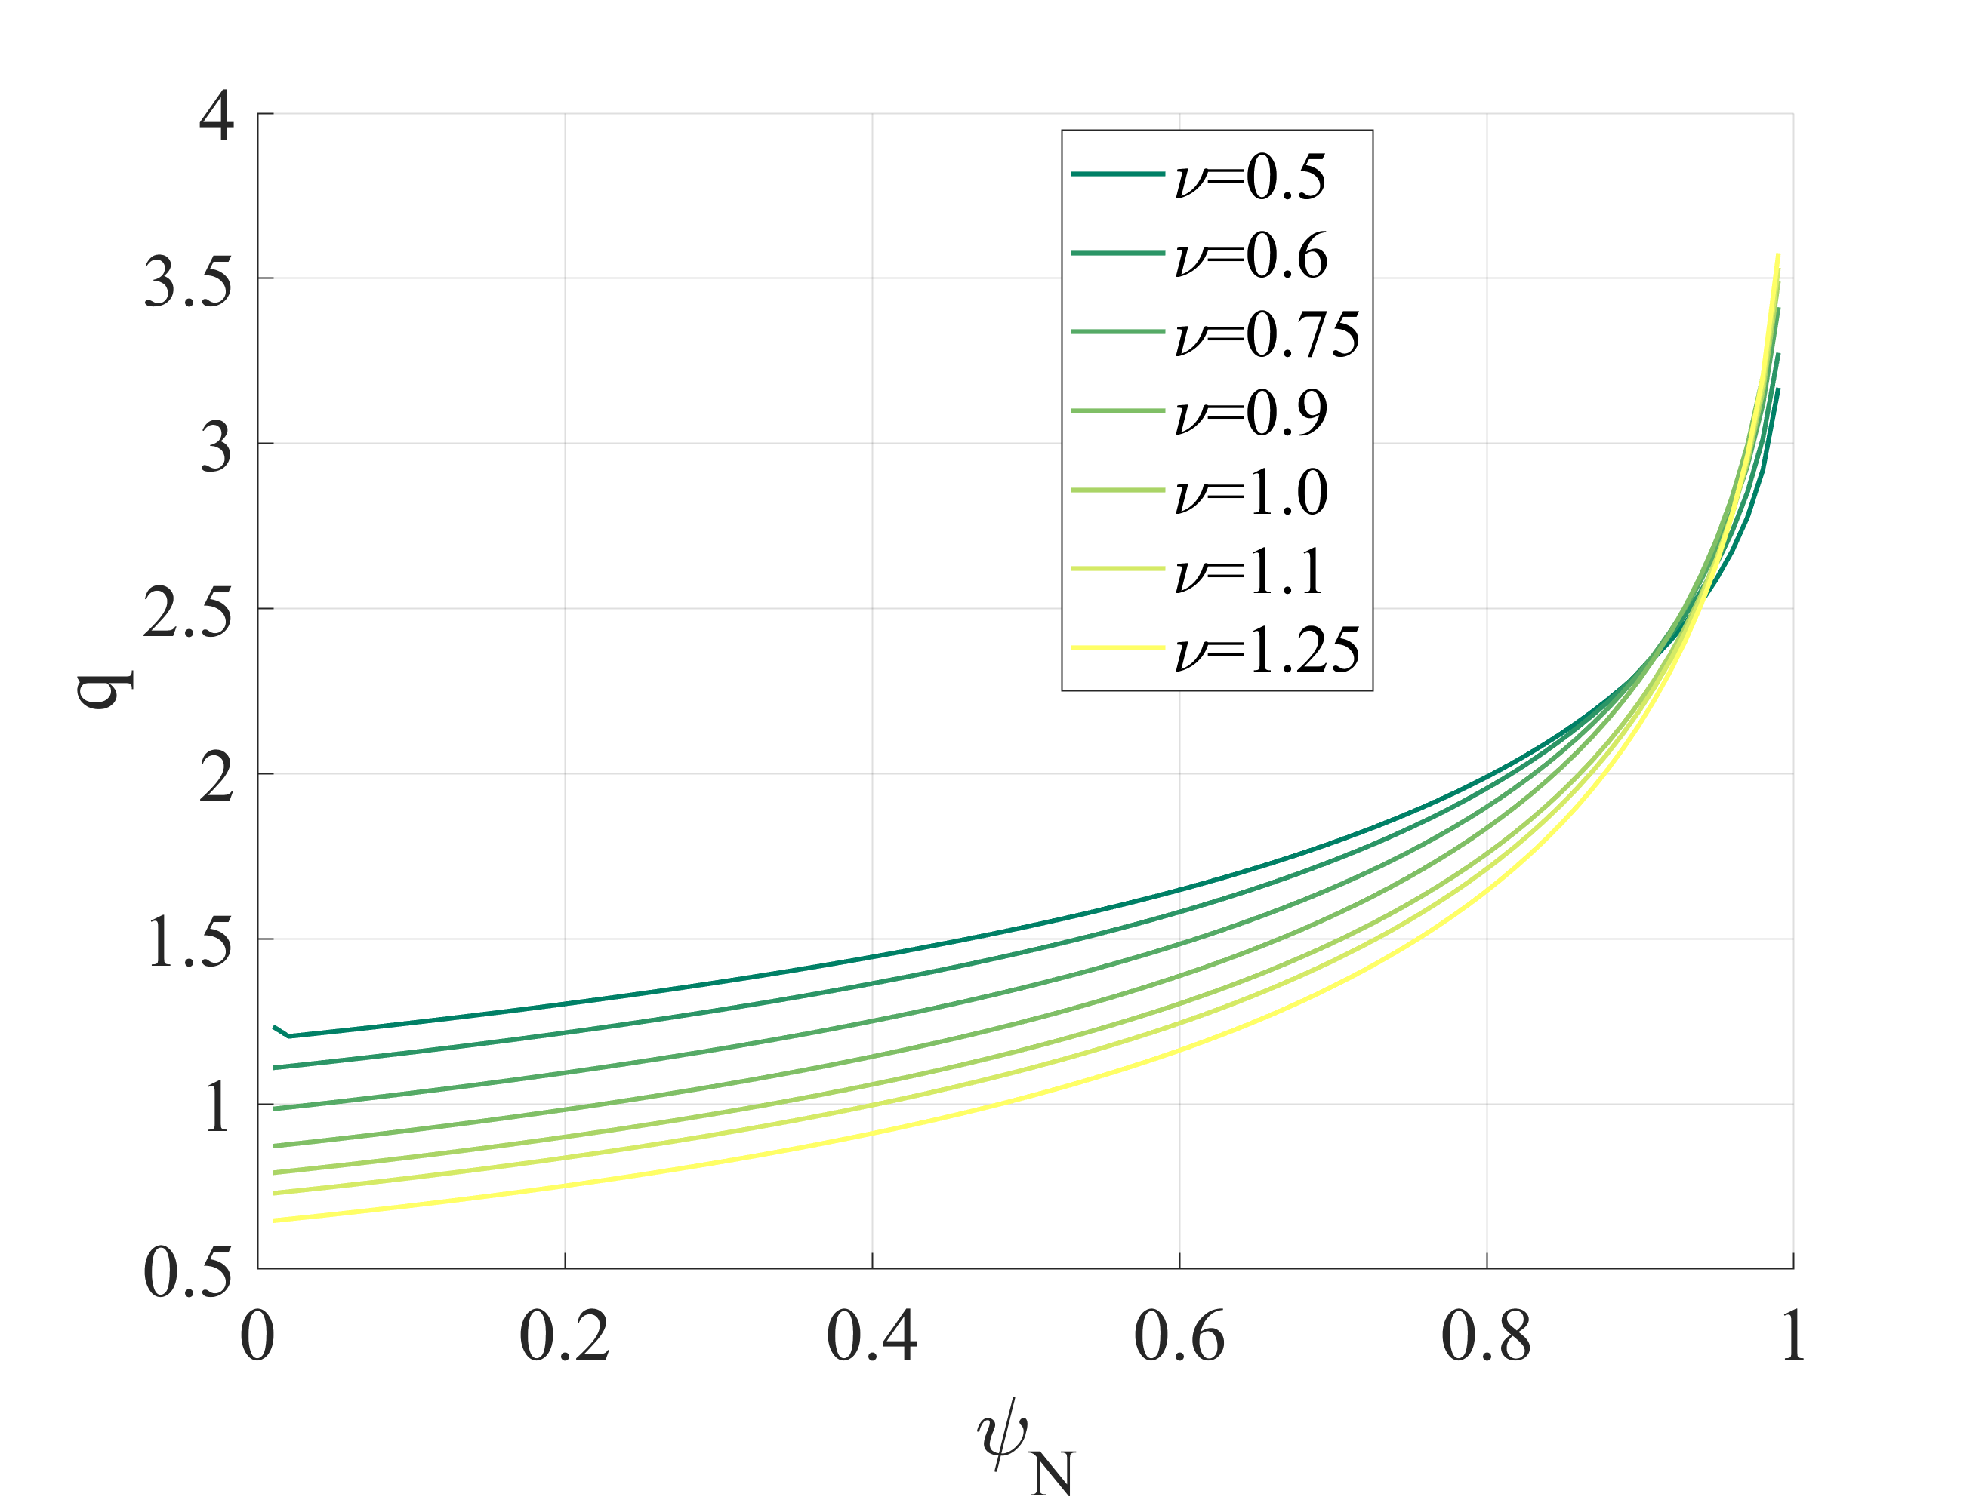
Scan over j profiles
MHD modes’ stability is decided by global j profile, while their growth rates are related to local j gradient.
Wesson’s current density profile with one parameter $ν$[3]:
$$j=j_{0}{(1−{(r/a)}^{2})}^{ν}$$
Lower $ν$: flat j and q profiles; higher $ν$: peaked j and q profile
3D MHD simulation using JOREK (toroidal harmonics n=1,2,3)
Fixed boundary
Fixed temperature and density profiles
Plasma parameters (ITER-like, after hydrogen injection and TQ):
Main species | B₀ | n_{e,core} | T_{e,core} | I_{p0}
Hydrogen | 5.3 T | 5x10²⁰ m⁻³ | 10 eV | ~15 MA (may change slightly under different profiles)
[3] J. Wesson, D. J. Campbell. Tokamaks.

Slide 18
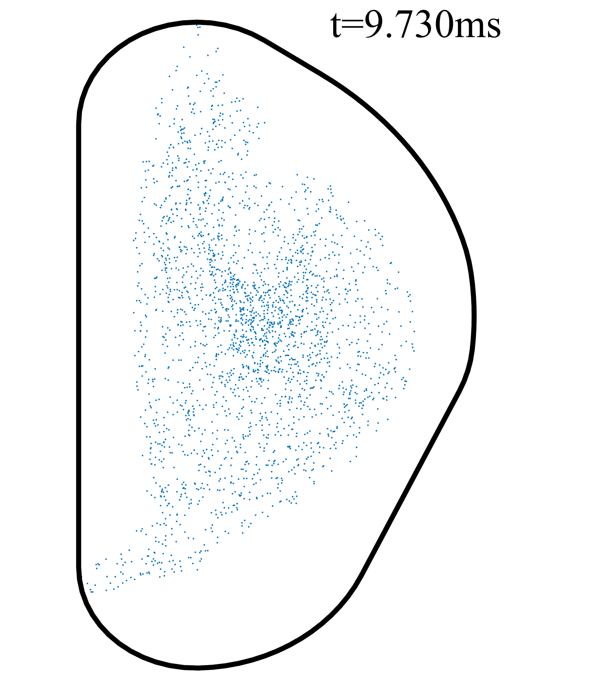
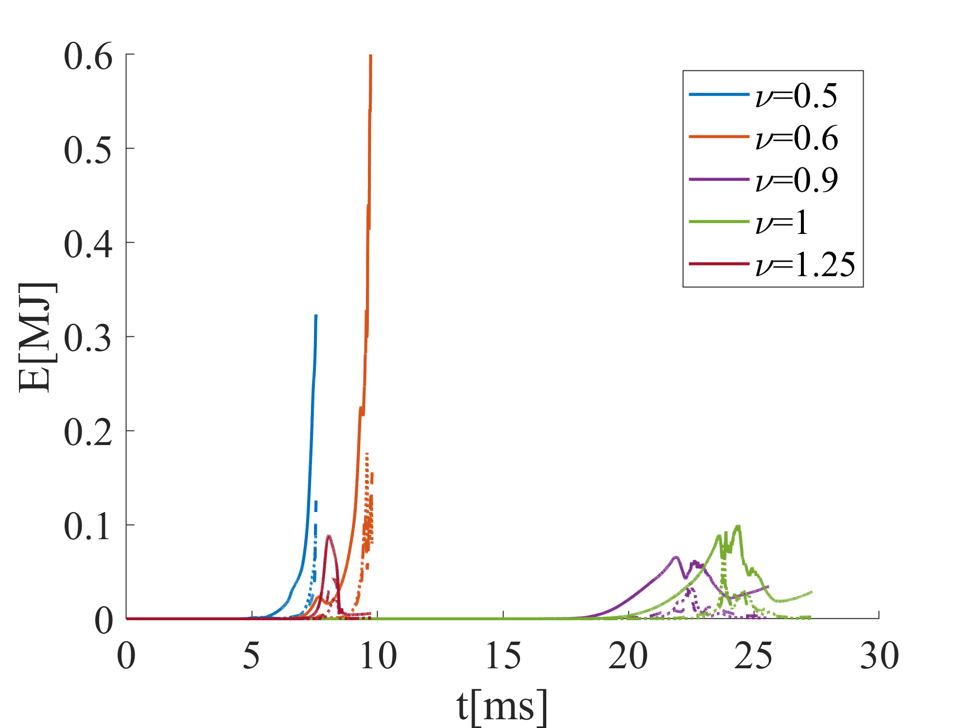
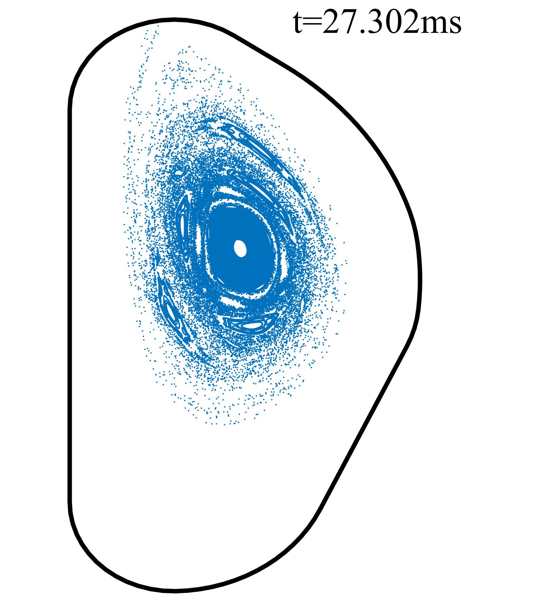
Scan over j profiles
$ν=0.5,0.6$: $E_{mag}$ saturates at high level; completely stochastic magnetic field.
$ν=0.9,1.0$: $E_{mag}$ saturates at ~0.1 MJ, then decays to ~0.01 MJ. Closed FSs still exist.
Solid: n=1
Slashed: n=2
Dotted: n=3
$$ν=0.6$$
$$ν=1$$
$ν>1$: high initial growth rate due to 1/1 kink mode. Stabilized after q=1 FS vanishes.

Slide 19
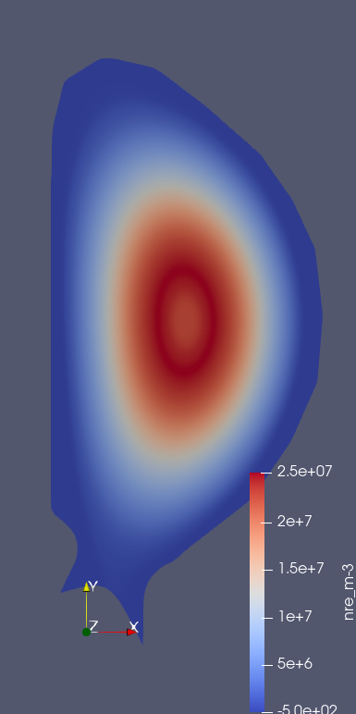
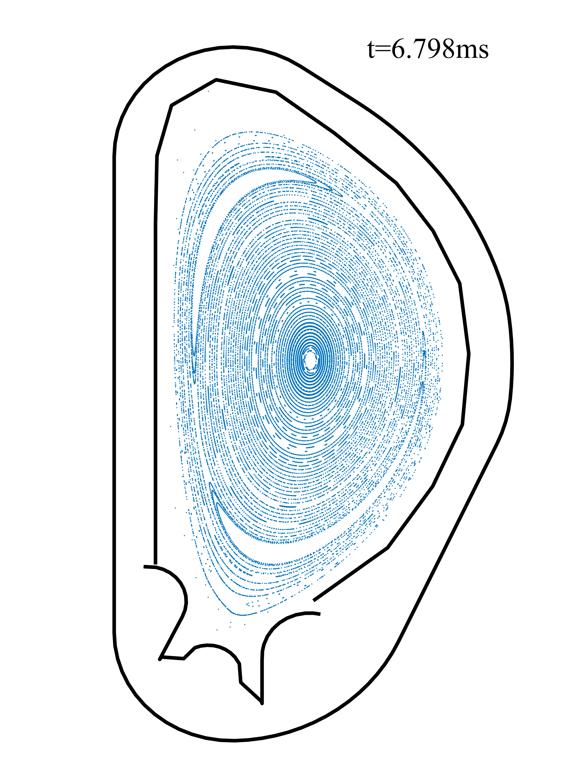
RE fluid diffusion model : transport before stochasticity
Corrected RE avalanche model; add D_{hyper}=1d-10 JU and tgnum_nre=2 to enable larger dt~0.1
Before stochasticity grows to core plasma, I_{RE} is insensitive to transport model.
D_{RE,//} = 10⁶ m²/s is adequate for early stage of CQ to save computational resource.

Slide 20
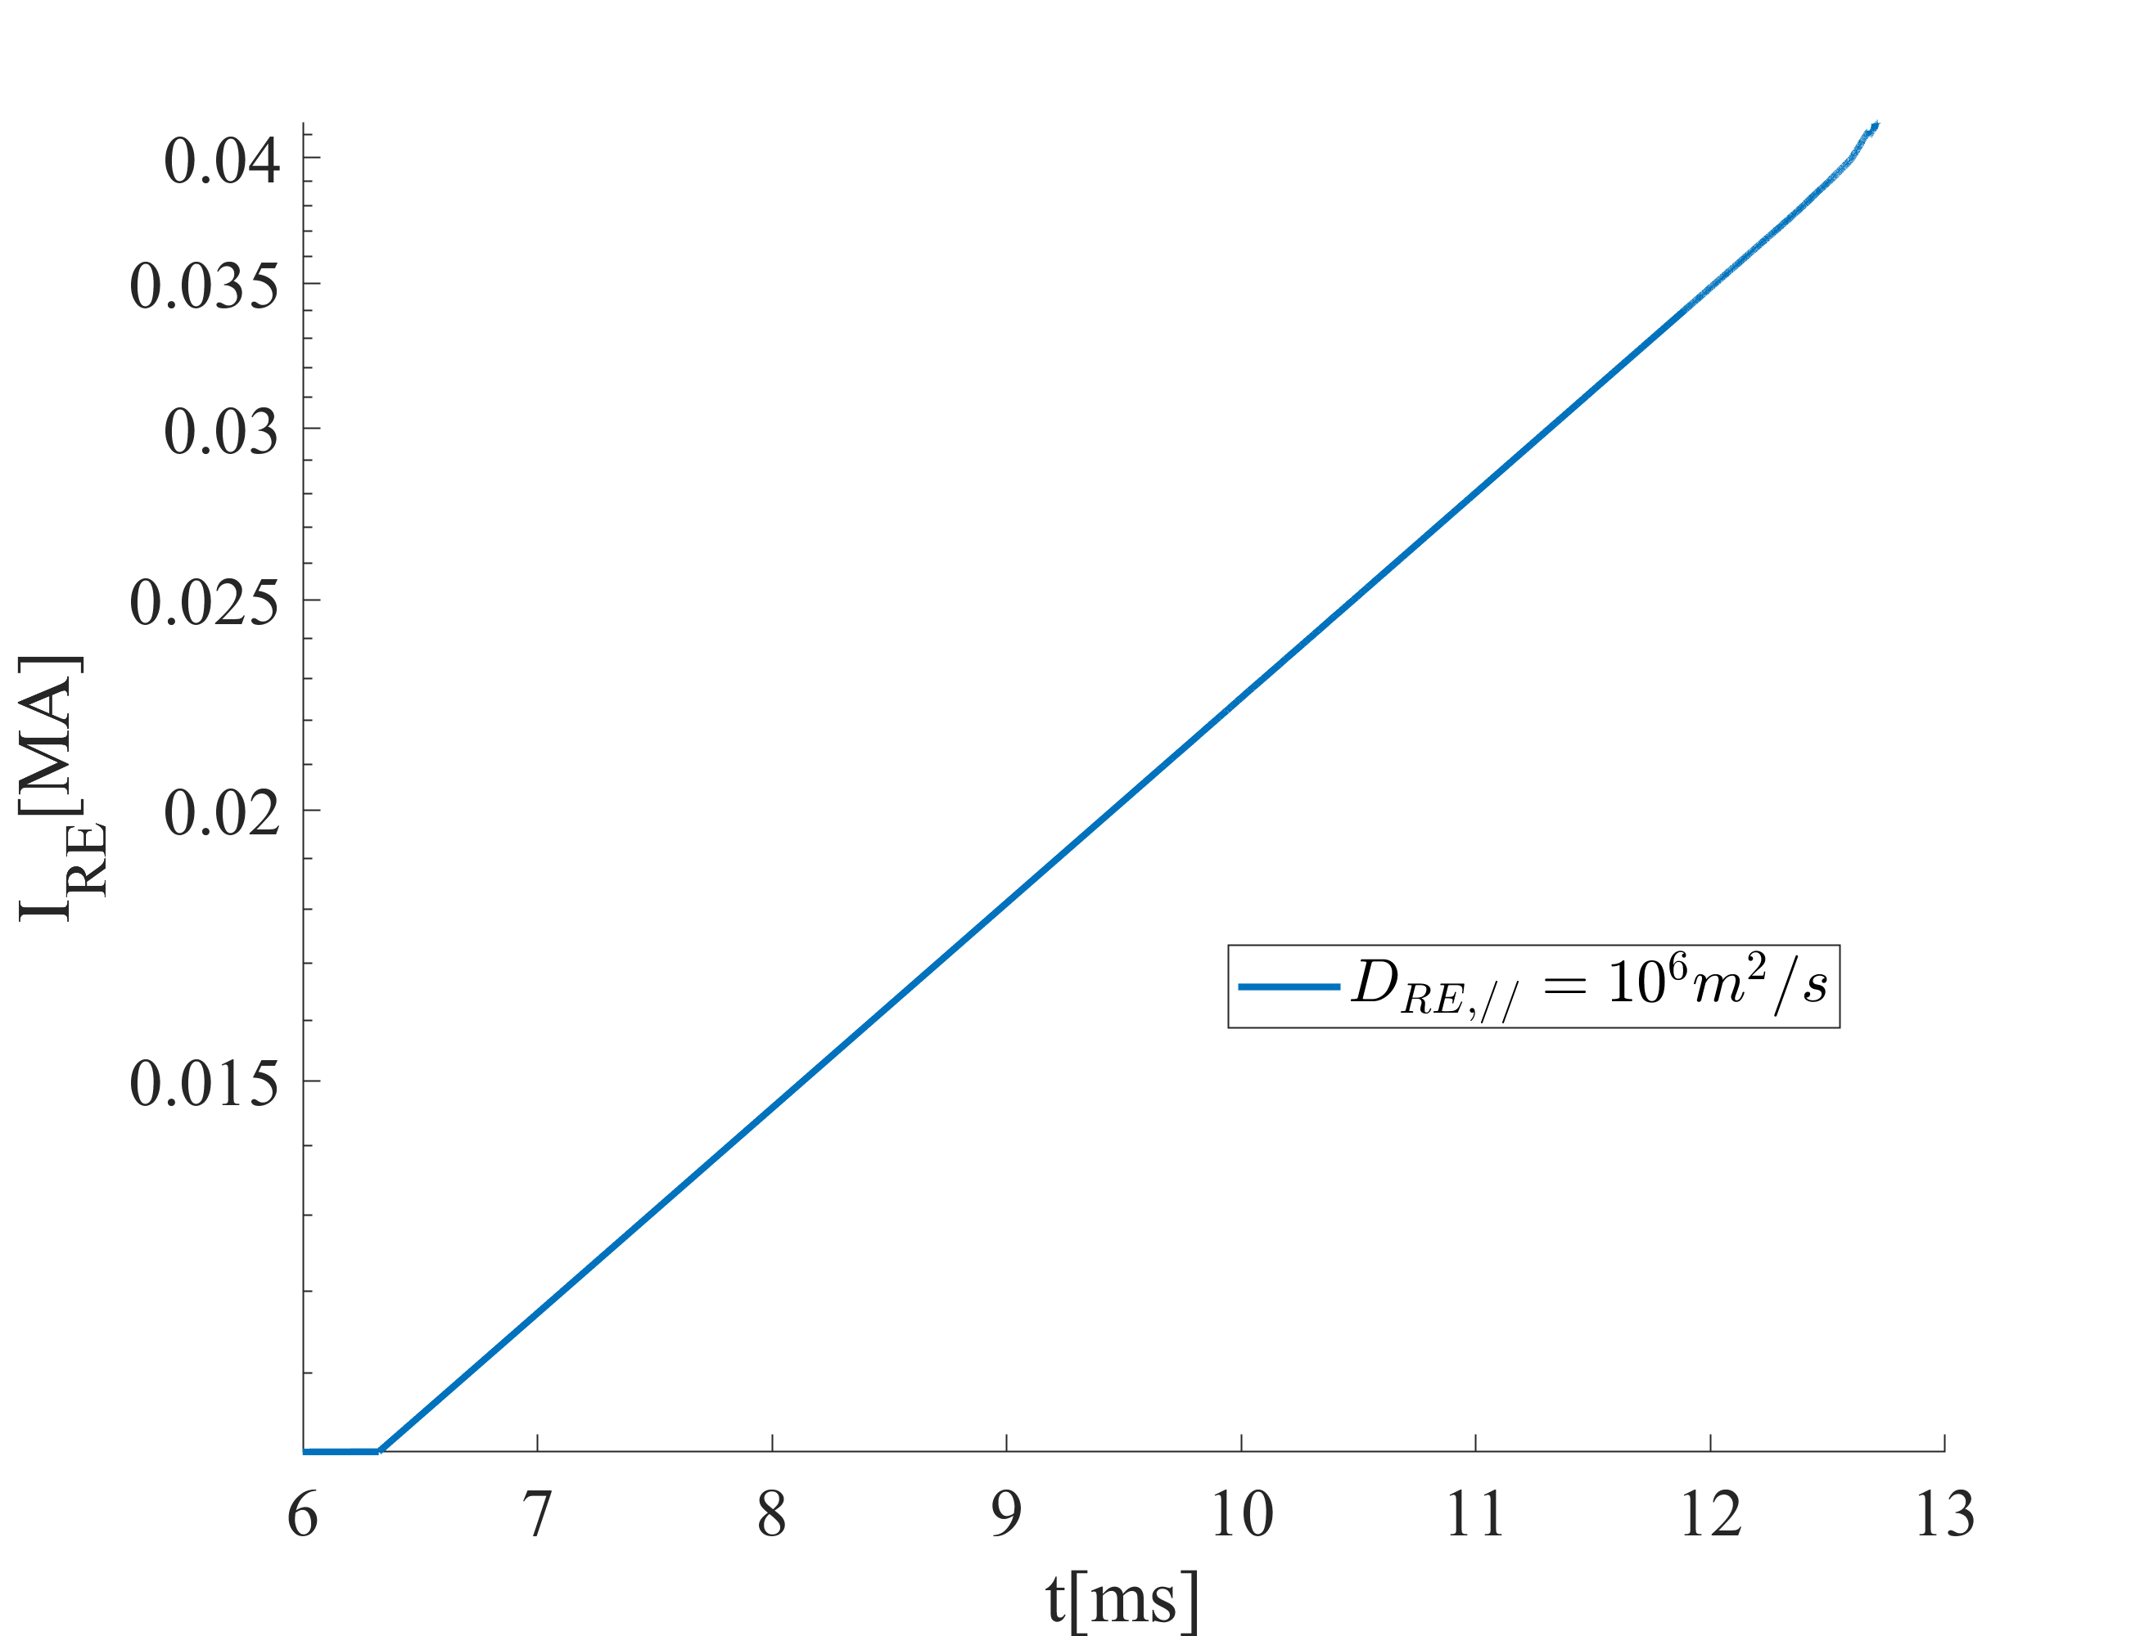
RE fluid diffusion model : transport in stochastic field
Scan over D_{RE,//} within 0.04 ms under global stochasticity
Observable RE loss start from D_{RE,//} =1d9 m²/s with $τ_{RE,dif}≪1/γ_{avalanche}$
Advection model with $v_{||}=c$ is running for benchmark.
dt = 0.02 for D_{RE,//} =1d9 m²/s; dt < 0.01 for D_{RE,//} =1d10 m²/s. Unfeasible for ~1 ms (3000 JU) simulation.

Slide 21
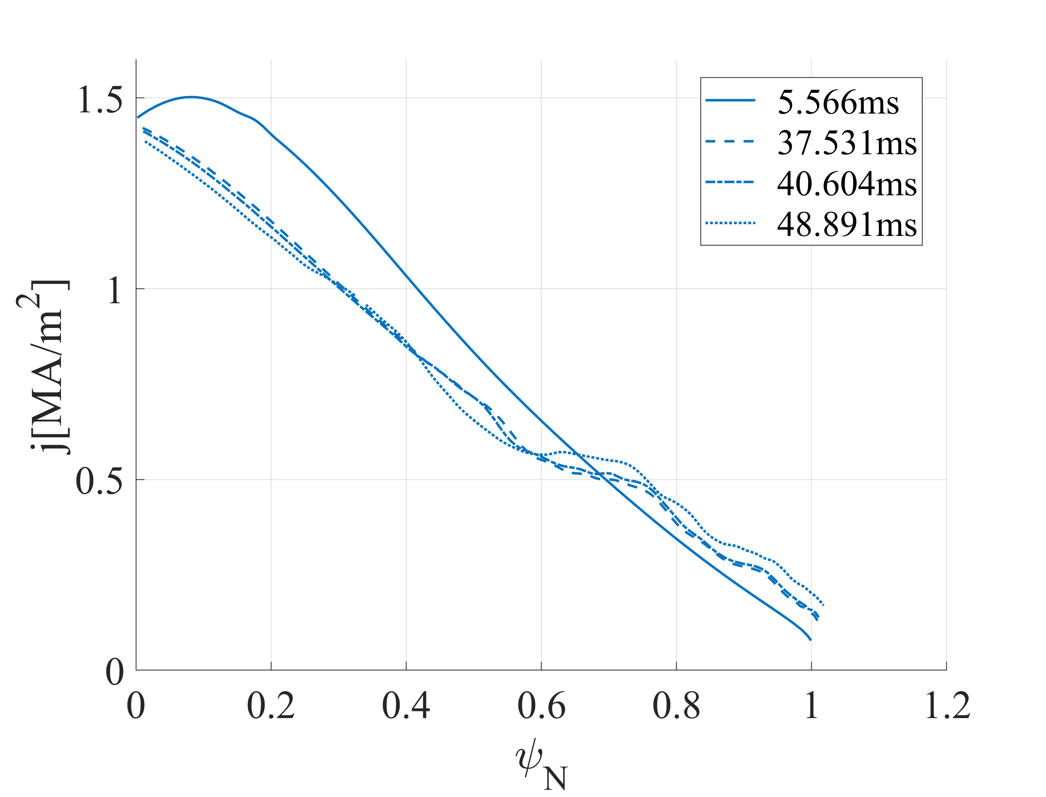
Current profile evolution
Case 1
Case 2

Slide 22
Outlook: more realistic RE avalanche and transport
On simulations:
More realistic plasma scenario: mode energies, profiles of current, density, impurity, and temperature from TQ simulations will be used [8].
After magnetic stochasticity grows to the high n_{RE} region (core plasma), D_{RE,//} will be increased to >10⁹ m²/s to mimic RE transport in stochastic field lines.
Hypothesis: post-TQ MHD is unstable like Case 2. Magnetic stochasticity grows from marginal to global within 1 ms. The corresponding high D_{RE,//} phase with small dt (<0.1 JU) won’t last long. Core*hour consumption ~1M.
On code:
Under small $j_{RE}$ limit, n_{re} evolution equations could be decoupled with MHD equations: MHD is solved without REs, then the RE fluid evolution is solved based on the resulting fields, like in the particle model. Different dt might be applied to MHD and RE fluid evolution to save CPU hours.
[8] D. Hu, et al. NF 2021.

