Slide 1
Hybrid kinetic-MHD simulations of runaway electron beam termination events
H. Bergström, S. Liu, M. Hoelzl, V. Bandaru, K. Särkimäki, M.M. Skyllas, JOREK Team, JET Contributors

Slide 2
Outline
Background
Coupling to the MHD and verification
Hybrid simulation of RE beam termination in JET
Beam termination in ITER and wall load studies

Slide 3
Outline
Background
Coupling to the MHD and verification
Hybrid simulation of RE beam termination in JET
Beam termination in ITER and wall load studies

Slide 4
Modelling of REs
REs can strike the wall resulting in localized heat loads and melting of the wall material.
Avalanche mechanism is exponentially sensitive to the plasma current!
Major obstacle for future large scale machines like ITER. There is a need for predictive simulations.
Modelling REs is challenging:
Low collisionality means fluid approach is difficult.
Accurate prediction of transport in stochastic fields needed during beam formation/termination.
REs dominate the dynamics towards later stages of disruption.

Slide 5
Runaways in
REs simulated kinetically by pushing macroscopic marker particles in the JOREK fields.
Often used as a form of post-processing.
Downside: Markers are evolved on very small time scales, can be computationally expensive.
Advantage: Great at accurate transport modelling.

Slide 6
Runaways in
REs simulated kinetically by pushing macroscopic marker particles in the JOREK fields.
Often used as a form of post-processing.
Downside: Markers are evolved on very small time scales, can be computationally expensive.
Advantage: Great at accurate transport modelling.

Slide 7
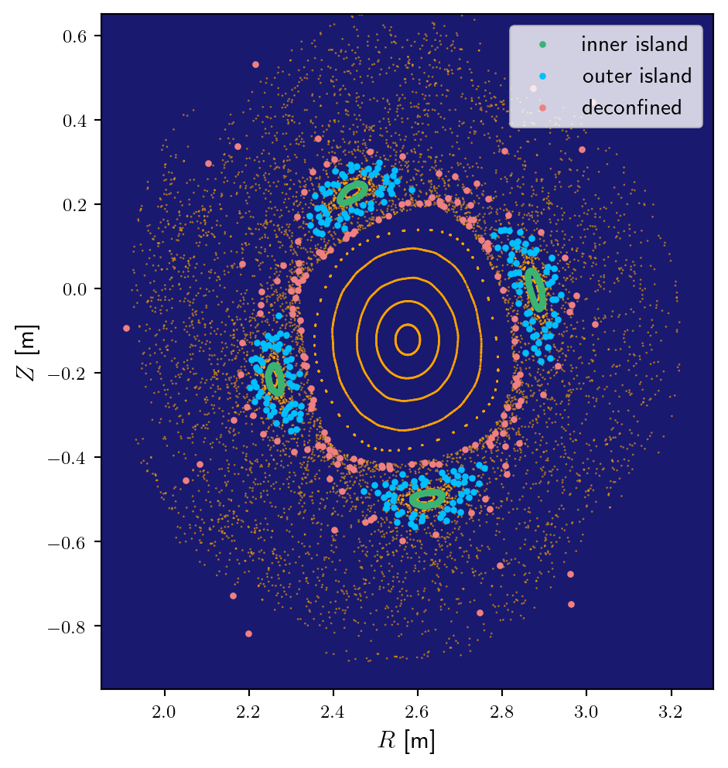
Runaways in
REs simulated kinetically by pushing macroscopic marker particles in the JOREK fields.
Often used as a form of post-processing.
Downside: Markers are evolved on very small time scales, can be computationally expensive.
Advantage: Great at accurate transport modelling.

Slide 8
The need for coupling
Marker tracing can give us insight into particle transport in stochastic fields, BUT!
Effect of REs on bulk plasma is not taken into account.
REs dominate the dynamics during later stage of disruption.

Slide 9
The need for coupling
Marker tracing can give us insight into particle transport in stochastic fields, BUT!
Effect of REs on bulk plasma is not taken into account.
REs dominate the dynamics during later stage of disruption.
A coupled fluid RE model has been implemented, allowing for a more complete treatment of the MHD.
However, such models struggle to capture accurate transport.
Necessitates coupling between kinetic model and MHD equations.

Slide 10
Outline
Background
Coupling to the MHD and verification
Hybrid simulation of RE beam termination in JET
Beam termination in ITER and wall load studies

Slide 11
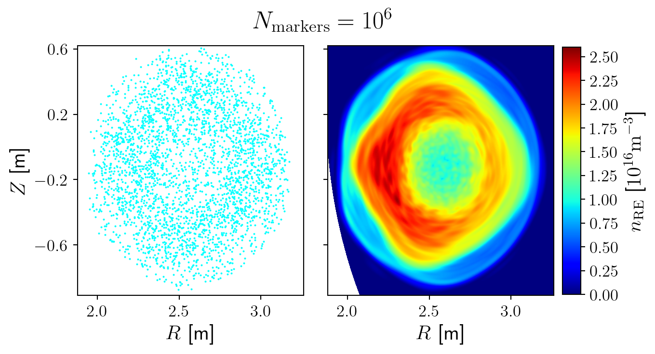
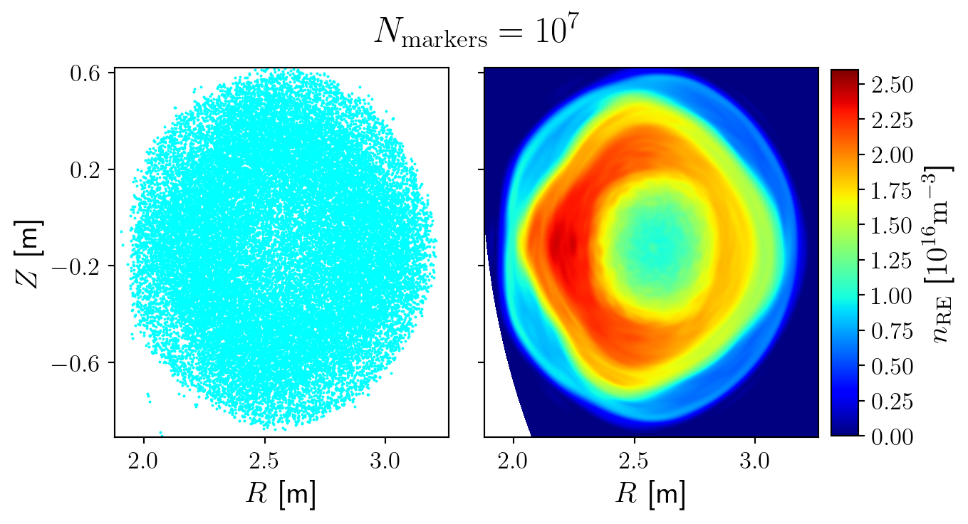
From particles to fluid
Given a distribution of markers, we take the fluid moment and project onto the finite elements.
To reduce noise: time averaging + spatial smoothing (in poloidal plane and parallel to field lines).

Slide 12
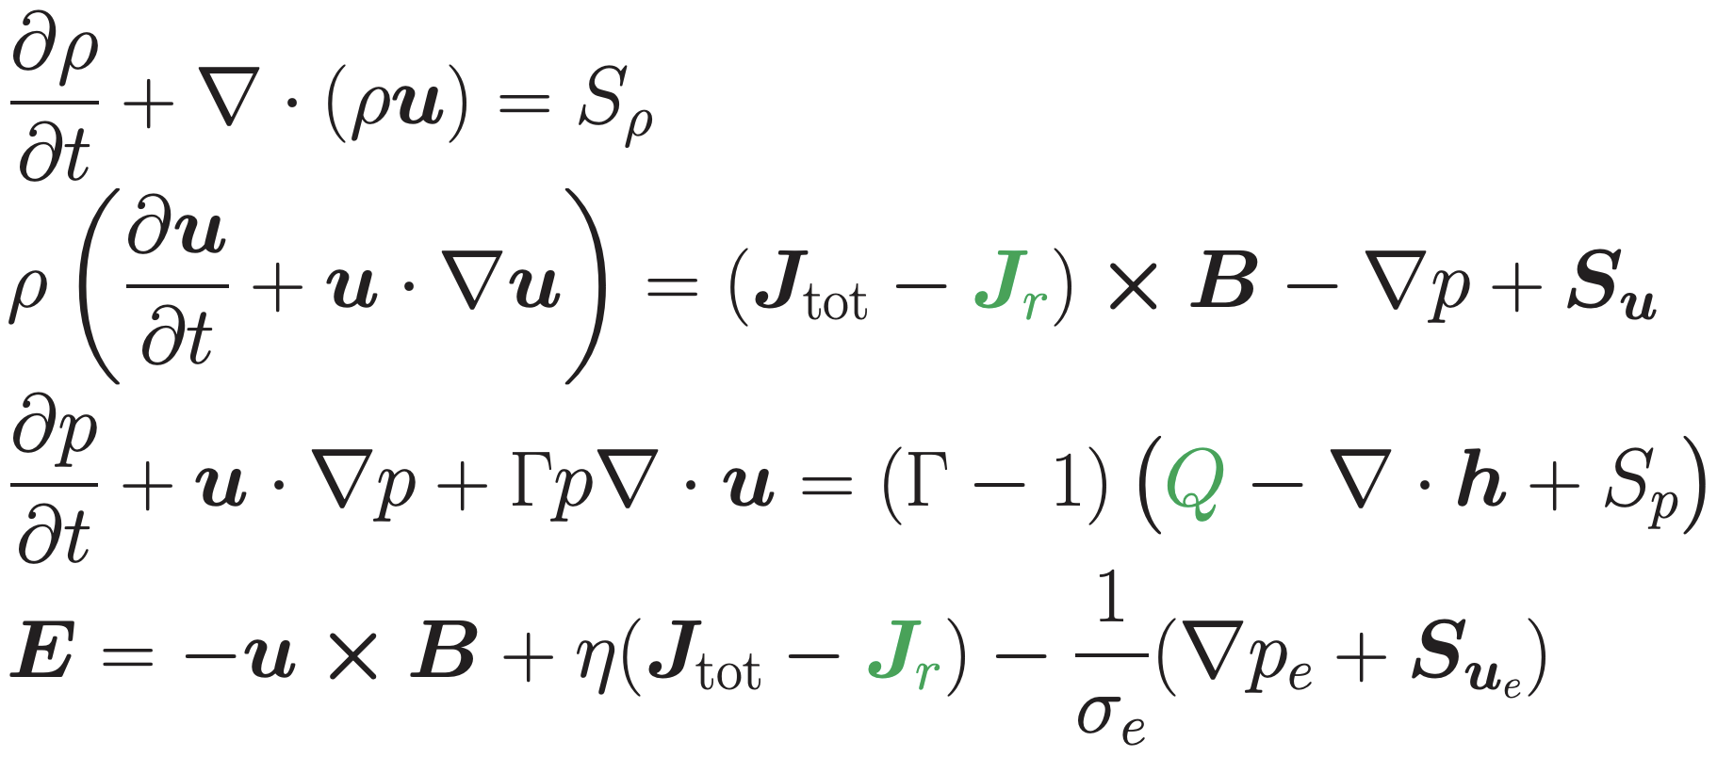
MHD with REs
In the presence of REs the MHD equations can be simplified to:
Usually referred to as a current coupling scheme. An alternative approach is to use a pressure coupling scheme:

Slide 13
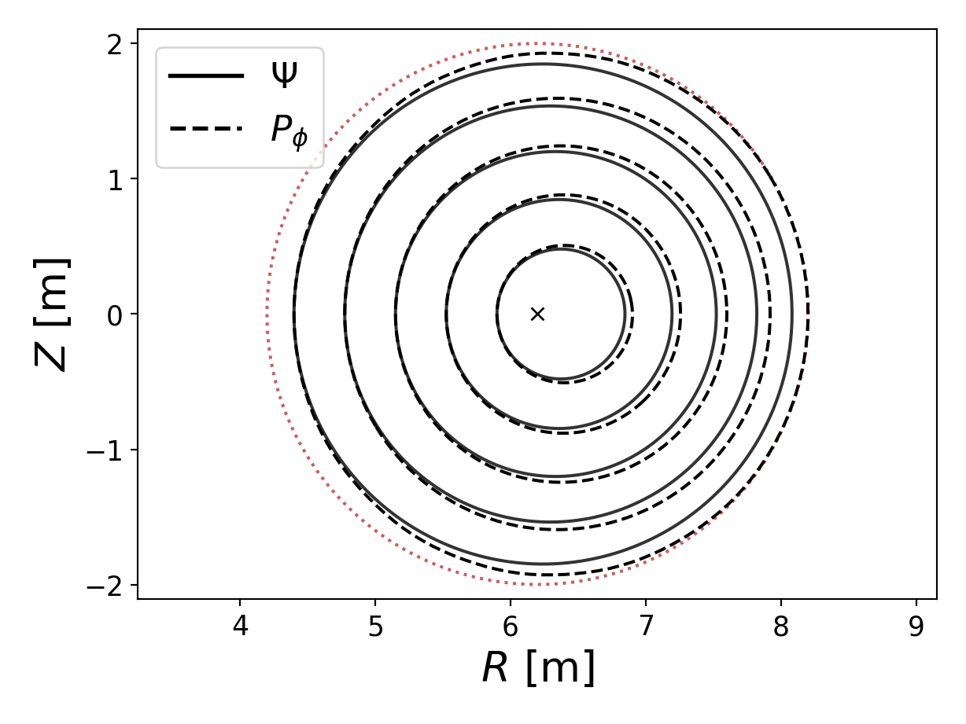
2D Verification: radial force balance
Main idea: study equilibrium where full current is carried by REs.
There will be a relative shift of flux surfaces and RE drift orbit surfaces.
Shafranov shift of such an equilibrium varies with energy of REs.
Analytical predictions for single energy, small pitch angle case made in: V. Bandaru et al [1]
[1] V. Bandaru et al, Phys. Plasmas 30 092508 (2023)

Slide 14
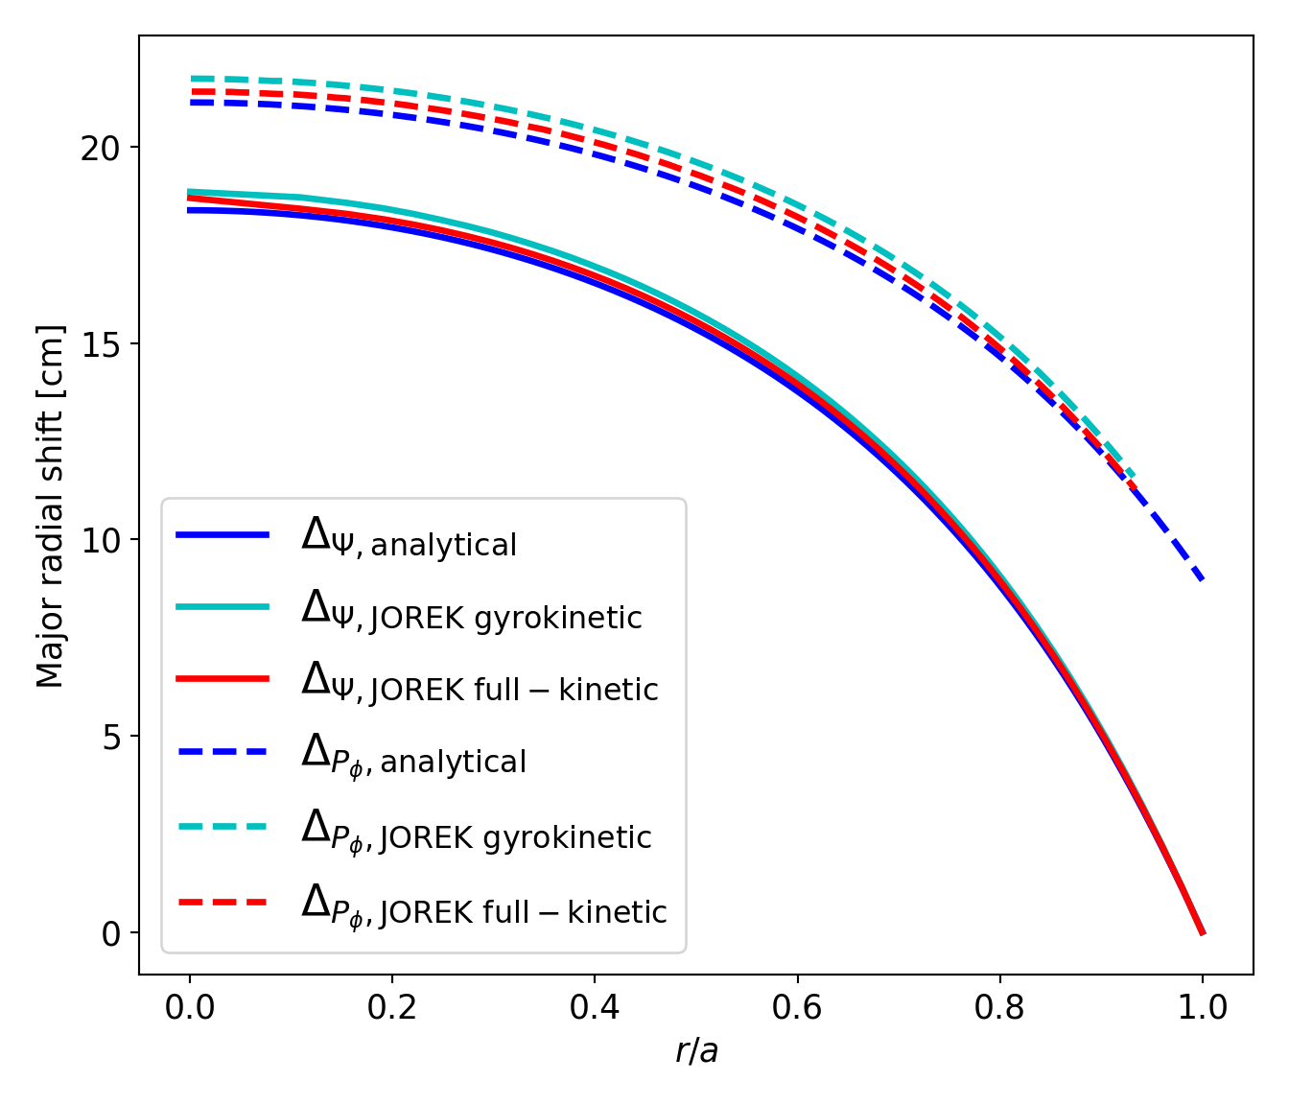
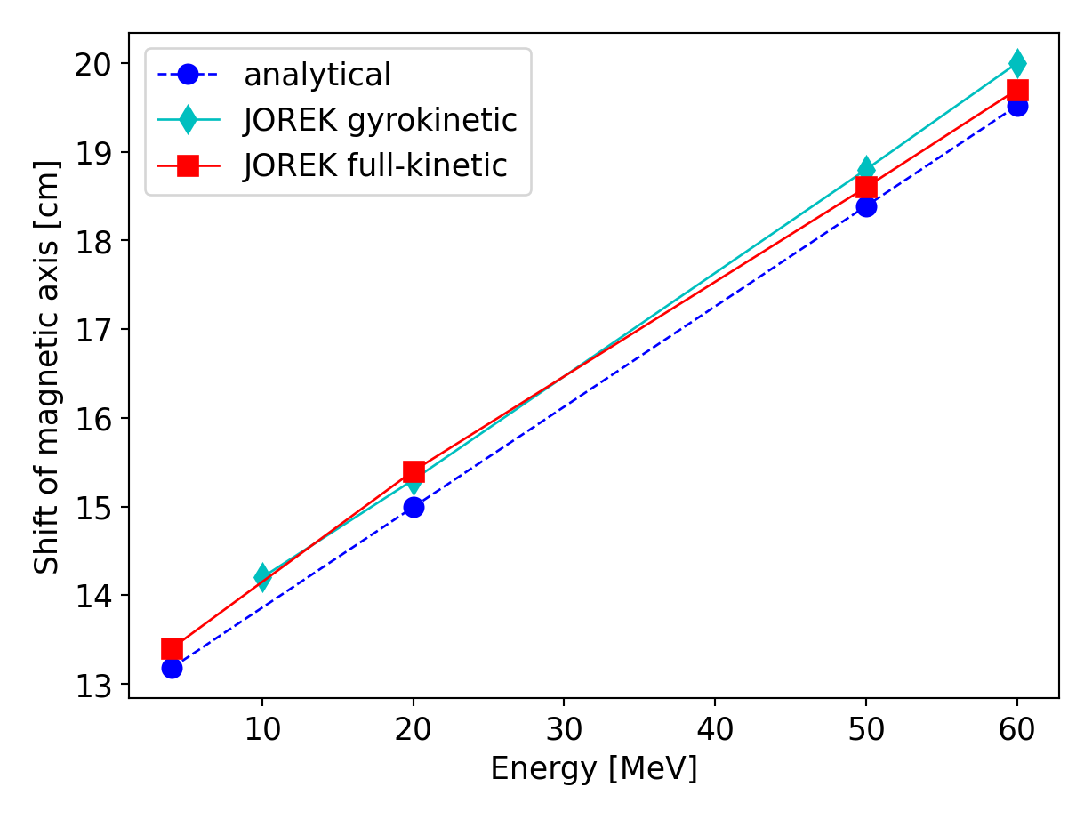
2D Verification: radial force balance
Simulations show good agreement with predictions!
Simulation data offset by: ~0.5MeV

Slide 15
Outline
Background
Coupling to the MHD and verification
Hybrid simulation of RE beam termination in JET
Beam termination in ITER and wall load studies

Slide 16
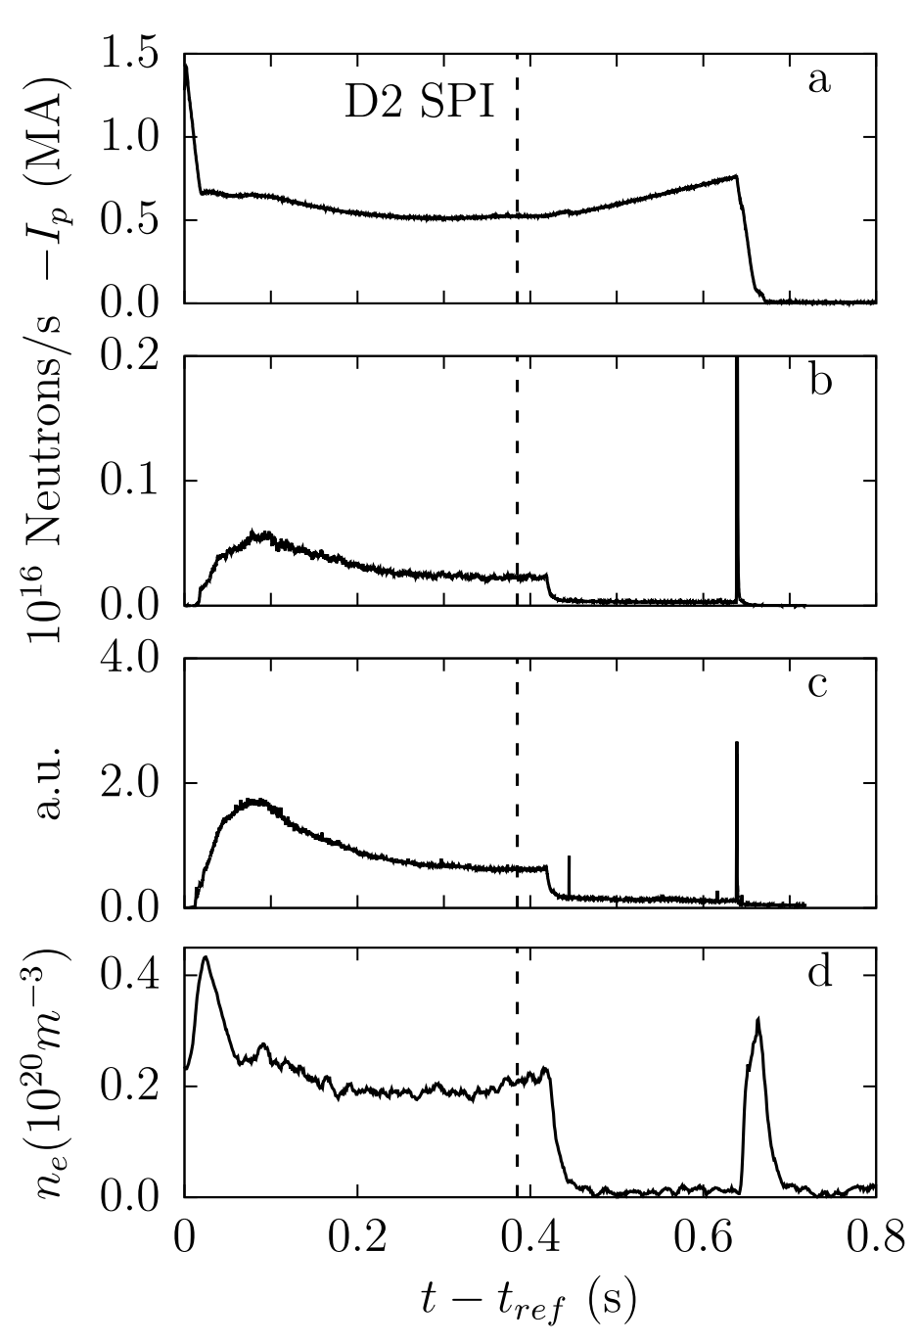
Benign beam termination in JET
First application of coupled model concerns JET shot: #95135.
Example of benign beam termination:
Disruption triggered by injection of argon.
Second injection of deuterium during runaway plateau, helps flush out impurities.
Fast MHD activity → near complete loss of REs.
Benign termination of discharge, no localized wall damage observed.
Illustrations taken from: V. Bandaru et al, Plasma Phys. Control. Fusion 63 035024 (2021)

Slide 17
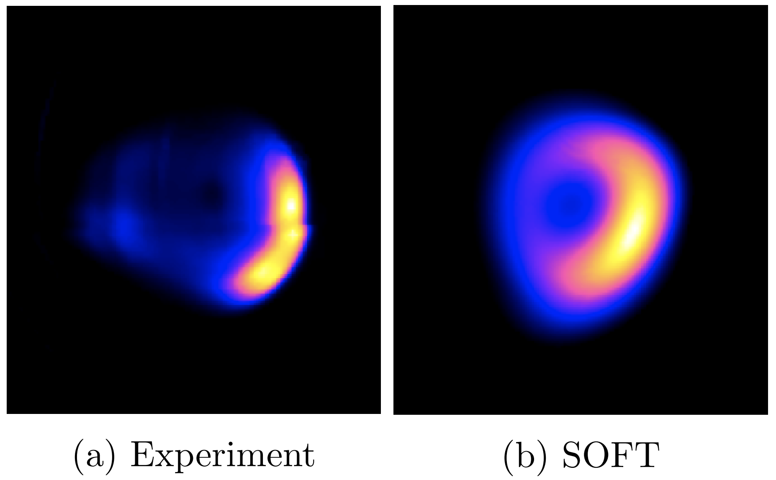
Benign beam termination in JET
We are here!
Simulation starting point a few ms before crash.
Runaway population initialized based on:
Plasma current
Observed synchrotron radiation → hollow current profile
MHD activity (given different q-profiles)
Illustrations taken from: V. Bandaru et al, Plasma Phys. Control. Fusion 63 035024 (2021)

Slide 18
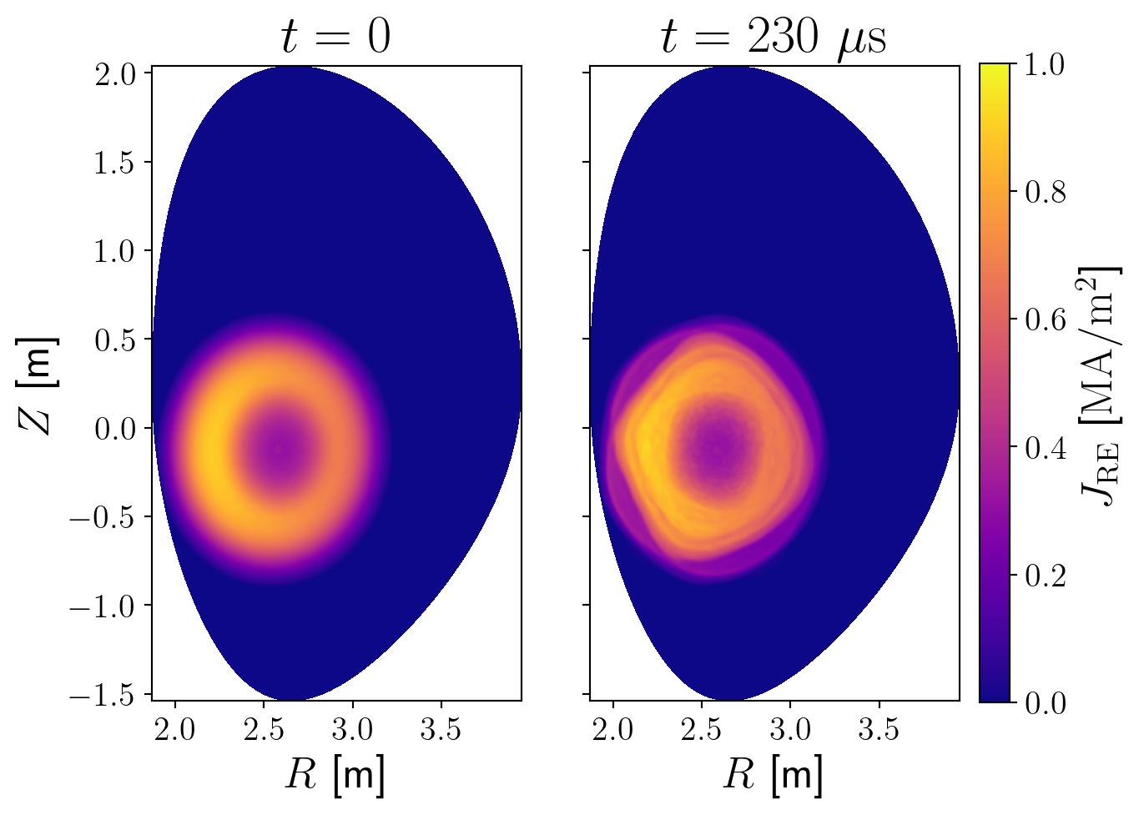
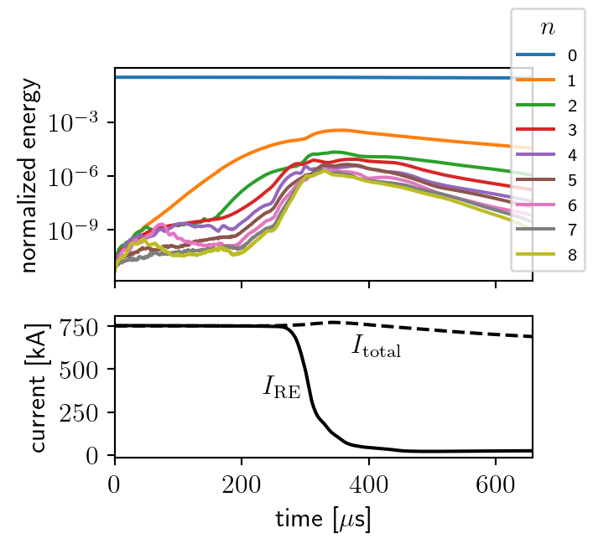
Benign beam termination in JET
Rapid growth of (m,n)=(4,1) double tearing mode observed, quickly saturating.
REs initialized with 500 keV and pitch 0.99
Stochastization of outermost flux surfaces after ~230𝜇s.

Slide 19
Final RE current ~25 keV
REs lost on ~100 𝜇s timescale

Slide 20
Outline
Background
Coupling to the MHD and verification
Hybrid simulation of RE beam termination in JET
Beam termination in ITER and wall load studies

Slide 21
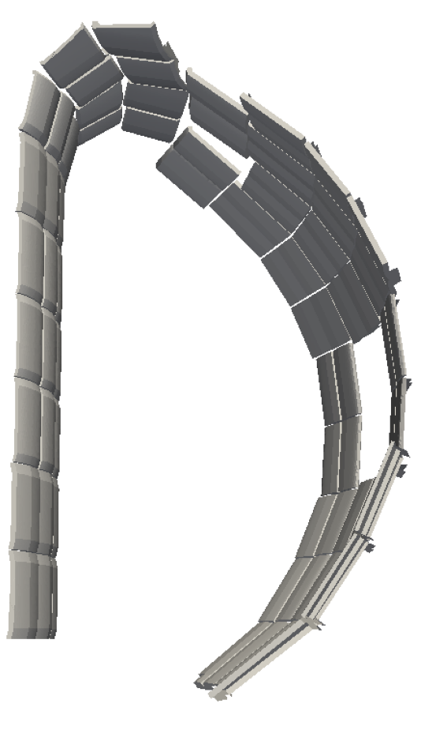
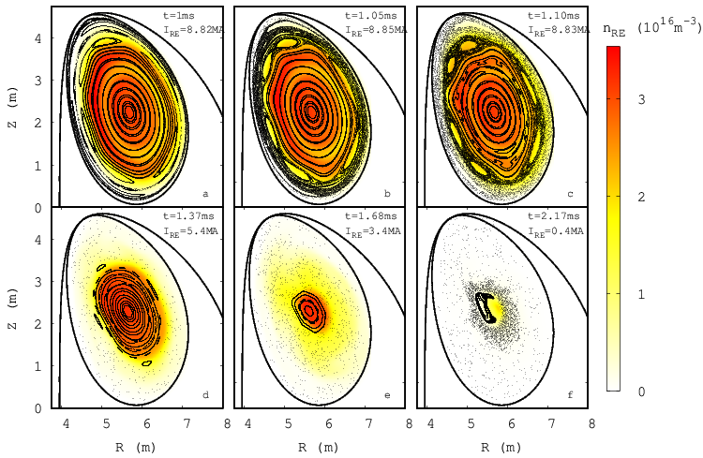
Beam termination in ITER
2D disruption simulation including VDE and RE avalanche using the RE fluid model [2].
Switching to 3D, growth of a (m,n)=(2,1) and (6,4) dominated tearing mode is seen.
Eventual stochatsization and rapid loss of REs.
Simulation post-processed using kinetic REs.
Transport and collision with 3D wall was studied.
Monoenergy/monopitch assumed:
[2] V. Bandaru et al, Nucl. Fusion 64 076053 (2024)
Illustration taken from: [2]

Slide 23
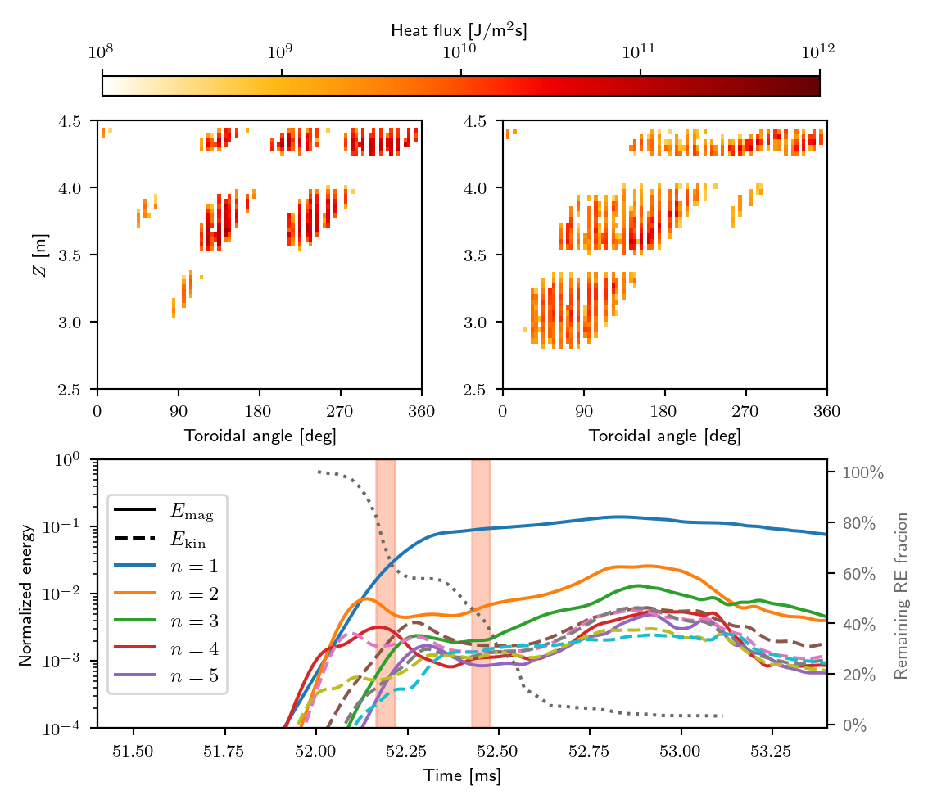
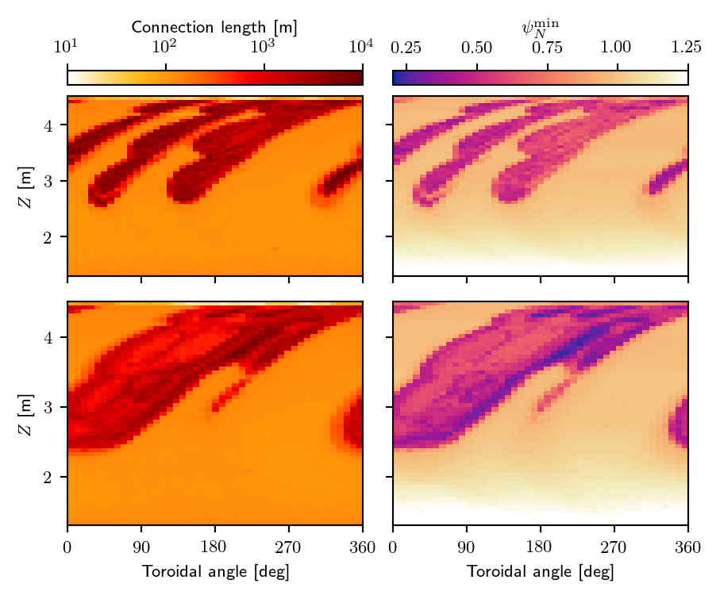
Beam termination in ITER
Periodicity of heat flux related to relative mode amplitudes at the time
Magnetic footprint: starting along the contour of the wall, field lines are traced to determine “wall to wall” connection length and minimal flux.

Slide 24
Beam termination in ITER
Periodicity of heat flux related to relative mode amplitudes at the time.
Magnetic footprint: starting along the contour of the wall, field lines are traced to determine “wall to wall” connection length and minimal flux.
For a fixed field (~52.45 ms) no apparent dependence on starting position of particle.
$$ψ_{n}$$

Slide 25
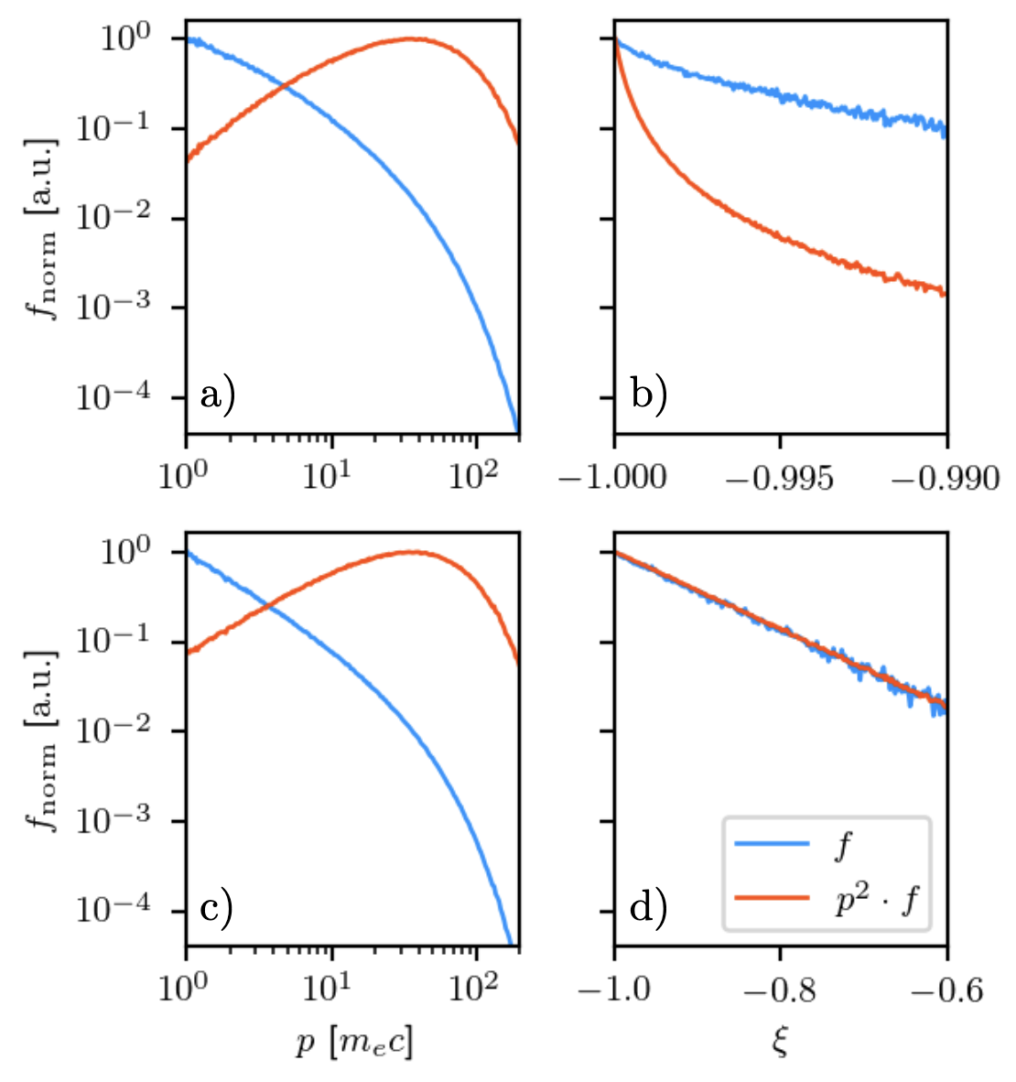
Beam termination in ITER
Dependence on momentum space distribution studied by assuming avalanche dominated distribution from O. Embréus et al [3]:
Higher pitch angle case studied by letting
[1] O. Embréus et al, Journal of Plasma Physics 84(5) 905840506 (2018)

Slide 26
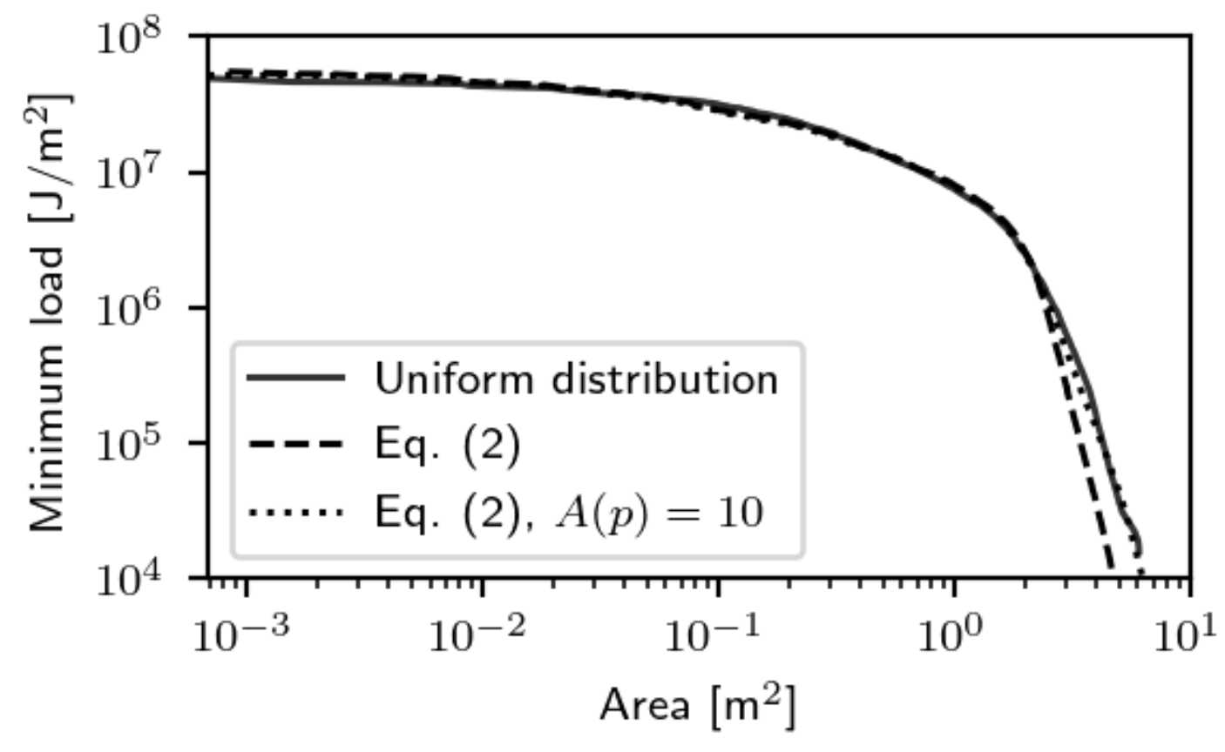
Beam termination in ITER
Dependence on momentum space distribution studied by assuming avalanche dominated distribution from O. Embréus et al [3]:
Higher pitch angle case studied by letting
Only minor change in deposition observed.
[1] O. Embréus et al, Journal of Plasma Physics 84(5) 905840506 (2018)

Slide 27
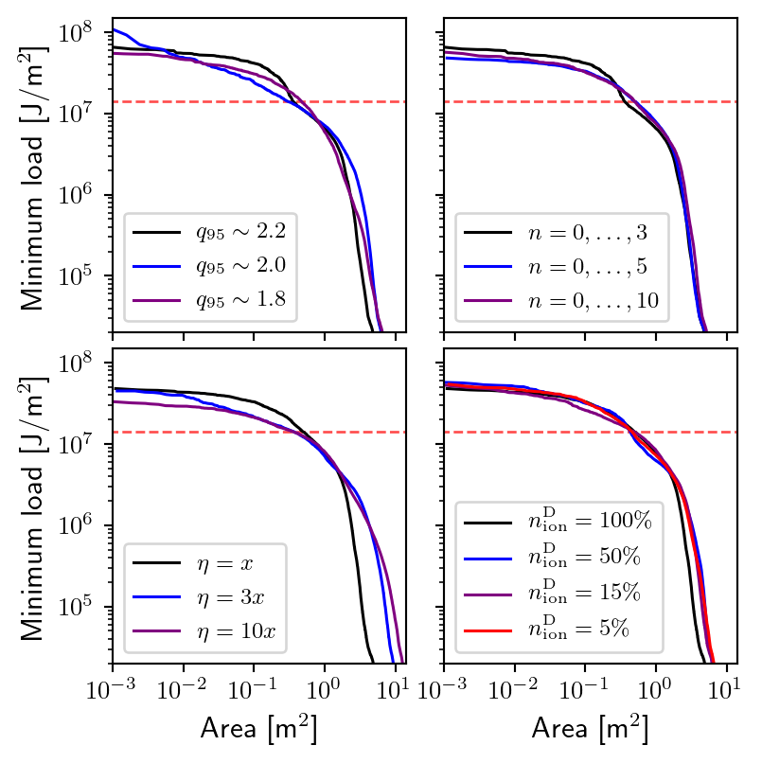
Beam termination in ITER
Study properties of benign beam termination: simulations with different q₉₅, resistivity and ion density.
~0.5m² exceeding beryllium melt limit (~14 MJ/m²)
Notable increase in wetted surface for higher resistivities.

Slide 28
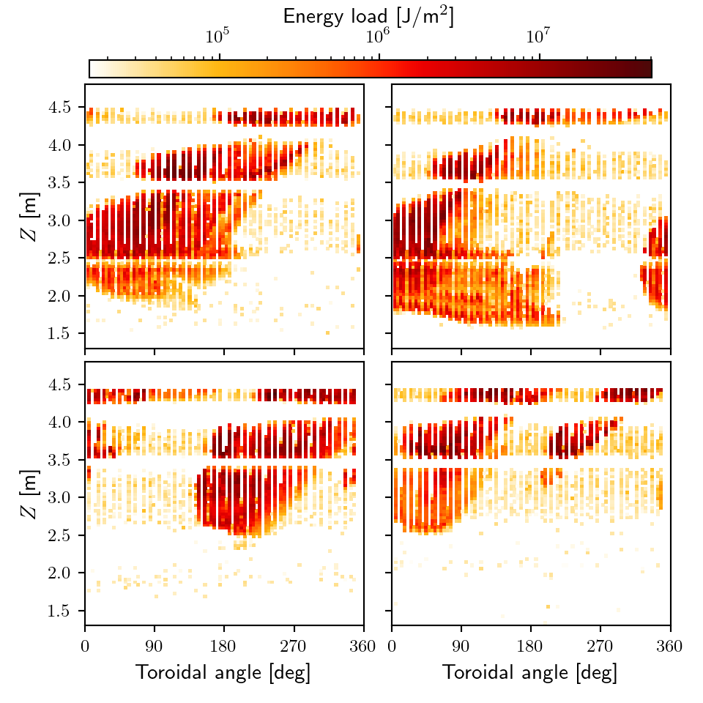
Beam termination in ITER
Study properties of benign beam termination: simulations with different q₉₅, resistivity and ion density.
~0.5m² exceeding beryllium melt limit (~14 MJ/m²)
Notable increase in wetted surface for higher resistivities.
$$η=3x$$
$$η=10x$$
Higher resistivity: deposition extends further down along wall.
Lower q₉₅: n=2 mode grows larger, seen in toroidal pattern.
$$q_{95}=2.0$$
$$q_{95}=1.8$$

Slide 29
Summary and outlook
Kinetic model of REs has been coupled to the MHD in JOREK:
2D verification based on force balance shows good agreement with analytical results.
3D verification based on linear TM growth rates currently ongoing.
First application to beam termination scenario in JET. Able to capture full current conversion.
Simulation with 20 MeV REs ongoing, study effect on termination + allow for synthetic synchrotron imaging.
Beam termination in ITER studied (w.o. kinetic coupling), heat loads on first wall determined.
Higher resistivity → larger MHD activity → greater spread of loads.
Very weak sensitivity to momentum space distribution (neglecting coupling).

